Slide 1
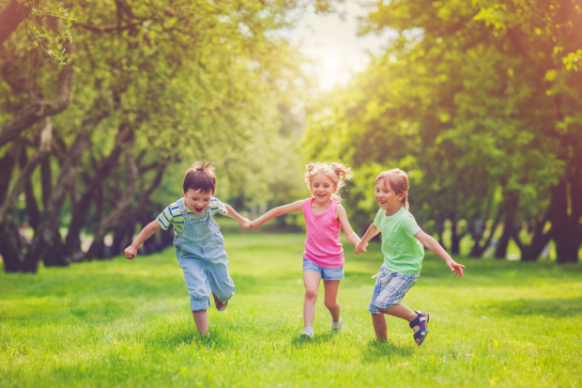
Relationships Education
Staff training session 1

Slide 2
Relationships Education training 1
What is Relationships Education?
School data for Relationships Education
The importance of Relationships Education
What is covered in Relationships Education?
When should these topics be taught?

Slide 3
Relationships Education training 2
Delivering effective Relationships Education
Tops tips for delivering Relationships Education
Looking at lessons plans
Assessment
Answering difficult questions

Slide 4
Ground Rules
Ground Rules
R - Respect
O – Openness
C – Confidential
K - Kind

Slide 5
My Relationships Education
What information about growing up did you get:
From your parents?
From school lessons?
From your friends?
From magazines etc.?
What was good? What would you change?

Slide 6
School XXX HRBS 2019
Question | A | B | C
% of pupils who said parents had discussed body changes with them | 35% | 55% | 75%
% pupils who said teachers had discussed body changes with them | 14% | 34% | 54%
% of pupils who worry about puberty and growing up 'quite a lot' or 'a lot'. | 8% | 18% | 28%
% of pupils who can usually or always say no to a friend when a friend asks them to do something they don’t want to do | 20% | 30% | 50%

Slide 7
School XXX HRBS 2019
Question | A | B | C
% of pupils who said parents had discussed body changes with them | 35% | 55% | 75%
% pupils who said teachers had discussed body changes with them | 14% | 34% | 54%
% of pupils who worry about puberty and growing up 'quite a lot' or 'a lot'. | 8% | 18% | 28%
% of pupils who can usually or always say no to a friend when a friend asks them to do something they don’t want to do | 20% | 30% | 50%

Slide 8
What do you know about Relationships Education?

Slide 9
Relationships Education in primary schools
Part of PSHE
Linked to safeguarding
Puberty in upper KS2 (year 4, 5 and 6)
Sex education in year 6
Puberty and Sex Education lessons usually covered in Summer Term
Statutory guidance used from September 2020
Range of topics: e.g. keeping clean, routine, good and bad touch, saying no, assertiveness, good friendships, self esteem, communicating

Slide 10
Updated guidance for Relationships Education.
Will be called Relationships Education in primary schools (was previously RSE)
Schools will follow this statutory guidance from September 2020
Parents will only be able to withdraw children from sex education lessons (year 6 only).

Slide 11
What has to be covered in primary schools?

Slide 12
Relationships Education
Families and people who care for me
Caring friendships
Respectful relationships
Online relationships
Being safe

Slide 13
Health Education
Mental wellbeing
Internet safety and harms
Physical health and fitness
Healthy eating
Drugs, alcohol and tobacco
Health and prevention
Basic first aid
Changing adolescent body

Slide 14
Sex education
Not statutory from September 2020
Many primary schools may choose to teach sex education in year 6 – however this is not a statutory requirement
If schools do teach sex education, parents can withdraw their child from sex education lessons

Slide 15
Four main topics
Growing up
Our bodies
Keeping safe
Relation-ships and family life

Slide 16
Relationships Education themes
Respect Emotions Friendships
Saying No Good and bad touch
Differences Families and people who care for me
Puberty Empathy Keeping safe
Communicating Building self-esteem
Sex Solving problems

Slide 17
Meet the Health Improvement Team
Why is Relationships Education important?
What skills does it teach children?
Notes:
Buy Back
- Hosting the conference as part of our MHIS - toolkit
17

Slide 18
Why is Relationships Education important?
Develop confidence in talking, listening and thinking about feelings and relationships.
Are able to name parts of the body and describe how the body works.
Have the skills, language and confidence to protect themselves.
Are prepared for puberty.

Slide 19
Meet the Health Improvement Team
When should these be taught?
Timeline activity
Notes:
Buy Back
- Hosting the conference as part of our MHIS - toolkit
19

Slide 20
Relationships Education and safeguarding
Universal language spoken by all
CSE and grooming – links to online safety
Appropriate and inappropriate touch
Promotes healthy relationships

Slide 21
Where do children learn about Relationships Education topics?
Keeping safe
Healthy friendships
Families
Stereotypes
Body changes
Healthy body image
Saying no

Slide 22
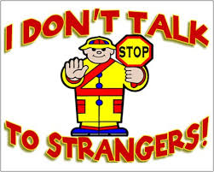

Slide 23
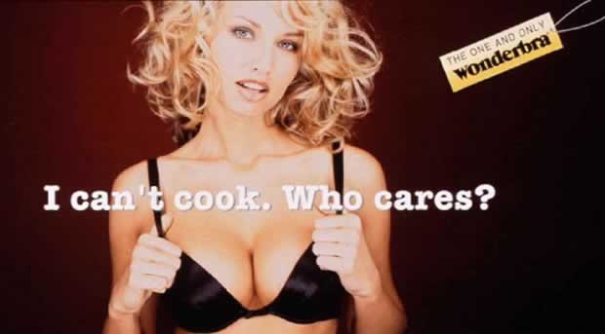

Slide 24
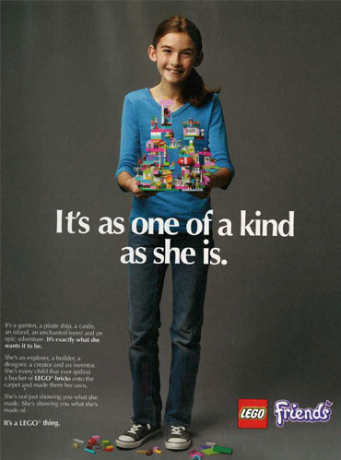

Slide 25
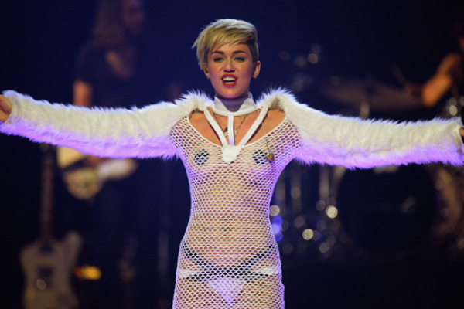
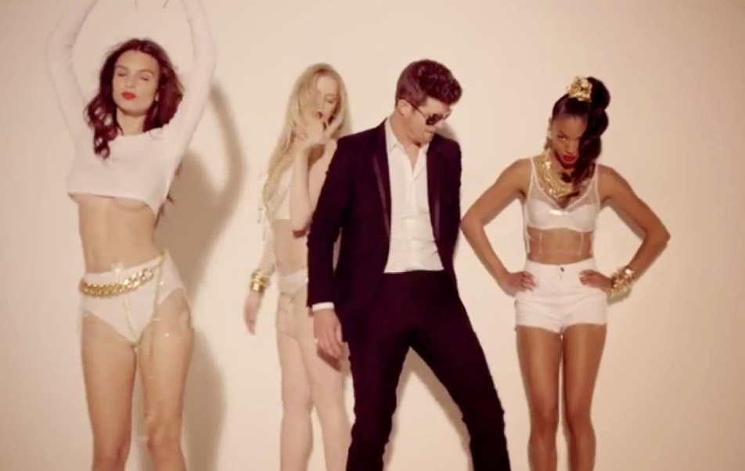

Slide 26
Florida Whistle
Go girl you can twerk it,
Let me see you whistle while you work it,
I’mma lay it back, don’t stop it,
‘Cause I love it how you drop it, drop it, drop it on me,
Now, shawty let that whistle blow-oh, oh oh,
Yeah, baby let that whistle blow-oh oh!
Can you blow my whistle baby, whistle baby
Let me know,
Bruno Mars – Locked out of heaven
“Open up your gates cause I can’t wait to see the light,
And right there is where I wanna stay,
Cause your sex takes me to paradise,
Yeah your sex takes me to paradise.”
Katie Perry – Last Friday Night
Barbie’s on the barbeque, Is this a hickie or a bruise?
Pictures of last night ended up online, I’m screwed,
Oh well, it’s a blacked out blur, but I’m pretty sure it ruled.

Slide 27
Where do children and young people learn about Relationships Education related issues?
TV Magazines Radio
Music videos Gaming Parents
Siblings Peer School
Internet Disney Films

Slide 29
Thank
you for attending!
meadec@ealing.gov.uk
www.egfl.org.uk
020 8825 6173
Notes:
29

