Slide 1
Launched 1st July 2025
ChatHealth Messaging Service
For ages 13 to 19 to get advice and help with contraception and sexual health

Slide 2
We can support young people with…
Routine Testing
Pregnancy
Concerns
Contraception
Emergency
Contraception
Abortion
Signposting
STI Symptoms
Our Clinics
Signposting
PEP or PREP
STI Concerns

Slide 3
Our details
Available for: 13 to 19 year olds
Response Time: within 24 hours
Text number: 07312 263 856
Or go to chathealth.nhs.uk to start a chat
Look out for more information around school/college!
Did you know you can text a nurse or doctor to get confidential health advice?

Slide 4
You can find us on socials!
@lnwh_nhs
@lnwh_nhs
@London North West University Healthcare NHS Trust

Slide 5
Confidentiality
You can give your name or text a healthcare professional anonymously – it’s completely up to you.
We will not pass on anything you say to anyone else, unless you or someone else is at significant risk of harm. If we did need to share anything you have told us, we would always try to discuss this with you first.
For our safety and yours the conversation will be stored on electronic records that can be seen by other healthcare professionals who all follow the same confidentiality rules.

Slide 6
How the service works…
We aim to reply to you within one working day, and you should get an immediate bounce-back to confirm we received your text.
Texts will not be seen outside of normal working hours. If you need help before you hear back from us, contact your doctor, visit an NHS walk-in centre, call NHS 111, or visit https://111.nhs.uk. If it is an emergency, dial 999 or visit A&E.
Our text number does not receive voice calls or MMS picture messages.
You can prevent the healthcare professional from sending messages to you by texting STOP to our number.
Please respect your schools mobile phone policy. Messages are charged at your usual rate.

Slide 7
Feedback from young people
This sexual health chat has always given useful advice and help with things I didn't know about. It’s a great service for young and adolescents!
I don’t like calling into clinics when I’m not sure if it’s for a valid reason. Chatting by text is most definitely a good idea.
This conversation really helped me today. The experience of using ChatHealth was excellent and a big help and relief when discussing such a confidential issue.

Slide 8
FAQs: ChatHealth Messaging Service
“Our school/college has a ‘no phones’ policy. Can we still use the service?”
Yes, our marketing materials encourage you to respect school phone use policies, and many students use the service outside of school hours and lesson times.
“Is the service free?”
Yes, we provide the service free of charge. Any SMS messages sent whilst using the service may incur the usual network provider charges.
“Is the service compatible with all mobile phones?”
SMS text messages can be sent to the service from any kind of mobile phone which has sufficient credit and network signal.
“Who provides the service?”
The ChatHealth messaging service is provided by
London North West University Healthcare NHS Trust
and is a registered trademark of Leicestershire Partnership NHS Trust which is the operating body.
For more information about ChatHealth Terms of Service, go to chathealth.nhs.uk/privacy

Slide 9
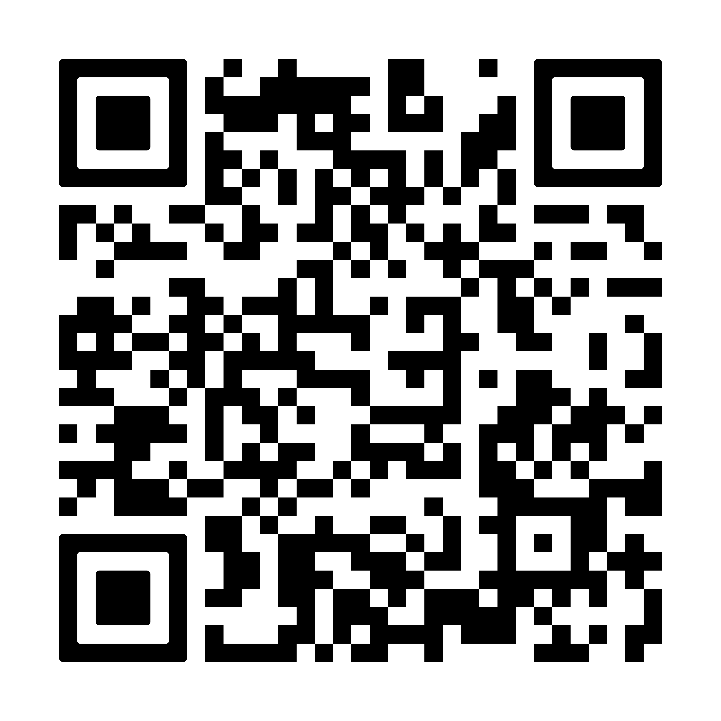
Further help and advice for young people:
Text a nurse or doctor for confidential advice and support
See videos, find health information, take quizzes, and find out the truth behind the rumours.

Slide 10
Clinic Information:
Patrick Clements Clinic at Central Middlesex Hospital - Brent
Acton Lane, London, NW10 7NS
Tel: 020 8453 2221
Mattock Lane Health Centre - Ealing
78 Mattock Lane, Ealing, W13 9NZ
Contraception Tel: 020 3255 0084
Sexual Health Tel: 020 8966 6380
Caryl Thomas Clinic - Harrow
Headstone Drive, Wealdstone, HA1 4UQ
Tel: 020 3893 8575
The Wakley Centre - Hillingdon
Grange Road, Hayes, UB3 2RR
Tel: 020 8453 2751 or 020 8453 2752
Find out more information about our opening times by visiting our website
https://shc.lnwh.nhs.uk/clinics

