Slide 1
Introduction to the Early Years Childcare expansion and National Wraparound Childcare programme 2023-2026
November 2023
Leah Forgacz-Cooper: Early Years Project Manager. Families Information Service
Email:forgaczcooperl@ealing.gov.uk
CHILDREN’S & ADULTS’ SERVICES

Slide 2
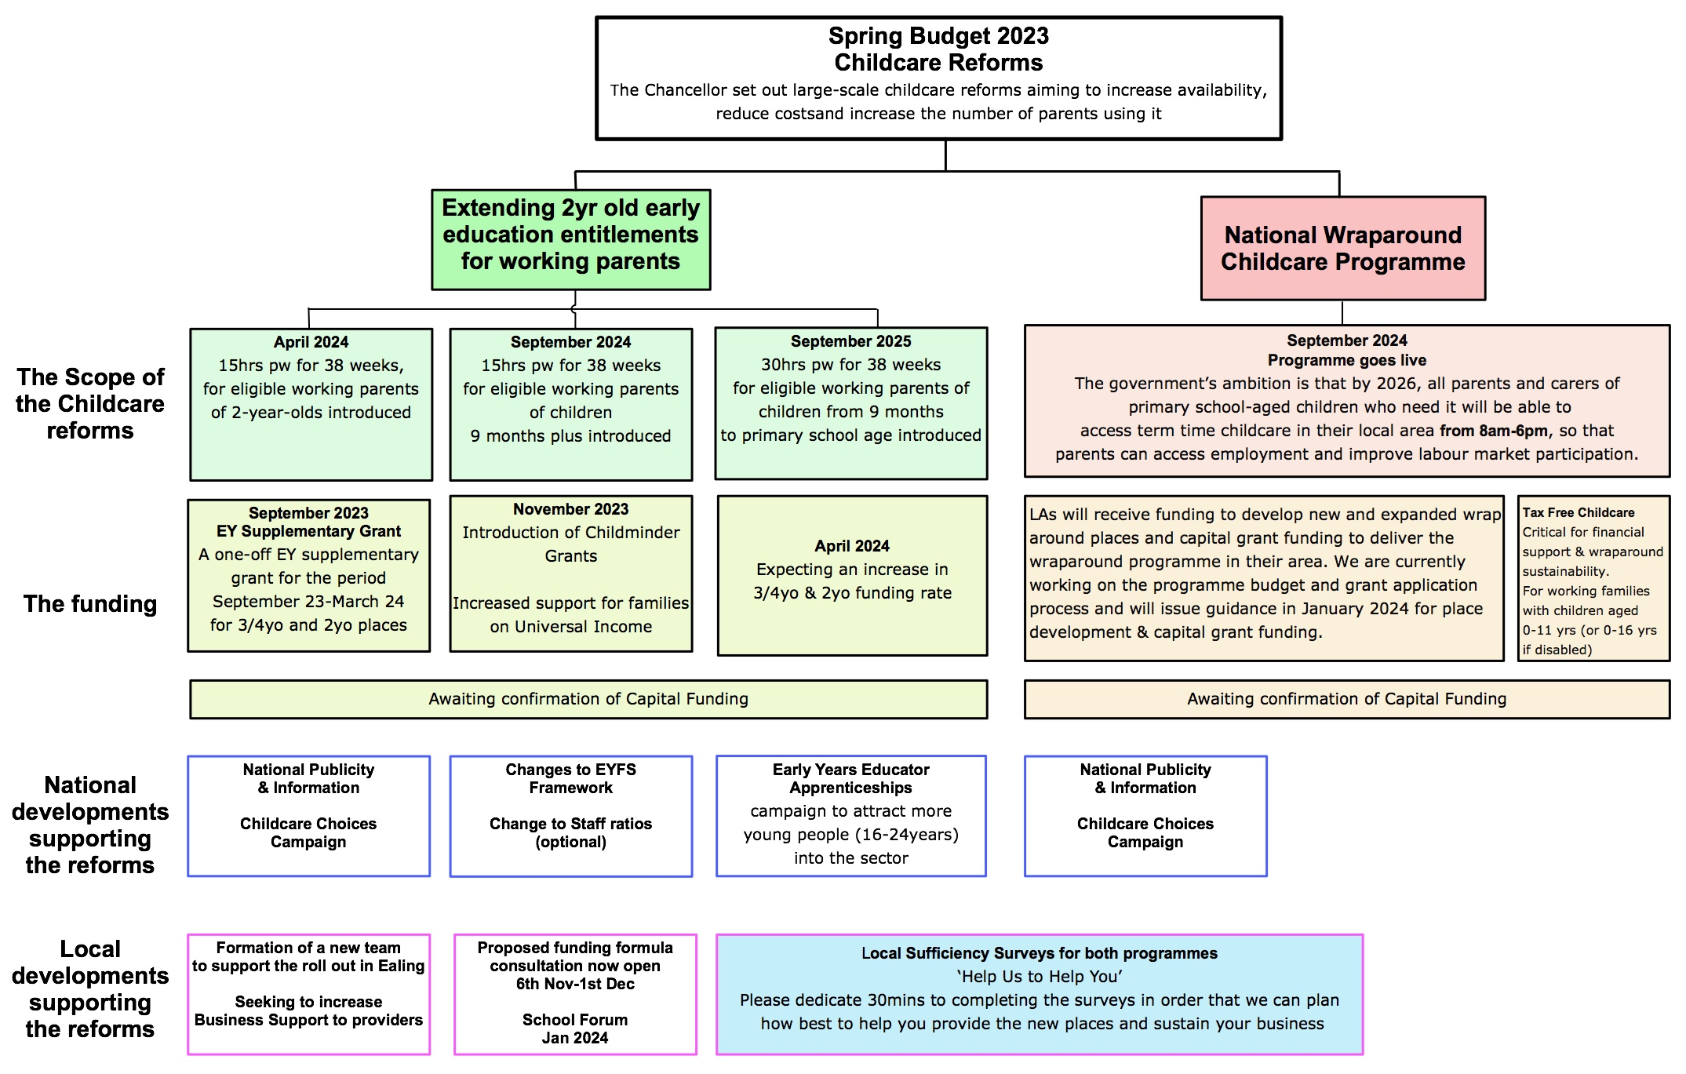
1. Overview of the childcare reforms
2
Notes:
£368.9M net budget

Slide 3
2. Key areas of change, milestones & timeline
Areas of change | Sept 2023 | Nov-March 2024 | April 2024 | June 2024 | Sept 2024 | Sept 2025 | Sept 2026
1. Extending early entitlements for working parents | Currently, parents who work more than 16 hours a week and earn less than £100,000 are entitled to 30hours free childcare a week for children aged three to four. |  | Programme Launch 15hrs pw for 38 weeks, for eligible working parents of 2-year-olds introduced |  | Programme Launch 15hrs pw for 38 weeks for eligible working parents of children 9 months plus introduced | Programme Launch 30hrs pw for 38 weeks for eligible working parents of children from 9 months to primary school age introduced
2. Wrap around childcare programme E.g. Breakfast & Afterschool clubs-8am-6pm |  | Local authorities expected to start planning and preparation for rollout of national programme DfE publishes guidance for schools LA information sessions LA to submit completed supply & demand mapping data to DfE |  | Deadline for LAs to submit delivery plan for programme funding to DfE SLAs, including monitoring agreements constructed and agreed between Schools/ Providers & LA & Grants distributed | Programme Launch National wraparound financial support to primary schools begins for two academic years | National wraparound financial support to primary schools continues | Wraparound financial support finishes in April 2026 All schools able to offer 8am-6pm wraparound on their own or in partnership
EY Supplementary Grant | A one-off EY supplementary grant for the period September 23-March 24 for 3/4yo and 2yo places
Expected increased funding rates |  |  | Expecting an increase in 3/4yo & 2yo funding rate
Childminder grants | Childminder grants become available.
Families on Universal income | Will pay childcare support up-front
Change in staff ratios (optional) | Changes to ratios for 2yr olds 1:4-1:5. Clarifying term ‘adequate supervision’ while children eating |  | Further measures for flexibility of operation expected. Early 2024
New ‘Provider specific’ EYFS Frameworks | Changes to ratios for 2yr olds 1:4-1:5. Childminders can care for current max 3 children, when caring for siblings. Clarifying term ‘adequate supervision’ while children are eating |  | Further measures for flexibility of operation expected. Early 2024
3

Slide 4
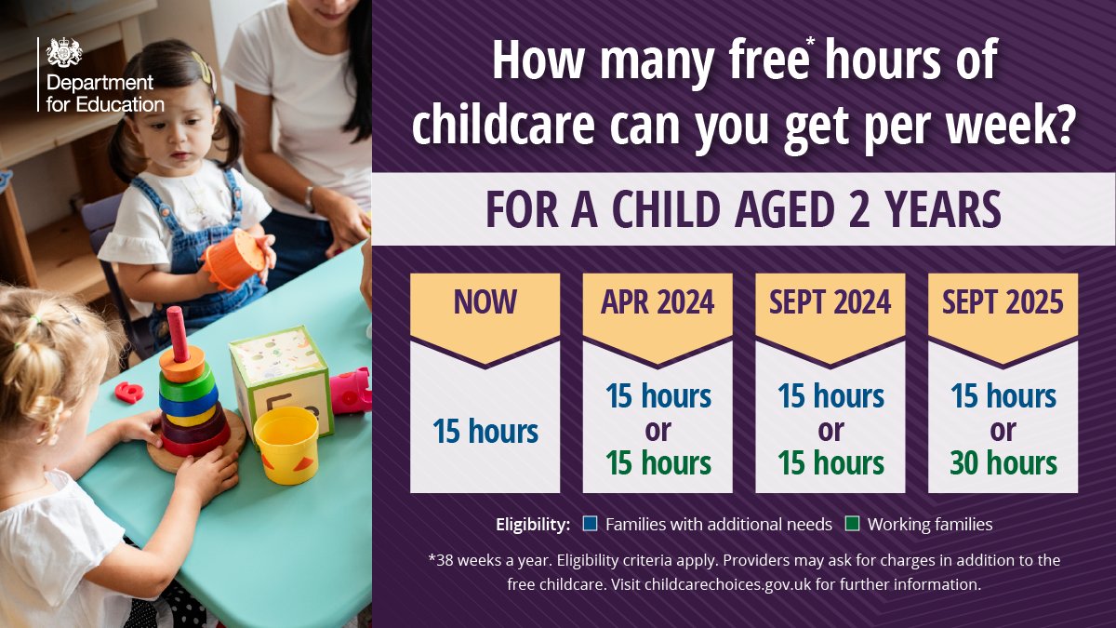
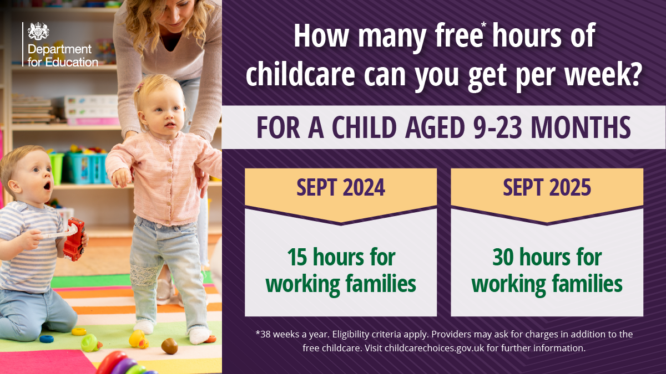
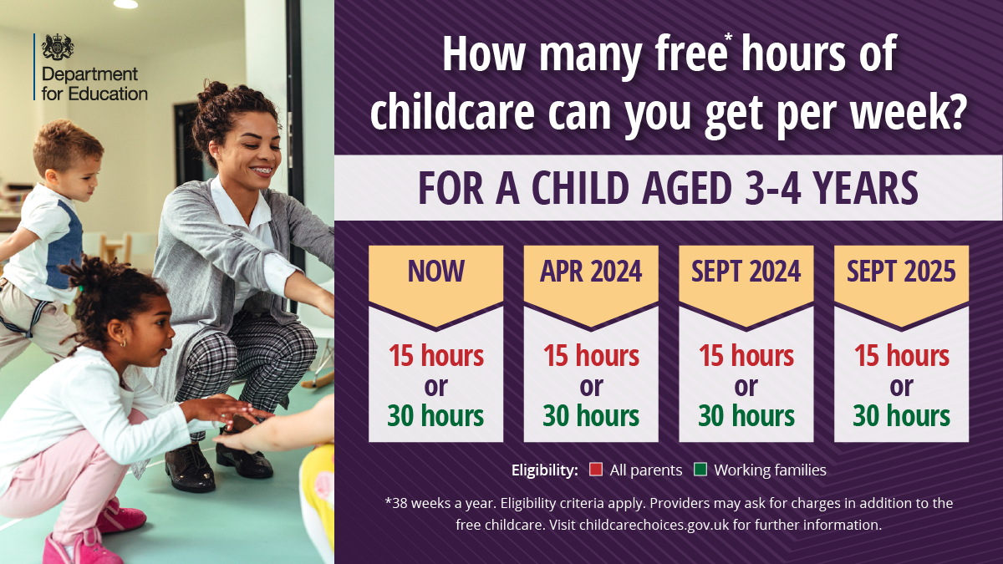
4. Key Points: EY entitlements/ Wraparound childcare/ Survey
Change to EY entitlements | Wrap around childcare | Sufficiency Survey
 | The term ‘wraparound childcare’ refers to provision directly before and after the school day during school term time for primary school age children from reception (including children under 5 years of age) to Year 6, from 8am-6pm This provision can be offered by schools and private, voluntary and independent (PVI) providers (including childminders and early years settings) and can be run on a school site or at another setting in the area. It should not require parents to pick their children up from school and drop them off at another location | Help Us to Help You Ealing will be better placed to understand the needs of the sector which in turn will help with the roll out of the extension to early years entitlements and ensure we understand the sufficiency of places across the borough Please spare 30 mins of your time to tell us about the current situation in your nursery and what your plans are for the future. There are 3 online workshops to support with completion: Tuesday 21st at 10am Thursday 30th at 3pm and Tuesday 5th at 1pm. Please email Leah if you would like to attend. Closing date for completion is Friday 8th December. One provider will be drawn at random to receive a prize voucher from those completing the survey Link to survey https://forms.office.com/e/aYt7Dc44Ae
4

Slide 5
5. Early Years Supplementary Grant Funding for Ealing:
Sep 23- March 24
6. Proposed funding formula for 2024/25
The purpose of this consultation is to seek the views, comments and where applicable, preferred options from key partners and stakeholders on arrangements of the Early Years block funding arrangements for 2024-25.
To seek views/comments on the Early Years Inclusion fund – proposal to hold at current levels.
To seek views/comments on the Early Years central spend – proposal to hold at current levels.
To seek views/comments on the Early Years Funding Pass Through - proposal to hold at current levels.
Events will be held both online and Face to Face to support with the consultation process
Key Dates:
Consultation Opens – 6th November 2023
Consultation Closes – 1st December 2023
School Forum - 18th January 2024
Unfortunately, we have no definitive figures to work with at present due to non-publication by the DfE
Early Years Supplementary Grant (EYSG) – this is in place until March 2024 and is paid as a grant on top of the usual funding amount. Once new base rates are announced and implemented for April 2024, the EYSG will end.
EYSG amounts are calculated based on your Synergy portal returns
There were some technical difficulties last month in relation to the system coping with the various elements of the grant being paid through the normal portal funding process.
For September, the EYSG was paid as a separate amount on top of your usual Synergy funded amount. If the technical issues remains a challenge, then we will continue to fund the EYSG as a separate monthly amount until March 2024.
5

Slide 6
7. Key Contacts
EY Programme Manager
8.Key Contacts
Early Years Finance
Leah Forgacz-Cooper:
Early Years Project Manager. Families Information Service
Email:forgaczcooperl@ealing.gov.uk
Bryn Jones
Early Years Data Officer (Funding queries)
BJones@ealing.gov.uk
Bridget Keni
Early Years Support Officer (Portal queries/ basic payment queries)
Kenib@ealing.gov.uk
Anne Reilly
Early Years Business and Finance Manager
Reillya@ealing.gov.uk
Key point of contact and funding timetable can be found at:
Business and early years' funding | Ealing Grid for Learning (egfl.org.uk)
9. EGFL Page
https://www.egfl.org.uk/services-children/early-years/expansion-early-education-entitlements-and-wrap-around-provision-primary-schools-2023-2025
10. Childcare Choices
Childcare Choices is a cross-government campaign that aims to make more parents aware of the financial support on offer to help them with the costs of childcare.
The Childcare Choices website has now been updated to allow parents to find out what they will be eligible for and when to apply
There is also a resource page for childcare providers covering:
Tax Free Childcare
Business Resources
Link: https://www.childcarechoices.gov.uk
6

