Slide 1
Anti Bullying Week
2019

Slide 2
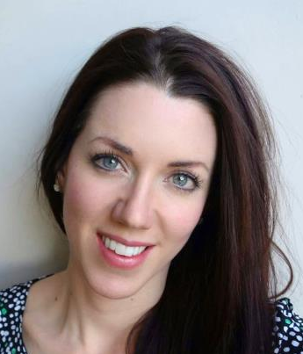
Meet the health improvement team
Karen Gibson
HIT manager Safeguarding
Nicole McGregor
Nutrition & exercise
Officer
Claire Vaughan
RSE & PSHE
Officer

Slide 3
What we do
Safeguarding prevention
Mental health and emotional wellbeing
Nutrition
&
exercise
PSHE
RSE

Slide 4
What you will come away with today
Increased confidence in developing a whole school approach to Anti-bullying week.
Increased knowledge of the resources available to support ABW
Looked though resources and complied a list of what is suitable for your school.

Slide 5
Anti-bullying Week 11 – 15 November 2019

Slide 6
Tuesday:
Odd Socks Day

Slide 7
Thursday:
Stop, Speak, Support

Slide 8
Friday:
Friendship Friday

Slide 9
Anti Bullying Week aims
This year the goal is to inform schools and settings, children and young people, parents and carers to know that it takes a collective responsibility to stop bullying.
This campaign aims to create empowering, positive messages addressing the fact that when it comes to bullying CHANGE STARTS WITH US!

Slide 10
Step 1:
Whole School Anti Bullying survey
Whole School Assembly
Whole school display
Ensure policy is shared and up to date

Slide 11
Anti Bullying Week Survey:
Needs to be done before any activities
Hands up survey in each class
Feedback initial results to staff
Repeat at the end for impact

Slide 12
Step 2: Define bullying
Physical
Verbal
Face to face or online
Emotional

Slide 13
Activities for definition and types
Pictures
What is happening?
Rude, mean, bullying
Draw and write
Drama activities

Slide 16
Step 3:
PSHE lessons

Slide 17
Meet the Health Improvement Team
Anti-bullying week in the PSHE scheme of work.
YEAR GROUP | LESSON NUMBER | LEARNING OBJECTIVE
Nursery | Lesson 7 – 9 | To play with other children.
Reception | Lesson 7 – 9 | To explain how to be kind to others .
Notes:
Buy Back
- Hosting the conference as part of our MHIS - toolkit
17

Slide 18
Meet the Health Improvement Team
Anti-bullying week in the PSHE scheme of work.
YEAR GROUP | LESSON NUMBER | LEARNING OBJECTIVE
Year 1 | Lesson 8 Lesson 9 | To be able to identify different behaviours which might be bullying? ABW specific
Year 2 | Lesson 8 Lesson 9 | To identify what bullying is and how it makes people feel. ABW specific
Notes:
Buy Back
- Hosting the conference as part of our MHIS - toolkit
18

Slide 19
Meet the Health Improvement Team
Anti-bullying week in the PSHE scheme of work.
YEAR GROUP | LESSON NUMBER | LEARNING OBJECTIVE
Year 3 | Lesson 8 Lesson 9 | To developing an awareness and definition of bullying and unkindness. ABW specific
Year 4 | Lesson 8 Lesson 9 | To develop an awareness of the role of victims, bullies and bystanders. ABW specific
Notes:
Buy Back
- Hosting the conference as part of our MHIS - toolkit
19

Slide 20
Meet the Health Improvement Team
Anti-bullying week in the PSHE scheme of work.
YEAR GROUP | LESSON NUMBER | LEARNING OBJECTIVE
Year 5 | Lesson 8 Lesson 9 | To explore how and why people are excluded. ABW specific
Year 6 | Lesson 8 Lesson 9 | To explore ways in which human beings are similar and different. ABW specific
Notes:
Buy Back
- Hosting the conference as part of our MHIS - toolkit
20

Slide 21
Step 4:
Activities for Anti Bullying Week

Slide 22
EYFS
Making school safe for all
Celebrating differences
Being a good friend

Slide 23
Key Stage 1
Compliment wall
Choose kindness cards
Helping hands mural
Elmer the Elephant

Slide 24
KS2
Being me resources (year 5 and 6)
Debate or pledges
Comic strips
Recognising and celebrating differences

Slide 25
High school
Being me resources
Debate
Run assemblies/parent workshops
Recognising and celebrating differences

Slide 26
Step 5: hold an assembly
Each class can share work they did during Anti Bullying Week
Do a survey or questionnaire
Get verbal feedback

Slide 28
Extra resources
Top tips
Book list
Positive message wall
Fundraising event

Slide 29
Use of film
The films in this strand have been chosen as a collective call to action against bullying. The heroes in these films band together to beat the bullies in their worlds, inspiring and empowering us to do the same.
By standing together with our friends in need, we too can have the confidence to be and feel just as super and extraordinary as these heroes. Films in this strand include The Lion King, The Iron Giant, Maleficent and How to Train your Dragon 2.

Slide 30
INTO film
The Into Film Festival is an exciting and unique event for young people, taking place around the UK this November.
The Festival helps bring learning to life for 5–19-year-olds by inspiring young people to watch, make and understand film in new and creative ways, as well as helping to build a lifelong passion for film.

Slide 31
INTO film
Free screenings available.
Resources provided to watch the films and do pre and post work based on themes in the classroom.

Slide 32
‘Educating Rowley’
© 20th Century Fox (2010). All rights reserved
Diary of a Wimpy Kid

Slide 33
Think about…
In what ways is Greg being a good friend to Rowley?
Do you think that he is not being a good friend to Rowley?
How do you think Rowley feels about this?
Diary of a Wimpy Kid

Slide 34
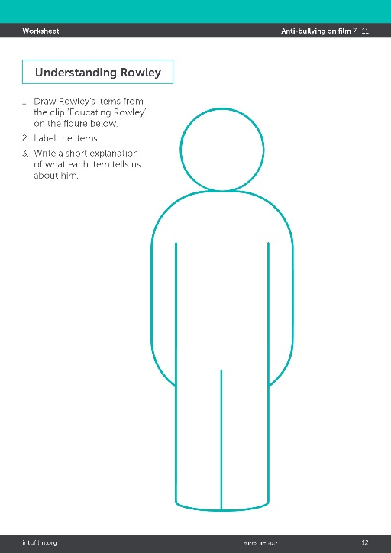
Understanding Rowley
Greg thinks that Rowley’s belongings will get him bullied in middle school, but what does each item tell us about Rowley?
Draw Rowley’s items on the figure on the Understanding Rowley worksheet.
Label the items and write a short explanation of what it tells us about him.
Diary of a Wimpy Kid

Slide 35
Step 5: Hold a parent workshop
Define bullying
Discuss types of bullying
Share schools procedure for bullying
Share policy

Slide 36
Step 5: hold an assembly
Each class can share work they did during Anti Bullying Week
Do a survey or questionnaire
Get verbal feedback

Slide 37
Step 6: Evaluate
Post hands up survey
Collect examples of work
Take pictures of display and assemblies
Feedback from parents

Slide 38
PSHE Twitter: @EalingPshe

Slide 41
Please complete workshops evaluation
https://www.surveymonkey.co.uk/r/hittraining1920

Slide 42
Thank
you for attending!
Notes:
42

