Slide 1
Year 1
Living in the wider world
Lesson 1

Slide 2
PSHE
What does PSHE stand for?
Personal
Social
Health
Economic

Slide 4
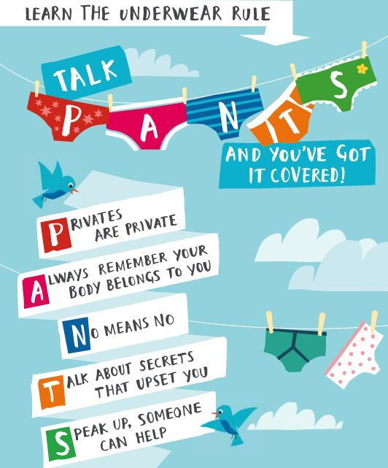

Slide 5
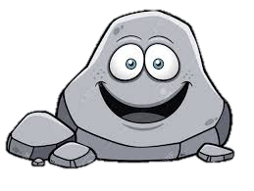
R - Respect
O – Openness
C – Confidential
K - Kind

Slide 6
Learning objective:
To choose a charity to fundraise for

Slide 7
Money

Slide 8
Charity

Slide 10
Year 1
Living in the wider world
Lesson 2

Slide 11
PSHE
What does PSHE stand for?
Personal
Social
Health
Economic

Slide 14
R - Respect
O – Openness
C – Confidential
K - Kind

Slide 15
Learning objective:
To sort wants and needs

Slide 16
What do you think people need to spend money on? Why?

Slide 17
What do you think people would like to spend money on? How is this different to need?

Slide 18
Need to do with our money
Want to do with our money

Slide 26
Year 1
Living in the wider world
Lesson 3

Slide 27
PSHE
What does PSHE stand for?
Personal
Social
Health
Economic

Slide 30
R - Respect
O – Openness
C – Confidential
K - Kind

Slide 31
Learning objective:
To explore boy and girl wants and needs

Slide 33
Boys needs
Girls needs

Slide 34
Boys wants
Girls wants

Slide 35
Are girls and boys wants and needs the same or different?

Slide 36
Year 1
Living in the wider world
Lesson 4

Slide 37
PSHE
What does PSHE stand for?
Personal
Social
Health
Economic

Slide 40
R - Respect
O – Openness
C – Confidential
K - Kind

Slide 41
Learning objective:
To celebrate being me

Slide 43
Year 1
Living in the wider world
Lesson 5

Slide 44
PSHE
What does PSHE stand for?
Personal
Social
Health
Economic

Slide 47
R - Respect
O – Openness
C – Confidential
K - Kind

Slide 48
Learning objective:
To plan a fundraising event

Slide 49
Our charity:
Our fundraising event:

Slide 50
Year 1
Living in the wider world
Lesson 6

Slide 51
PSHE
What does PSHE stand for?
Personal
Social
Health
Economic

Slide 54
R - Respect
O – Openness
C – Confidential
K - Kind

Slide 55
Learning objective:
To hold and evaluate a fundraising

Slide 56
Year 1
Living in the wider world
Lesson 7

Slide 57
PSHE
What does PSHE stand for?
Personal
Social
Health
Economic

Slide 60
R - Respect
O – Openness
C – Confidential
K - Kind

Slide 61
Learning objective:
To teach children about personal information.

Slide 62
How I can keep myself safe

Slide 63
https://vimeo.com/29383001

Slide 64
Stranger

Slide 65
Personal Information

Slide 67
Year 1
Living in the wider world
Lesson 8

Slide 68
PSHE
What does PSHE stand for?
Personal
Social
Health
Economic

Slide 71
R - Respect
O – Openness
C – Confidential
K - Kind

Slide 72
Learning objective:
To understand personal information

Slide 73
Year 1
Living in the wider world
Lesson 9

Slide 74
PSHE
What does PSHE stand for?
Personal
Social
Health
Economic

Slide 77
R - Respect
O – Openness
C – Confidential
K - Kind

Slide 78
Learning objective:
To identify places and people who make me feel safe

Slide 80
Places I feel safe in school.

Slide 81
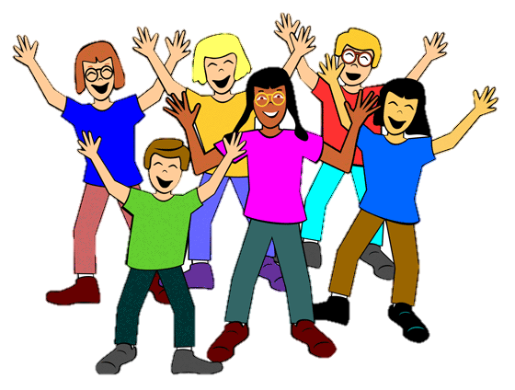
Adults who help me feel safe in school.

Slide 82
Year 1
Resilience Toolkit
Myself
Lesson 10

Slide 83
PSHE
What does PSHE stand for?
Personal
Social
Health
Economic

Slide 86
R - Respect
O – Openness
C – Confidential
K - Kind

Slide 87
Learning objective:
To explain what a safe classroom looks like

Slide 88
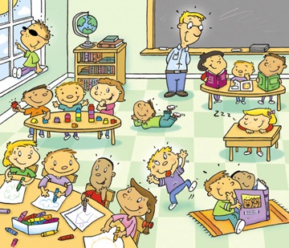

Slide 90
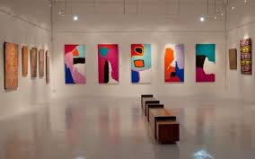

Slide 91
Year 1
Living in the wider world
Lesson 11

Slide 92
PSHE
What does PSHE stand for?
Personal
Social
Health
Economic

Slide 95
R - Respect
O – Openness
C – Confidential
K - Kind

Slide 96
Learning objective:
To identify how to keep safe at home

Slide 98
Year 1
Living in the wider world
Lesson 12

Slide 99
PSHE
What does PSHE stand for?
Personal
Social
Health
Economic

Slide 102
R - Respect
O – Openness
C – Confidential
K - Kind

Slide 103
Learning objective:
To understand bad secrets

Slide 104
If I tell you a secret you have to tell me one back and then I’ll be your friend.

Slide 105
Who to tell if you are worried about a secret.

