Slide 1
Delivering effective Relationships and Sex Education

Slide 2
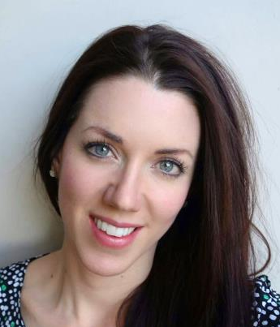
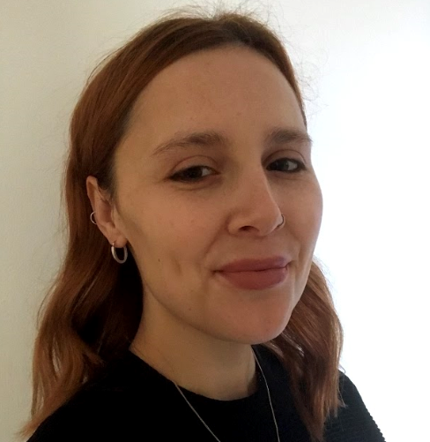
Meet the health improvement team
Karen Gibson
HIT manager Safeguarding
Nicole McGregor
Nutrition & exercise
officer
Claire Vaughan
RSE & PSHE
officer
Emily Rayfield
Mental health & emotional wellbeing
officer

Slide 3
What we do
Safeguarding prevention
Mental health and emotional wellbeing
Nutrition
&
exercise
PSHE
RSE

Slide 4
Outcomes for training
Increased confidence delivering RSE lessons
Increased confidence answering questions during RSE lessons
Knowledge of when topics are taught

Slide 5
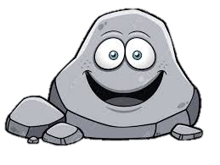
Ground Rules
Ground Rules
R - Respect
O – Openness
C – Confidential
K - Kind

Slide 6
My RSE
What information about growing up did you get:
From your parents?
From school lessons?
From your friends?
From magazines etc.?
What was good? What would you change?

Slide 7
What would you expect to be covered as part of RSE in primary schools?

Slide 8
Four main topics
Growing up
Our bodies
Keeping safe
Relation-ships and family life

Slide 9
RSE themes
Respect Emotions Friendships
Saying No Good and bad touch
Differences Families and people who care for me
Puberty Empathy Keeping safe
Communicating Building self-esteem
Sex Solving problems

Slide 10
Meet the Health Improvement Team
Why is RSE important?
What skills does it teach children?
Notes:
Buy Back
- Hosting the conference as part of our MHIS - toolkit
10

Slide 11
Why is RSE important?
Develop confidence in talking, listening and thinking about feelings and relationships.
Are able to name parts of the body and describe how the body works.
Have the skills, language and confidence to protect themselves.
Are prepared for puberty.

Slide 12
Meet the Health Improvement Team
When should these be taught?
Timeline activity
Notes:
Buy Back
- Hosting the conference as part of our MHIS - toolkit
12

Slide 13
Reception Our lives | Lesson 1: Our day Lesson 2: Keeping ourselves clean Lesson 3: Families
Year 1 Growing and caring for ourselves | Lesson 1: Keeping clean Lesson 2: Growing and changing Lesson 3: Families and care
Year 2 Differences | Lesson 1: Differences, boys and girls Lesson 2: Differences, male and female Lesson 3: Naming the body parts
Year 3 Valuing difference and keeping safe | Lesson 1: Differences male and female Lesson 2: Personal space Lesson 3: Family differences
Year 4 Growing up | Lesson 1: Growing and changing Lesson 2: What is puberty? Lesson 3: Puberty and changes
Year 5 Puberty | Lesson 1: Talking about puberty Lesson 2: Male and female changes Lesson 3: Puberty and hygiene
Year 6 Puberty, relationships and reproduction | Lesson 1: Puberty and reproduction Lesson 2: Understanding relationships Lesson 3: Conception and pregnancy Lesson 4: Communicating in relationships

Slide 14
RSE and safeguarding
Universal language spoken by all
CSE and grooming – links to online safety
Appropriate and inappropriate touch
Promotes healthy relationships

Slide 15
Meet the Health Improvement Team
Sample lesson:
Year 2 lesson 1
Introducing differences between boys and girls
Notes:
Buy Back
- Hosting the conference as part of our MHIS - toolkit
15

Slide 16
Teaching about body parts
Year 2
Use story with children
Normalise the language
Don’t need to explain why boys and girls have different body parts

Slide 17
Meet the Health Improvement Team
Sample lesson:
Year 4 lesson 2
What is puberty?
Notes:
Buy Back
- Hosting the conference as part of our MHIS - toolkit
17

Slide 18
Teaching about puberty
Periods – end of year 4
Boy and girl changes – year 5 and 6
Focus on body preparing for becoming an adult
Scientific process of puberty

Slide 19
Meet the Health Improvement Team
Sample lesson:
Year 6 lesson 3
Conception and pregnancy
Notes:
Buy Back
- Hosting the conference as part of our MHIS - toolkit
19

Slide 20
Sex education
Year 6 only
Scientific process of how a baby is conceived and born

Slide 21
What is important to remember?
Normalise the themes being discussed
Be sensitive to discussions
You don’t need to answer everything immediately
Safeguarding – If in doubt – shout!

Slide 22
What is important to remember?
Don’t feel pressured
Visual timetable
Question box
Prepare and practice!

Slide 23
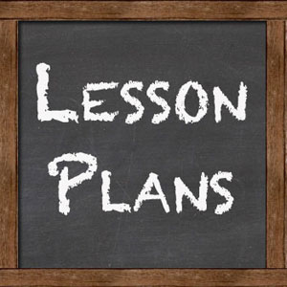
Lesson plans

Slide 24
Tricky questions

Slide 26
Please complete workshops evaluation
https://www.surveymonkey.co.uk/r/hittraining1920

Slide 27
Thank
you for attending!
Notes:
27

