Slide 1


Relationships Education Policy

Slide 2


Focus for today’s workshop
Sharing our schools Relationships Education Policy

Slide 3

Ground Rules
R - Respect
O – Openness
C – Confidential
K - Kind

Slide 4



What is Relationships Education?

Slide 5
What is Relationships Education?
Forms part of the PSHE (personal, social, health and economic) curriculum.
Taught in the Summer Term from nursery to year 6.
Puberty lessons are covered in year 4, 5 and 6.
Sex Education is covered in year 6 only – you have the right to withdraw your child from this lesson.
Relationships Education also covers keeping safe, good and bad touch, people who help us, good friendships and peer pressure. These lessons are taught throughout the year.

Slide 6

Statutory guidance for primary schools

Slide 7
Relationships Education
Families and people who care for me
Caring friendships
Respectful relationships
Online relationships
Being safe

Slide 8
Health Education
Mental wellbeing
Internet safety and harms
Physical health and fitness
Healthy eating
Drugs, alcohol and tobacco
Health and prevention
Basic first aid
Changing adolescent body

Slide 9
Sex education in primary schools
There is no statutory requirement to teach sex education in primary schools.
Lots of schools choose to deliver lessons on sex education in year 6 only (1 lesson)
However parents will have the right to withdraw their children from sex education lessons if they so wish.

Slide 10
Learning objectives for Relationships Education

Slide 11
Year group | Learning objectives for Relationships Education lessons
Nursery | To consider the routines and patterns of a typical day To explain how to keep myself clean and healthy and explain why it is important To identify the people in my family and explain where I can get help
Reception | To consider the routines and patterns of a typical day To explain how to keep myself clean and healthy and explain why it is important To identify the people in my family and explain where I can get help
Year 1 | To understand how to keep myself clean and healthy and explain why it is important To understand how I have grown and changed since birth To identify the people in my family, while recognizing that not all families look like mine To explain where I can get help and support.
Year 2 | To explore stereotypes To explain personal boundaries To understand how boys and girls are different and to name boy and girl body parts To understand the stages in the human lifecycle To identify the people in my family, while recognizing that not all families look like mine To explain where I can get help and support.
Year 3 | To understand how boys and girls are different and to name boy and girl body parts To explain personal boundaries To identify the people in my family, while recognizing that not all families look like mine To explain where I can get help and support To understand good friendships
Year 4 | To identify the people in my family, while recognizing that not all families look like mine To explain where I can get help and support To understand basic facts about puberty To begin to understand menstruation To understand good friendships
Year 5 | To explore the emotional and physical changes that occur during puberty To understand male and female puberty changes To explore the impact of puberty on the body and the importance of physical hygiene To explore ways to get support during puberty To understand what makes a family and who to turn to for help and support
Year 6 | To recap the male and female changes that happen during puberty To understand what makes a family and who to turn to for help and support To explore positive and negative ways of communicating in relationships To understand healthy relationships The understand the human reproductive system (parents can withdraw children from this lesson.)

Slide 12
Relationships Education vocabulary list

Slide 13
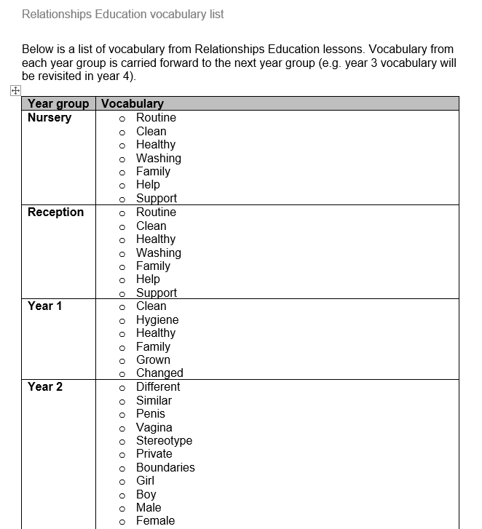

Slide 14


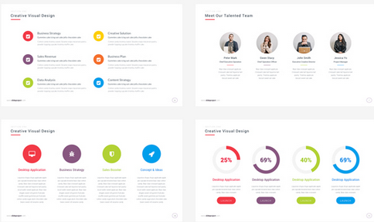
Meet the Health Improvement Team
Relationships Education policy
Notes:
Buy Back
- Hosting the conference as part of our MHIS - toolkit
14

Slide 15
Need for updated policy
Updated policy needed to be developed as this is a requirement based on the DfE guidance.

Slide 16
Update on policy
Section 1:
Rationale:
How we define Relationships Education
Links to Ofsted
Links to the morals and values of our school

Slide 17
Update on policy
Section 2:
Statutory requirements:
Outlines what schools have to cover
Section 3:
Policy development
Outlines how we have developed this policy

Slide 18
Update on policy
Sections 4:
Aims and objectives:
o Develop confidence in talking, listening and thinking about feelings and relationships;
o Teach pupils the correct vocabulary to describe themselves and their bodies;
o Be prepared for puberty and understand the basic changes that happen during puberty;
o Understand how to keep their bodies healthy and clean;
o Understand how to keep themselves and their bodies safe;
o Help pupils develop feeling of self-respect, confidence and empathy;
o Help pupils recognise healthy friendships;
o Provide a framework in which sensitive discussions can take place;
o Foster respect for the views of other people

Slide 19
Update on policy
Section 5:
Equal Opportunities :
Ensuring our curriculum meets all needs. SEND, boys and girls, preparing for puberty

Slide 20
Update on policy
Section 6:
Content:
What we teach
Puberty years 4, 5, and 6
Sex education year 6 only

Slide 21
Update on policy
Section 6:
Delivery:
School staff
Any external visitors will be shared with staff
Mixed gender groups
Training:
Provided for staff as needed

Slide 22
Update on policy
Section 7:
Child protection
Section 8: Partnerships with parents
Parents will be informed about the Relationships Education programme at the start of the academic year, as part of information provided on what their children will be learning.

Slide 23
Update on policy
Section 8: Partnerships with parents
Parents do not have the right to withdraw their children from statutory Relationships and Health Education lessons (see outline of Relationships and Health education in appendix 1). Parents also cannot withdraw their children from the statutory National Science Curriculum (see appendix 1)
Parents have the right to withdraw their children from the non-statutory components of sex education (taught in 6 only) within Relationships Education (see appendix 1). Requests for withdrawal from these lessons should be put in writing and addressed to the headteacher. In the event of a child being withdrawn from a lesson, that child must stay in school and will be assigned to another class until that specific lesson is over.

Slide 24
Update on policy
Section 9: Roles and responsibilities
Governors
Staff
Parents
Pupils

Slide 25
Update on policy
Appendix
APPENDIX 1: Curriculum coverage – science, relationships education and health education
APPENDIX 2: Learning objectives
APPENDIX 3: Vocabulary
APPENDIX 4: Parent letter

Slide 26
Next steps

