Slide 1
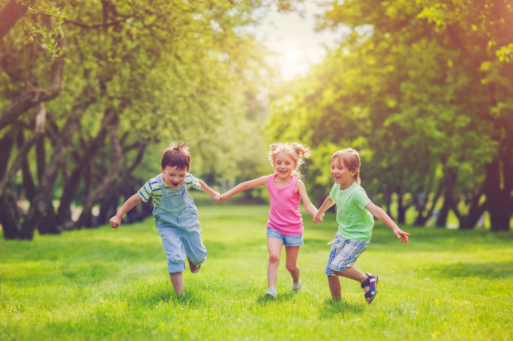
Relationships Education
Staff training session 2

Slide 2
Relationships Education training 1
What is Relationships Education?
School data relating to Relationships Education
Type important of Relationships Education?
What is covered in Relationships Education?
When should these topics be taught?

Slide 3
Relationships Education training 2
Delivering effective Relationships Education
Tops tips for delivering Relationships Education
Looking at lessons plans
Assessment
Answering difficult questions

Slide 4
Ground Rules
Ground Rules
R - Respect
O – Openness
C – Confidential
K - Kind

Slide 5
Delivering Relationships Education lessons

Slide 6
Relationships Education lessons
Previously, schools in Ealing used Christopher Winter resources for these lessons
We have now written our own lessons – therefore CW resources will no longer be used
No video content or books used for lessons

Slide 7
Year group | Learning objectives for Relationships Education lessons
Nursery | To consider the routines and patterns of a typical day To explain how to keep myself clean and healthy and explain why it is important To identify the people in my family and explain where I can get help
Reception | To consider the routines and patterns of a typical day To explain how to keep myself clean and healthy and explain why it is important To identify the people in my family and explain where I can get help
Year 1 | To understand how to keep myself clean and healthy and explain why it is important To understand how I have grown and changed since birth To identify the people in my family, while recognizing that not all families look like mine To explain where I can get help and support.
Year 2 | To explore stereotypes To explain personal boundaries To understand how boys and girls are different and to name boy and girl body parts To understand the stages in the human lifecycle To identify the people in my family, while recognizing that not all families look like mine To explain where I can get help and support.
Year 3 | To understand how boys and girls are different and to name boy and girl body parts To explain personal boundaries To identify the people in my family, while recognizing that not all families look like mine To explain where I can get help and support To understand good friendships
Year 4 | To identify the people in my family, while recognizing that not all families look like mine To explain where I can get help and support To understand basic facts about puberty To begin to understand menstruation To understand good friendships
Year 5 | To explore the emotional and physical changes that occur during puberty To understand male and female puberty changes To explore the impact of puberty on the body and the importance of physical hygiene To explore ways to get support during puberty To understand what makes a family and who to turn to for help and support
Year 6 | To recap the male and female changes that happen during puberty To understand what makes a family and who to turn to for help and support To explore positive and negative ways of communicating in relationships To understand healthy relationships The understand the human reproductive system (parents can withdraw children from this lesson.)

Slide 8
Vocabulary list for primary schools. This should also be in your policy you may wish to have this on your website too covers vocabulary that is taught in Relationships Education lessons from Summer term

Slide 9
Relationships Education lessons
3 lessons per year group
Embedded within PSHE planning
Covered in Summer term
Resources are in PSHE planning, PSHE planning PowerPoints also has resources embedded within
All Relationships Education lessons are marked on planning

Slide 10
Relationships Education lessons
Red on planning indicates an assessment opportunity
Green indicates a key question
Blue indicates an evidence gathering opportunity

Slide 12
What is important to remember?
Normalise the themes being discussed
Be sensitive to discussions
You don’t need to answer everything immediately
Safeguarding – If in doubt – shout!

Slide 13
What is important to remember?
Don’t feel pressured
Visual timetable
Question box
Prepare and practice!

Slide 14
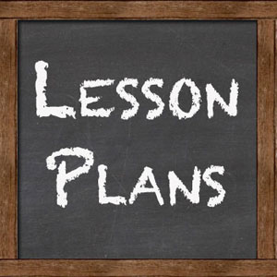
Lesson plans

Slide 15
Relationships Education lessons
The following slides break down each year groups planning
I have added screenshots of all resources – however I have not included all PowerPoint slides.
If you are sharing with parents, remember to share resources but also share the slides
I have added extra information about the lessons parents tend to have the most questions about

Slide 16
Nursery
Lessons 6, 7 and 8 are the Relationships Education lessons for Nursery.
Learning objectives:
Lesson 1: To consider the routines and patterns of a typical day
Lesson 2: To explain how to keep myself clean and healthy and explain why it is important
Lesson 3: To identify the people in my family and explain where I can get help

Slide 18
Families
Families look different - not all families will look like their family, what is important is that our family loves us and takes care of us.
Circle time talking about our family
Children bring in photographs of their family
Talk about people who are special to them
Create a family tree
Draw their family
Make a family frame

Slide 19
Reception
Lessons 6, 7 and 8 are the Relationships Education lessons for Reception.
Learning objectives:
Lesson 1: To consider the routines and patterns of a typical day
Lesson 2: To explain how to keep myself clean and healthy and explain why it is important
Lesson 3: To identify the people in my family and explain where I can get help

Slide 21
Families
Families look different - not all families will look like their family, what is important is that our family loves us and takes care of us.
Circle time talking about our family
Children bring in photographs of their family
Talk about people who are special to them
Create a family tree
Draw their family
Make a family frame

Slide 22
Year 1
Lessons 9, 10 and 11 are the Relationships Education lessons for Year 1.
Learning objectives:
Lesson 1: To understand how to keep myself clean and healthy and explain why it is important
Lesson 2: To understand how I have grown and changed since birth
Lesson 3: To identify the people in my family, while recognizing that not all families look like mine & to explain where I can get help and support.

Slide 24
Families
Families look different - not all families will look like their family, what is important is that our family loves us and takes care of us.
My family
Who is in my family?
What does family mean to me?
How is my family similar/different to other people in my class
Who takes care of me?

Slide 25
Year 2
Lessons 4, 5 and 6 are the Relationships Education lessons for Year 2.
Learning objectives:
Lesson 1: To explore stereotypes and to explain personal boundaries
Lesson 2: To understand how boys and girls are different and to name boy and girl body parts and to understand the stages in the human lifecycle
Lesson 3: To identify the people in my family, while recognizing that not all families look like mine and to explain where I can get help and support

Slide 27
Body parts
Linked to story of a mum who is pregnant and everyone is guessing if she has a baby boy or girl.
Child asks his mum is the doctor/nurse will have to guess.
Mum explain that doctor looks for private parts of a baby to tell if it is a boy or girl.
These parts are private – links to PANTS rule
Body parts enable mum, dad, doctor, nurse etc. to be able to tell if we are a boy or a girl.

Slide 28
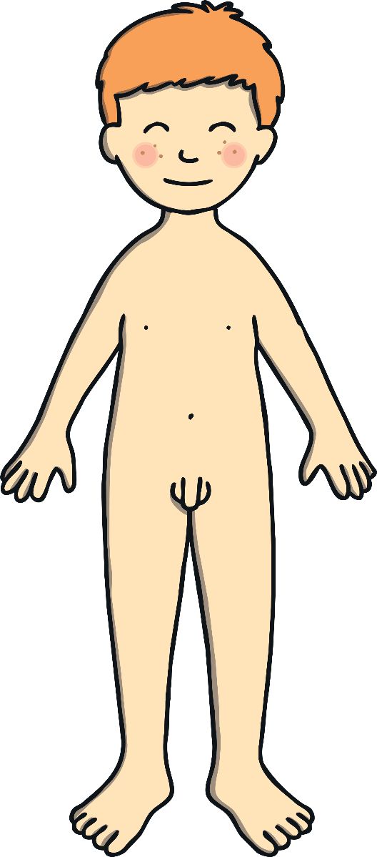
Boys’ Bodies
Boys have a body part called a penis.
People have other names they use for this part of the body, but the scientific word is penis.
Boys, males and men have a penis

Slide 29
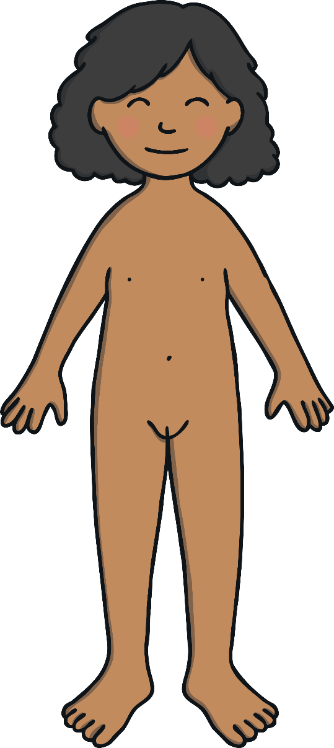
Girls’ Bodies
Girls have a vagina,
People have other names for these too, but vulva and vagina are the scientific words.
Girls, female, women have a vagina

Slide 30
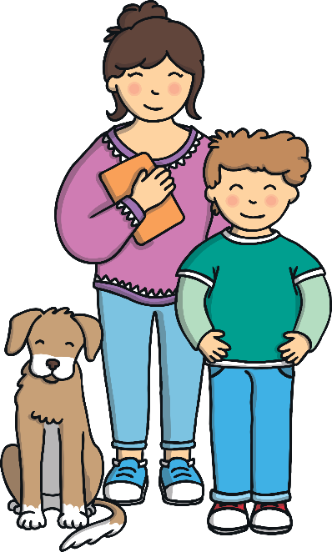
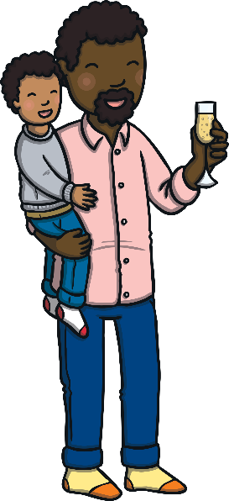
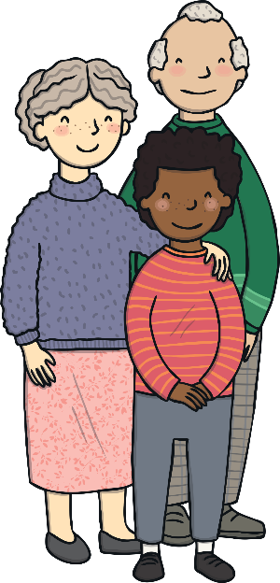
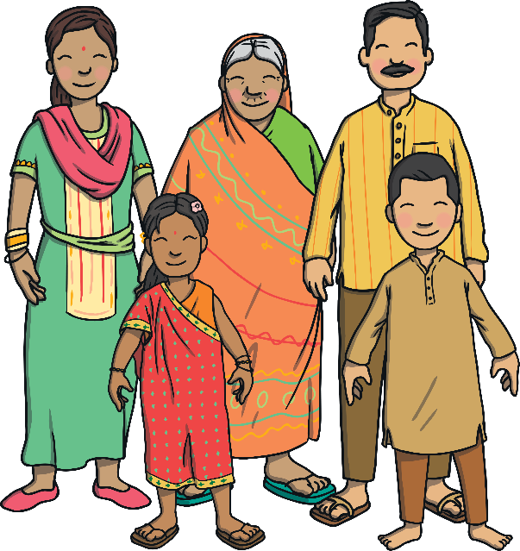
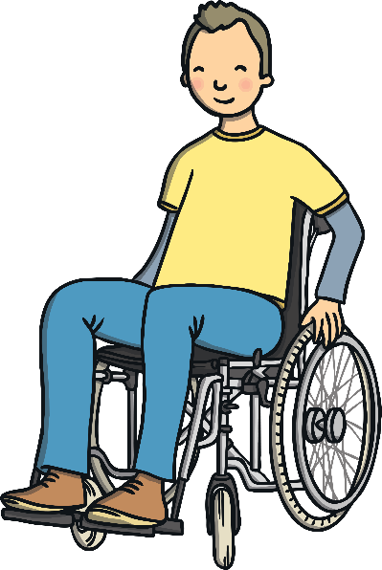
Our Families
We all belong to family groups.
These family groups will all be different. Some may be big, others may be small and they may have a different mix of people in them.
This is OK, we are all different and difference is something to be celebrated!
Who is in your family? Tell a partner.

Slide 31
Families
Families look different - not all families will look like their family, what is important is that our family loves us and takes care of us.
How does our family make us feel?
The different occasions when we need our families
How our family can help us
Children draw their family network and then add reasons why each family member they have chosen to draw is important to them

Slide 32
Year 3
Lessons 2, 3 and 4 are the Relationships Education lessons for Year 3
Learning objectives:
Lesson 1: To understand how boys and girls are different and to name boy and girl body parts & o explain personal boundaries
Lesson 2: To identify the people in my family, while recognizing that not all families look like mine & to explain where I can get help and support
Lesson 3:To understand good friendships

Slide 34
Body parts
Linked to PANTS rule
Good and bad touch
Good and bad secrets
Sorting body parts – boy only, girl only, both
Body part bingo – boy only, girl only, both

Slide 35
Families
Families look different - not all families will look like their family, what is important is that our family loves us and takes care of us.
Families around the word
Muluken’s family
Similarities and differences
What all families have in common
Our wider family – step families, aunts, uncles, grandparents, cousins

Slide 36
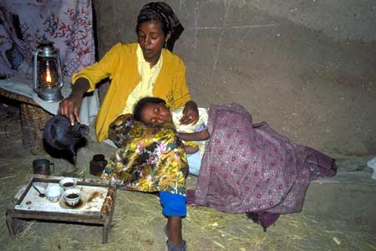
Notes:
6. Muluken sleeps on her mother's lap.
Photo: Rhodri Jones/Oxfam
Muluken sleeps on her mother's lap. There is no electricity in Gerba Sefer village, and so the family use a paraffin lamp. At night it can get cold and it's sometimes frosty in November and December. Discussion: Do we waste power (eg electricity) in the North? What can we do to save energy at home?

Slide 37
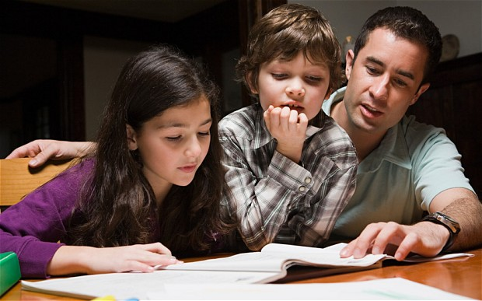

Slide 38
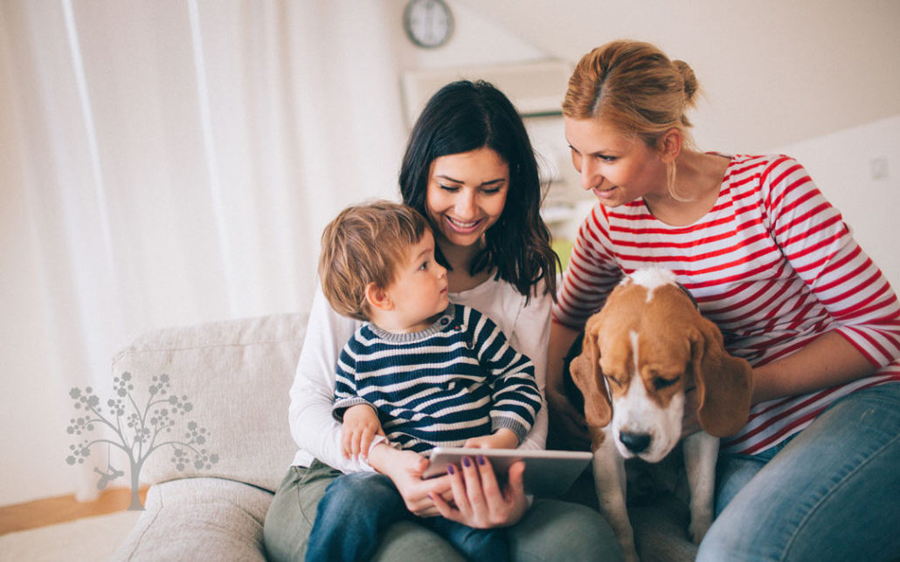

Slide 39
Year 4
Lessons 2, 3 and 4 are the Relationships Education lessons for Year 4
Learning objectives:
Lesson 1: To understand good friendships
Lesson 2: To identify the people in my family, while recognizing that not all families look like mine & to explain where I can get help and support
Lesson 3: To understand basic facts about puberty & to begin to understand menstruation

Slide 42
Puberty
What does puberty mean - change, growing and maturing from a child to an adult.
Common question group activity: does puberty happen at the same time for everyone? Do these changes happen to everyone? Why do these changes happen.
Naming body parts using correct words
Sweat glands, change to voice, body changes, pubic hair and periods are the main difference discussed in this lesson

Slide 43
Periods
1. When a girl reaches puberty, she will have lots of hormonal changes (chemical changes) happening in her body. These chemical changes are causing her body to grow and change during puberty
2. These hormones will also cause a girl’s period to start.
3. All girls start their period during puberty, some start sooner than others.
4. These hormones cause an egg to be released from a girls ovary.
5. This egg then travels down your fallopian tube and into your uterus.
6. When the egg reaches the uterus, the uterus lining (the muscular tissue) becomes thicker to protect the egg.
7. When the egg does not need to be protected anymore (usually by day 28 of a girls monthly cycle) the uterus sheds (gets rid) of its lining.
8. this causes a period, or monthly bleed for girls. Explain that the blood lost during a period is not the same as the blood in our veins and arteries, it is waste blood and tissue that our body no longer needs.
9. explain that once a girl has had her period (shed the lining of her uterus, which usually lasts 3-4 days) the cycle begins again.
10. Explain to begin with, this may not happen every month, but eventually the cycle usually becomes regular and will happen every month.
11. Explain that to keep ourselves clean and healthy when we have a period, girls use sanitary towels (pads). Use the PP to explain what a sanitary towel is

Slide 44
Puberty for Girls
Larynx (voice box)
grows
Grow taller
Sweat glands produce more sweat
Skin becomes oilier
Gain hair on arms and legs
Grow hair under armpits
Grow breasts
Grow pubic hair
Start to menstruate
All parts of the
body grow
Remember that everybody's body looks different!

Slide 45
Puberty for Boys
Larynx (voice box) grows –
‘Adam’s apple’
Grow taller
Skin becomes oilier
Become more muscular
Grow facial hair
Grow hair under armpits
Grow hair on chest
Sweat glands produce more sweat
Testicles and penis develop
Grow pubic hair
Gain hair on arms and legs
All parts of the
body grow
Remember that everybody's body looks different!

Slide 46
Families
Families look different - not all families will look like their family, what is important is that our family loves us and takes care of us.
What does family mean
Family members – extended families
Similarities and differences in families
Different combinations in families
My family
What is the most important thing for a family – ranking top 9 things

Slide 47
Year 5
Lessons 2, 3 and 4 are the Relationships Education lessons for Year 5
Learning objectives:
Lesson 1: To explore the emotional and physical changes that occur during puberty. To understand male and female puberty changes. To explore the impact of puberty on the body and the importance of physical hygiene & explore ways to get support during puberty
Lesson 2: To explore the emotional and physical changes that occur during puberty. To understand male and female puberty changes. To explore the impact of puberty on the body and the importance of physical hygiene & explore ways to get support during puberty
Lesson 3: To understand what makes a family and who to turn to for help and support

Slide 49
Puberty
What is puberty?
Boy changes, girl change, changes for both – sorting activity
Recap of periods
Emotional changes
Hormonal changes – story of a young boy who finds it difficult to control his mood

Slide 50
Families
Families look different - not all families will look like their family, what is important is that our family loves us and takes care of us.
Similarities and differences in our class
Why family is important – emotional support, keeps us safe
Respect
Falling out – resolving conflict
Leo’s homework story

Slide 52
Year 6
Lessons 2, 3 and 4 are the Relationships Education lessons for Year 6
Learning objectives:
Lesson 1: To explore positive and negative ways of communicating in relationships & understand healthy relationships
Lesson 2: To recap the male and female changes that happen during puberty & understand what makes a family and who to turn to for help and support
Lesson 3: The understand the human reproductive system. Not statutory, parents can withdraw from this lesson

Slide 53
Puberty
What is puberty?
Boy changes, girl change, changes for both – sorting activity
Emotional changes
Wet dreams and erections
Body changes
Scientific vocabulary for body parts
Myths and facts group work

Slide 54
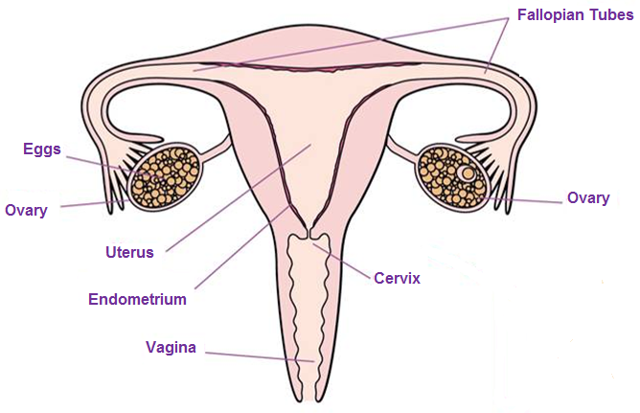
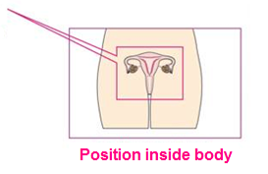
The Female Reproductive System

Slide 55
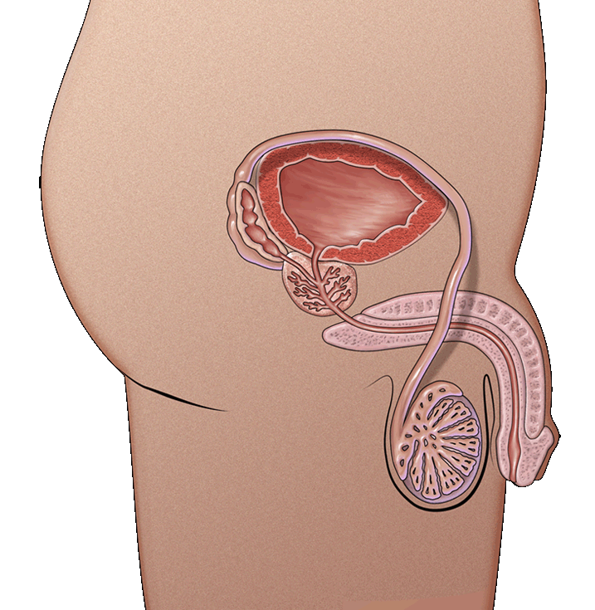
Penis Anatomy
Urethra
The tube through which urine and semen leaves the boy’s body
Penis
Tube-like organ that hangs outside the body
Come in all sizes and shapes, determined by our genes
Testicles or testes
Usually two, one hangs lower
Where sperm are made
Scrotum
Bag of skin that holds testicles
Keeps them at right temperature to make sperm, slightly cooler than body’s temperature
Gets bigger and baggier and turns a darker colour during puberty

Slide 56
Human reproduction – not statutory
Sequencing steps
No video
No book
No pictures

Slide 57
Human reproduction lesson

Slide 58
Topics
FGM
Different families
Gender identify
Abuse

Slide 59
Assessment
Highlighted in red on lesson plans
Each unit of work (3-4 lessons) will have a baseline assessment and an endline assessment. These will need to be done with all children.
Evidence is highlighted in blue – as a year group please decide what pieces of evidence you are collecting (group/individual) to ensure consistency across year group.

Slide 60
Tricky questions

Slide 62
Thank
you for attending!
meadec@ealing.gov.uk
www.egfl.org.uk
020 8825 6173
Notes:
62

