Slide 1
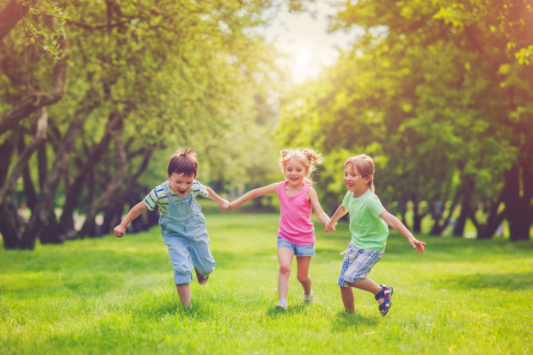
Relationships Education
Parent workshop 1

Slide 2
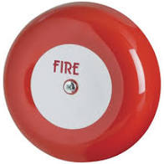
Housekeeping

Slide 3
Ground Rules
R - Respect
O – Openness
C – Confidential
K - Kind

Slide 4
XX Primary School HRBS 20XX
Question | A | B | C
% of pupils who said parents had discussed body changes with them | 33% | 43% | 63%
% pupils who said teachers had discussed body changes with them | 38% | 68% | 88%
% of pupils who worry about puberty and growing up 'quite a lot' or 'a lot'. | 12% | 22% | 32%
% of pupils who can usually or always say no to a friend when a friend asks them to do something they don’t want to do | 23% | 43% | 63%

Slide 5
XX Primary School HRBS 20XX
Question | A | B | C
% of pupils who said parents had discussed body changes with them | 33% | 43% | 63%
% pupils who said teachers had discussed body changes with them | 38% | 68% | 88%
% of pupils who worry about puberty and growing up 'quite a lot' or 'a lot'. | 12% | 22% | 32%
% of pupils who can usually or always say no to a friend when a friend asks them to do something they don’t want to do | 23% | 43% | 63%

Slide 6
What is Relationships Education?

Slide 7
What is Relationships Education?
Forms part of the PSHE (personal, social, health and economic) curriculum.
Lessons on puberty and body changes (year 4, 5 and 6 only) are usually taught in Summer Term.
Human reproduction (year 6 only) usually taught in Summer term
However relationships education also takes place throughout the year. Lessons about keeping safe, good and bad touch, people who help us, good friendships and peer pressure are taught consistently in all year groups.

Slide 8
DfE statutory guidance for primary schools

Slide 9
Relationships Education
Families and people who care for me
Caring friendships
Respectful relationships
Online relationships
Being safe

Slide 10
Health Education
Mental wellbeing
Internet safety and harms
Physical health and fitness
Healthy eating
Drugs, alcohol and tobacco
Health and prevention
Basic first aid
Changing adolescent body

Slide 11
Sex education in primary schools
There is no statutory requirement to teach sex education in primary schools.
Many schools do deliver lessons on sex education in year 6, and will continue to do so after September 2020.
However parents will have the right to withdraw their children from sex education lessons if they so wish.

Slide 12
Why is Relationships Education important?
Develop confidence in talking, listening and thinking about feelings and relationships.
Are able to name parts of the body and describe how the body works.
Have the skills, language and confidence to protect themselves.
Are prepared for puberty.

Slide 13
Relationships Education and safeguarding
Universal language spoken by all
CSE and grooming – links to online safety
Appropriate and inappropriate touch
Promotes healthy relationships

Slide 14
Four main topics
Growing up
Our bodies
Keeping safe
Relation-ships and family life

Slide 15
Relationships Education themes
Respect Emotions Friendships
Saying No Good and bad touch
Differences Families and people who care for me
Puberty Empathy Keeping safe
Communicating Building self-esteem
Sex Solving problems

Slide 16
Where do children learn about Relationships Education topics?
Keeping safe
Healthy friendships
Families
Stereotypes
Body changes
Healthy body image
Saying no

Slide 18
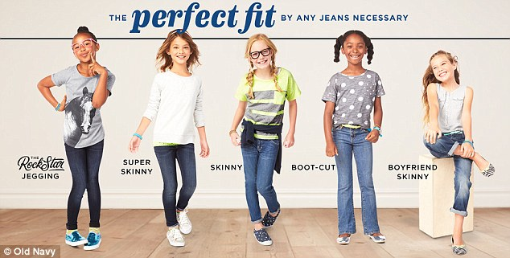
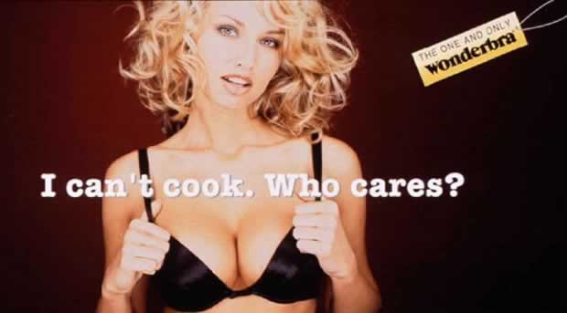

Slide 19
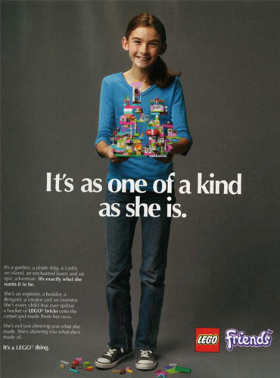

Slide 20
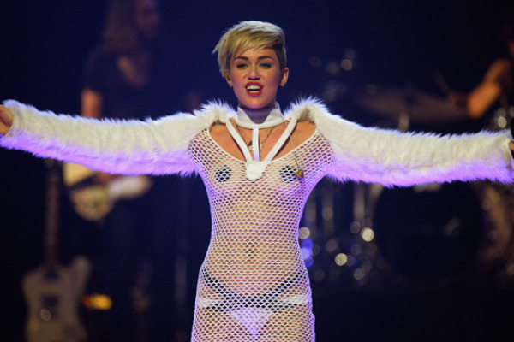
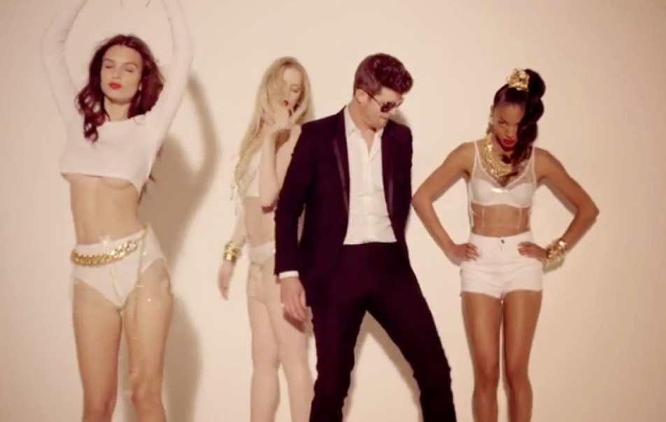

Slide 21
Florida Whistle
Go girl you can twerk it,
Let me see you whistle while you work it,
I’mma lay it back, don’t stop it,
‘Cause I love it how you drop it, drop it, drop it on me,
Now, shawty let that whistle blow-oh, oh oh,
Yeah, baby let that whistle blow-oh oh!
Can you blow my whistle baby, whistle baby
Let me know,
Bruno Mars – Locked out of heaven
“Open up your gates cause I can’t wait to see the light,
And right there is where I wanna stay,
Cause your sex takes me to paradise,
Yeah your sex takes me to paradise.”
Katie Perry – Last Friday Night
Barbie’s on the barbeque, Is this a hickie or a bruise?
Pictures of last night ended up online, I’m screwed,
Oh well, it’s a blacked out blur, but I’m pretty sure it ruled.

Slide 22
Where do children and young people learn about Relationships Education related issues?
TV Magazines Radio
Music videos Gaming Parents
Siblings Peer School
Internet Disney Films

Slide 24
Thank
you for attending!
Notes:
24

