Slide 1


Train the Trainer
How to deliver effective RSE staff training

Slide 2


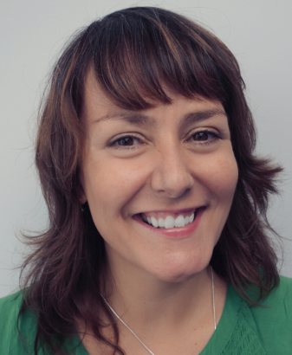
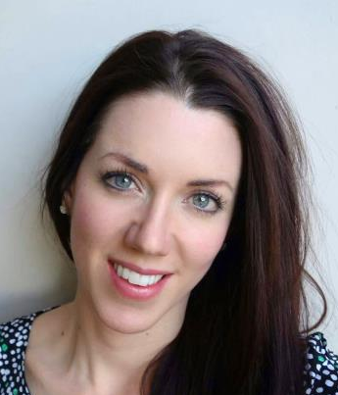

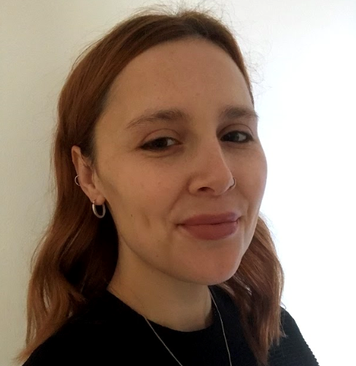

Meet the health improvement team
Karen Gibson
HIT manager Safeguarding
Nicole McGregor
Nutrition & exercise
officer
Claire Vaughan
RSE & PSHE
officer
Emily Rayfield
Mental health & emotional wellbeing
officer

Slide 3

Aims for this workshops
Increased confidence deliver RSE staff training
Increased confidence talking to staff about RSE
Access resources for staff training
Answering difficult questions from staff
Advising staff how to teach RSE effectively

Slide 4
What is the focus of your staff training?
General RSE information
Update on new guidance
Looking at curriculum
Answering tricky questions
Upskilling staff
Other?

Slide 5
Sample PowerPoint
This would take approx. 2 hours INSET or 2x 1 hour sessions

Slide 6
Aims for today’s session:
Increased confidence in how to deliver effective RSE
Increased knowledge of what RSE is
Had an opportunity to look at and discuss RSE lesson plans and resources

Slide 7
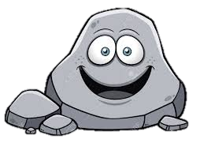
Ground Rules
Ground Rules
R - Respect
O – Openness
C – Confidential
K - Kind

Slide 8
My RSE
What information about growing up did you get:
From your parents?
From school lessons?
From your friends?
From magazines etc.?
What was good? What would you change?

Slide 9
XXXX Primary School HRBS 2019
Question | A | B | C
% of pupils who said parents had discussed body changes with them | 22% | 52% | 72%
% pupils who said teachers had discussed body changes with them | 28% | 58% | 78%
% of pupils who worry about puberty and growing up 'quite a lot' or 'a lot'. | 10% | 20% | 30%
% of pupils who can usually or always say no to a friend when a friend asks them to do something they don’t want to do | 38% | 48% | 58%

Slide 10
XXXX Primary School HRBS 2019
Question | A | B | C
% of pupils who said parents had discussed body changes with them | 22% | 52% | 72%
% pupils who said teachers had discussed body changes with them | 28% | 58% | 78%
% of pupils who worry about puberty and growing up 'quite a lot' or 'a lot'. | 10% | 20% | 30%
% of pupils who can usually or always say no to a friend when a friend asks them to do something they don’t want to do | 38% | 48% | 58%

Slide 11
What do you know about RSE?
Group work

Slide 12
RSE in primary schools
Part of PSHE
Linked to safeguarding
Puberty in upper KS2
Sex education in year 6
Usually covered in Summer Term
Updated guidance will be used from September 2020
Range of topics: e.g. keeping clean, routine, good and bad touch, saying no, assertiveness, good friendships, self esteem, communicating

Slide 13
Updated guidance for RSE.
Will be called Relationships Education in primary schools
Schools will follow updated guidance from September 2020
Parents will only be able to withdraw children from sex education lessons (year 6 only).

Slide 14
What has to be covered in primary schools?

Slide 15
Relationships Education
Families and people who care for me
Caring friendships
Respectful relationships
Online relationships
Being safe

Slide 16
Health Education
Mental wellbeing
Internet safety and harms
Physical health and fitness
Healthy eating
Drugs, alcohol and tobacco
Health and prevention
Basic first aid
Changing adolescent body

Slide 17

What would you expect to be covered as part of RSE in primary schools?

Slide 18
Four main topics
Growing up
Our bodies
Keeping safe
Relation-ships and family life

Slide 19
RSE themes
Respect Emotions Friendships
Saying No Good and bad touch
Differences Families and people who care for me
Puberty Empathy Keeping safe
Communicating Building self-esteem
Sex Solving problems

Slide 20


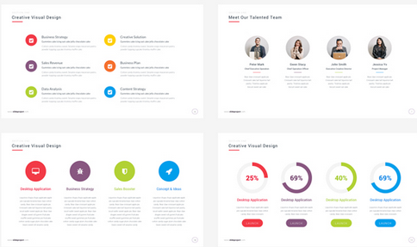
Meet the Health Improvement Team
Why is RSE important?
What skills does it teach children?
Group work
Notes:
Buy Back
- Hosting the conference as part of our MHIS - toolkit
20

Slide 21
Why is RSE important?
Develop confidence in talking, listening and thinking about feelings and relationships.
Are able to name parts of the body and describe how the body works.
Have the skills, language and confidence to protect themselves.
Are prepared for puberty.

Slide 22
Meet the Health Improvement Team
When should these be taught?
Timeline activity
Notes:
Buy Back
- Hosting the conference as part of our MHIS - toolkit
22

Slide 23
These are the LOs for this academic year – from Christopher Winter resources (part of Ealing PSHE scheme of work)
Reception Our lives | Lesson 1: Our day Lesson 2: Keeping ourselves clean Lesson 3: Families
Year 1 Growing and caring for ourselves | Lesson 1: Keeping clean Lesson 2: Growing and changing Lesson 3: Families and care
Year 2 Differences | Lesson 1: Differences, boys and girls Lesson 2: Differences, male and female Lesson 3: Naming the body parts
Year 3 Valuing difference and keeping safe | Lesson 1: Differences male and female Lesson 2: Personal space Lesson 3: Family differences
Year 4 Growing up | Lesson 1: Growing and changing Lesson 2: What is puberty? Lesson 3: Puberty and changes
Year 5 Puberty | Lesson 1: Talking about puberty Lesson 2: Male and female changes Lesson 3: Puberty and hygiene
Year 6 Puberty, relationships and reproduction | Lesson 1: Puberty and reproduction Lesson 2: Understanding relationships Lesson 3: Conception and pregnancy Lesson 4: Communicating in relationships

Slide 24
These are the LOs for next academic year – based on DfE guidance.
Year group | Learning objectives for Relationships Education lessons
Nursery | To consider the routines and patterns of a typical day To explain how to keep myself clean and healthy and explain why it is important To identify the people in my family and explain where I can get help
Reception | To consider the routines and patterns of a typical day To explain how to keep myself clean and healthy and explain why it is important To identify the people in my family and explain where I can get help
Year 1 | To understand how to keep myself clean and healthy and explain why it is important To understand how I have grown and changed since birth To identify the people in my family, while recognizing that not all families look like mine To explain where I can get help and support.
Year 2 | To explore stereotypes To explain personal boundaries To understand how boys and girls are different and to name boy and girl body parts To understand the stages in the human lifecycle To identify the people in my family, while recognizing that not all families look like mine To explain where I can get help and support.
Year 3 | To understand how boys and girls are different and to name boy and girl body parts To explain personal boundaries To identify the people in my family, while recognizing that not all families look like mine To explain where I can get help and support To understand good friendships
Year 4 | To identify the people in my family, while recognizing that not all families look like mine To explain where I can get help and support To understand basic facts about puberty To begin to understand menstruation To understand good friendships
Year 5 | To explore the emotional and physical changes that occur during puberty To understand male and female puberty changes To explore the impact of puberty on the body and the importance of physical hygiene To explore ways to get support during puberty To understand what makes a family and who to turn to for help and support
Year 6 | To recap the male and female changes that happen during puberty To understand what makes a family and who to turn to for help and support To explore positive and negative ways of communicating in relationships To understand healthy relationships The understand the human reproductive system (parents can withdraw children from this lesson. See section 8)

Slide 25
RSE and safeguarding
Universal language spoken by all
CSE and grooming – links to online safety
Appropriate and inappropriate touch
Promotes healthy relationships

Slide 26
Where do children learn about RSE topics?
Keeping safe
Healthy friendships
Families
Stereotypes
Body changes
Healthy body image
Saying no

Slide 27







Slide 28

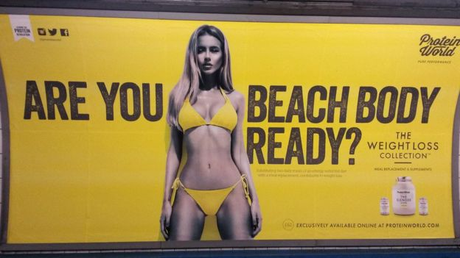

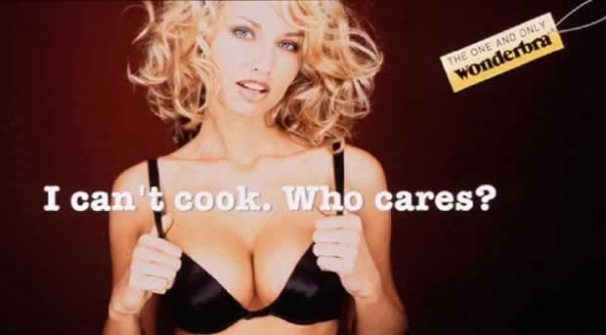


Slide 29
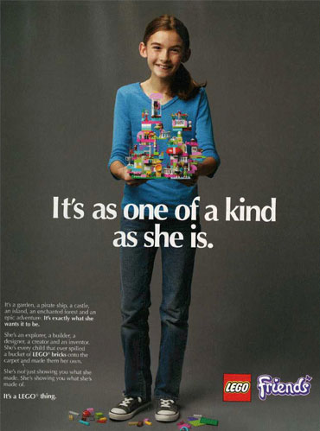



Slide 30


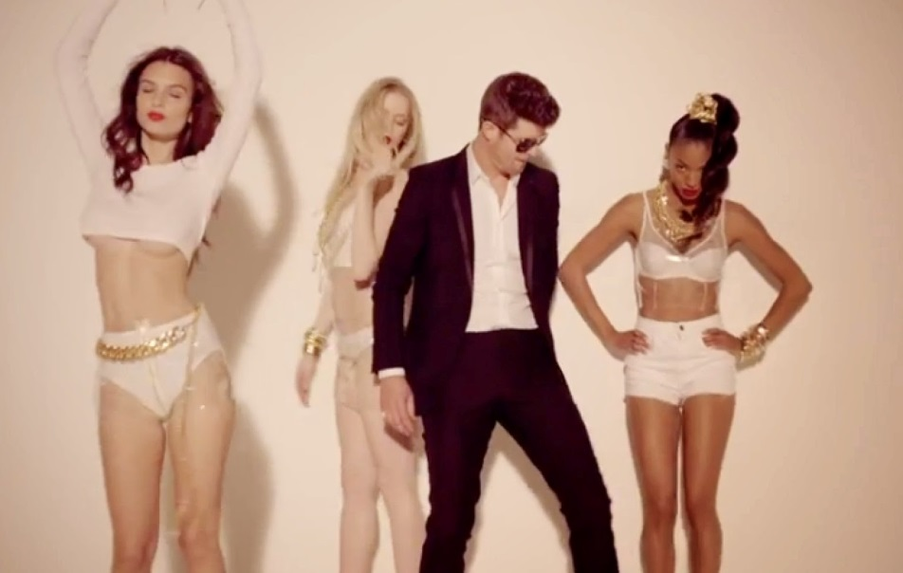

Slide 31
Florida Whistle
Go girl you can twerk it,
Let me see you whistle while you work it,
I’mma lay it back, don’t stop it,
‘Cause I love it how you drop it, drop it, drop it on me,
Now, shawty let that whistle blow-oh, oh oh,
Yeah, baby let that whistle blow-oh oh!
Can you blow my whistle baby, whistle baby
Let me know,
Bruno Mars – Locked out of heaven
“Open up your gates cause I can’t wait to see the light,
And right there is where I wanna stay,
Cause your sex takes me to paradise,
Yeah your sex takes me to paradise.”
Katie Perry – Last Friday Night
Barbie’s on the barbeque, Is this a hickie or a bruise?
Pictures of last night ended up online, I’m screwed,
Oh well, it’s a blacked out blur, but I’m pretty sure it ruled.

Slide 32
Where do children and young people learn about RSE related issues?
TV Magazines Radio
Music videos Gaming Parents
Siblings Peer School
Internet Disney Films

Slide 33
What is important to remember?
Normalise the themes being discussed
Be sensitive to discussions
You don’t need to answer everything immediately
Safeguarding – If in doubt – shout!

Slide 34
What is important to remember?
Don’t feel pressured
Visual timetable
Question box
Prepare and practice!

Slide 35
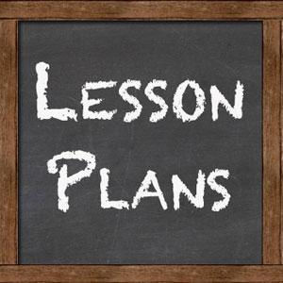
Lesson plans

Slide 36

Tricky questions

Slide 37


Slide 38
Please complete workshops evaluation
https://www.surveymonkey.co.uk/r/hittraining1920

Slide 39

Thank
you for attending!
Notes:
39

