Slide 1




Slide 2

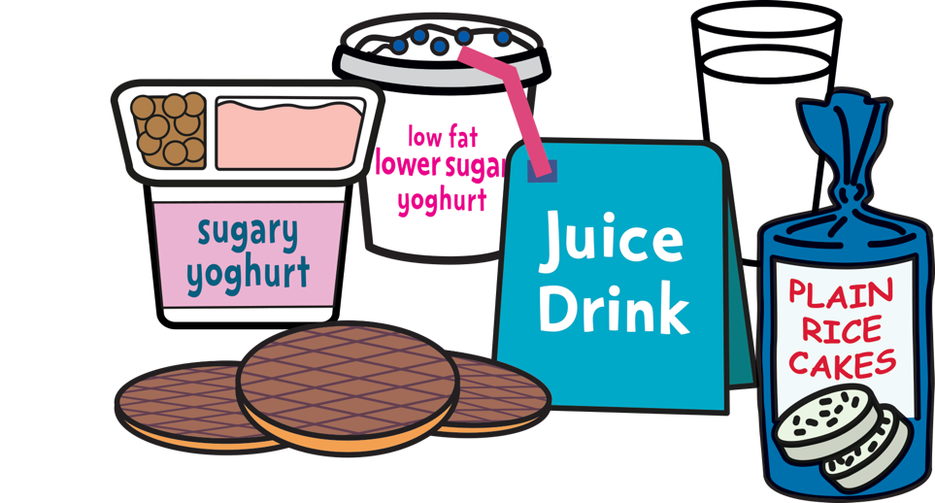

Notes:
Ask children ‘What does it mean to be food smart?’ and find out what they think this phrase means. (You may wish to also use an alternative phrase, like ‘being healthy’, to help younger pupils.)
Invite pupils to share their ideas and congratulate them on any good suggestions they share.
Explain that we are all eating too much sugar, a kind of fat called saturated fat, and salt. There are surprising amounts of sugar, saturated fat and salt in the everyday food and drinks we enjoy. We might seem fine on the outside, but too much sugar and saturated fat can lead to the build-up of harmful fat on the inside that we can’t see. This fat can cause serious diseases in the future.
But when we’re food smart, we make healthier food and drink choices that are lower in sugar, saturated fat and salt.
This assembly is going to help all of us to be food smart and begin to learn how we can make these healthier food and drink choices!

Slide 3


Notes:
Ask pupils if they can name some foods that are high in sugar. (The biggest source of sugar in children’s diets is sugary drinks like cola, fizzy pop, juice drinks, squashes, cordials and energy drinks. There can also be lots of sugar in sweets and chocolate, fruit juice, buns, cakes, pastries and fruit pies, biscuits and breakfast cereals.)
Ask pupils to guess how much sugar they eat each day. As a reference unit, you may want to show pupils a single sugar cube or pass a few around.
How many cubes like this do they think they should eat each day (at most) in the foods they enjoy?
Gather pupils’ ideas and share them with the group, to get a feel for the range of values they have suggested.
Remind pupils that eating too much sugar can lead to the build-up of harmful fat we can’t see. Ask pupils if they can name some of the health harms too much fat can cause. (These include heart disease, type 2 diabetes and some cancers. And too much sugar can also cause tooth decay.)
Gather pupils’ suggestions.
Show the brief Sugar Boy video clip (1:06).
Ask pupils if they can remember some key facts from the video:
How many sugar cubes does an average child eat every year? (5,543)
How many cubes of sugar are in an average can of cola? (9)

Slide 4

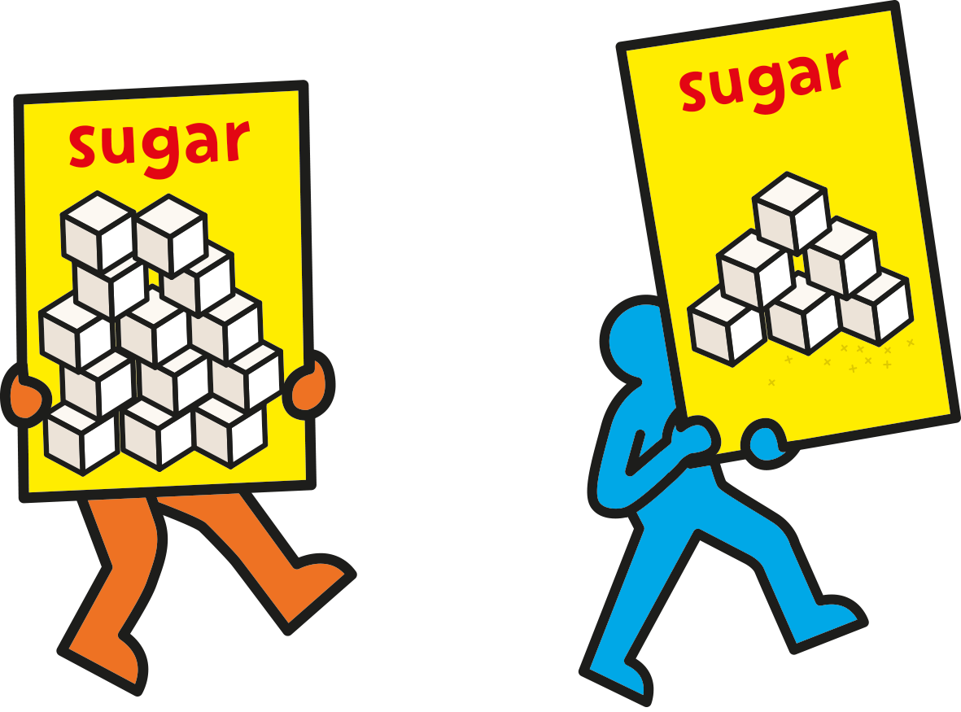
Notes:
Explain that most children are eating over 13 cubes of sugar each day. If you have prepared one, circulate the jar containing 13 cubes of sugar.
Ask pupils what they think about this amount of sugar. Does it seem like a lot, or a little? Highlight that this is more than twice as much as the maximum they should be eating!
Explain that to stay healthy a child aged 7 to 11 should eat no more than 6 cubes of sugar a day or less – that’s about 24 grams of sugar. Now circulate the jar containing 6 cubes or 24 grams of sugar. (A child aged 5 to 7 should eat no more than 5 cubes, or 19 grams, each day.)
See if pupils can recall from the ‘Sugar Boy’ video that an average can of cola contains 9 cubes of sugar. That means that drinking just 2/3 of a can, or around 200ml, would provide the maximum daily limit.

Slide 5

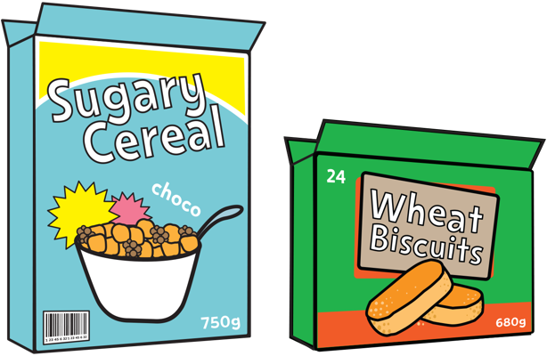

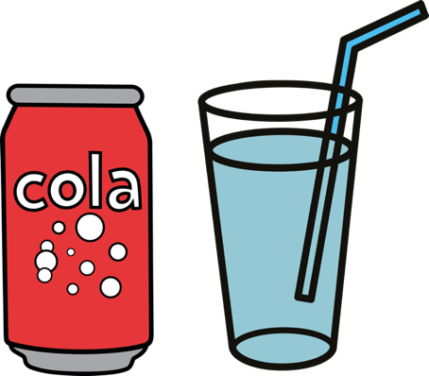
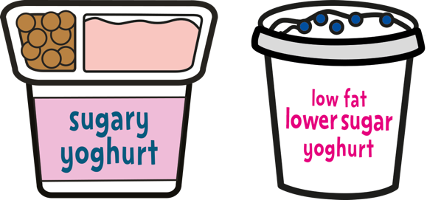
Notes:
This slide offers pupils four sets of choices, which highlight to all pupils that many of our favourite foods contain far more sugar than is healthy. Because we will usually eat more than one or two of these foods every day, it’s really easy to eat much more sugar than we should.
Explain that sugar is present in many of our favourite foods.
For each choice, ask pupils to indicate which food they would prefer to eat, using a show of hands. Now ask pupils to suggest which food in each pair is the healthier choice that contains less sugar.
Once pupils have made their choices and suggestions, click to reveal the healthier choice in each case on the next slide.

Slide 6

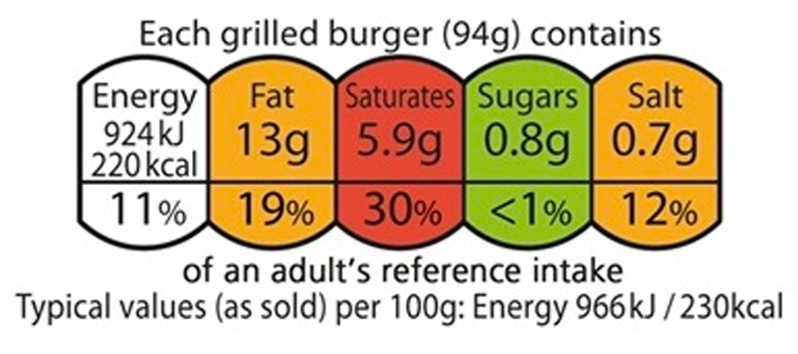
Notes:
Explain that it’s important to know how much sugar is in the foods we choose, so we can aim to keep within our maximum daily amounts.
Likewise, we also need to be careful about the amount of saturated fat and salt we eat, because these can also lead to health harms in the future, as well.
Ask older pupils if they can tell you some types of food that might contain too much saturated fat? (Foods that come from animals like meat, butter, milk and cheese contain saturated fat, and some of the biggest contributors to children’s saturated fat intake are biscuits, buns, cakes, pastries and fruit pies, confectionery (because they contain butter and milk) and other processed meats like sausages and burgers.)
What about salt? (As well as in obvious things like crisps, there is salt in everyday foods that don’t even taste that salty like bread, breakfast cereal, ready meals, sauces, gravies, baked beans and pizza.)
Ask pupils if they can think of ways they could find out about how much sugar, saturated fat or salt is in a food product? (Reading the label, looking online, asking an adult.)
Have pupils seen the food labels on packaging, which are sometimes colour-coded to work like traffic lights? They tell us about the sugar, saturated fat and salt in these products.
RED means HIGH. Think about how often you choose it and how much of it you eat.
AMBER means MEDIUM. It’s an OK choice, although going for green is even better.
GREEN means LOW, which makes it a healthier choice.
Choose foods with more GREENs and AMBERs on the label, and fewer REDs.

Slide 7

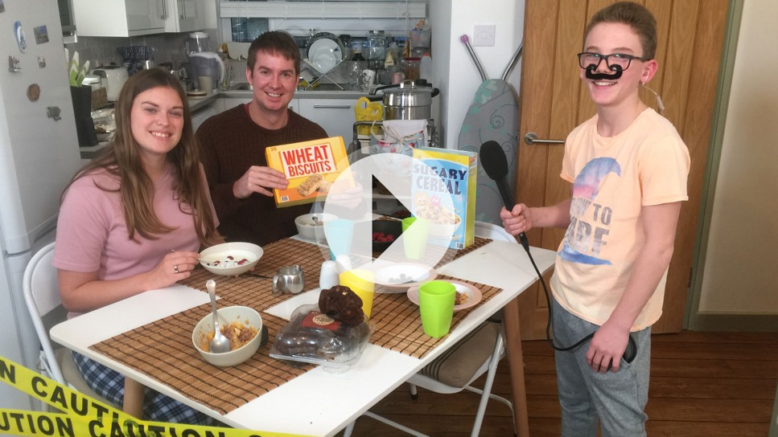
Notes:
Explain to pupils that when we know how to find this information, choosing healthier alternatives to sugary food becomes much easier! And the good news is that it isn’t difficult!
As well as using food labels, there’s a new Be Food Smart app that helps you make healthier food and drink choices that are lower in sugar, saturated fat and salt. With a simple scan you can see how much sugar, saturated fat and salt is in your food, with hints and tips for healthier choices.
Click to open the assembly film page on the Change4Life School Zone, where you will be able to play the film.
This shows pupils how to find out how much sugar is in food using food labels and the Food Smart app, and reinforces some of the benefits of making healthier choices.
When pupils have watched the film, ask them:
how do the children find out what is really in their food and drink?
what did they find out that surprised them?
what are they going to do in future after using the app?
Explain that they can ask their parents to download the app and they can be Food Detectives like the children in the films.

Slide 8

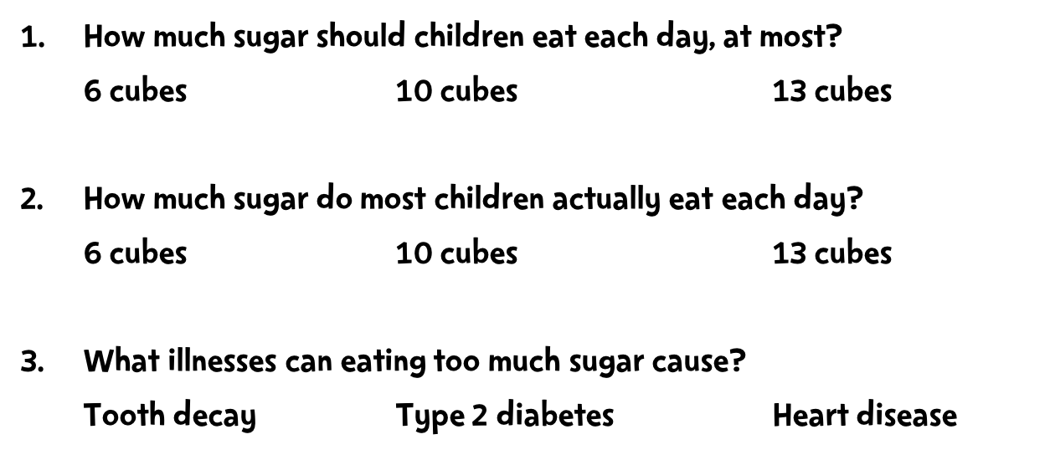
Notes:
Use this quick quiz to remind pupils of some key facts, debunk some common misconceptions about sugar and reinforce that children should – with their parents’ help – be food smart and aim to stay within their maximum daily amounts.
Read out each question and ask pupils to indicate their answer using a show of hands – go with the most popular option in each case.
Answers:
6 cubes for 7-10 year-olds (24 grams) – less for 4-6 year olds (about 5 cubes (19 grams)).
13 cubes. Some children may eat less than this, but some may eat much more. Using the Be Food Smart app can help them find out.
All of these, and other diseases like some forms of cancer. Some may take many years to take effect, but some, like tooth decay or excess weight, can affect even very young children.
Remind pupils that being food smart isn’t just about sugar – it’s about watching how much saturated fat and and salt they eat, as well. Food labels and the Be Food Smart app will help will all of these.

Slide 9



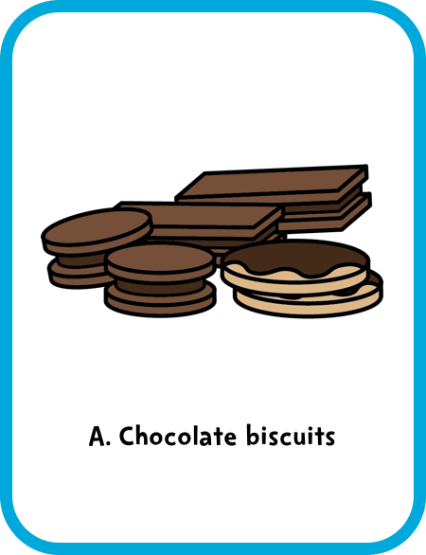
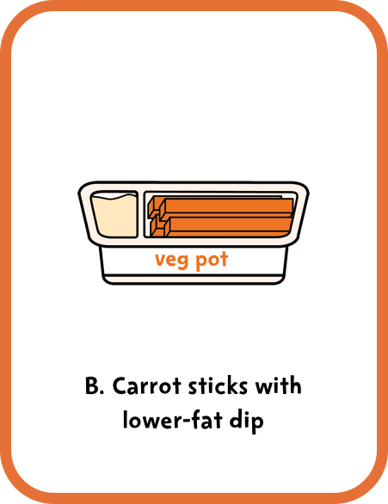
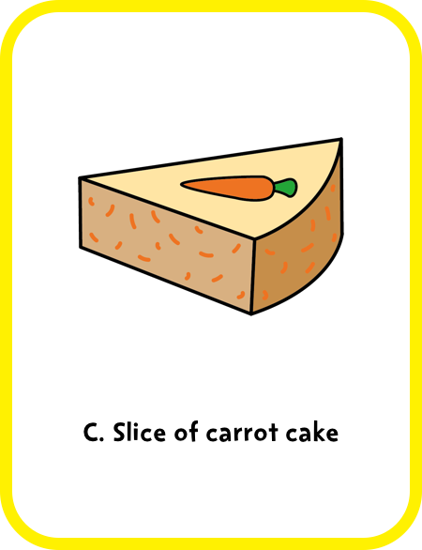


Notes:
Answer: B. Carrot sticks with lower-fat dip.
Fruit and veg are a great choice for snacks. You can try veg with a lower-fat dip. Chocolate biscuits and carrot cake can contain lots of added sugar and saturated fat so we shouldn’t eat them often.
Encourage audience participation. After a pupil reads out the question/answer options, they could choose a volunteer to answer, ask for a show of hands, or audience members could hold up A, B or C cards according to their guess.
Remember that fresh fruit and vegetables, plain milks and plain natural yoghurts all contain ‘intrinsic sugars’, which we don’t need to worry about. 5 A Day guidance specifies that dried fruit and fruit juice, vegetable juice and smoothies are not suitable to be consumed between meals due to dental concerns.
For more information, see the EatWell guide: https://campaignresources.phe.gov.uk/schools/resources/eatwell-guide

Slide 10



Slide 11

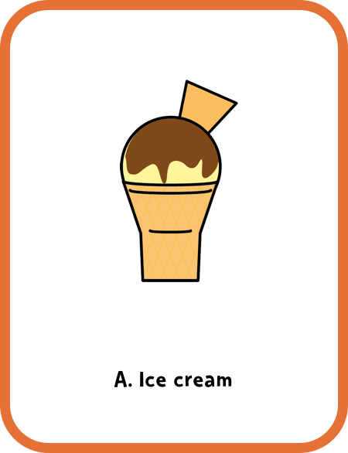
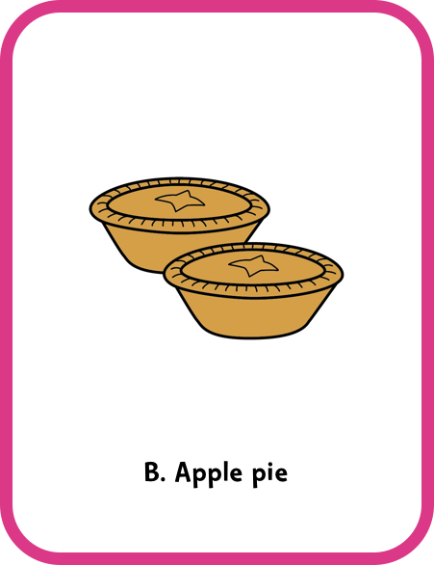
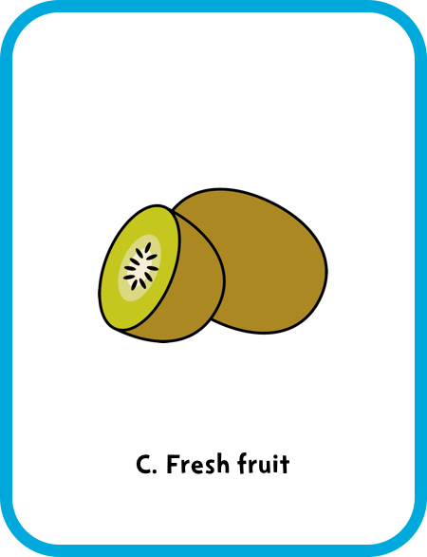

Notes:
Answer: C. Fresh fruit.
Fresh fruit and vegetables, plain milks and plain natural yoghurts all contain ‘intrinsic sugars’, which we don’t need to worry about. But ice cream and apple pie can contain lots of added sugar so we shouldn’t eat them often.
Encourage audience participation. After a pupil reads out the question/answer options, they could choose a volunteer to answer, ask for a show of hands, or audience members could hold up A, B or C cards according to their guess.
5 A Day guidance specifies that dried fruit and fruit juice, vegetable juice and smoothies are not suitable to be consumed between meals due to dental concerns. For more information, see the EatWell guide: https://campaignresources.phe.gov.uk/schools/resources/eatwell-guide

Slide 13

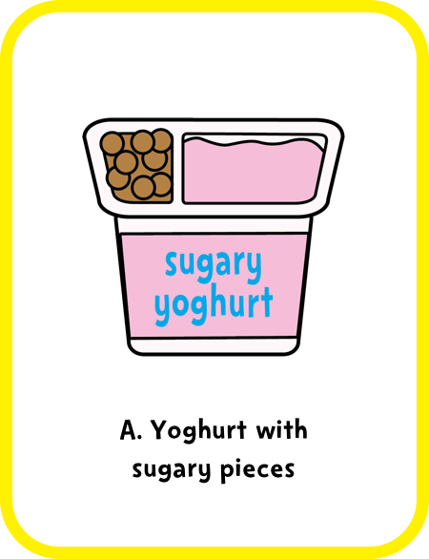
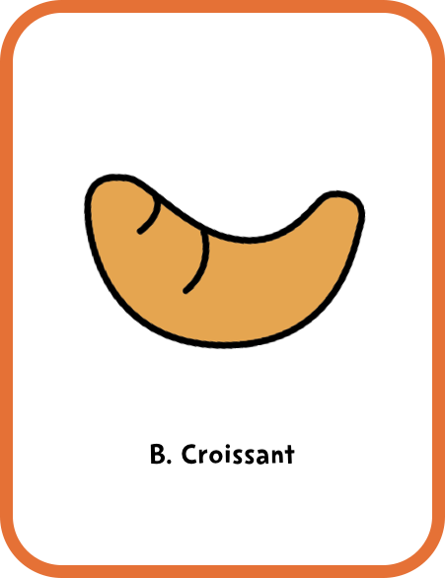
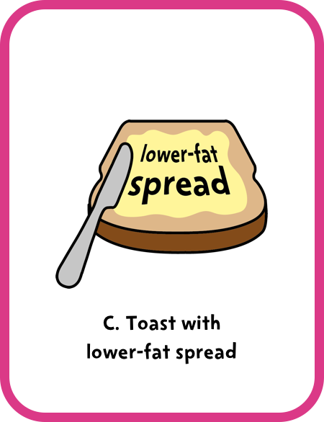


Notes:
Answer: C. Toast with lower-fat spread.
Sugary yoghurt and pastries can contain lots of added sugar and saturated fat so we shouldn’t eat them often. Fruit and veg are a great choice for snacks.
Encourage audience participation. After a pupil reads out the question/answer options, they could choose a volunteer to answer, ask for a show of hands, or audience members could hold up A, B or C cards according to their guess.
Remember that fresh fruit and vegetables, plain milks and plain natural yoghurts all contain ‘intrinsic sugars’, which we don’t need to worry about. 5 A Day guidance specifies that dried fruit and fruit juice, vegetable juice and smoothies are not suitable to be consumed between meals due to dental concerns.
For more information, see the EatWell guide: https://campaignresources.phe.gov.uk/schools/resources/eatwell-guide

Slide 15

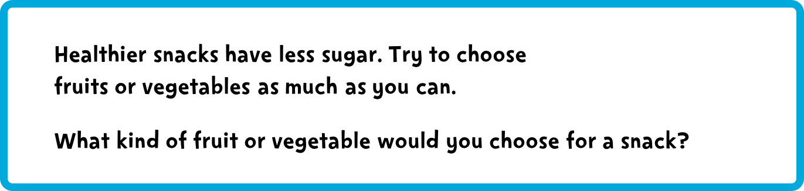


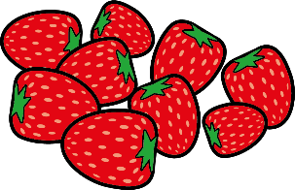
Notes:
Extension: if your pupils have created an ‘advert’, this could be a good time to show/perform it.

Slide 16

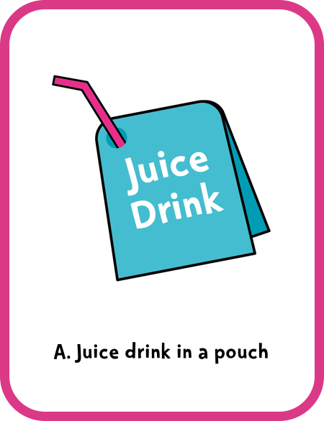
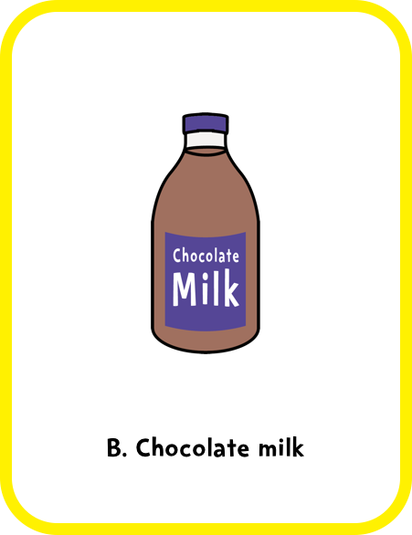
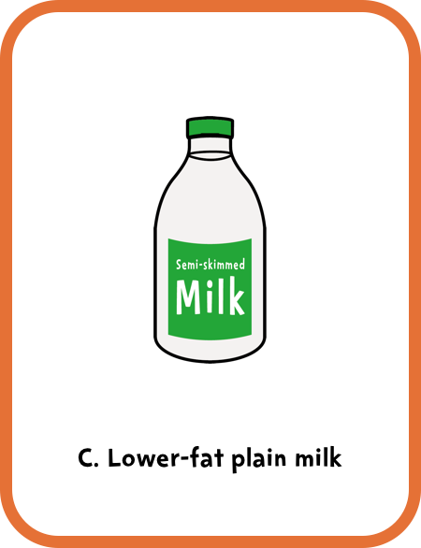
Notes:
Answer: C. Lower-fat plain milk.
Juice drinks in a pouch and flavoured milks can contain lots of added sugar so we shouldn't drink them often. Lower-fat milks or plain water are always the best drink choices.
Encourage audience participation. After a pupil reads out the question/answer options, they could choose a volunteer to answer, ask for a show of hands, or audience members could hold up A, B or C cards according to their guess.
Remember that fresh fruit and vegetables, plain milks and plain natural yoghurts all contain ‘intrinsic sugars’, which we don’t need to worry about. 5 A Day guidance specifies that dried fruit and fruit juice, vegetable juice and smoothies are not suitable to be consumed between meals due to dental concerns.
For more information, see the EatWell guide: https://campaignresources.phe.gov.uk/schools/resources/eatwell-guide

Slide 18

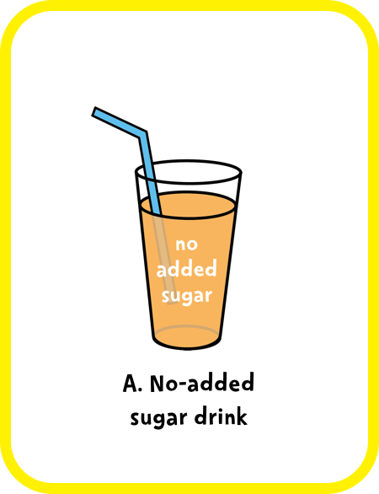
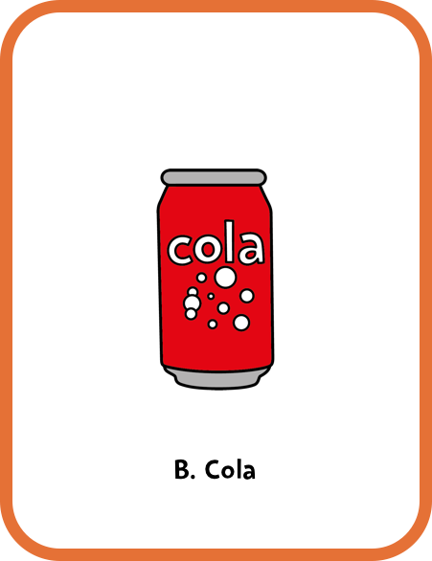
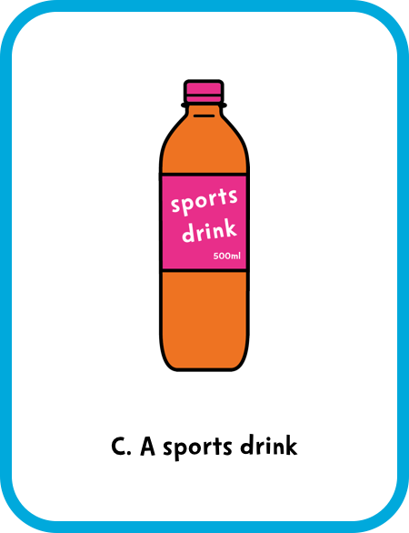

Notes:
Answer: A. No-added sugar drink.
Cola and sports drinks can contain lots of added sugar so we shouldn't drink them often. Some manufacturers create no-added sugar drinks, which are a better choice than sugary or sports drinks. Lower-fat milks or plain water are always the best drink choices.
Encourage audience participation. After a pupil reads out the question/answer options, they could choose a volunteer to answer, ask for a show of hands, or audience members could hold up A, B or C cards according to their guess.
Remember that fresh fruit and vegetables, plain milks and plain natural yoghurts all contain ‘intrinsic sugars’, which we don’t need to worry about. 5 A Day guidance specifies that dried fruit and fruit juice, vegetable juice and smoothies are not suitable to be consumed between meals due to dental concerns.
For more information, see the EatWell guide: https://campaignresources.phe.gov.uk/schools/resources/eatwell-guide

Slide 20
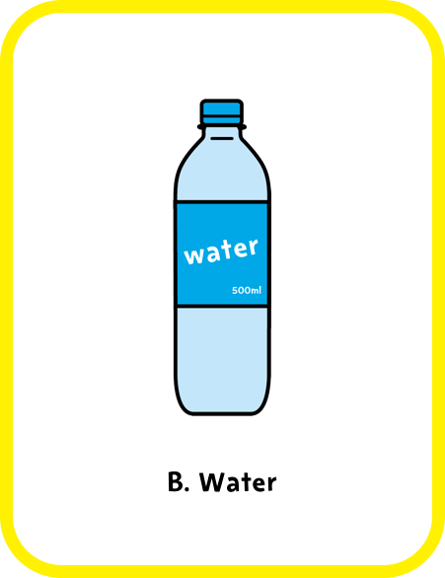
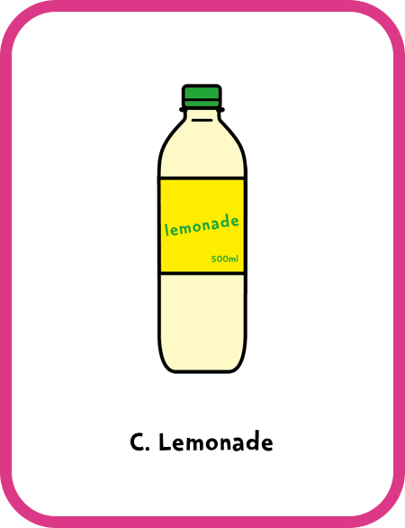
Notes:
Answer: B. Water.
Juice drinks in a pouch and lemonade can contain lots of added sugar so we shouldn't drink them often. Some manufacturers create no-added sugar drinks, which are a better choice than sugary or sports drinks. Lower-fat milks or plain water are always the best drink choices.
Encourage audience participation. After a pupil reads out the question/answer options, they could choose a volunteer to answer, ask for a show of hands, or audience members could hold up A, B or C cards according to their guess.
Remember that fresh fruit and vegetables, plain milks and plain natural yoghurts all contain ‘intrinsic sugars’, which we don’t need to worry about. 5 A Day guidance specifies that dried fruit and fruit juice, vegetable juice and smoothies are not suitable to be consumed between meals due to dental concerns.
For more information, see the EatWell guide: https://campaignresources.phe.gov.uk/schools/resources/eatwell-guide

Slide 22

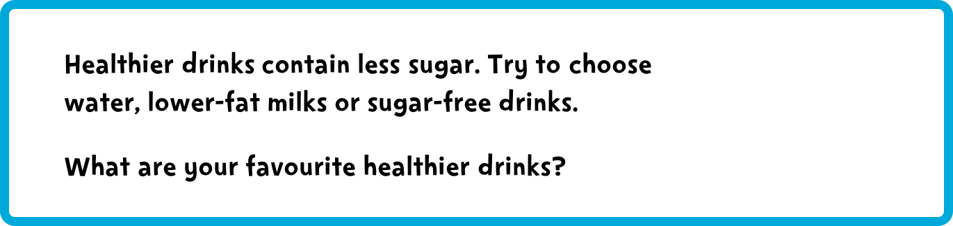


Notes:
This reinforces the key message.
Pupils could include a demonstration for the audience of the amount of sugar in two bottled drinks using the Food Scanner app.

Slide 23
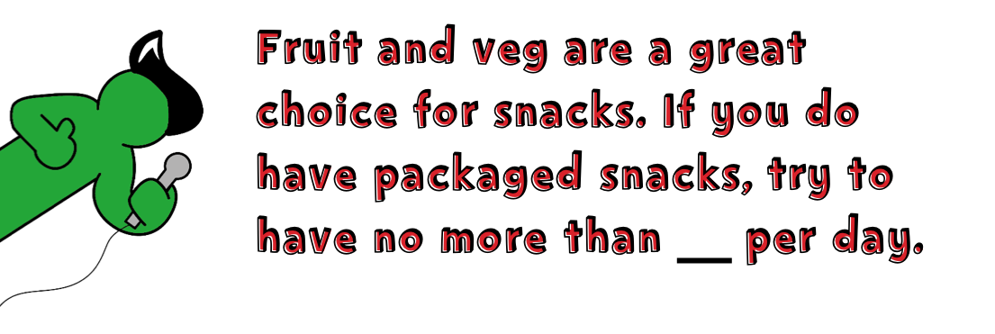
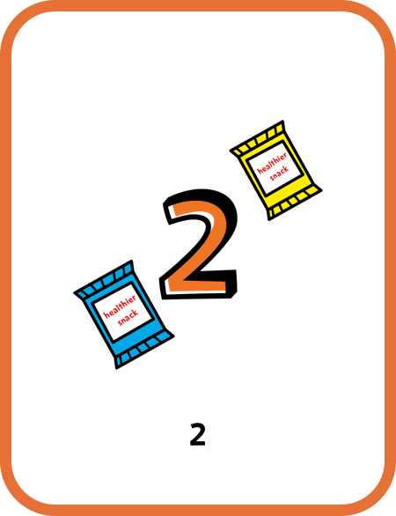
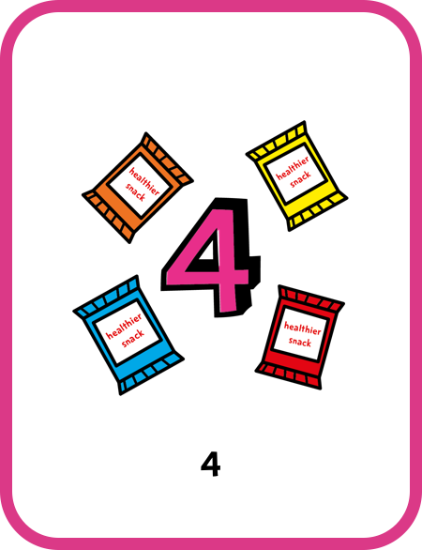
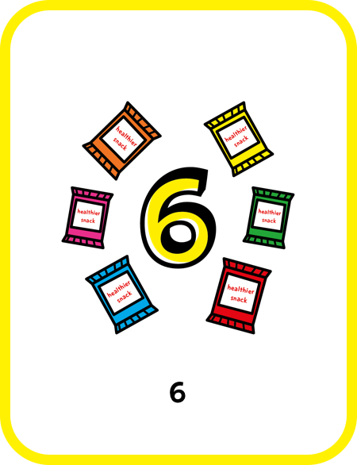
Notes:
Answer: A. 2.
Fruit and veg are a great choice for snacks. If you do have a packaged snack, try to have no more than two per day.
Encourage audience participation. After a pupil reads out the question/answer options, they could choose a volunteer to answer or ask for a show of hands.

Slide 25

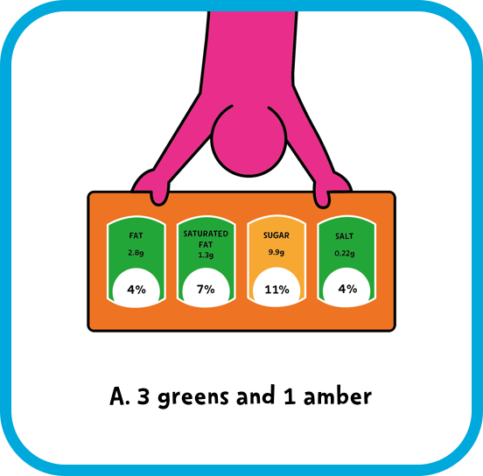
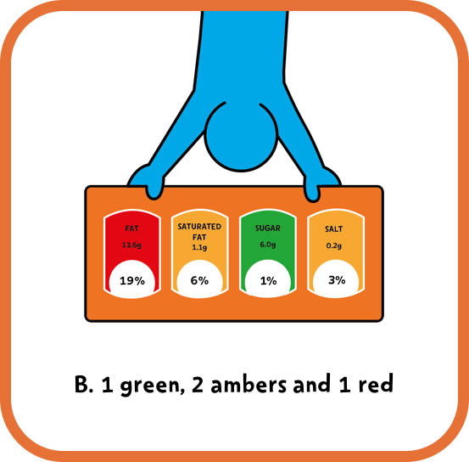

Notes:
Answer: A. 3 greens and 1 amber.
Look for mostly green, or greens and ambers on the label. Cut down on reds!
Encourage audience participation. After a pupil reads out the question/answer options, they could choose a volunteer to answer, ask for a show of hands, or audience members could hold up the A or B card according to their guess.

Slide 26
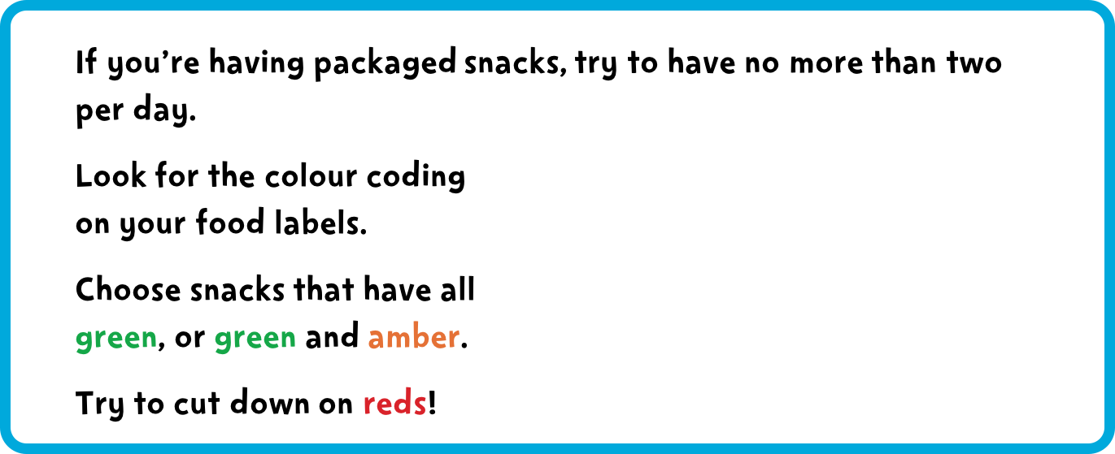
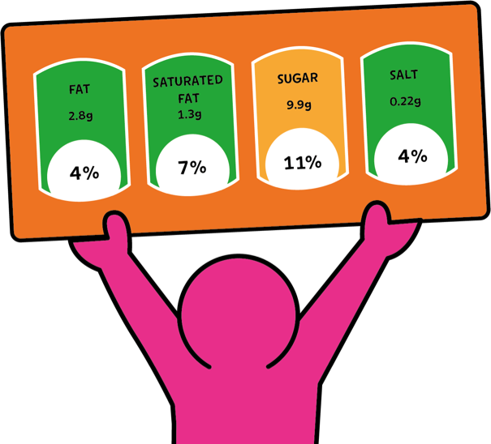
Notes:
This reinforces the key message. You (or your pupils) could ask the audience to remember what colour they should avoid on packaged snacks, and what the maximum number of packaged snacks they should have in a day is.
Pupils could show the audience examples of snacks that have mostly greens and snacks that have reds on the label.

Slide 27










Slide 28


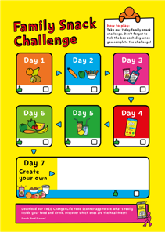

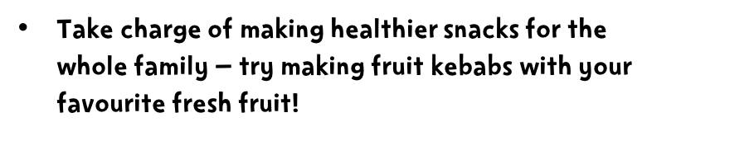
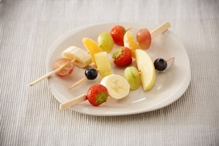
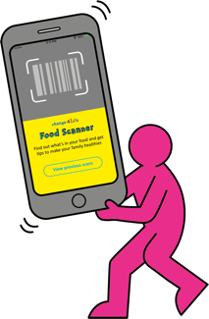


Notes:
If your class has prepared ideas for Day 7 of the Family Snack Challenge, they can present them now. They can ask the audience to vote on their favourite challenge idea (let parents and carers vote too!).
Don’t forget to tell parents and carers to search Change4Life for more fun snack recipes and ideas.

Slide 29
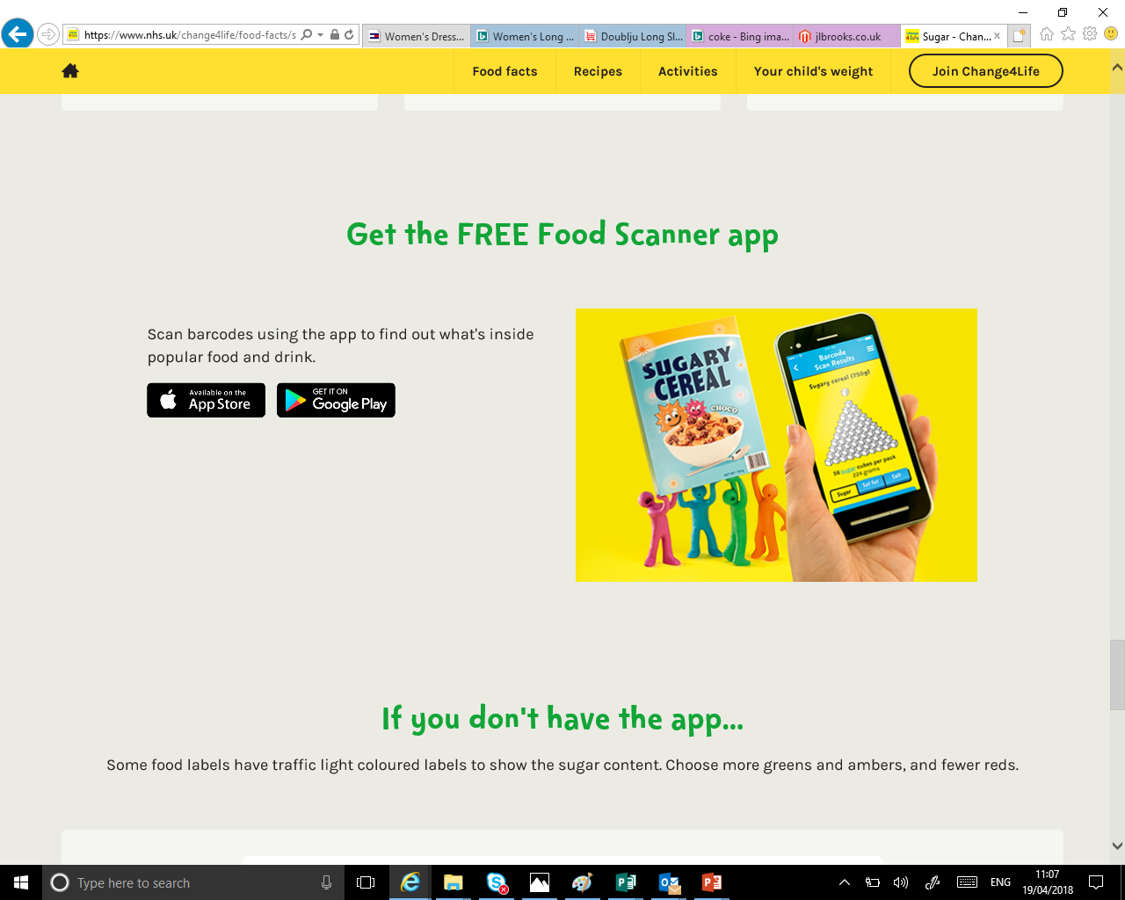
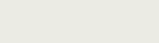

Slide 30
The end

