Slide 1
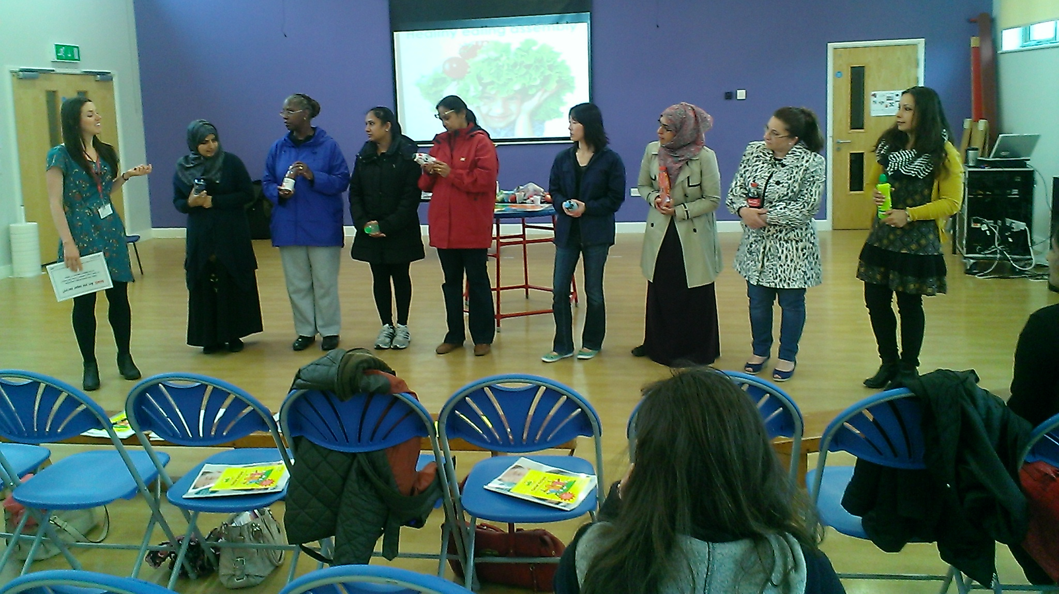
Healthy eating workshop for parents

Slide 2
Aims of this session
Provide ideas for parent workshops on healthy eating
Provide ideas for engaging hard-to-reach parents
Improve your knowledge on healthy eating

Slide 3
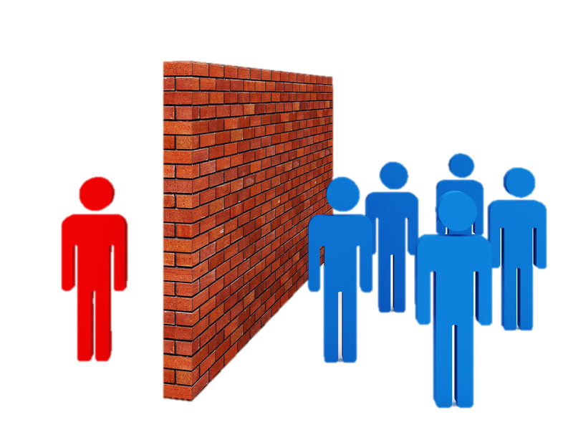
What are the barriers to engaging parents?

Slide 4
How to engage hard-to-reach parents
Offer cooking workshops
Offer a completion certificate
On-site child-care or activities for kids
Translate flyer into main languages
Tie in with existing event i.e. coffee morning, health fair
Get child to write/ design invitation
Offer workshops in main languages
Use your PSA & governors
Notes:
One school in Ealing, Stanhope Primary School, has seen a significant reversal in the obesity trend. Between 2013 and 2015, Stanhope’s Reception and Year 6 pupils had the highest rates of overweight and obesity compared to any other school in Ealing. However, the most recent National Child Measurement Programme (NCMP) data released in August showed a very different picture!
The NCMP measures the BMI of both reception and Year 6 pupils. The NCMP and has been running since 2007/8 and therefore, schools can now see how their Year 6 pupils weight has changed since reception.

Slide 5
How to get a good attendance
Run workshop at 9am
Offer freebies i.e. goodie bag, or cook something
Staff member promotes/ recruits at entrance
Advertise ‘spaces are limited’
Notes:
One school in Ealing, Stanhope Primary School, has seen a significant reversal in the obesity trend. Between 2013 and 2015, Stanhope’s Reception and Year 6 pupils had the highest rates of overweight and obesity compared to any other school in Ealing. However, the most recent National Child Measurement Programme (NCMP) data released in August showed a very different picture!
The NCMP measures the BMI of both reception and Year 6 pupils. The NCMP and has been running since 2007/8 and therefore, schools can now see how their Year 6 pupils weight has changed since reception.

Slide 6
How to promote your workshop
Flyer home to parents
Include in parent newsletter
Promote via text or email to parents
Posters at reception & gate
Notes:
One school in Ealing, Stanhope Primary School, has seen a significant reversal in the obesity trend. Between 2013 and 2015, Stanhope’s Reception and Year 6 pupils had the highest rates of overweight and obesity compared to any other school in Ealing. However, the most recent National Child Measurement Programme (NCMP) data released in August showed a very different picture!
The NCMP measures the BMI of both reception and Year 6 pupils. The NCMP and has been running since 2007/8 and therefore, schools can now see how their Year 6 pupils weight has changed since reception.

Slide 7
Workshop activities

Slide 8
Are you sugar savvy?
Notes:
One school in Ealing, Stanhope Primary School, has seen a significant reversal in the obesity trend. Between 2013 and 2015, Stanhope’s Reception and Year 6 pupils had the highest rates of overweight and obesity compared to any other school in Ealing. However, the most recent National Child Measurement Programme (NCMP) data released in August showed a very different picture!
The NCMP measures the BMI of both reception and Year 6 pupils. The NCMP and has been running since 2007/8 and therefore, schools can now see how their Year 6 pupils weight has changed since reception.

Slide 9
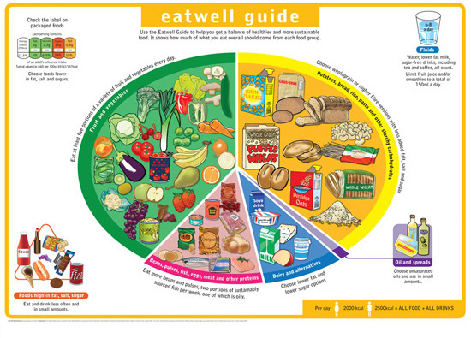
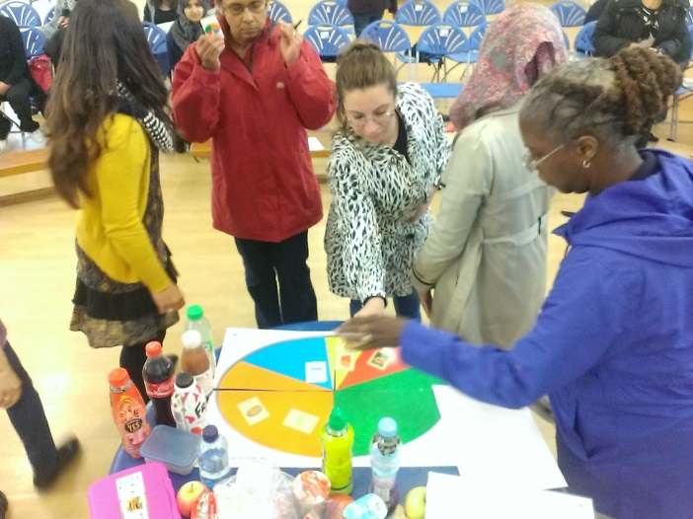
Eatwell Guide
Notes:
One school in Ealing, Stanhope Primary School, has seen a significant reversal in the obesity trend. Between 2013 and 2015, Stanhope’s Reception and Year 6 pupils had the highest rates of overweight and obesity compared to any other school in Ealing. However, the most recent National Child Measurement Programme (NCMP) data released in August showed a very different picture!
The NCMP measures the BMI of both reception and Year 6 pupils. The NCMP and has been running since 2007/8 and therefore, schools can now see how their Year 6 pupils weight has changed since reception.

Slide 10
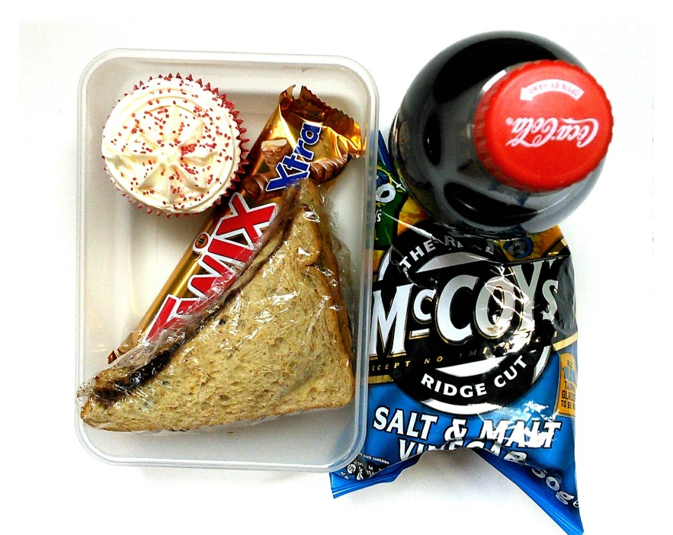
Put together a healthy lunchbox
Notes:
One school in Ealing, Stanhope Primary School, has seen a significant reversal in the obesity trend. Between 2013 and 2015, Stanhope’s Reception and Year 6 pupils had the highest rates of overweight and obesity compared to any other school in Ealing. However, the most recent National Child Measurement Programme (NCMP) data released in August showed a very different picture!
The NCMP measures the BMI of both reception and Year 6 pupils. The NCMP and has been running since 2007/8 and therefore, schools can now see how their Year 6 pupils weight has changed since reception.

Slide 11
How much hidden sugar & fat in that lunchbox?
?
?
Notes:
One school in Ealing, Stanhope Primary School, has seen a significant reversal in the obesity trend. Between 2013 and 2015, Stanhope’s Reception and Year 6 pupils had the highest rates of overweight and obesity compared to any other school in Ealing. However, the most recent National Child Measurement Programme (NCMP) data released in August showed a very different picture!
The NCMP measures the BMI of both reception and Year 6 pupils. The NCMP and has been running since 2007/8 and therefore, schools can now see how their Year 6 pupils weight has changed since reception.

Slide 12
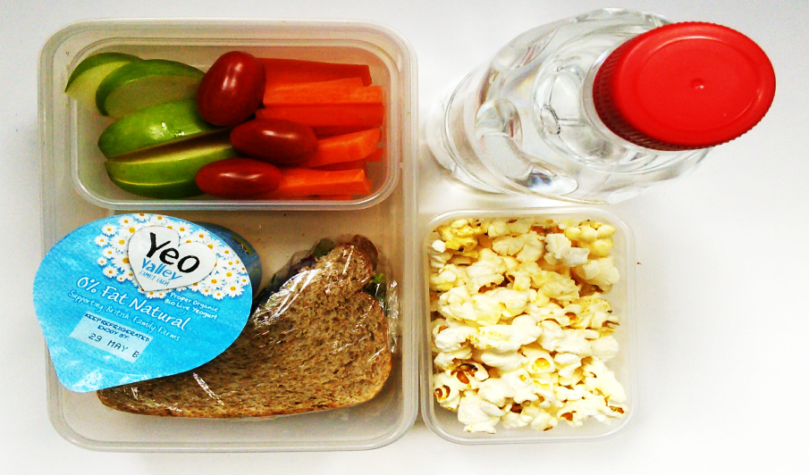
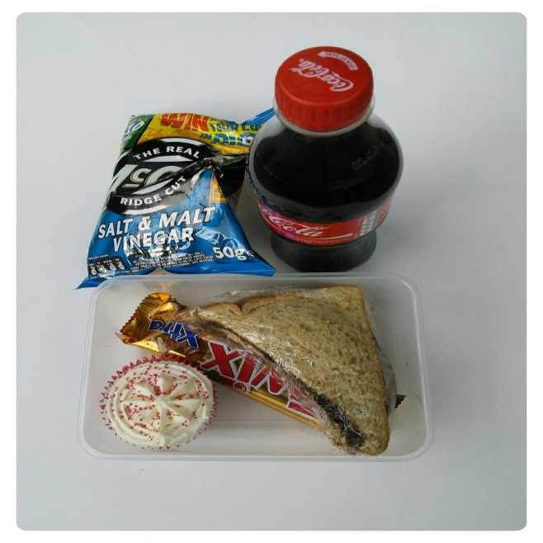
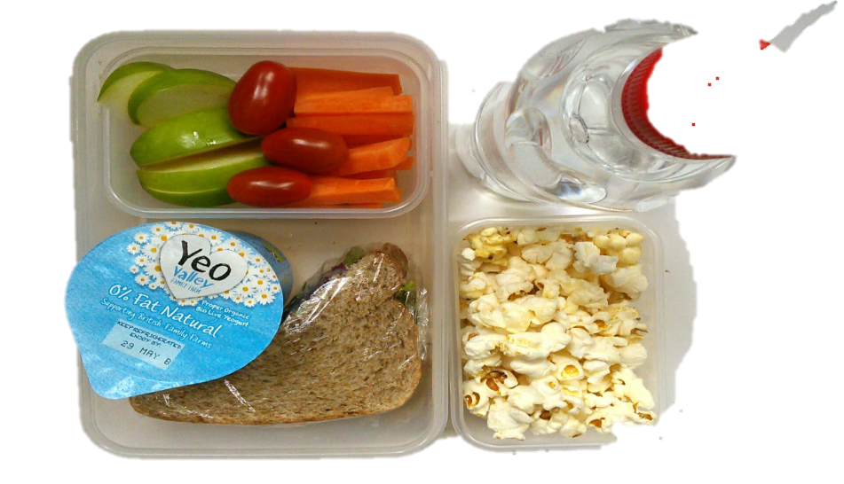
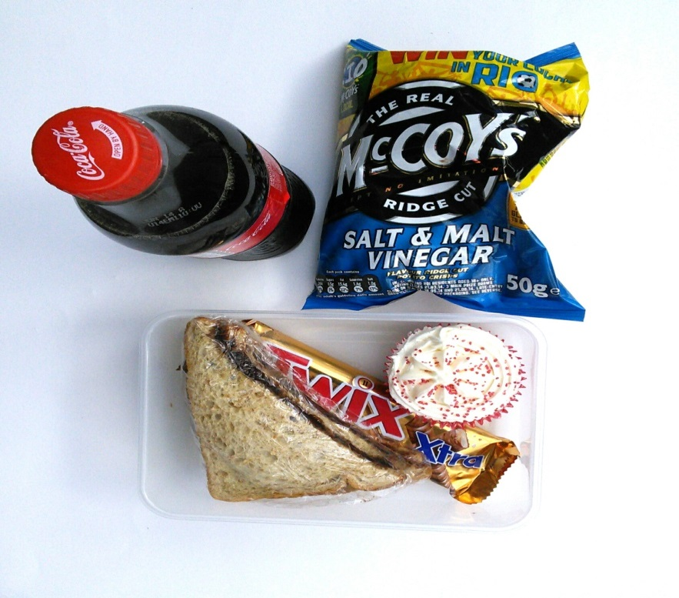
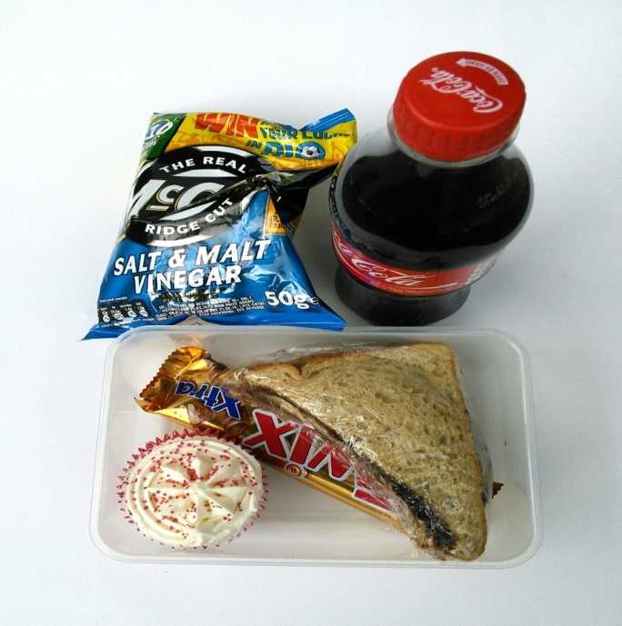
How many teaspoons of fat and sugar are in this lunchbox?

Slide 13
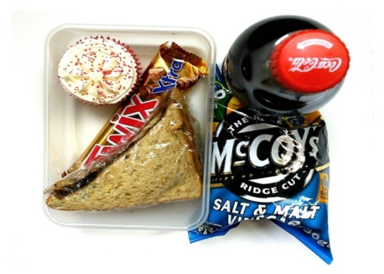
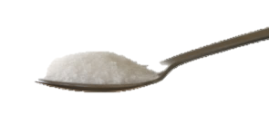
35
19
SUGAR: 35 TEASPOONS
FAT: 19 TEASPOONS

Slide 14
How many teaspoons of fat and sugar are in this lunchbox?

Slide 15
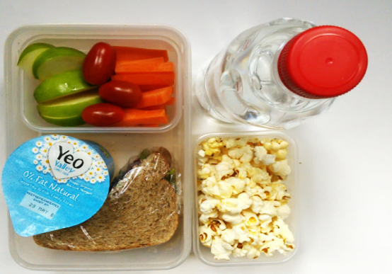
2
1

Slide 16
Healthy snack tasting
Notes:
One school in Ealing, Stanhope Primary School, has seen a significant reversal in the obesity trend. Between 2013 and 2015, Stanhope’s Reception and Year 6 pupils had the highest rates of overweight and obesity compared to any other school in Ealing. However, the most recent National Child Measurement Programme (NCMP) data released in August showed a very different picture!
The NCMP measures the BMI of both reception and Year 6 pupils. The NCMP and has been running since 2007/8 and therefore, schools can now see how their Year 6 pupils weight has changed since reception.

Slide 17
Resources for you to use

Slide 18
Workbook for parents
Notes:
One school in Ealing, Stanhope Primary School, has seen a significant reversal in the obesity trend. Between 2013 and 2015, Stanhope’s Reception and Year 6 pupils had the highest rates of overweight and obesity compared to any other school in Ealing. However, the most recent National Child Measurement Programme (NCMP) data released in August showed a very different picture!
The NCMP measures the BMI of both reception and Year 6 pupils. The NCMP and has been running since 2007/8 and therefore, schools can now see how their Year 6 pupils weight has changed since reception.

Slide 19
Sample session plan
Notes:
One school in Ealing, Stanhope Primary School, has seen a significant reversal in the obesity trend. Between 2013 and 2015, Stanhope’s Reception and Year 6 pupils had the highest rates of overweight and obesity compared to any other school in Ealing. However, the most recent National Child Measurement Programme (NCMP) data released in August showed a very different picture!
The NCMP measures the BMI of both reception and Year 6 pupils. The NCMP and has been running since 2007/8 and therefore, schools can now see how their Year 6 pupils weight has changed since reception.

Slide 20
End of presentation

