Slide 1
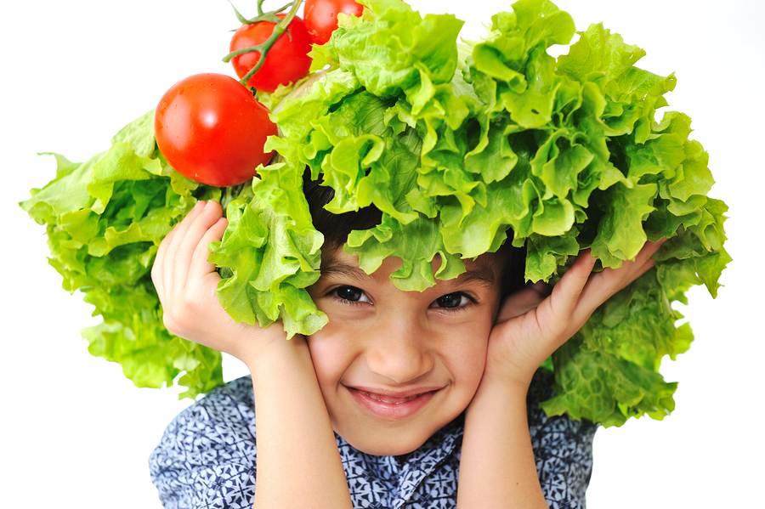
Healthy eating assembly

Slide 2
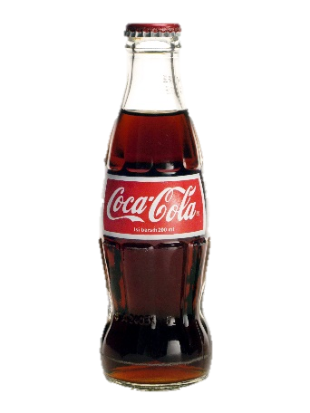
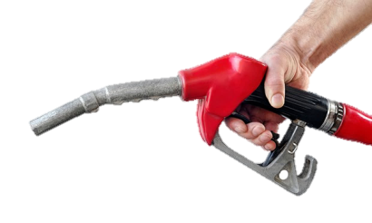
Like a car, our bodies need the right fuel? Why?
Notes:
Explain how we are DIFFERENT but we all need to look after our bodies to make sure they work well, and last a long time! We are the only one of us – se we need to take great care over ourselves.
What would happen if we put ‘milk’ into a car?
Why is it important we have the right fuel?
Our body is like a car, we need the right fuel to work properly.
What would happen if we have the wrong fuel? Like what?
What then is the RIGHT fuel?
More energetic – more energy to play, for longer
Better concentration – remembering things
Feel better, make you happier, look ???

Slide 3
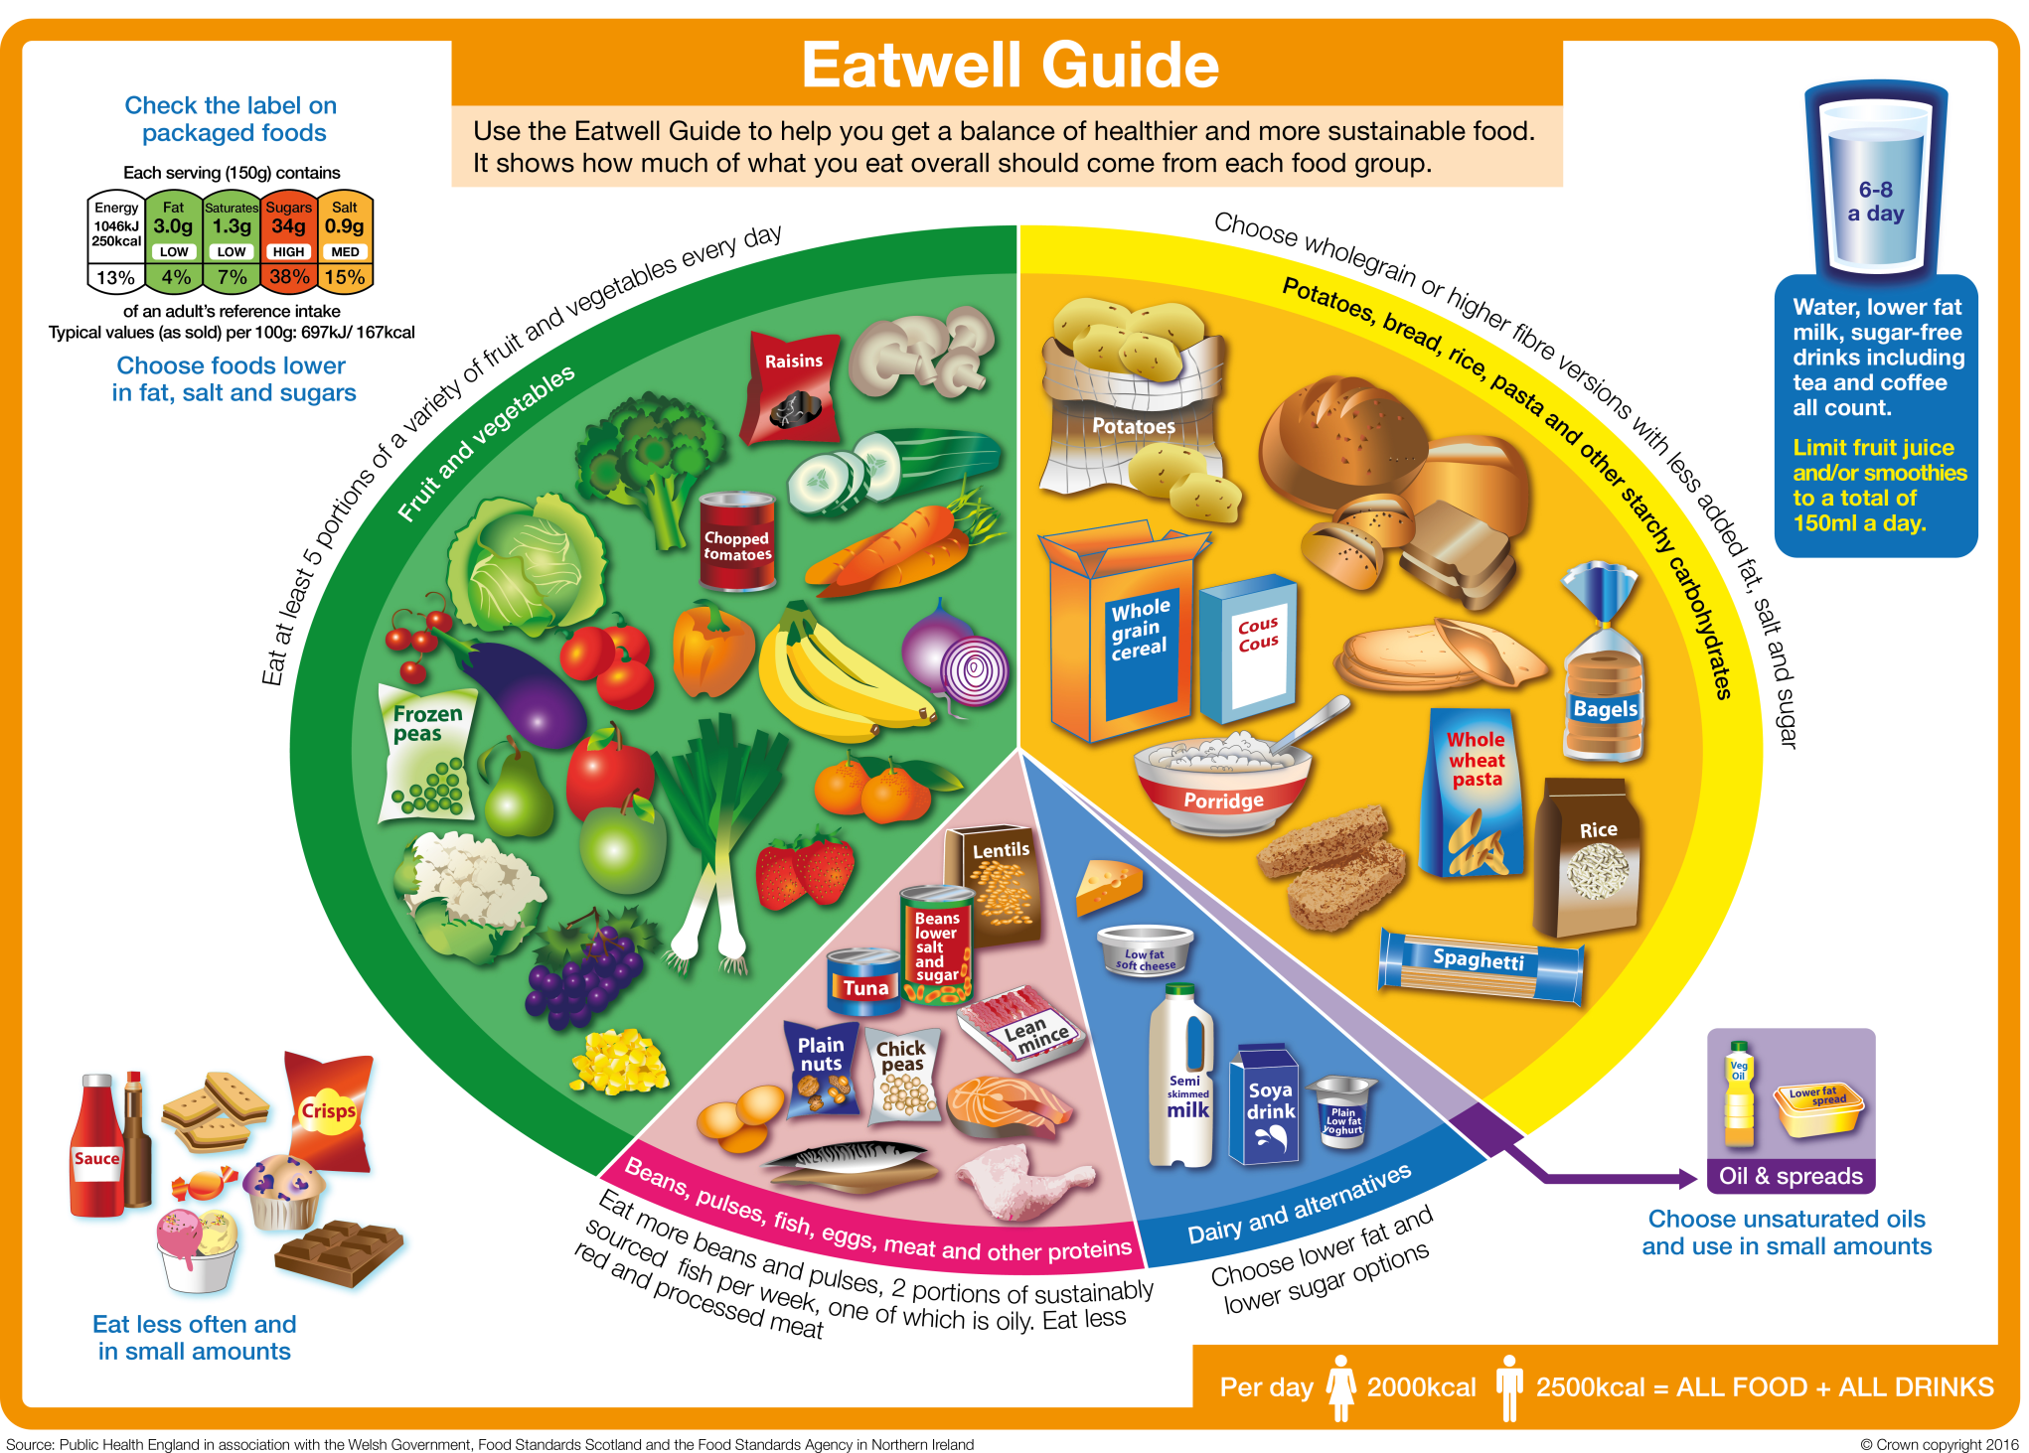
Fruit & vegetables
Starchy foods
Meat
High fat & sugar
Dairy

Slide 4
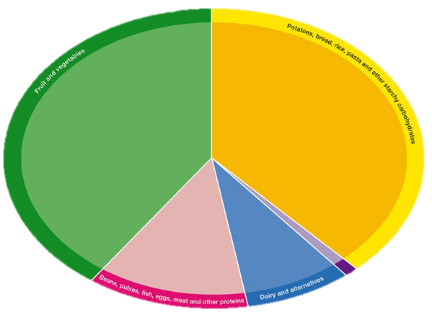
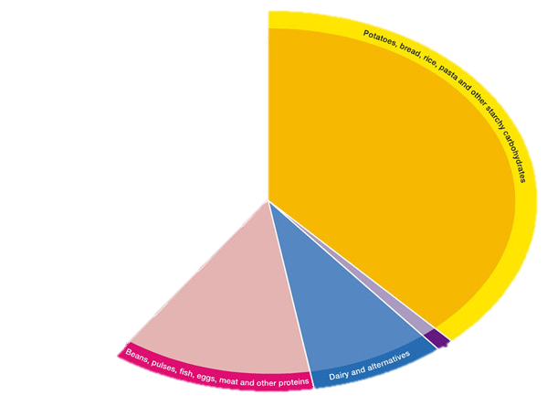
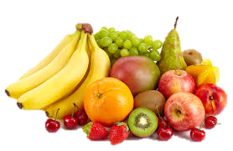
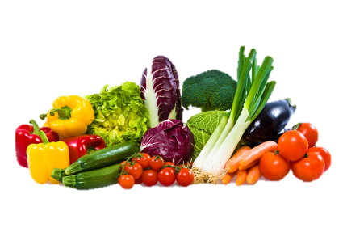
Fruit & vegetables: Have 5 or more a day

Slide 5
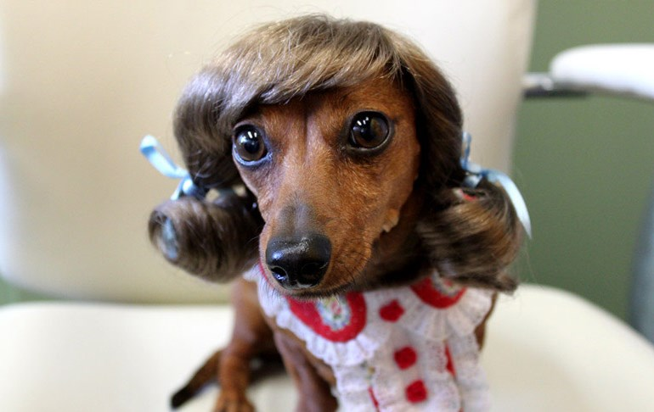
We feel happier
Fruit & veges for healthy skin, hair & bodies
We have healthy skin and hair

Slide 6
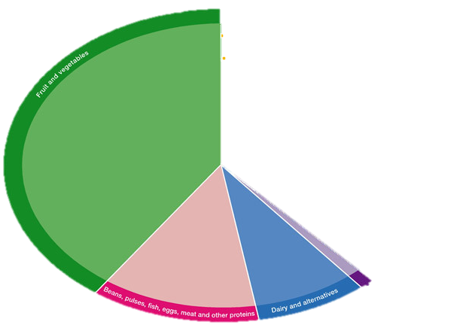
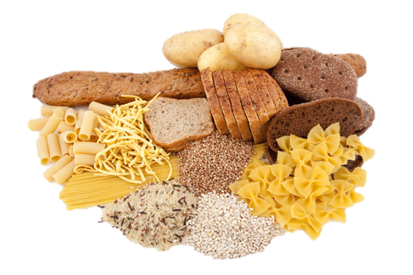
Starchy foods

Slide 7
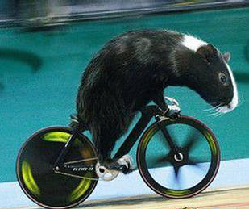
We feel happier
Starchy foods for brain power & energy
We have healthy skin and hair

Slide 8
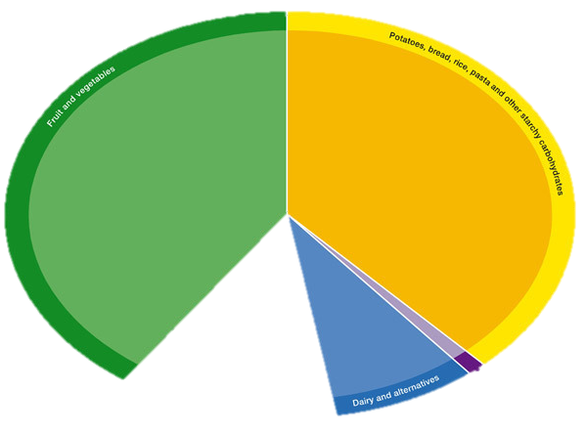
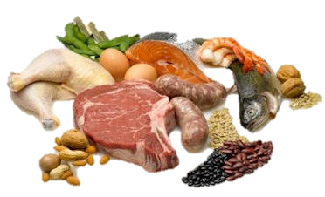
Meat & pulses

Slide 9
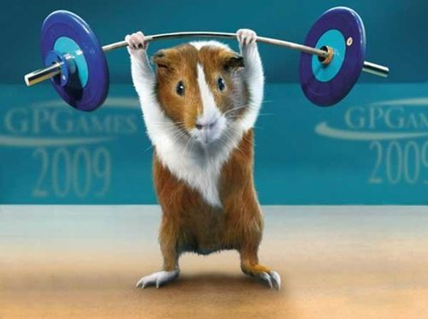
We feel happier
Meat for strength & muscles
We have healthy skin and hair

Slide 10
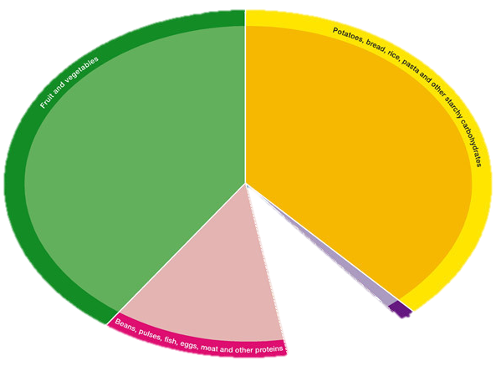
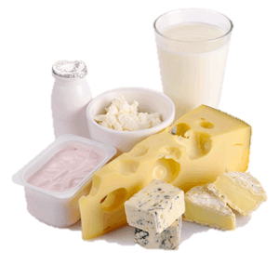
Dairy

Slide 11
We feel happier
Dairy for strong teeth
We have healthy skin and hair

Slide 12
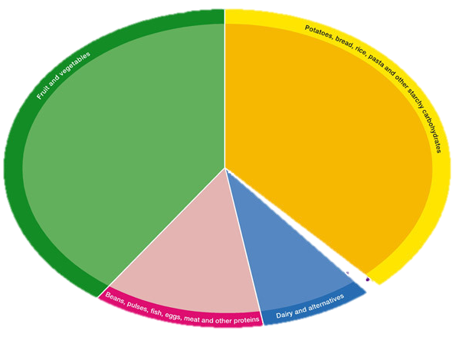
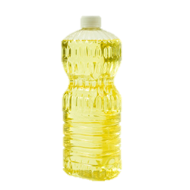
Fats & oils

Slide 13
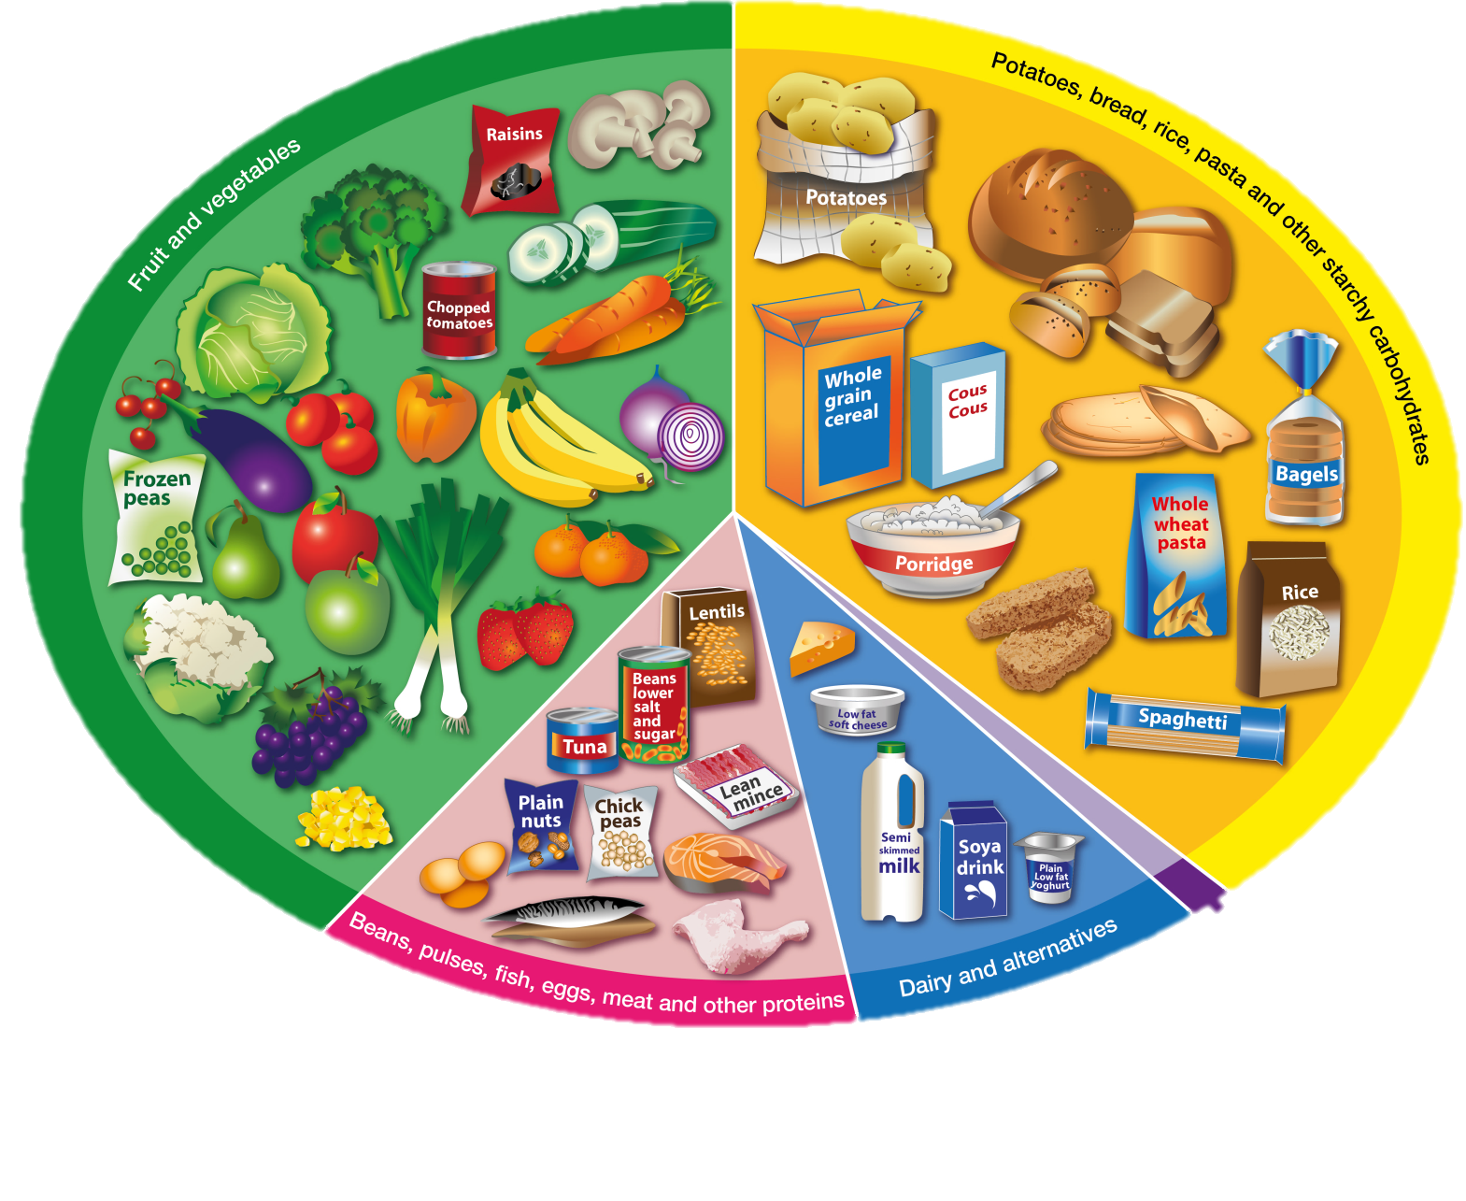
Foods high in fat and sugar

Slide 14
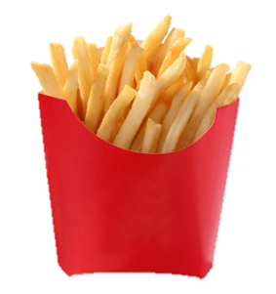
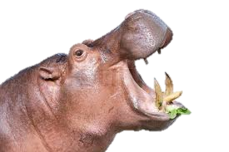
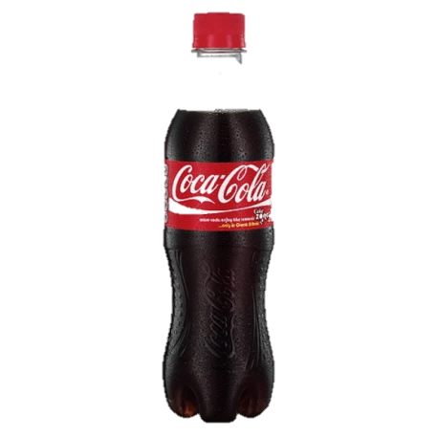
What happens if we eat junk all the time?

Slide 15
No energy to play
Dull skin and hair
Bad mood
Poor concentration
Weak teeth
Broken sleep
Get sick

Slide 16
How many cubes of sugar should kids have everyday?
6 cubes

Slide 17
How many cubes of sugar do kids have everyday?

Slide 18
How many cubes of sugar do kids have everyday?
19
cubes

Slide 19
How many cubes of sugar do kids have every week?
Notes:
133

Slide 20
133 cubes
Notes:
133

Slide 21
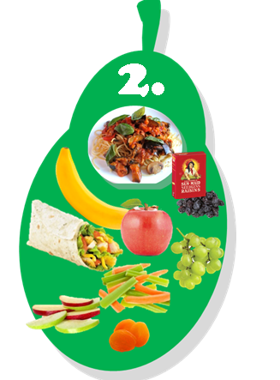
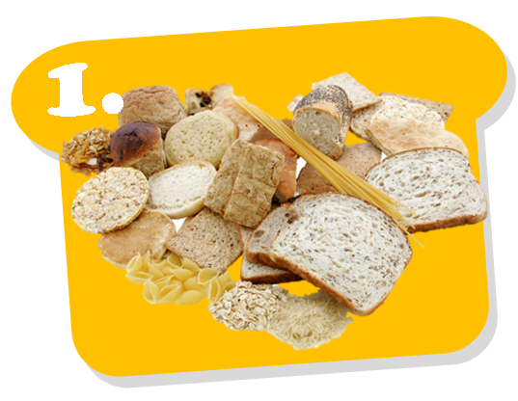
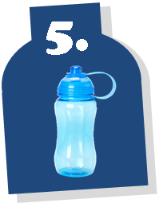
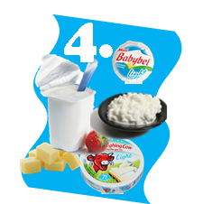
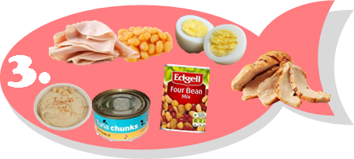
A healthy lunch in 5 steps:

Slide 22
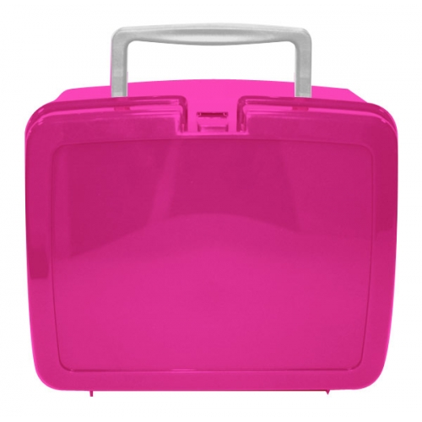
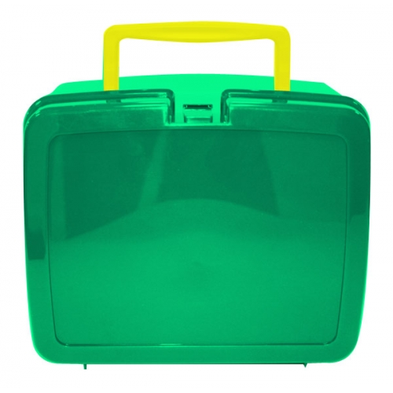
Let’s play a game!
Guess how many cubes of sugar are in each lunchbox?
?
?
Notes:
NMC & KG - Measure out the FAT & SUGAR content for each item into a jar & label them 1,2,3 etc
The children are asked to shout out the number jar that matches each item in packed lunch box
At end add up the TOTAL amount of SUGAR & FAT!!!
SHOW them the equivalent SUGAR & FAT content for the healthy packed lunch box!!

Slide 23
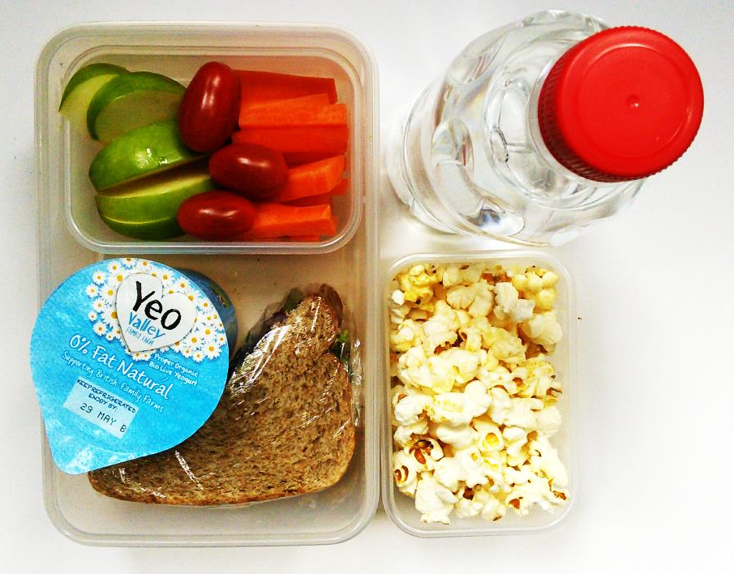
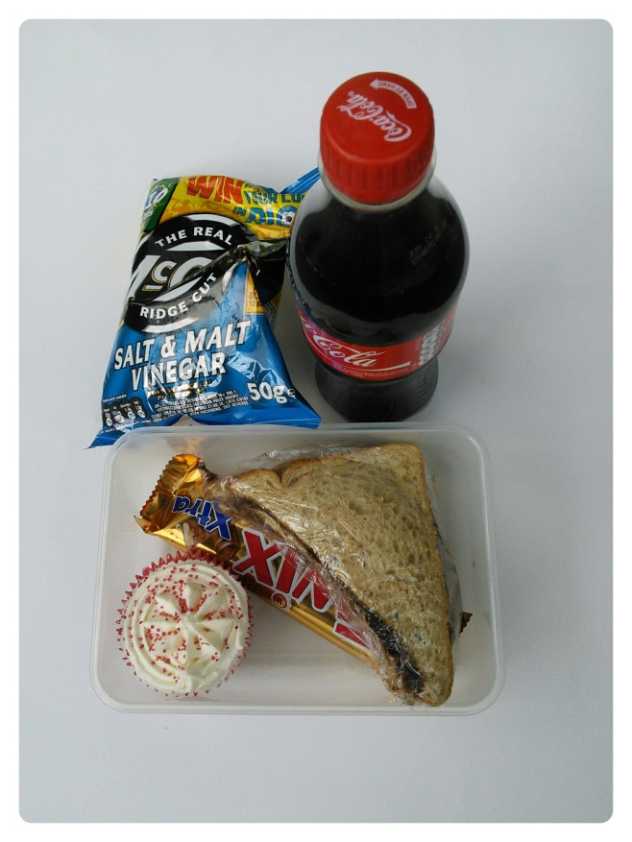
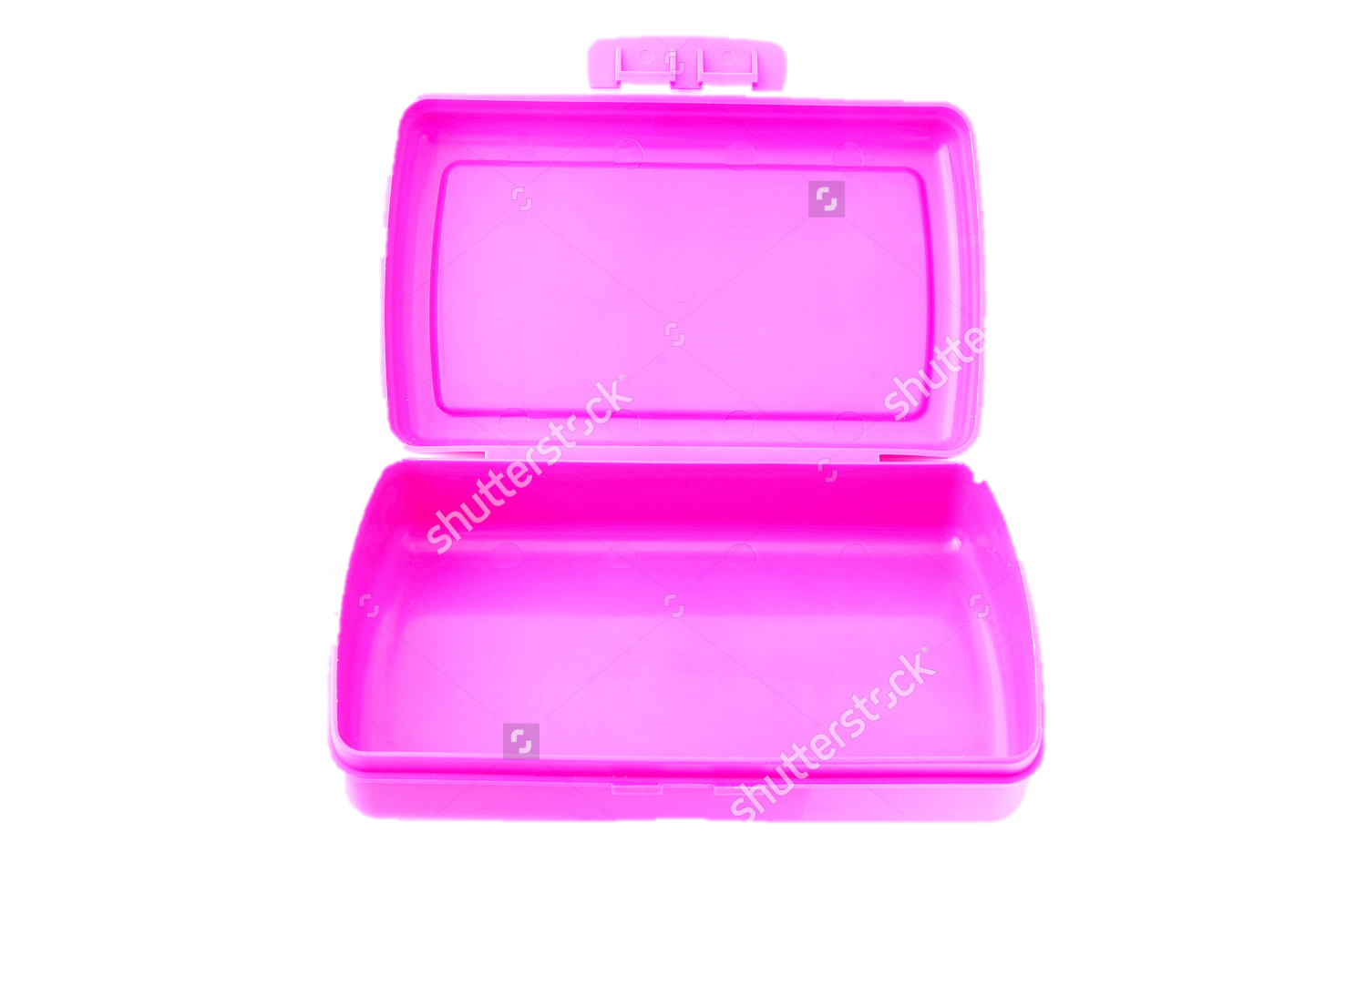
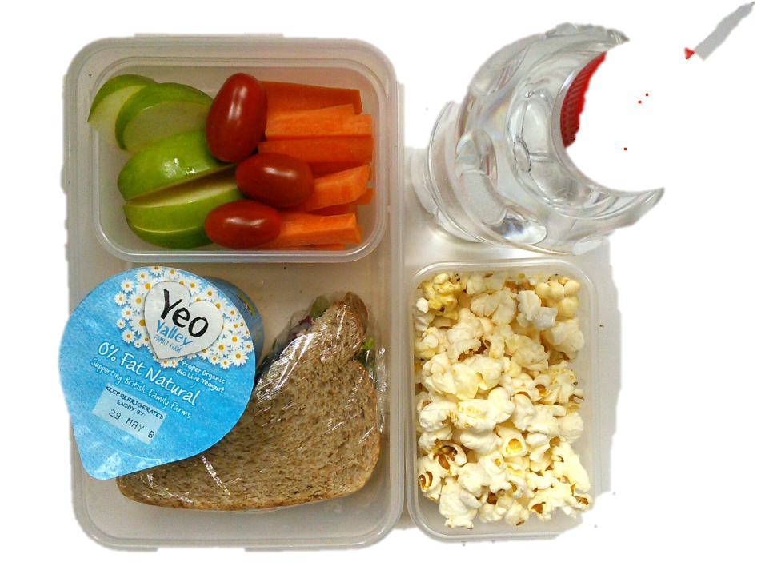
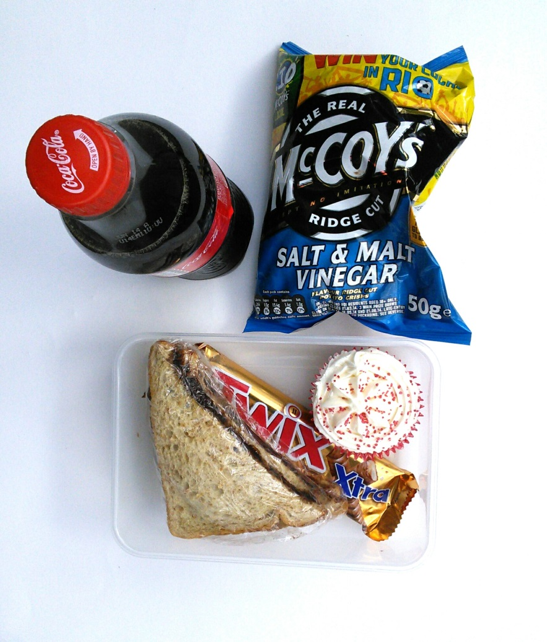
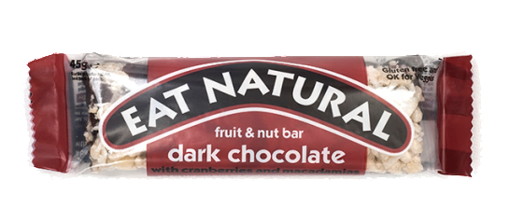
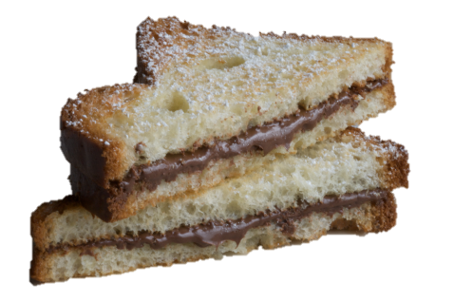
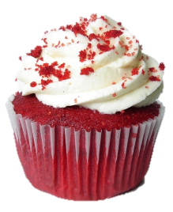
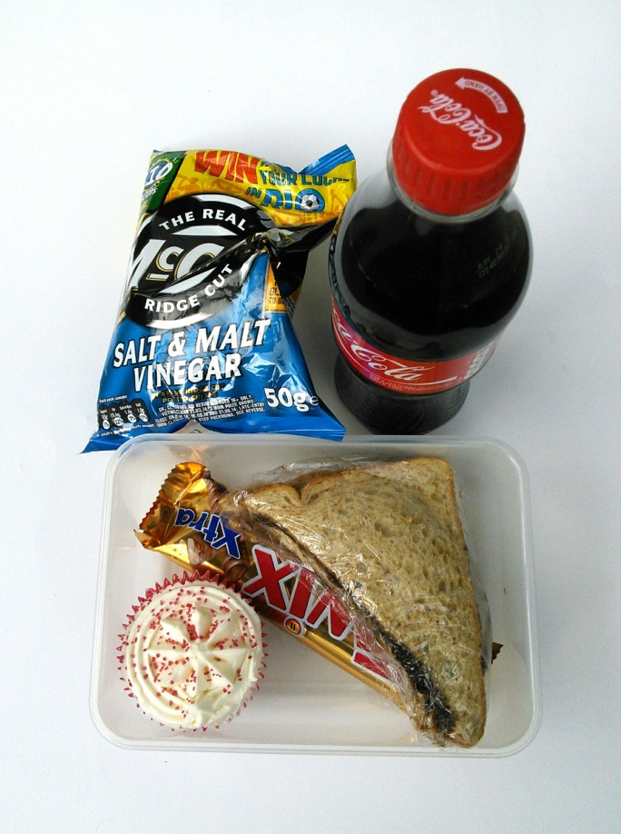
HOW MANY TEASPOONS OF SUGAR ARE IN THIS LUNCHBOX?
Notes:
Red velvet: fat (4.5 tsp), sugar (7 tsp)
Eat Natural: 4 tsps, 3 tsp fat
Capri sub: 4 tsps
Nutella sandwich: 5 tsps, 3 fat
TOTAL SUGAR: 20 TSP
TOTAL FAT: 11

Slide 24
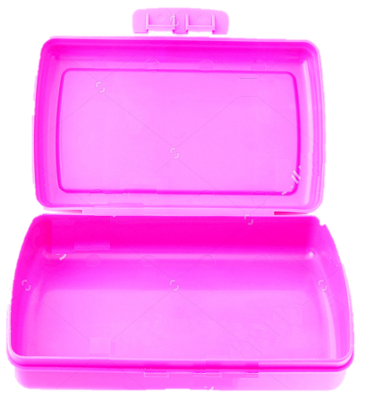
HOW MANY TEASPOONS OF SUGAR ARE IN THIS LUNCHBOX?
4 cubes
4 cubes
6 cubes
6 cubes
Notes:
Red velvet: fat (4.5 tsp), sugar (7 tsp)
Eat Natural: 4 tsps, 3 tsp fat
Capri sub: 4 tsps
Nutella sandwich: 5 tsps, 3 fat
TOTAL SUGAR: 20 TSP
TOTAL FAT: 11

Slide 25
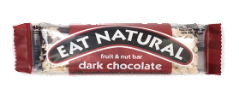
20 cubes of sugar
SUGAR: 35 TEASPOONS
FAT: 19 TEASPOONS

Slide 26
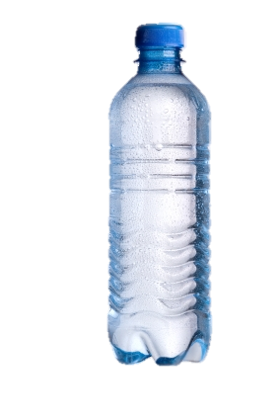
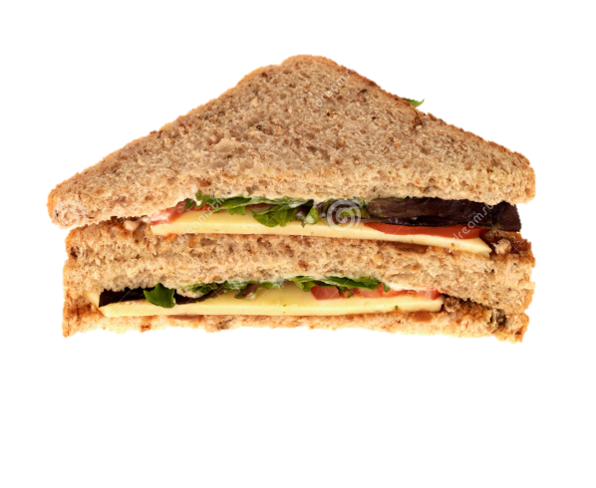
HOW MANY CUBES OF ADDED SUGAR ARE IN THIS LUNCHBOX?

Slide 27
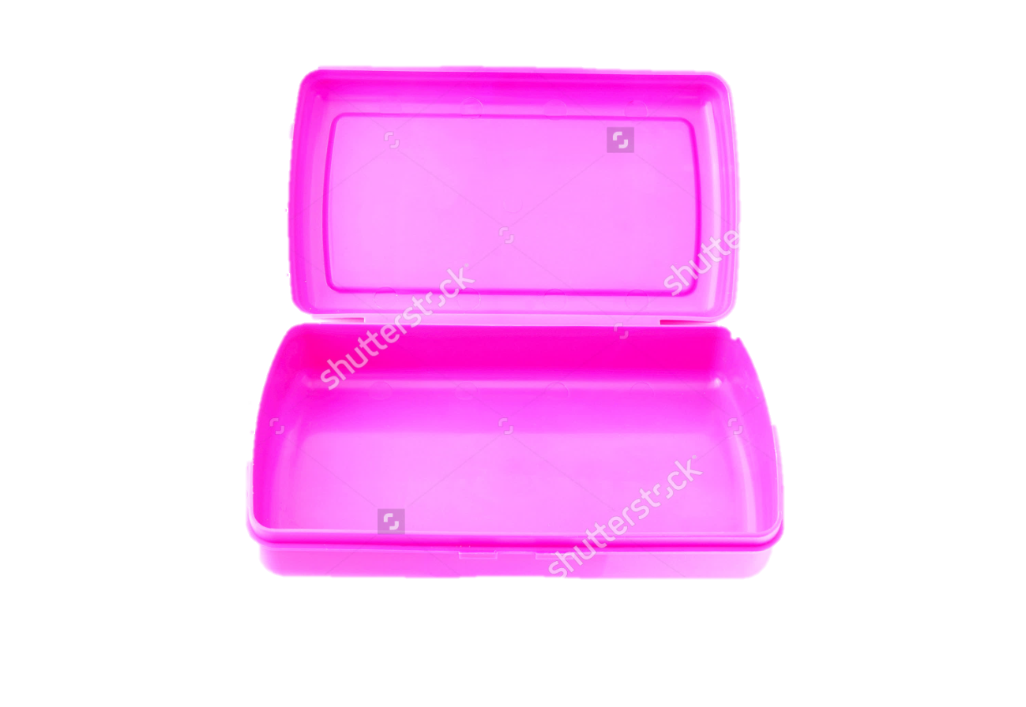
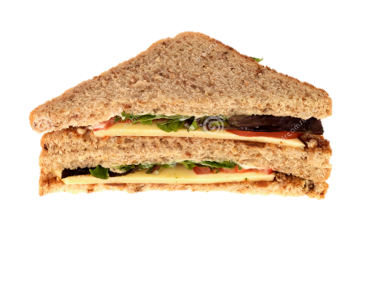
0 teaspoons sugar

Slide 28
New Packed Lunch rules Monday to Thursday Friday is treat day

Slide 29
Your packed lunch or school meal should have:

Slide 30
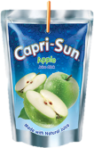
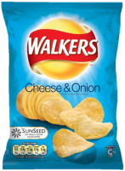
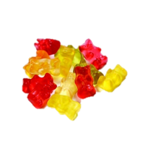
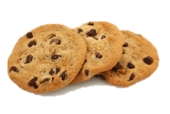
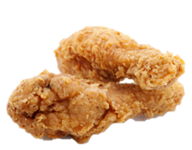
NEW PACKED LUNCH RULES
THESE FOODS ARE FOR FRIDAY’S ONLY
SUGARY DRINKS
CRISPS
CHOCOLATE & SWEETS
FRIED MEAT & PASTRY
BARS

Slide 31
NEW PACKED LUNCH RULES
THESE FOODS ARE FOR FRIDAY’S ONLY
SUGARY DRINKS
CRISPS
CHOCOLATE & SWEETS
FRIED MEAT & PASTRY
BARS

Slide 33
School dinner: How to get a token

Slide 34
Packed lunch: How to get a token

Slide 35
Thank you for listening

