Slide 1
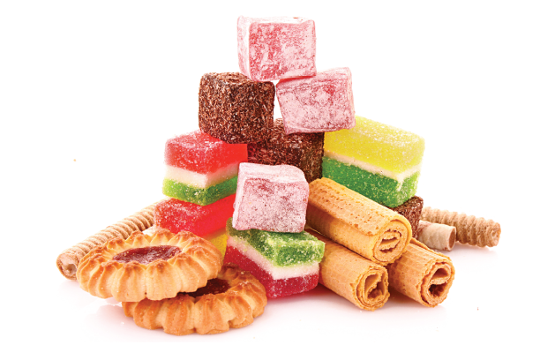
SUGAR

Slide 2
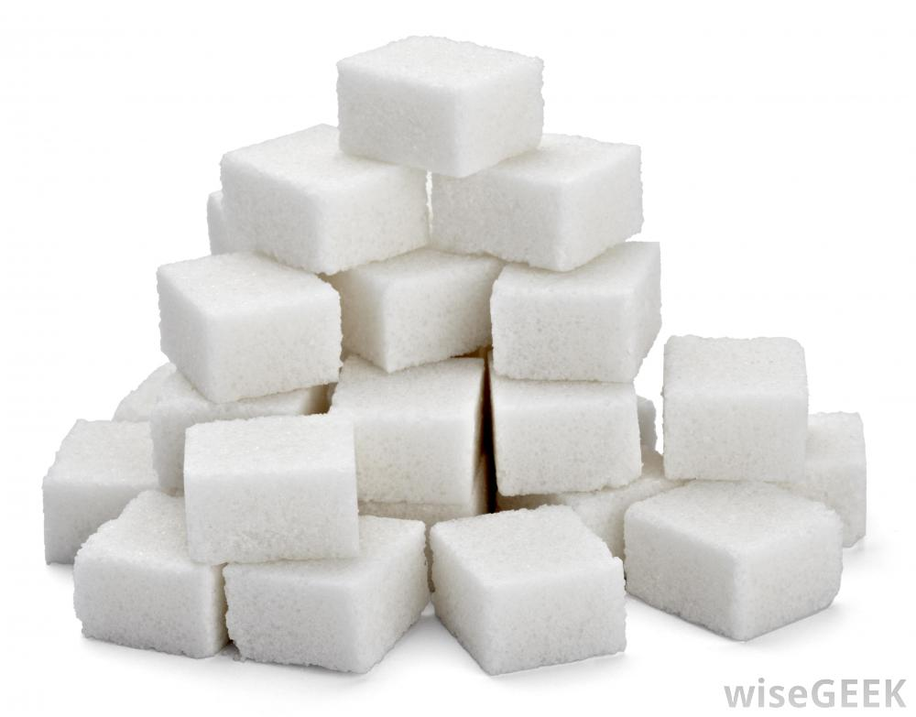
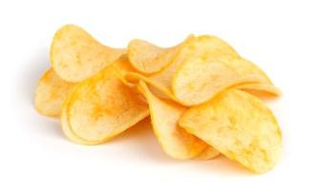
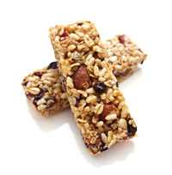
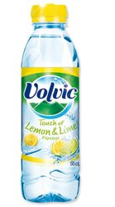
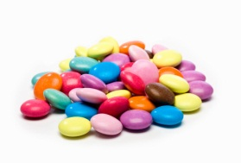
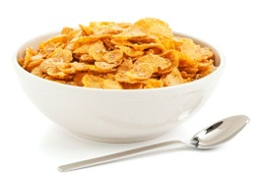
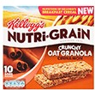
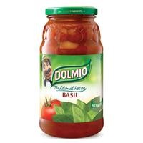
Notes:
You can find sugar in all sorts of things in the supermarket – even things you wouldn’t expect!

Slide 3
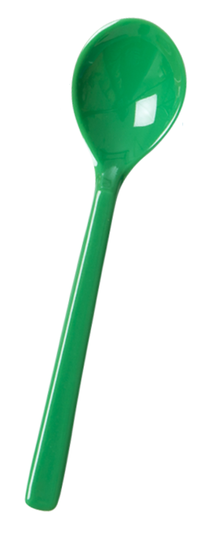
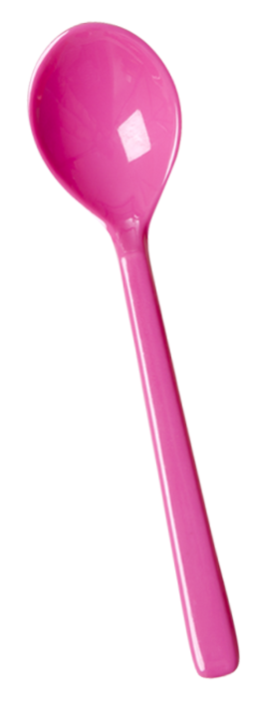
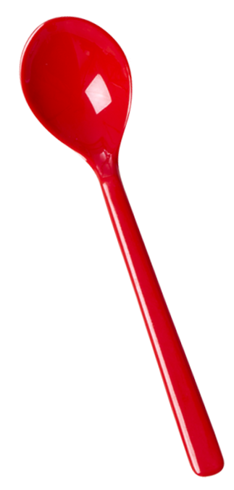
How many teaspoons of sugar a day can we have as part of a healthy diet?
Notes:
4-6 years No more than 19g/day 5 cubes
7-10 years No more than 24g/day 6 cubes
11 years+ No more than 30g/day 7 cubes

Slide 4
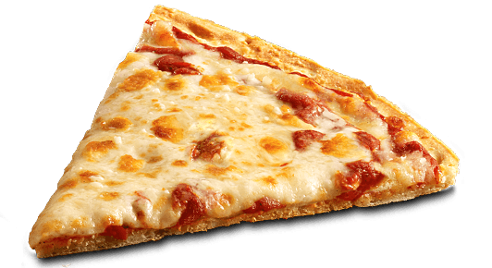
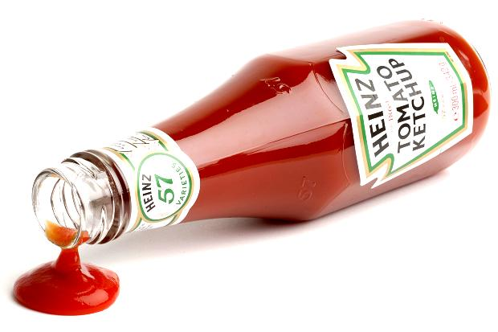
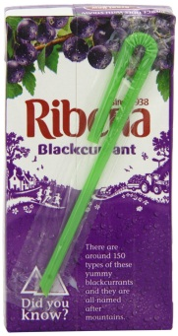
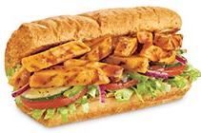
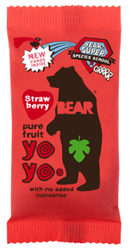
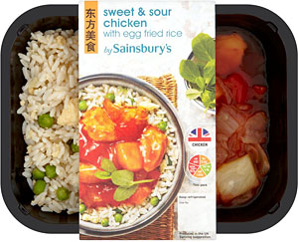
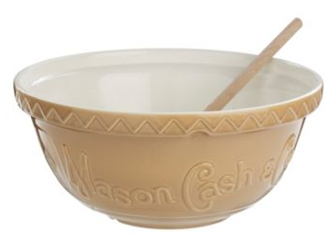
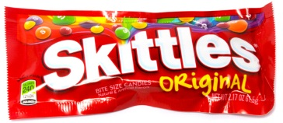
What is added sugar?
Notes:
WHAT IS FREE SUGAR ?
Free sugar is any sugar added when making the food. Not just in table sugar and cakes but in lots of savoury foods and foods labelled as ‘healthy choices’. Milk and whole pieces of fruit also have sugars but this isn’t considered ‘free sugar’.
‘Free sugars’ comprises all monosaccharides* and disaccharides* added to foods by the manufacturer, cook or consumer, plus sugars naturally present in honey, syrups and unsweetened fruit juices. *Monosaccharides are single sugar units (glucose and fructose) and disaccharides are two single units joined together (sucrose).

Slide 5
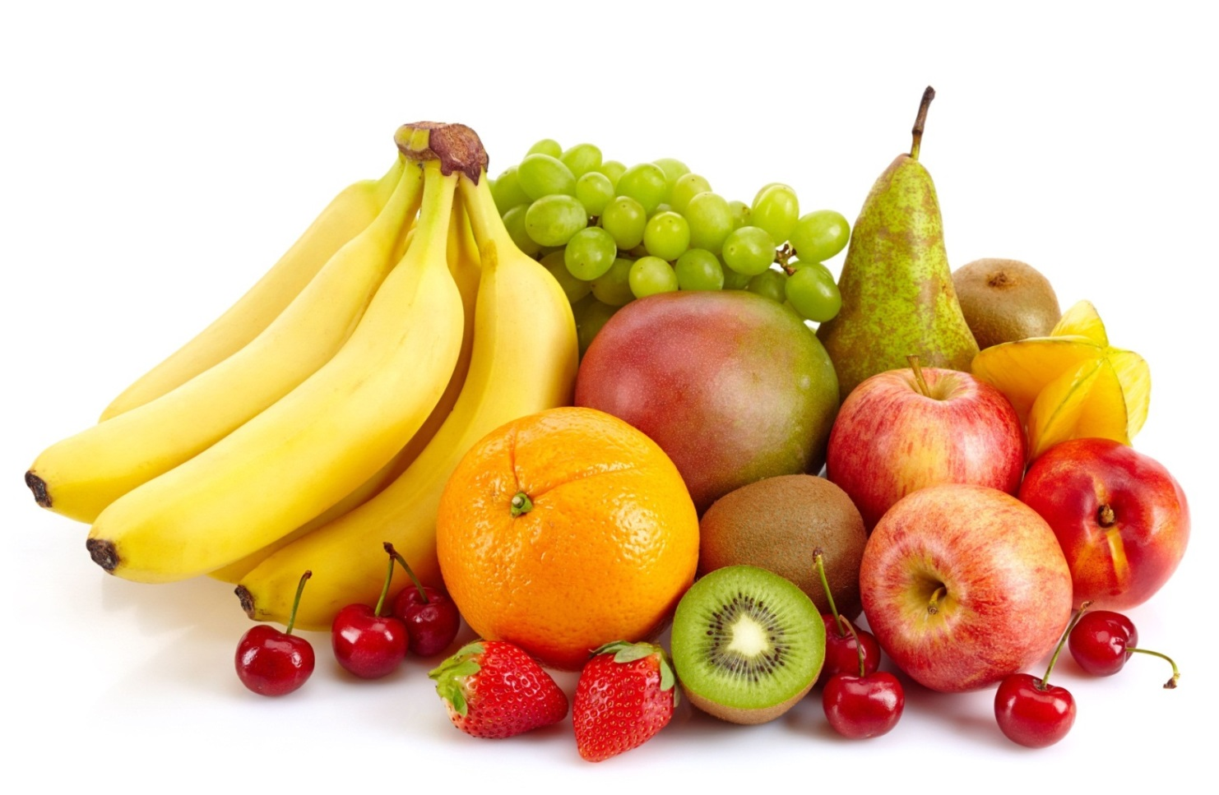
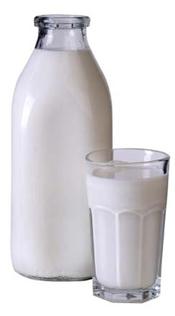
What is healthy sugar?
Notes:
Milk and whole pieces of fruit also have sugars but this isn’t considered ‘free sugar’.
Under this definition lactose (the sugar in milk) when naturally present in milk and milk products and the sugars contained within the cellular structure of foods (particularly fruits and vegetables) are excluded.

Slide 6
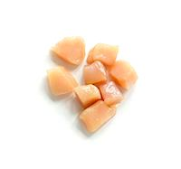
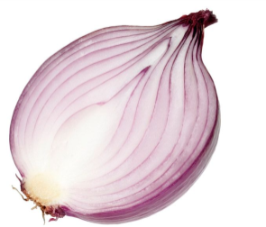
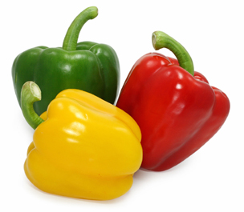
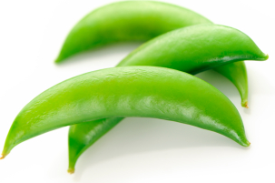
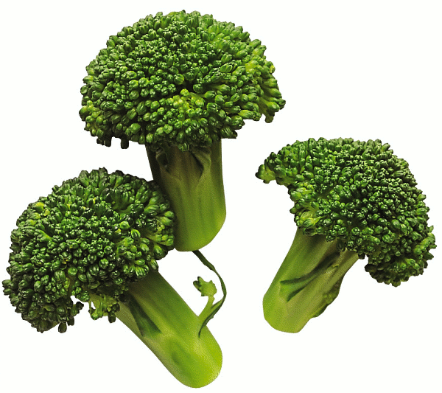
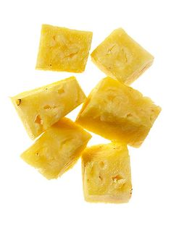
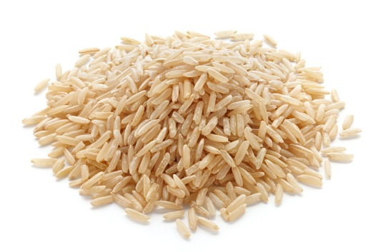
Let’s get sugar detecting!
Notes:
Sweet and Sour chicken microwave meal has 12 teaspoons of sugar! As much as a whole packet of skittles.
You can make your own meal (using pineapple for sweetness) with no added sugar!
Lots of ready meals have added sugar so check the labels and try making them yourself when you can.

Slide 7
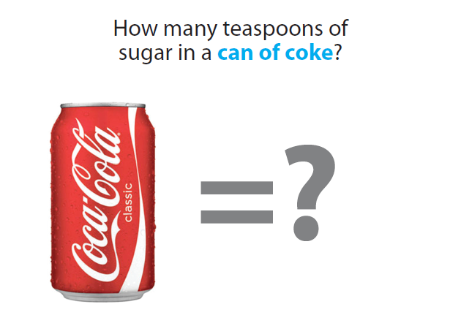
How many teaspoons of sugar in a can of Coke?

Slide 8
How many teaspoons of sugar in a can of Coke?

Slide 9
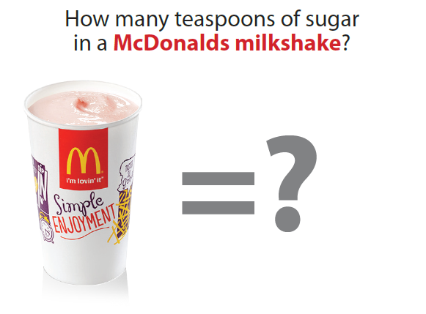
How many teaspoons of sugar in a McDonald’s Milkshake?

Slide 10
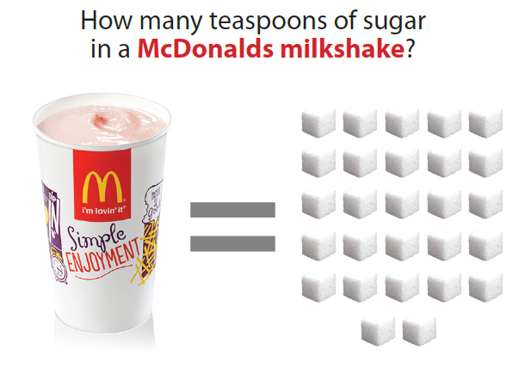
How many teaspoons of sugar in a McDonald’s Milkshake?

Slide 11
How many teaspoons of sugar in a Volvic Touch of Lemon and Lime?

Slide 12
How many teaspoons of sugar in a Volvic Touch of Lemon and Lime?

Slide 13
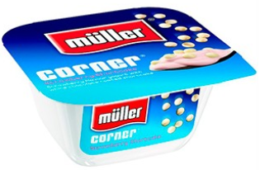
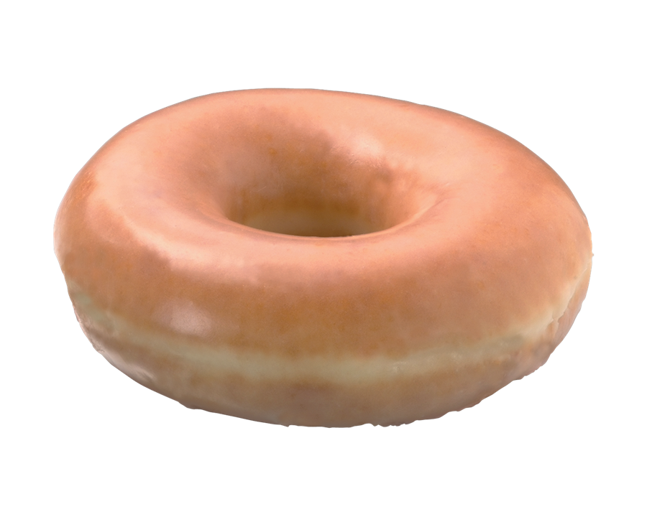
Which has more sugar?

Slide 14
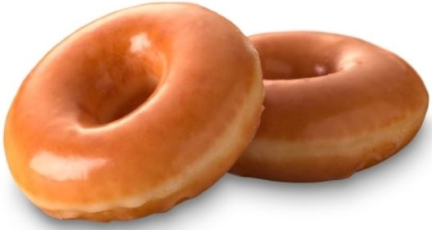
Which has more sugar?
Notes:
2 and a half teaspoons of sugar in each doughnut, 6 in Muller corner

Slide 15
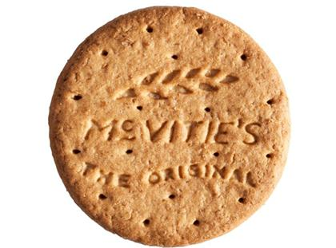
Which has more sugar?
Digestive Biscuit
Lucozade Sport

Slide 16
4.5 teaspoons of sugar
Notes:
Lucozade
18g of sugar per bottle – 4.5 teaspoons
Digestive Biscuits - 2.5g per biscuit – 7.2 biscuits = 18g of sugar

Slide 17
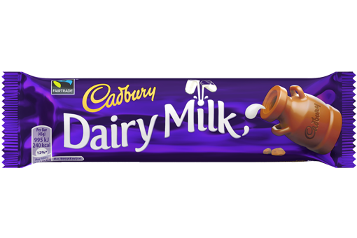
Which has more sugar?
Fruit Shoot
Dairy Milk
Notes:
Fruit shoot
23g

Slide 18
Nearly 6 teaspoons of sugar
Notes:
Fruit Shoot orange juice drink - each 200ml bottle has 23g of sugar, 5.75 teaspoons
Dairy milk – Sugars 14.7g per bar –3.65 teaspoons
One Fruit Shoot has the same amount of sugar as just over 1 and a half Dairy Milk chocolate bars

Slide 19
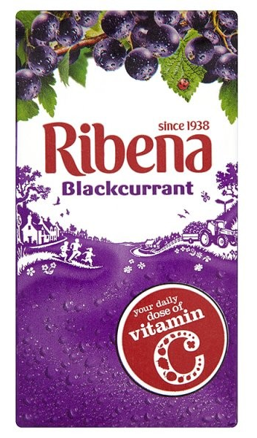
Which has more sugar?
Ribena
Krispy Kreme doughnut

Slide 20
5 teaspoons of sugar
Notes:
2 and a half teaspoons of sugar in each Krispy Kreme doughnut
Ribena – 20g of sugar – 5 teaspoons of sugar

Slide 21
Which has more sugar?
Monster Energy Drink
Candy Floss
Notes:
Monster Energy drink - 55g /13.75 teaspoons of sugar per can.
Candy Floss -
30 grams of sugar to make a typical serving size of cotton candy

Slide 22
Nearly 14 teaspoons of sugar
Notes:
Monster Energy drink - 55g /13.75 teaspoons of sugar per can.
Candy Floss - 30 grams of sugar to make a typical serving size of cotton candy
Monster Energy Drink has the same amount of sugar as nearly 1 and a half servings of candy floss

Slide 23
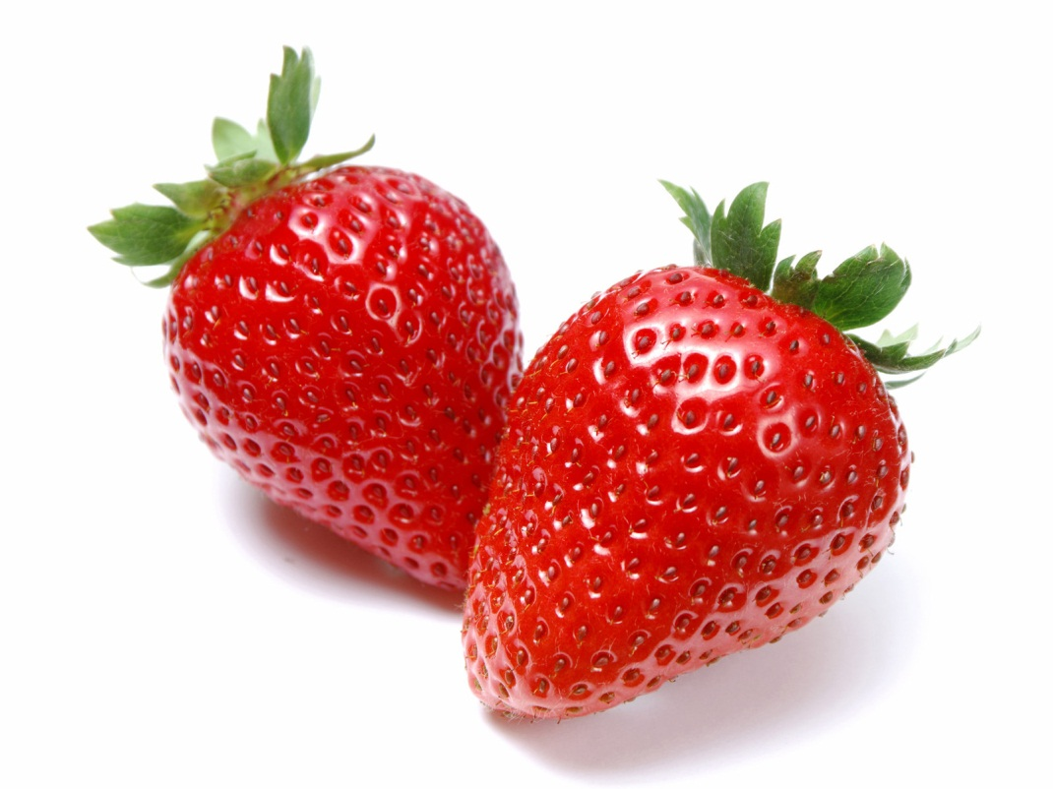
Sugar 49g
Sugar 4.9 g
10 teaspoons
1 teaspoons
Notes:
Per 100g

Slide 24
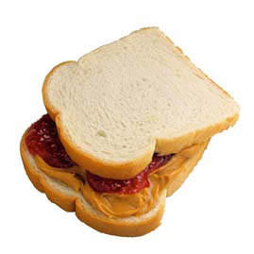
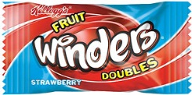
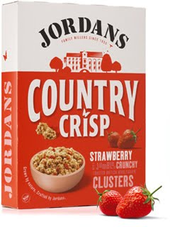
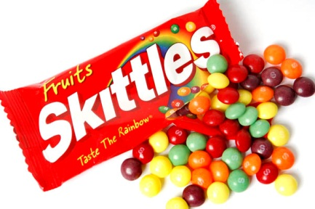
Notes:
Breakfast:
Country Crisp (5 teaspoons) and orange juice drink (5 teaspoons)-
Snack: Ribena (5 teaspoons) and Winder (2 teaspoons)-
Lunch: Peanut butter and jam on white bread (3 teaspoons), Muller yoghurt (6 teaspoons) and Ribena (5 teaspoons)
Snack: Yo Yo (2 teaspoons) bar and Volvic Lemon and Lime water (8 teaspoons)
Dinner: Heinz tomato soup (5 teaspoons), orange juice drink (5 teaspoons), skittles (12 teaspoons)
63 teaspoons in total (42 teaspoons is recommended for a whole week!)

Slide 25
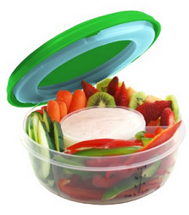
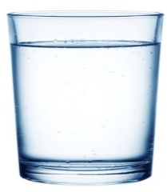
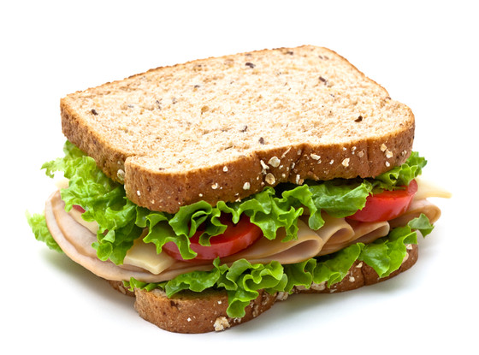
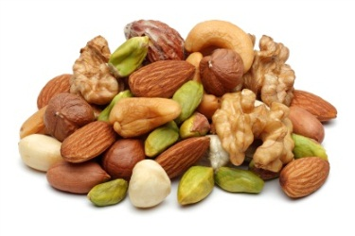
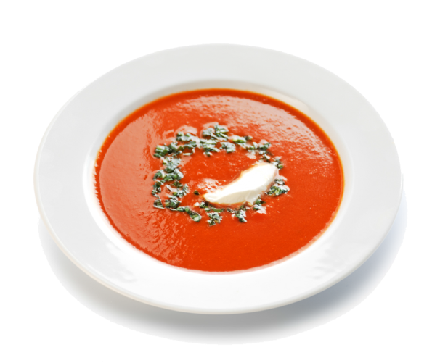
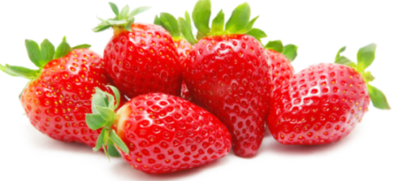
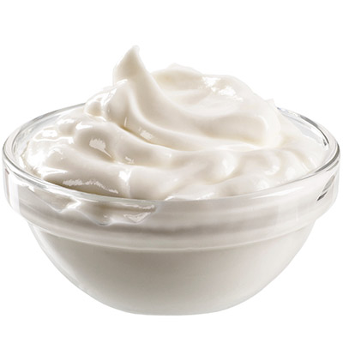
Notes:
Breakfast: porridge with chopped banana and a glass of milk (don’t need milk if porridge is made with milk)
Snack: vegetable sticks and dip (e.g. soft cheese/peanut butter/salsa/avocado – any low sugar dip, glass of water
Lunch: ham/cheese and salad sandwich on wholemeal bread, glass of water
Snack: nuts and seeds, water (could add frozen fruit ice cubes)
Dinner: homemade tomato soup (with bread/containing pasta & pulses/chicken/fish) , water with a slice of lemon, strawberries and yoghurt
Drinks: water is best for your teeth. Juice not ideal however if want a change from plain water then try juice diluted with water/slice lemon or lime/frozen fruits as fun ice cubes.

