Slide 1
BOUNCEBACKABILITY
3. Managing Difficult Emotions

Slide 2
Listen to the following situations and try to act out how you would feel in each one. Think about your face as well as your body language.
Emotion Scenarios

Slide 3
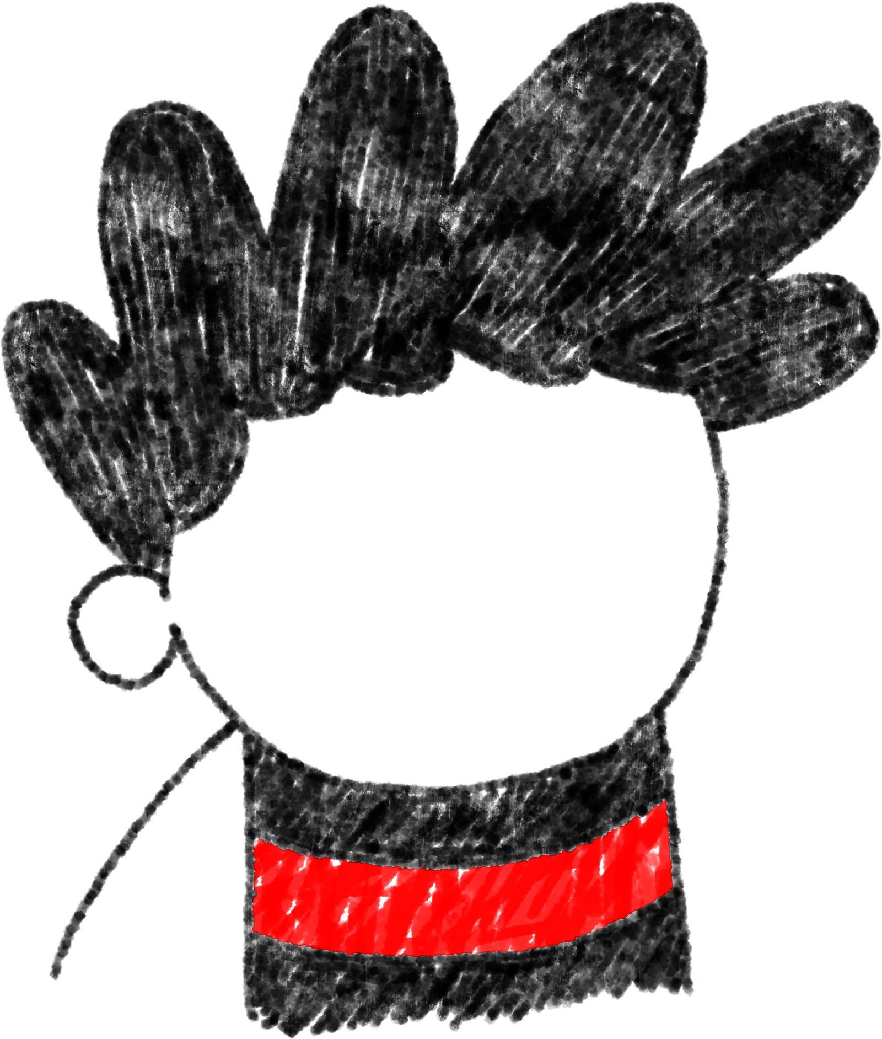
?
You passed your
guitar exam!

Slide 4
Someone in your class is having a big, exciting birthday party.
You are not invited.
?

Slide 5
You are not allowed to play outside until your room is tidy.
?

Slide 6
?
You trip and fall in the playground. You think someone might have pushed you.

Slide 7
The school holidays begin tomorrow!
?

Slide 8
Your best friend has made another friend.
They play together at
playtime but don’t want
you to join in.
?

Slide 9
?
You tried really hard but still got lots of spellings wrong in your test.

Slide 10
?
You have to read a poem in your class assembly and the whole school will be watching.

Slide 11
?
Your friend tells you
they are moving to
another school.

Slide 12
Someone nudges you
and now your painting
is ruined.
?

Slide 13
A person who you know is a bully is walking towards you in the corridor.
?

Slide 14
?
Your best friend got picked to be the main part in the school play.
You had been hoping you would be picked.

Slide 15
Everyone acted out one emotion for each of those scenarios but often we can feel lots of different emotions at the same time.
Can anyone think of any example from the scenarios when they might have felt more than one emotion?
You might feel a little cross at the teachers for not picking you.
You could feel jealous of your friend.
Your best friend got picked to be the main part in the school play.
You had been hoping you would be picked.
You might feel excited for your friend.
You might feel sad not to have been picked.
You might feel embarrassed because everyone knew you wanted that part.

Slide 16
Now think about the scenarios you acted out…
Rather than feeling sad, angry, jealous, frustrated or any of the other negative feelings you just acted out, could we behave differently so that we feel better?
For example, instead of feeling angry and getting upset, how could you react to this situation…?
‘You’ve hurt your leg and can’t take part in your favourite sport anymore’.

Slide 17
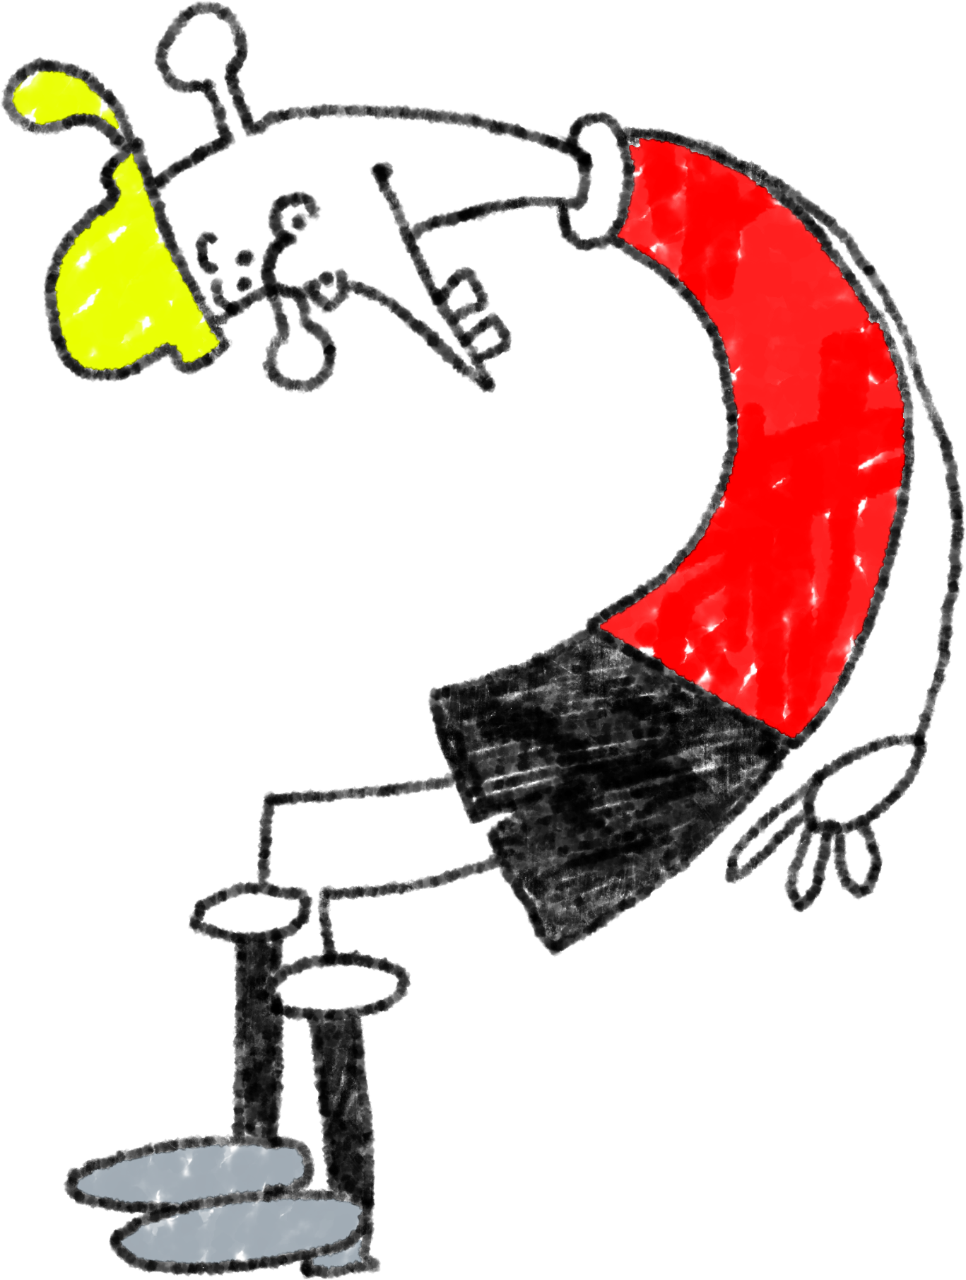
With your partner or group, look at the scenario you’ve been given. What would be the best way to react, so that it is the nicest situation that can be for you and those around you?

Slide 18
WELL DONE!

