Slide 1
BOUNCEBACKABILITY
5. Understanding Change

Slide 2
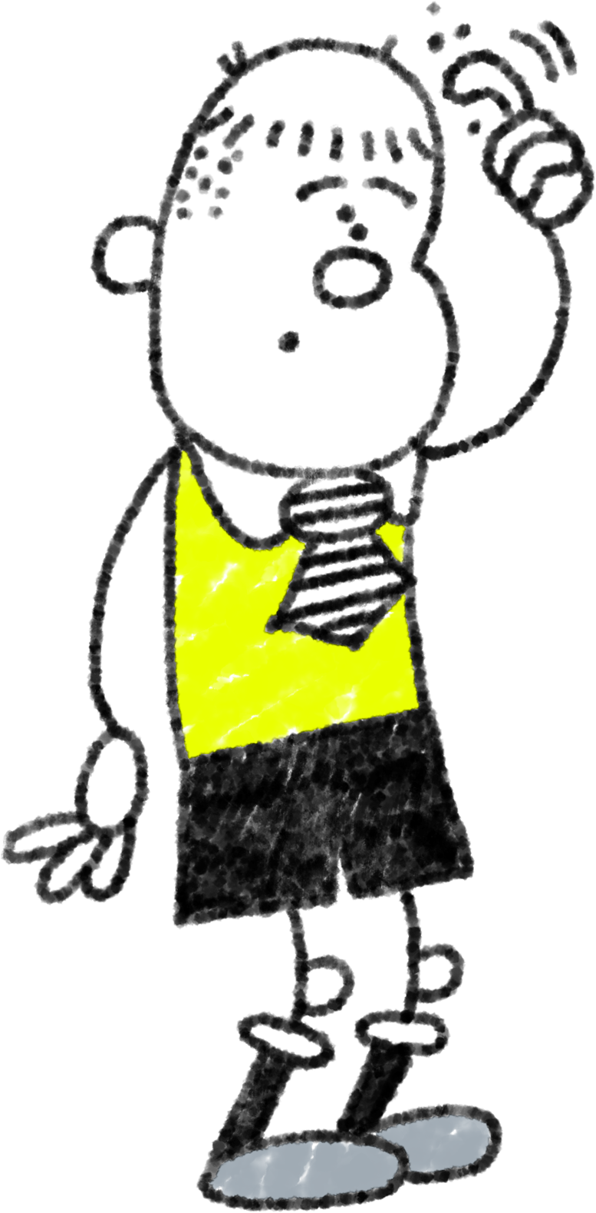
Can you unscramble these difficult situations?
mgovin to a ewn scholo
Gitteng a nwe pipul in oyur calss
lsoing a ept
igettng a enw ceather
Nmovig pu ot a wen yaer grupo
ingmov oushe
sparent steparaing
Gnettig a ewn brethor or sestir
A freind vmoing aawy

Slide 3
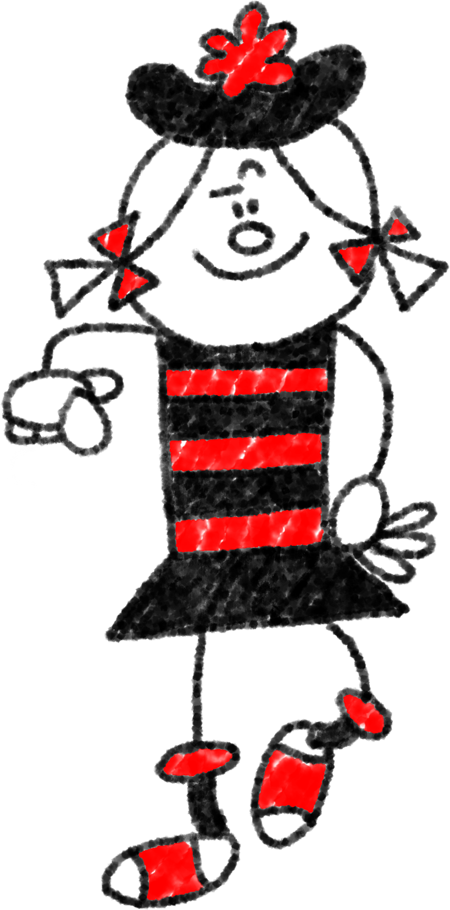
Lots of things around us change all the time. Change can be super exciting! But it can also be scary and uncomfortable.
Moving to a new school
mgovin to a ewn scholo
Losing a pet
soling a ept
Getting a new pupil in your class
Gitteng a nwe pipul in oyur calss
Getting a new teacher
ingettg a enw ceather
Moving up to a new year group
Moving house
Nmovig pu ot a wen yare grupo
Parents separating
A friend moving away
Getting a new brother or sister

Slide 4
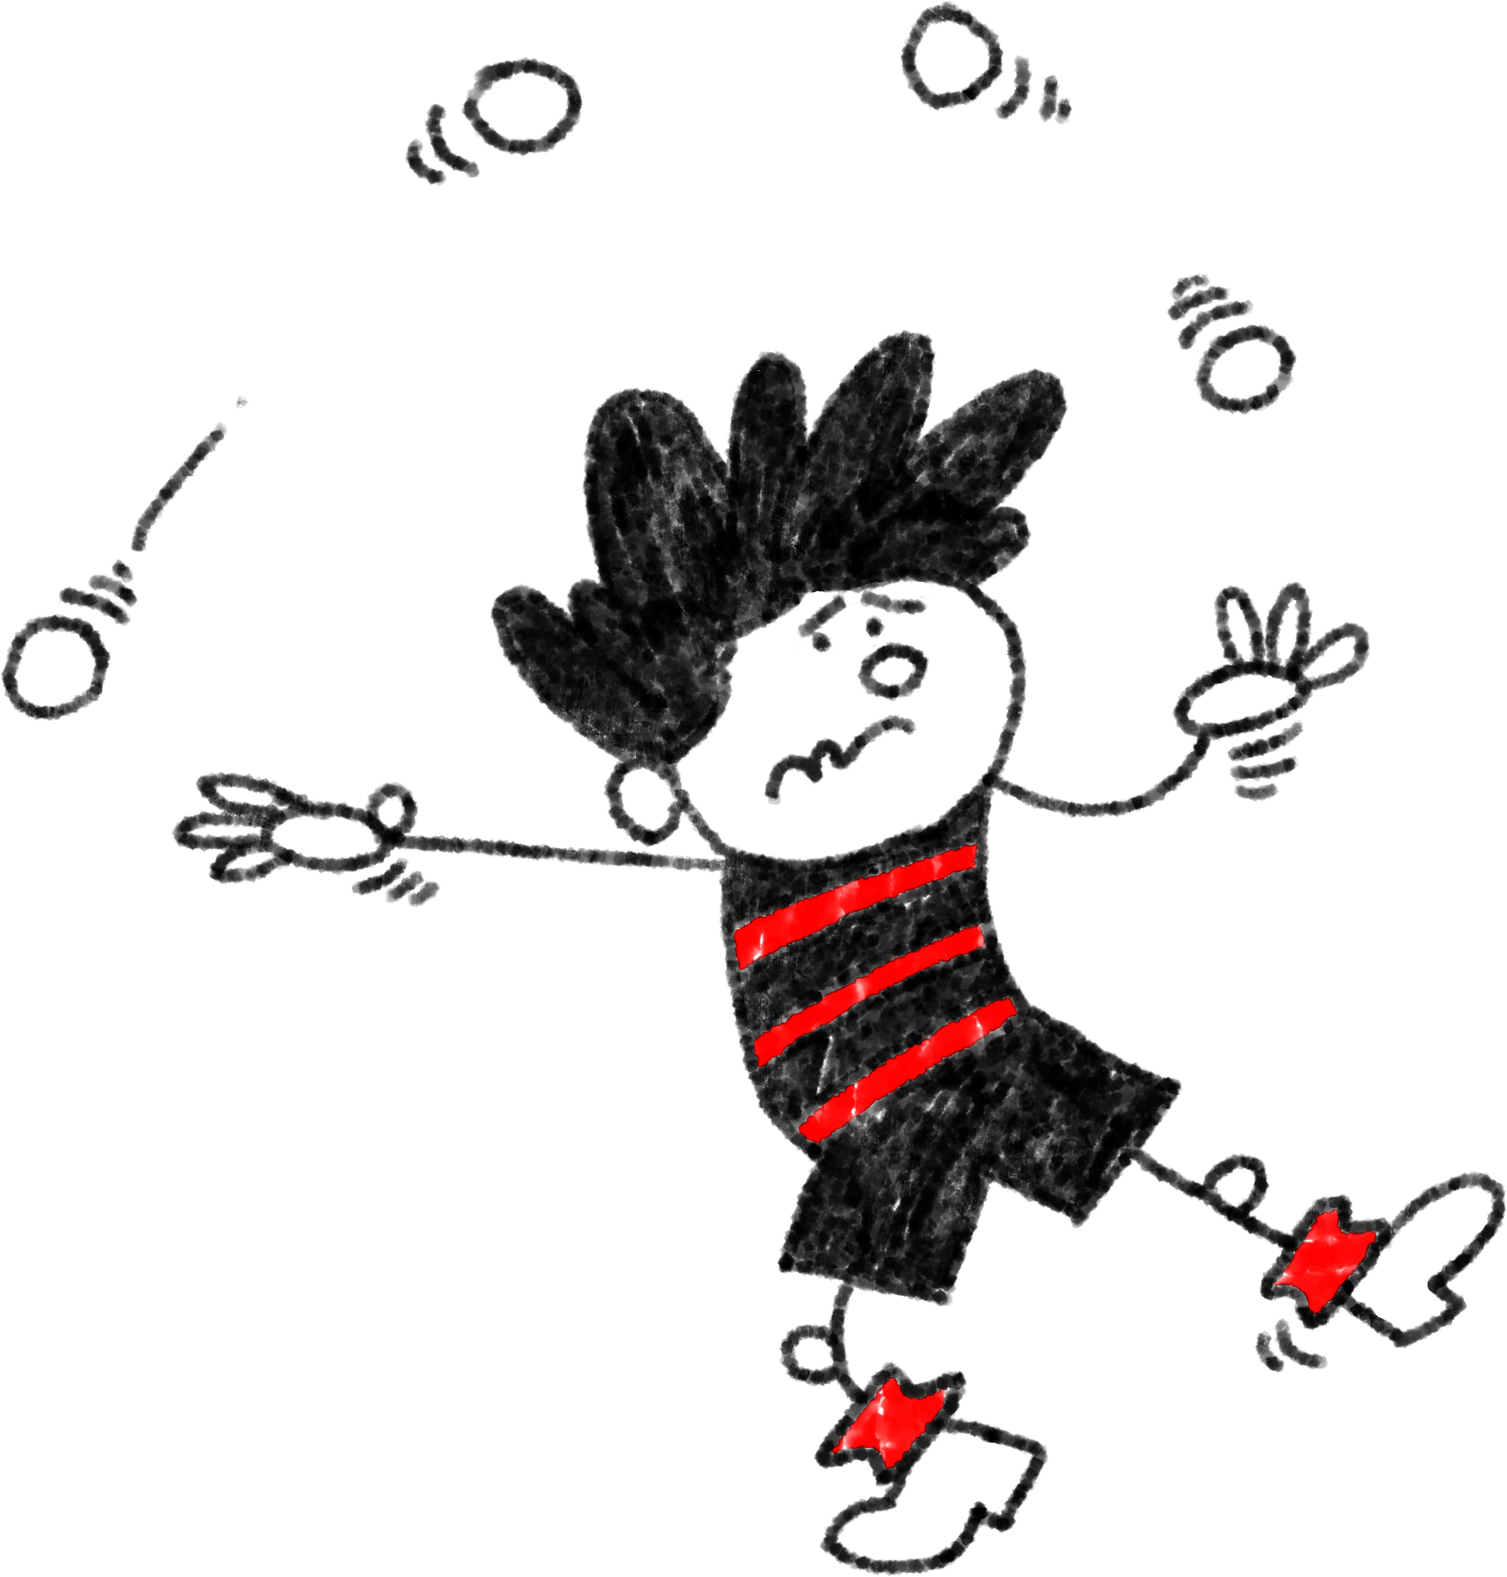
As we get older, and become more independent, things inevitably change.
Change is a part of life.
We cannot stop it.
But we can develop the skills we need to help us cope with the difficult feelings that change can can bring.
By doing this we are being resilient!

Slide 5
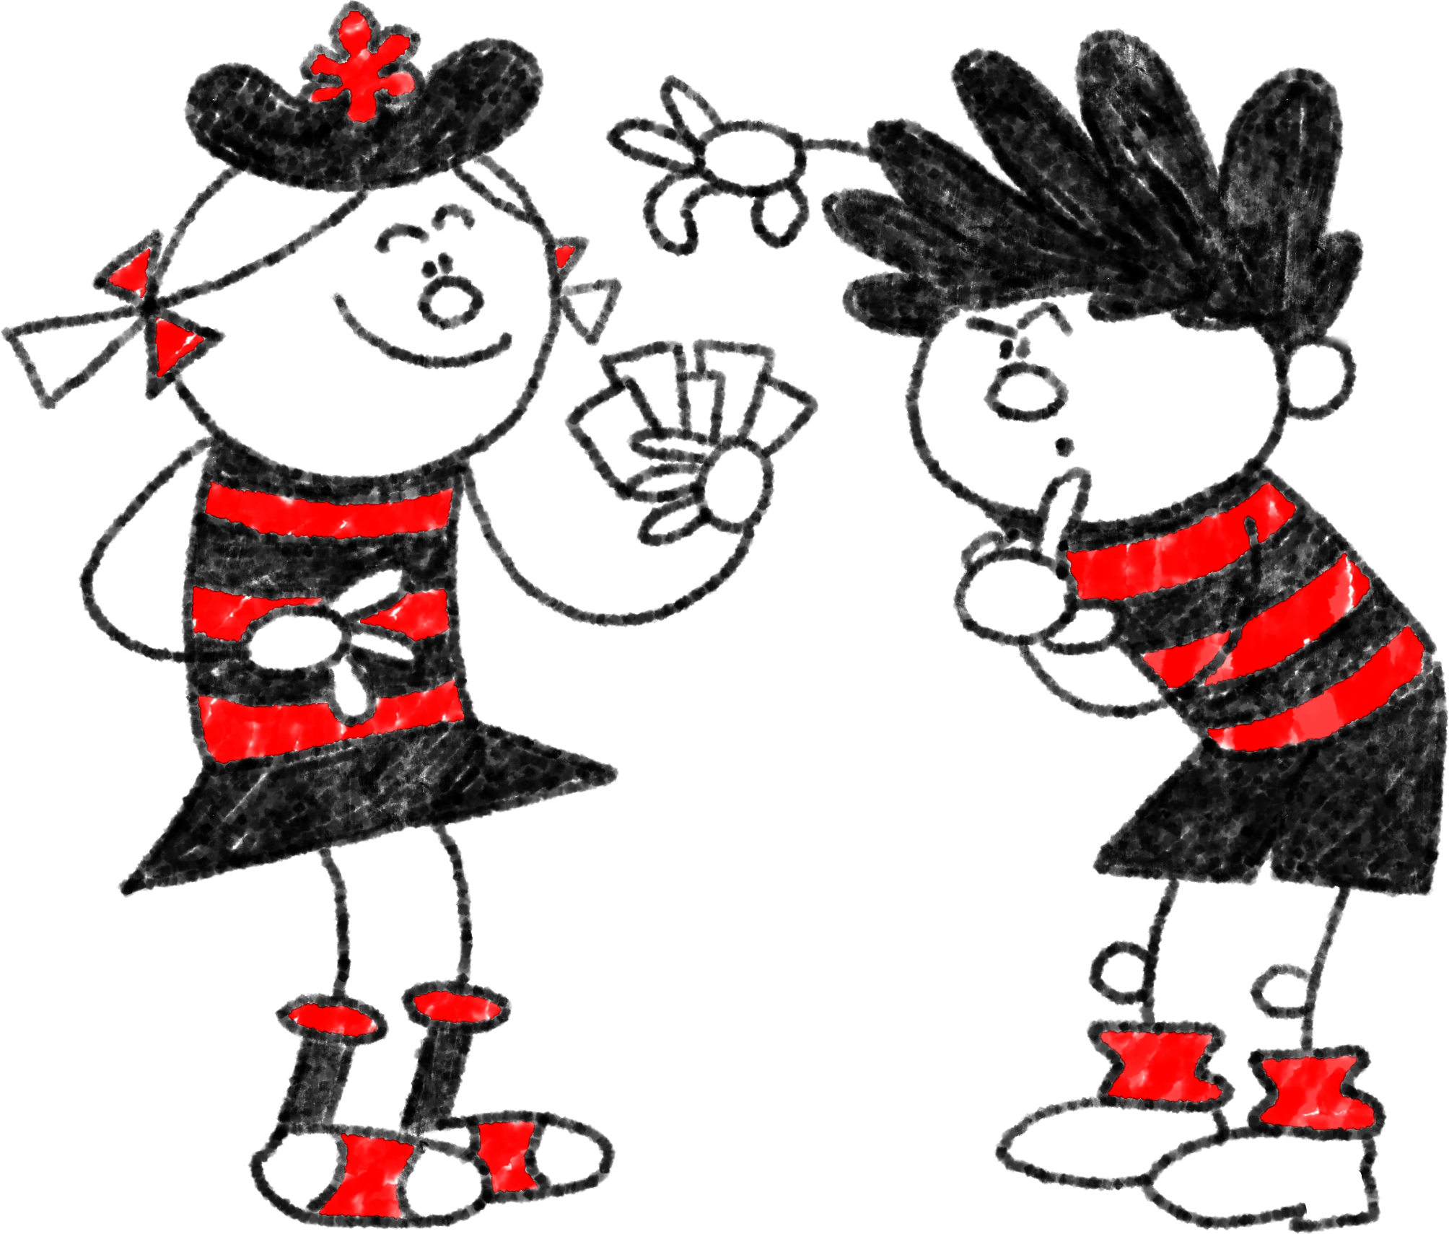
Take a scenario card and try to answer the following questions in your groups:
What feelings might you experience in this scenario?
What worries might you have?
Are there any things you could do to feel better about the situation?
Is there anybody that could help you?
What positive things could this change bring?

Slide 6
Understanding that things can’t be rosy all the time; change is part of growing up. But if we are brave and resilient, we will get through the harder times.
Getting support. From our teachers or parents and carers. They might have been through this themselves and have some good advice.
What can help us cope with change?
Remembering positive past experiences. Perhaps you can remember changing schools or teachers etc. before. It may have been scary to start with, but it all turned out okay.
Talking to our friends. Friends may be having the same worries. They can help you to relax.
Preparation. You may be more worried or nervous because you are unsure of what will happen. Try to find out as much as you can about the new situation and prepare yourself. This may help you feel calmer.

Slide 7
WELL DONE!

