Slide 1
PSHE and Citizenship
Health and Wellbeing | Back to School
PSHE and Citizenship | KS1 | Health and Wellbeing | Back to School | Feelings
Notes:
We hope you find the information on our website and resources useful. This resource is provided for informational and educational purposes only. It is intended to offer general information and should never be taken as professional advice on mental health. As information on mental health is complex and is a developing area, we do not warrant that the information provided is correct. You and your students should not rely on the material included within this resource and we do not accept any responsibility if you or your students do. As mental health is complex, you should undertake proper and relevant training before teaching on mental health. These resources are intended to support you once you have received such training. It is up to you to contact a suitably qualified health professional if you are concerned about your mental health and it is up to you to advise your students to contact a suitably qualified health professional if they are concerned about their mental health. When using this resource, you are responsible for the safety of those involved with using this resource, including staff and students. It is up to you to follow your school or organisation’s safeguarding policies and procedures should your use of this resource raise anything covered by the policies or procedures.

Slide 3
Aim
I can understand that change can feel tricky and know ways to help me feel better about it.
Success Criteria
I can talk about and understand my feelings.
I can explain why change can feel tricky and how to get support with this.
I can explain how to be in charge of my feelings and decide how I react or respond to them.
This resource is fully in line with the Learning Outcomes and Core Themes outlined in the PSHE Association’s Programme of Study.

Slide 4
The Big Questions

Slide 5
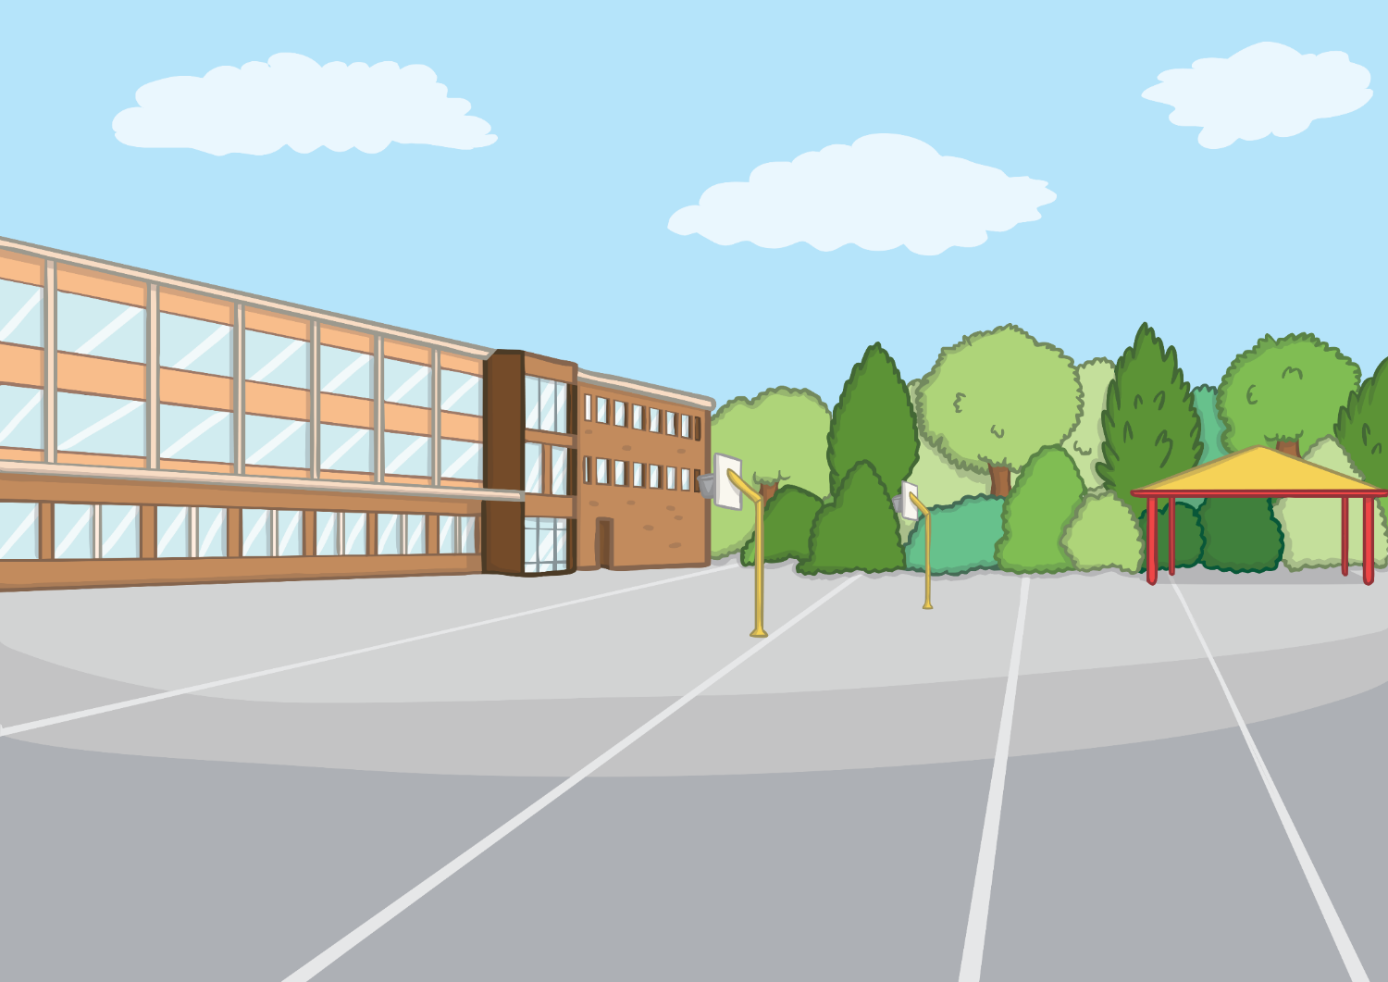
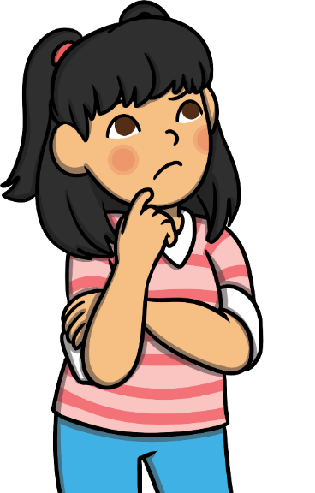
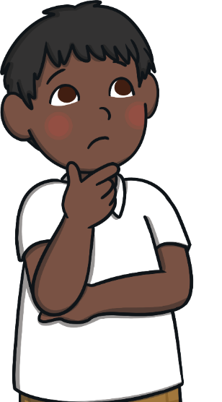
How does change feel?
What can I do to help me feel good?

Slide 6
Reconnecting

Slide 7
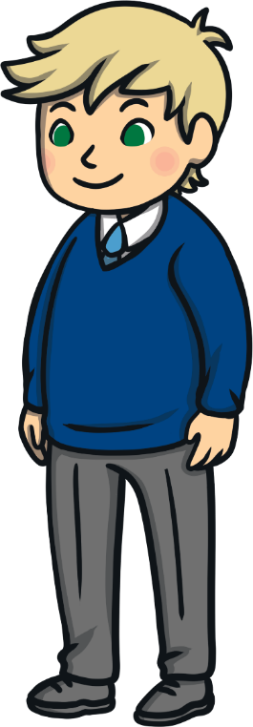
How Do I Feel Today?
How has coming back to school felt?
How did you feel before coming back?
How do you feel now?

Slide 8
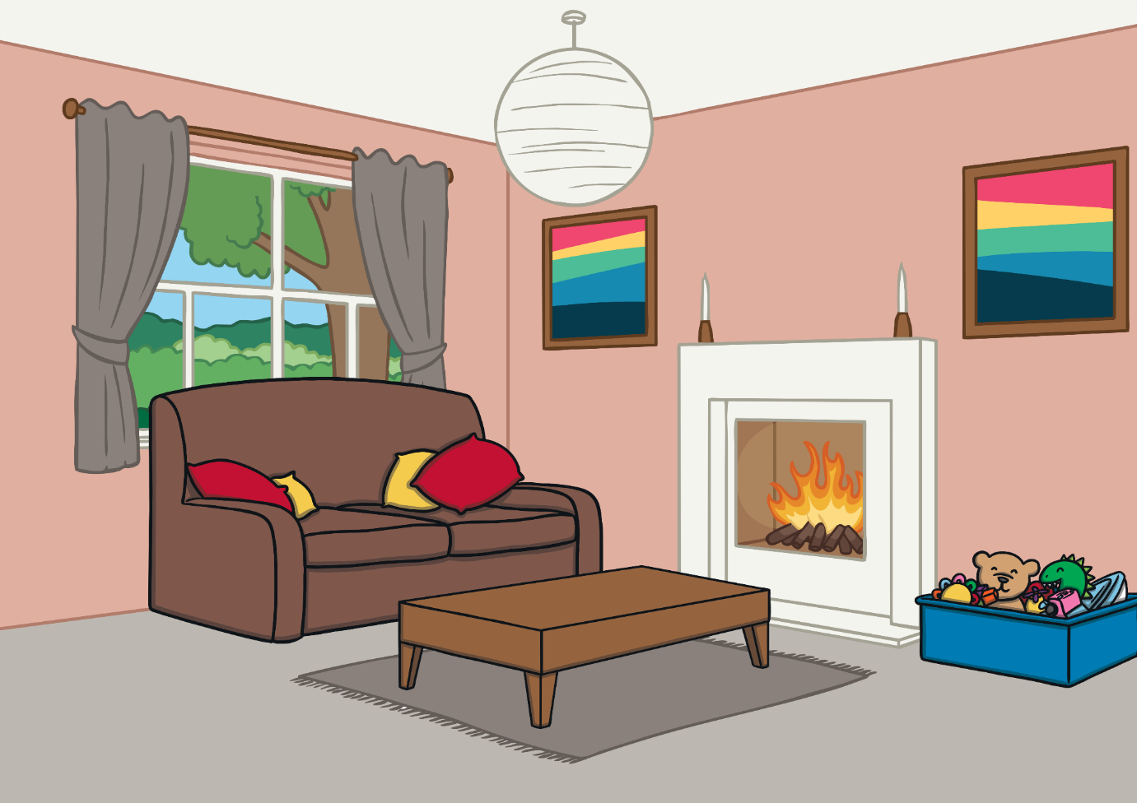
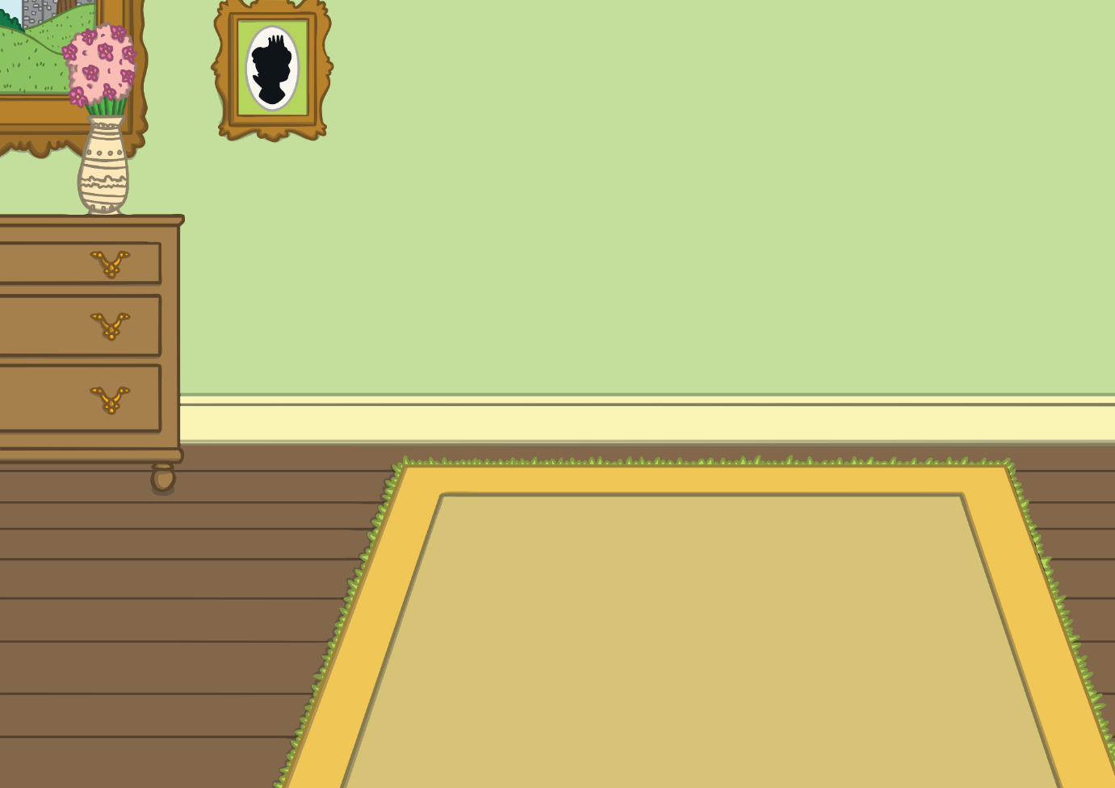
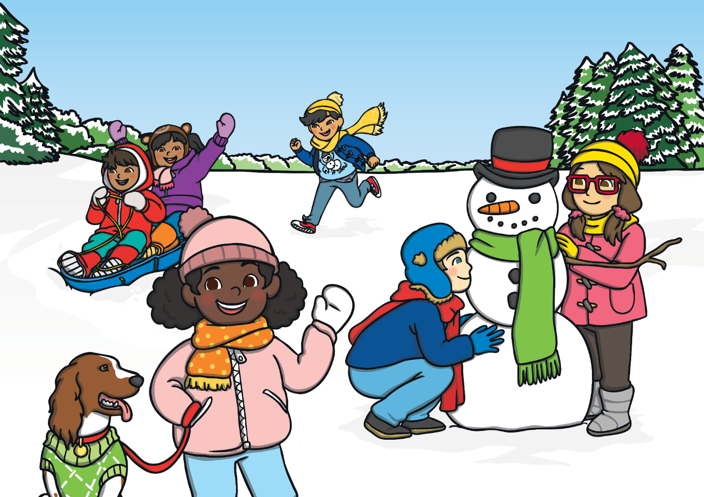
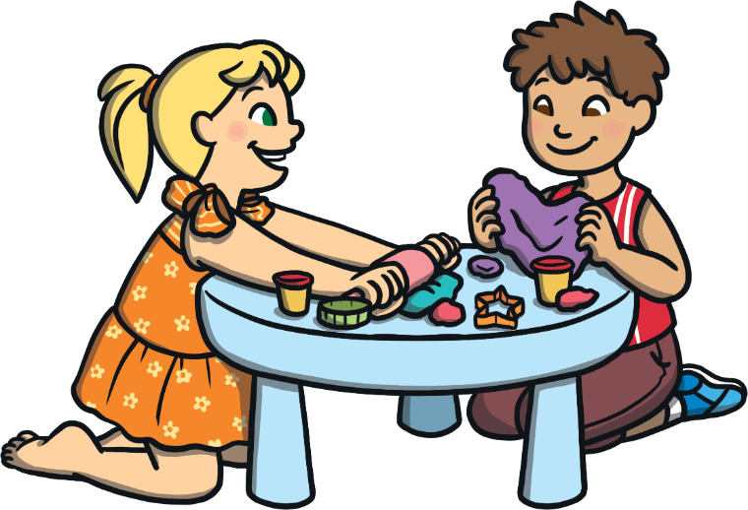
How Do I Feel Today?
Can you think of a time when you have had to ‘go back’ before?
Have you ever gone back home after staying somewhere else?
How did that feel?
Have you ever gone back home after going to play at a friend’s house?
How did that feel?
Have you ever gone back to school after a holiday before?
How did that feel?

Slide 9
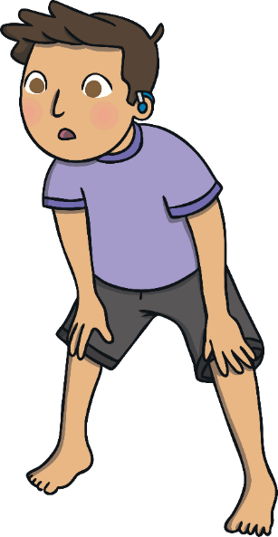
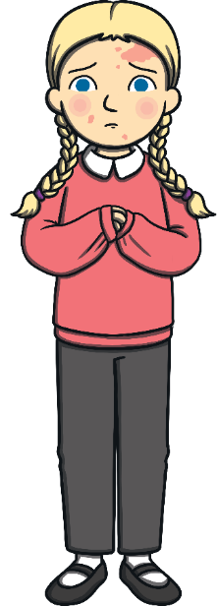
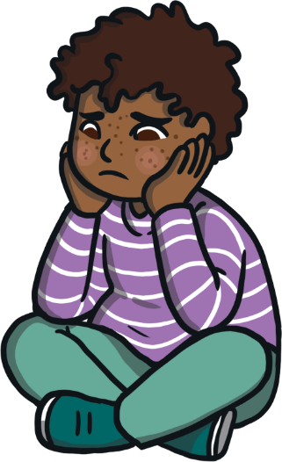
How Do I Feel Today?
Sometimes, coming back after a nice time, or even being used to a different way of living, can feel hard.
You may feel relaxed knowing you are back in school and life feels a bit more ‘normal’ again.
You may feel nervous or worried about things being different at school.
You may feel happy and excited to see your friends.
You may feel tired and sad but not quite know why.
You may feel sad that things are different from before.

Slide 10
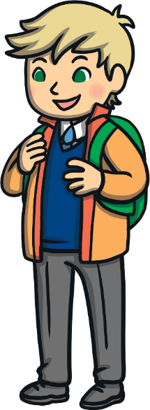
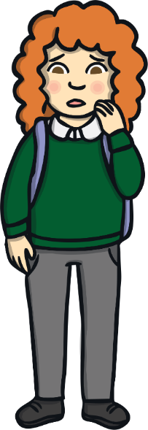
How Do I Feel Today?
We all feel differently when things change. This is because we all have different lives, different homes and different feelings. We are all different people.
Some people may have good feelings about being back at school together and some people might have more tricky feelings. Some people might have a mixture of feelings which might change within a day or from day to day.

Slide 11
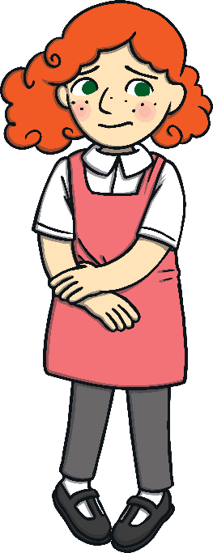
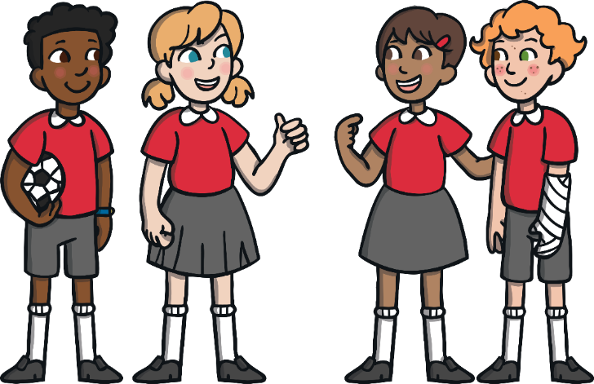
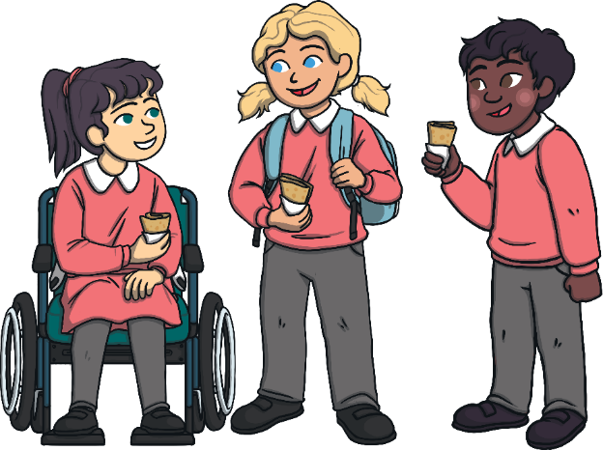
How Do I Feel Today?
No matter how we feel, our feelings are really important. They help us understand what is happening and what we need to do to be OK.
You may feel the same as your friends.
You may feel different from how your friends feel.
What really matters is that we can understand our feelings and know how to find help with them if they feel a bit too tricky or if they are stopping us feeling OK.
This is OK.
This is also OK.

Slide 12
Exploring

Slide 13
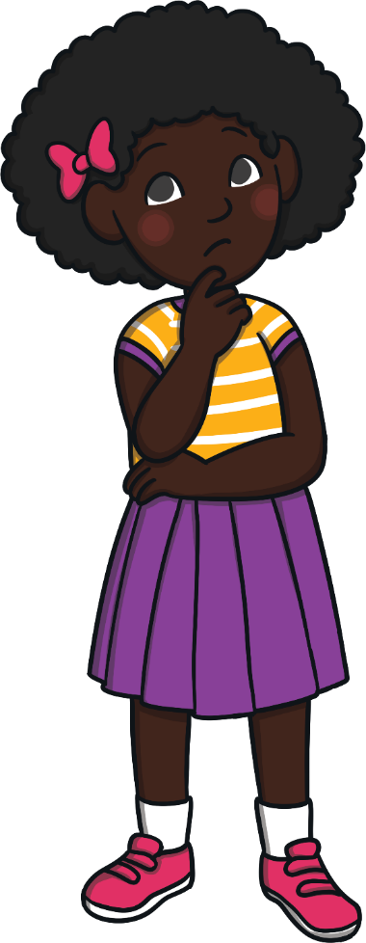
What Does ‘Normal’ Mean?
What do you think the word ‘normal’ means?
Normal means ordinary or usual and that things are as would be expected.
We might feel that even though we are back at school, things are not ordinary. Things may not be usual. Things may be different from expected.
This is because things are a little bit different.
You may have overheard grown-ups talking about ‘getting back to normal’ but you might have noticed that things are a bit different, even though you are back at school.

Slide 14
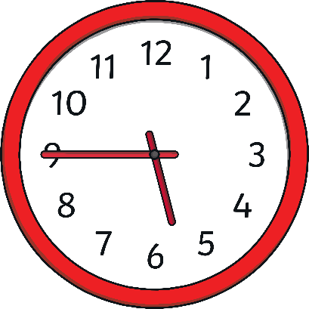
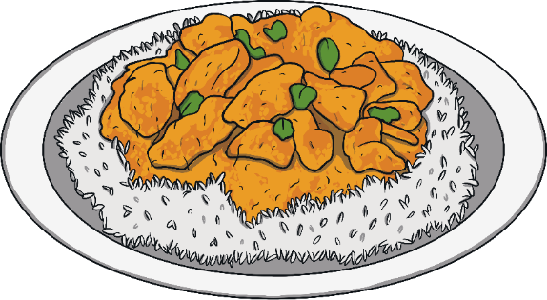
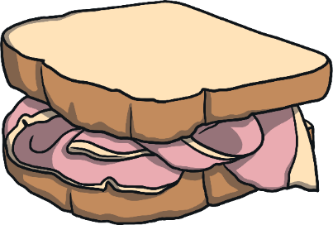
What Does ‘Normal’ Mean?
An example of normal things you do might be the meals you eat.
In the evening, you most likely have an evening meal called dinner or tea.
Every morning, you are likely to have breakfast.
Around midday, you probably have a meal called lunch or dinner.

Slide 15
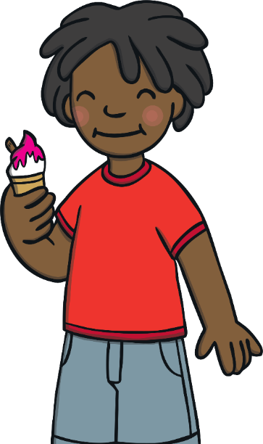
What Does ‘Normal’ Mean?
Are these all normal meals for you? Would you ever have a pudding after breakfast? Why not?
We think things are normal because:
other people tell us it is normal;
and it is what we are used to doing.
If we did have pudding every day after breakfast, we would start to think it was normal. We would think it was strange if other people didn’t do it too.

Slide 16
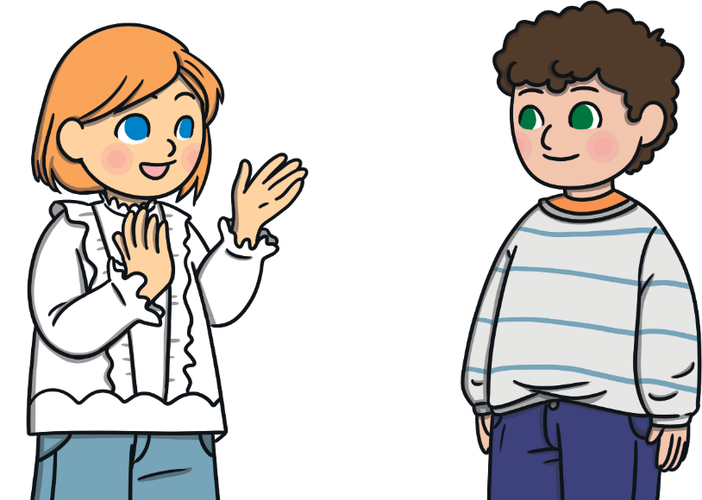
What Does ‘Normal’ Mean?
What feels ‘normal’ to us can change. As humans, we are really good at getting used to these changes but that doesn’t mean they are easy at first.
In pairs, think about how it feels to see and feel change.

Slide 17
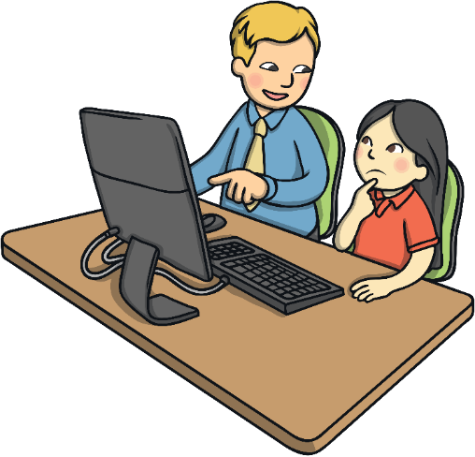
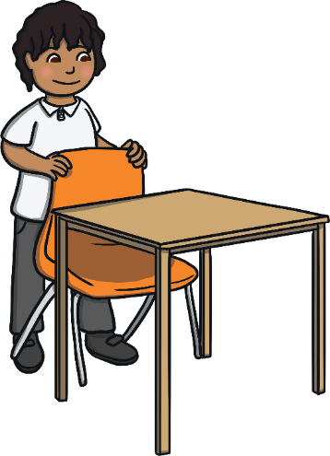
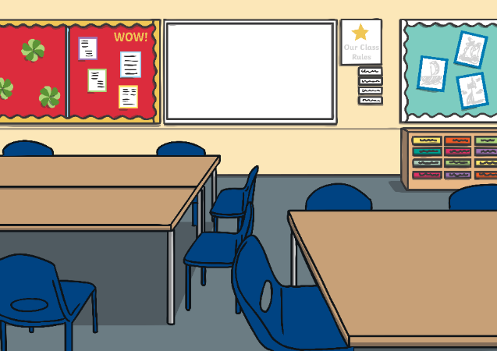
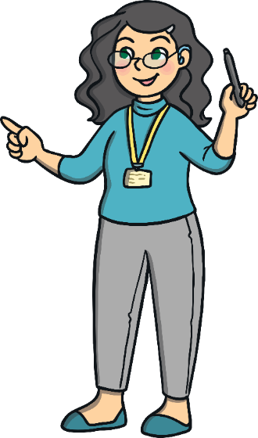
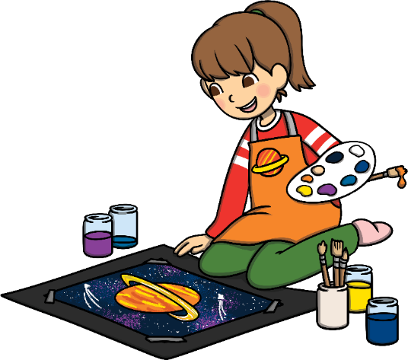
What Does ‘Normal’ Mean?
What we think of as ‘normal’ at school is decided from what we know happened before, what we read in books and what we see on the TV.
Things can change in school and the new things very quickly feel ‘normal’ to us.
Have you ever redecorated at home or at school?
Has there ever been new furniture at home or at school?
Have you had any building work at home or at school?
Has your seat in school ever changed?
Has your classroom in school ever changed?
Have you ever had something change in school or at home that felt strange at first but then became normal?
Has your teacher in school ever changed?

Slide 18
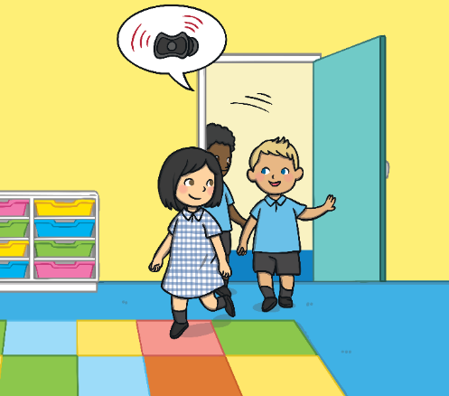
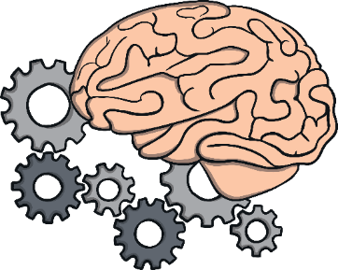
What Does ‘Normal’ Mean?
You may have found, after a holiday, that you have walked to your old classroom after playtime because you have forgotten that you have changed class!
This is because your brain is still getting used to the change.

Slide 19
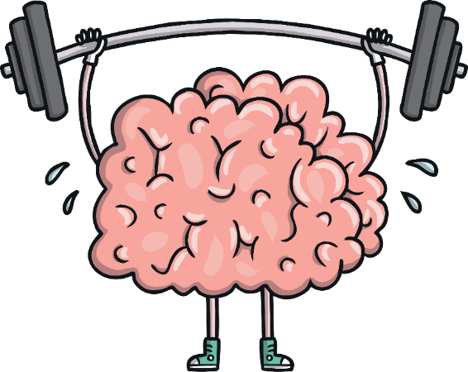
What Does ‘Normal’ Mean?
Our brains are amazing and can help us get used to changes and make the changes quickly feel normal.
Our brains will also look for things that are the same to help us realise that, even when some things have changed, other things are the same.
In pairs, think about things that are the same at school as they used to be.

Slide 20
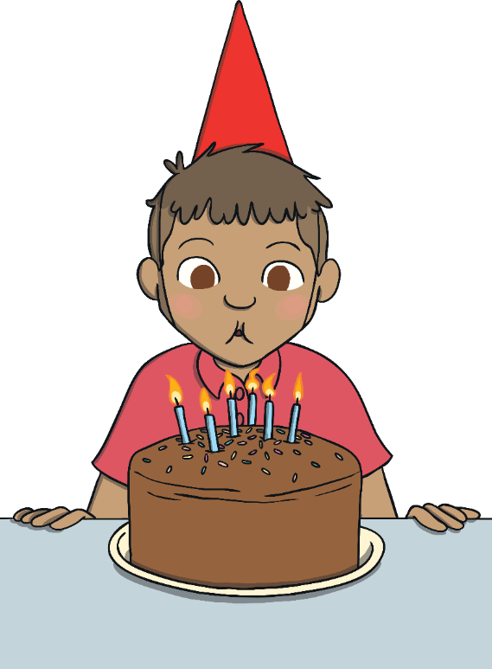
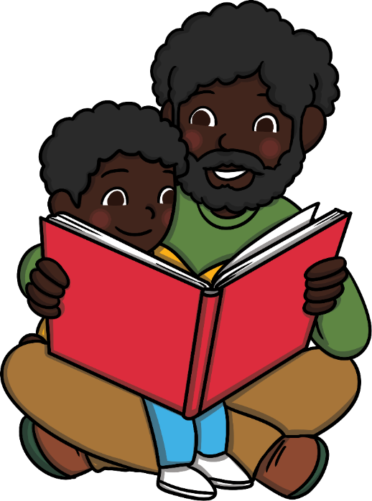
What Makes Me Feel Good?
What makes you feel good?
Both of these things will probably make you feel good.
How do you feel when it is your birthday and you know you are going to have lots of yummy food and get some presents?
How do you feel when you are sat with someone you love and reading a story together?
Are the feelings the same?

Slide 21
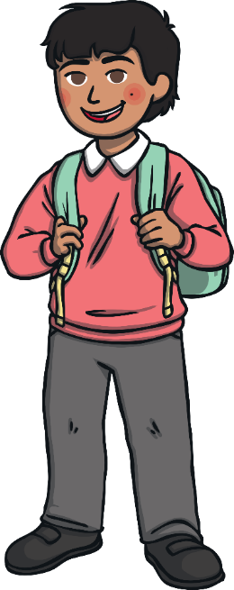
What Makes Me Feel Good?
There are many different ways you can feel good.
Being excited is most definitely a good feeling but it can often be quite a strong feeling. It may make you feel a bit low afterwards or it can be more difficult to make good choices.
Sometimes, people can think that feeling good has to mean being very happy and excited. You might feel that way about being back at school or you might not.
Feeling calm and OK is another good feeling. This feeling might stay with you for a longer amount of time.

Slide 22
What Makes Me Feel Good?
If you feel calm and settled at school, you can still be feeling ‘good’.
You can feel good and stable at school by looking for things that are still the same.
This is called ‘stability’.
Your stability helps you to cope with anything that is new or different.

Slide 23
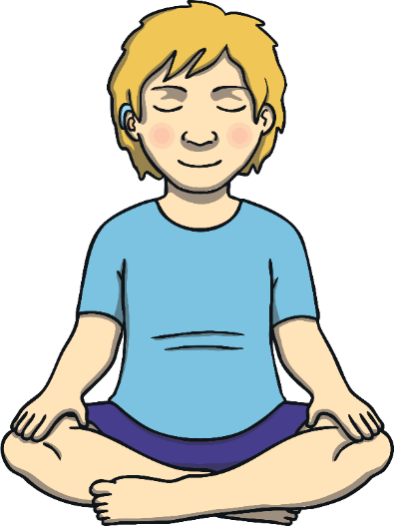
What Makes Me Feel Good?
Close your eyes now and think about all the things that are the same in school. Think about the buildings, the people and the friendships.
If you go slowly when things are changing, and stay focused on the things that are the same, the new things will very quickly begin to feel normal for you.

Slide 24
Consolidating
Reflecting

Slide 25
Consolidating

Slide 26
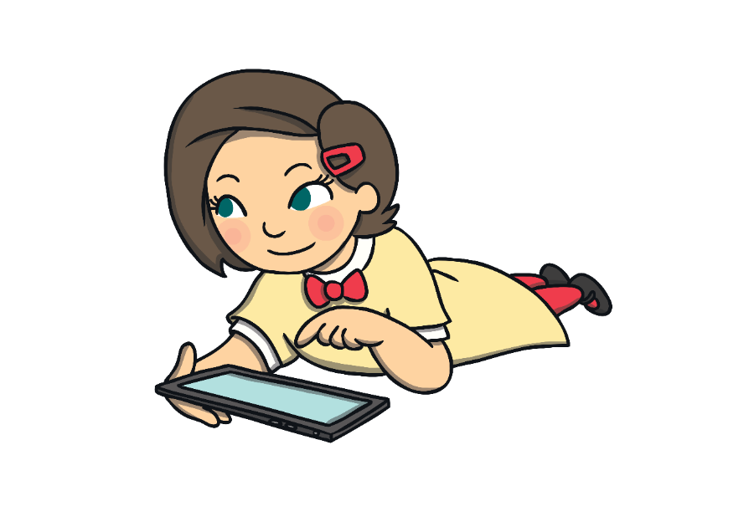
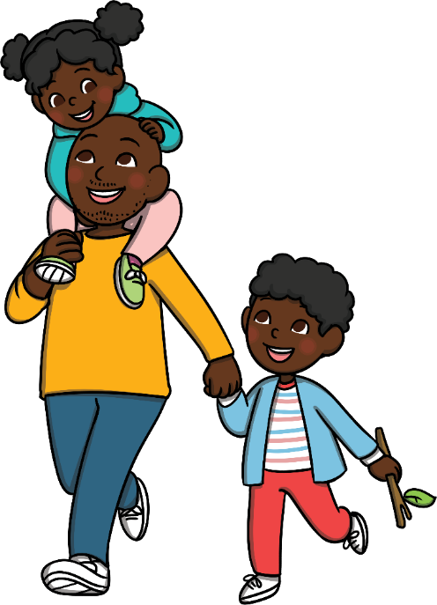
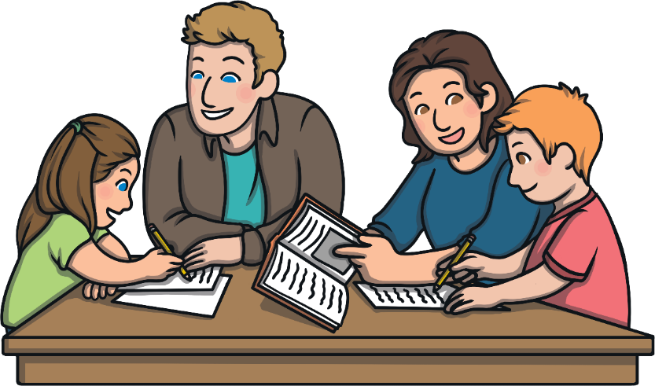
Positive Changes
You may have noticed that some good things have happened recently.
Perhaps you have been going for more walks with your family and found new places to explore.
You might have used a computer to keep in touch with people who live far away.
You might have spent more time with your family.

Slide 27
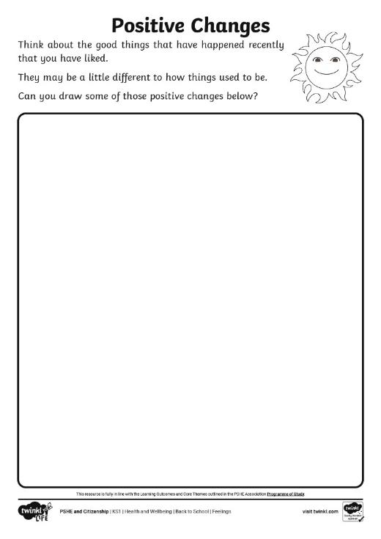
Positive Changes
Using your Positive Changes Activity Sheet, think about some things that have been a bit different but in a good way.
What are you looking forward to doing now that you are back at school?
This will help you to feel good!
Playing together with your friends is a really good way to explore how you are feeling and to help you feel OK.
Things might be a little different but your friends are still your friends and there are still ways you can play.

Slide 28
Reflecting

Slide 29
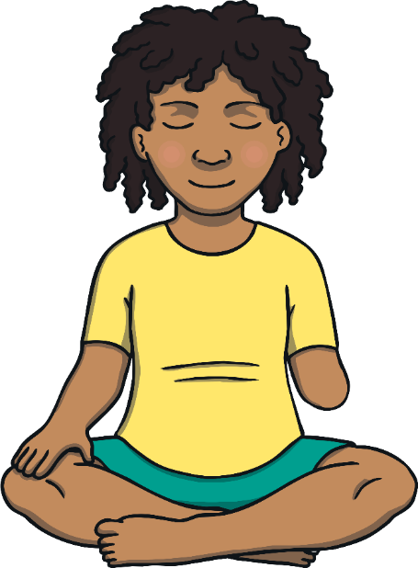
Emotion Boss
Close your eyes and think about one or two words that could be used to explain how you are feeling.
How are you feeling today?
How can you tell what are you are feeling?
Our feelings can sometimes be a bit confusing. We get signs about our feelings through how we think and how our body feels.
Do you think we are all feeling exactly the same at the same time?

Slide 30
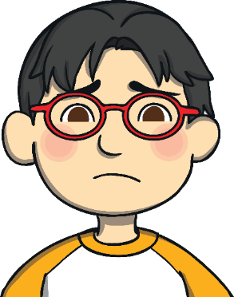
Emotion Boss
You will often have similar feelings in similar situations to your friends but your feelings will never be exactly the same.
We all have slightly different lives at home and we all have our own unique personalities. This means that you may feel differently to someone else, even in the same situation.
Some feelings are comfortable and make you feel good. However, other feelings can make life feel tricky if you aren’t sure what to do with those feelings.

Slide 31
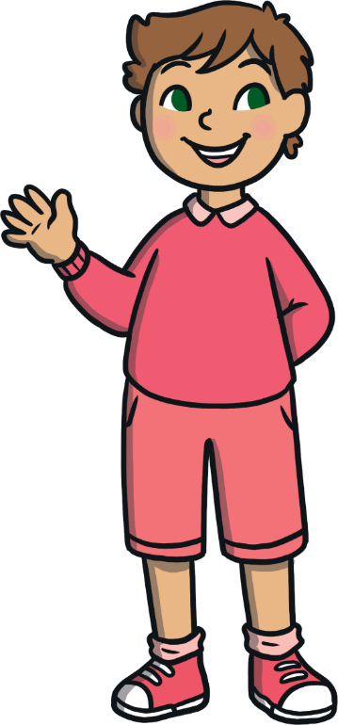
Emotion Boss
Sometimes, it can feel tempting to try and ‘block’ the trickier feelings and pretend you aren’t feeling that way. Doing this doesn’t make the feelings totally go away though and it can make them even trickier.
It is important to be able to understand your own feelings so that you can choose how you want to behave and how to work through them.

Slide 32
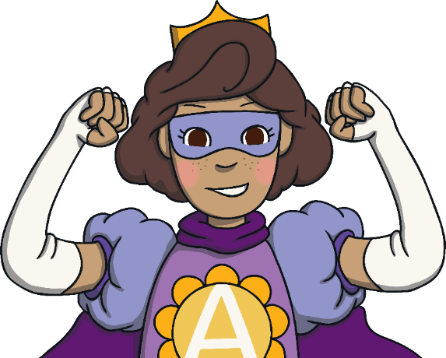
Emotion Boss
Being able to understand your own emotions and feelings is like having a special power.
When you understand how you are feeling, you can focus on that feeling and think about ways you can help with that feeling.
You can also understand why you are thinking or behaving a certain way.
This is being an ‘emotion boss’.
This gives you power and control over your own feelings and helps you to shape how you feel.

Slide 33
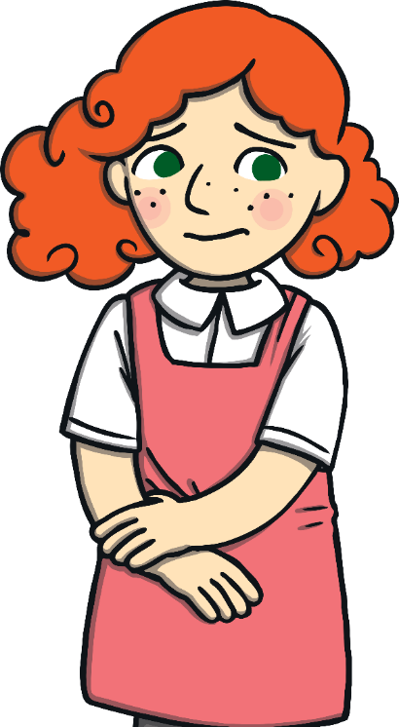
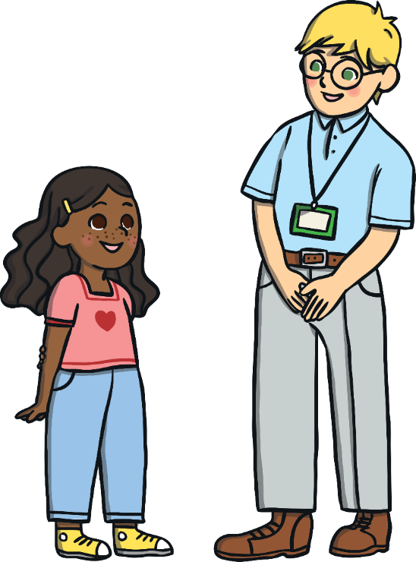
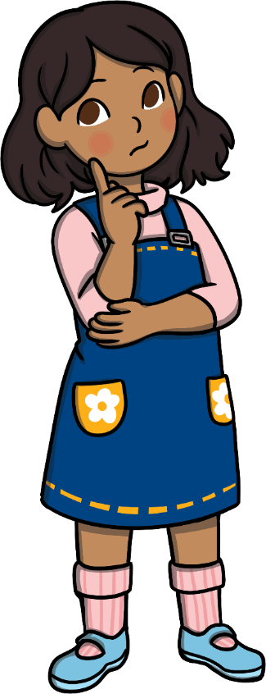
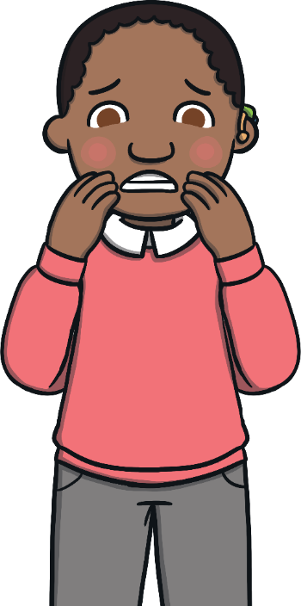
Emotion Boss
1
So, how do you become an emotion boss?
4. Continue to focus on your feelings, even if they are comfortable ones, and recognise how they feel. Make sure you are also there to help your friends with their feelings.
3. Decide how you could get help with your feelings, if you decided you’d like help.
Worrying is making me uncomfortable. I’d like help.
I’m feeling worried.
These steps give you control and power over how your feelings affect you. This control helps you to feel good.
All of your feelings are important and you don’t have to manage the more challenging ones alone. Friends and loved ones are there to help you.
1. Think about the feeling you are having and give it a name.
2. Think about whether this feeling could be helped to feel more comfortable.

Slide 34
The Big Questions

Slide 35
How does change feel?
What can I do to help me feel good?
What have you learnt today?
How will it help you in your daily life?

Slide 36
Aim
I can understand that change can feel tricky and know ways to help me feel better about it.
Success Criteria
I can talk about and understand my feelings.
I can explain why change can feel tricky and how to get support with this.
I can explain how to be in charge of my feelings and decide how I react or respond to them.
This resource is fully in line with the Learning Outcomes and Core Themes outlined in the PSHE Association’s Programme of Study.

