Slide 1
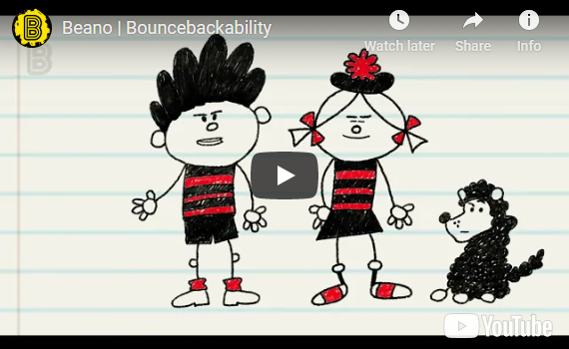
BOUNCEBACKABILITY
2. Being Brave

Slide 2
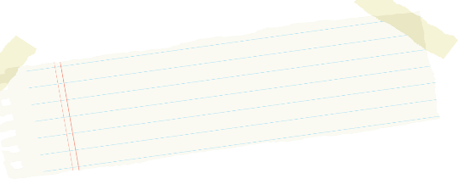


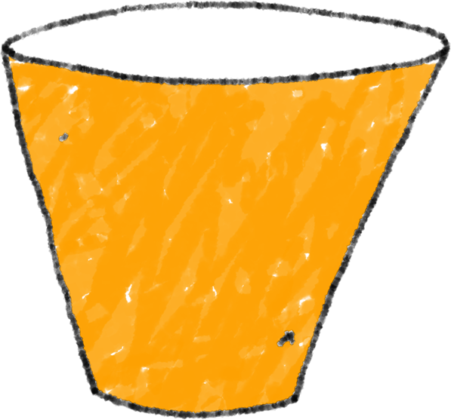
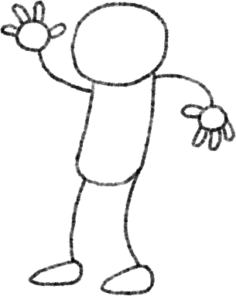
In your groups, you will be designing your own resilient superhero!
What helps make someone brave?
What powers will your superhero have that will make him or her brave?
Bounce-back-ability?
Have a look at the following pictures and see if they give you ideas….

Slide 3


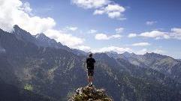
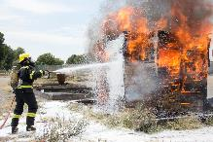

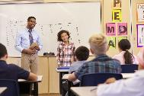

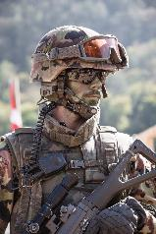

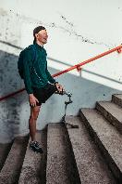


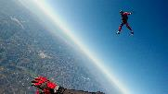
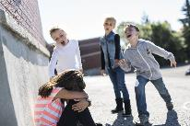
Which of these people do you think is brave?
What makes them brave?

Slide 4



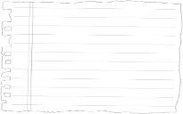



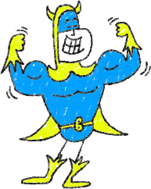





What makes people brave?
My Brave Superhero:
Knows others
care for them.
Believes in themselves.
Is willing to try new things
and aim high.
Sometimes still gets scared and worried but that wont stop him!
Knows what they’re good at and makes the most of it.
Understands the things they’re not so good at but does not let this hold them back.
Asks for help if needed and knows they’re
not alone.
Feels good about themselves.

Slide 5

We all find some things difficult and will all feel sad, scared or worried at times.
Being brave and picking ourselves up again is an important skill that will help us hugely when times are tough.
There’s a word to describe this idea of ‘bouncing back’ and not letting things get us down….does anybody know it?
Let’s guess the word!
R_ _ I_ _ _ N_ _

Slide 6
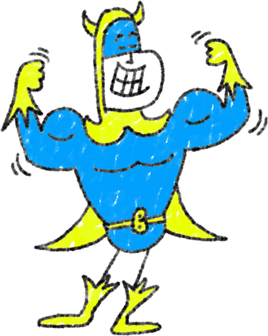
What can help you to show bravery and resilience at school?

Slide 7

WELL DONE!

