Slide 1
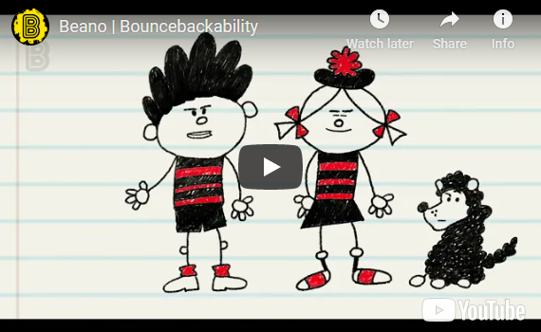
BOUNCEBACKABILITY
3. Managing Difficult Emotions

Slide 2



Alphabet Emotions!
A __________________
B __________________
C __________________
D __________________
E __________________
F __________________
G __________________
H __________________
I __________________
J __________________
K __________________
L __________________
M __________________
N __________________
O __________________
P __________________
Q __________________
R __________________
S __________________
T __________________
U __________________
V __________________
W __________________
X __________________
Y __________________
Z __________________

Slide 3

Emotion Scenarios
Check out the following situations and try to act out how you would feel in each one. Think about your face as well as your body language.

Slide 4
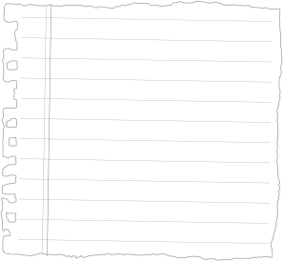


You went up a reading level.
?

Slide 5

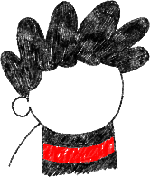
Someone in your class is having a big, exciting birthday party.
You are not invited.
?

Slide 6


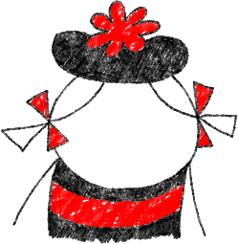
You are not allowed to play until your room is tidy.
?

Slide 7
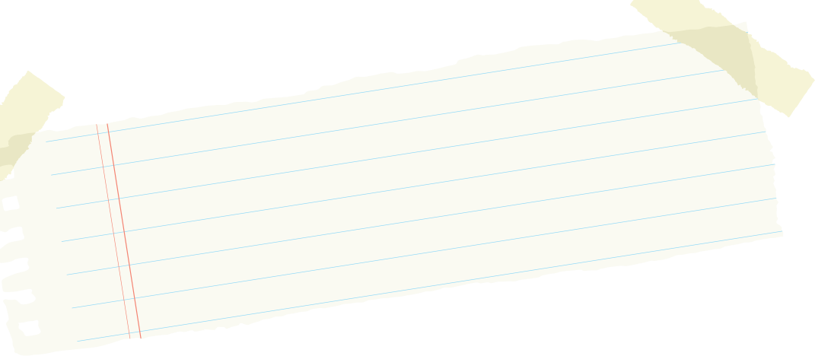

You lost your favourite toy in the playground. You think someone might have stolen it.
?

Slide 8



The school holidays
begin tomorrow!
?

Slide 9

Your best friend has made another friend.
They play together at playtime but don’t want you to join in.
?

Slide 10

You tried really hard but still got lots of spellings wrong in your test.
?

Slide 11


You have to read a poem in your class assembly
and the whole school
will be watching.
?

Slide 12


Your friend tells you they are moving
to another school.
?

Slide 13

Someone nudges you and now your painting is ruined.
?

Slide 14


A person who you know
is a bully is walking towards you in the corridor.
?

Slide 15

Your best friend got picked to be the main part in the school play.
You had been hoping you would be picked.
?

Slide 16
Often we can feel lots of different emotions at the same time.
Can anyone think of any example from the scenarios when they might have felt more than one emotion?
You might feel a little cross at the teachers for not picking you.
You could feel jealous of your friend.
Your best friend got picked to be the main part in the school play.
You had been hoping you would be picked.
You might feel excited for your friend.
You might feel sad not to have been picked.
You might feel embarrassed because everyone knew you wanted that part.

Slide 17
Now think about the scenarios you acted out…
Rather than feeling sad, angry, jealous, frustrated or any of the other negative feelings you just acted out, could we behave differently so that we feel better?
For example, instead of feeling angry and getting upset, how could you react to this situation…?
‘You’ve hurt your leg and can’t take part in your favourite sport anymore’.

Slide 18
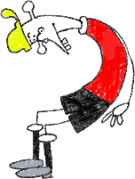
With your partner or group, look at the scenario you’ve been given.
What would be the best way to react, so that it is the nicest situation it can be for you and those around you?

Slide 19

WELL DONE!

