Slide 1
Anti-Bullying Week 2020 Primary Lesson PPT

Slide 2
Is this bullying?
The ABA (Anti-Bullying Alliance) defines bullying as:
The repetitive, intentional hurting of one person or group by another person or group, where the relationship involves an imbalance of power.
Bullying can be physical, verbal or psychological.
It can happen face-to-face or online.
Notes:
ABA definition of bullying. Very important that we have a shared understanding of what bullying is. You could replace with your own school definition.

Slide 3
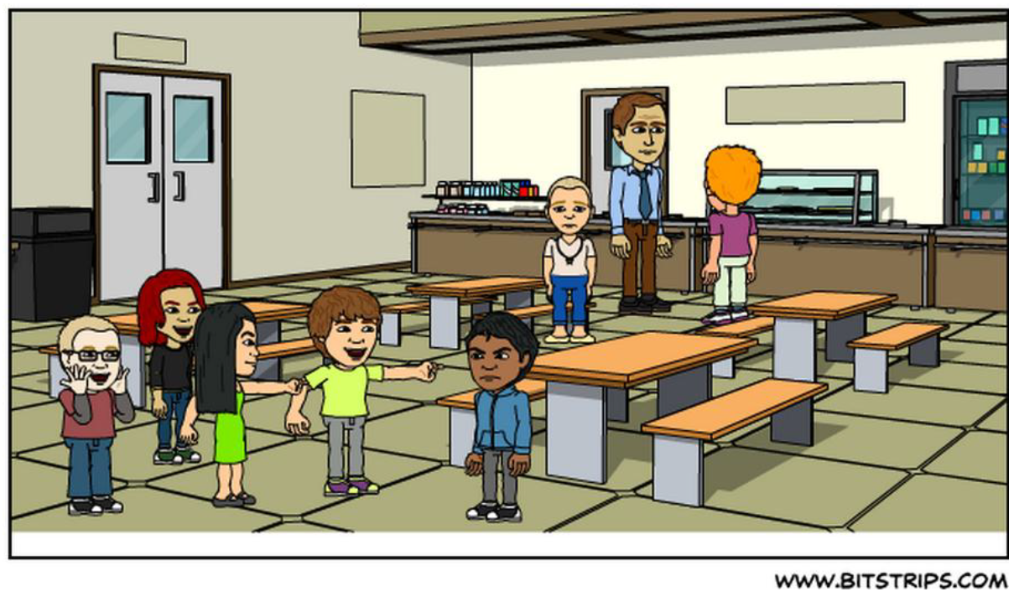
What is happening?
What can you see in this picture?
What do you think is happening here?
How do you think the children in the picture are feeling?

Slide 4
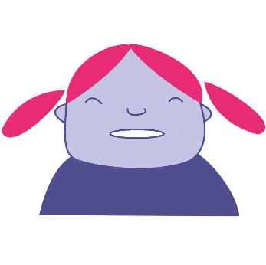
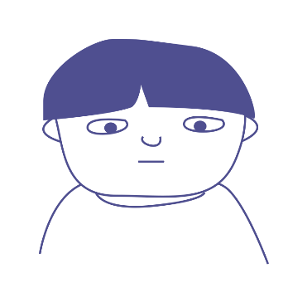
Bullying as a group behaviour
The ringleader (Bully) - Initiating and leading the bullying but not always the person ‘doing’ the bullying.
The target - The person at whom the bullying is aimed.
‘Ringleader’
‘Target’
Notes:
There is a target (some call that individual a ‘victim’) and a ringleader (some call that individual a ‘bully’). That ringleader does majority of the bullying activity and leads on it.
But there are other key roles that are important to be aware of.
Based on Salmivalli et al The Participant Role Scale. In: Cowie, H. and Wallace, P. Peer Support in Action: From Bystanding to Standing By. © Sage 2000.

Slide 5
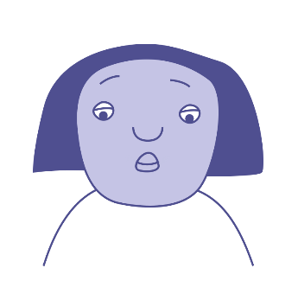
Bullying as a group behaviour
Reinforcer(s) - Supports the bullying, might laugh or encourage other people to ‘collude’ with what is going on.
‘Ringleader’
‘Target’
‘Reinforcer’
Notes:
There is also a group we call ‘reinforcers‘. They give power to the ringleader. They may not get involved directly in bullying but they incite the ‘ringleader’ and gather others to see what is happening.
They may laugh along with the bullying and give the ‘ringleader’ encouragement.
Based on Salmivalli et al The Participant Role Scale. In: Cowie, H. and Wallace, P. Peer Support in Action: From Bystanding to Standing By. © Sage 2000.

Slide 6
Bullying as a group behaviour
Assistant(s) - Actively involved in ‘doing’ the bullying.
‘Ringleader’
‘Target’
‘Reinforcer’
‘Assistant’
Notes:
Then there are Assistants. The ‘assistant’ joins in with the bullying even though someone else has started it, and provides physical or other assistance to the ‘ringleader’.
Based on Salmivalli et al The Participant Role Scale. In: Cowie, H. and Wallace, P. Peer Support in Action: From Bystanding to Standing By. © Sage 2000.

Slide 7
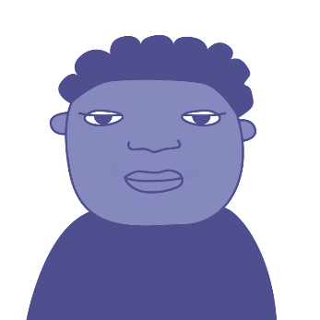
Bullying as a group behaviour
Defender(s) - Stands up for someone being bullied. Knows that bullying is wrong and feels confident enough to do something about it. This might involve talking to an adult in school.
‘Ringleader’
‘Target’
‘Reinforcer’
‘Defender’
‘Assistant’
Notes:
Then there are a group called ‘defenders’. The ‘defender’ supports and defends the ‘target’. They may do this openly by confronting the ringleader but may also do this more covertly for example, by telling a teacher or calling into question the power of the ‘ringleader’ with the ‘reinforcer’ and ‘assistant’. They may also provide friendship and encouragement to the ‘target’ empowering them to ‘say no’ to the bullying happening to them.
Based on Salmivalli et al The Participant Role Scale. In: Cowie, H. and Wallace, P. Peer Support in Action: From Bystanding to Standing By. © Sage 2000.

Slide 8
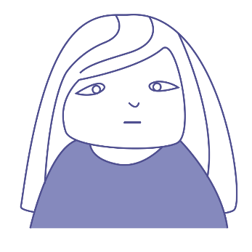
Bullying as a group behaviour
‘Ringleader’
‘Target’
‘Reinforcer’
‘Outsider’
Outsider(s) - Ignores any bullying and doesn’t want to get involved.
‘Defender’
‘Assistant’
Notes:
Finally, on the periphery of the bullying incident is the group called ‘outsiders’. An ‘outsider’ stays removed from the bullying situation and either pretends not to notice or really isn’t aware of what is happening. The ‘outsider’ does nothing about the bullying.
Based on Salmivalli et al The Participant Role Scale. In: Cowie, H. and Wallace, P. Peer Support in Action: From Bystanding to Standing By. © Sage 2000.

Slide 9
Bullying as a group behaviour
The ringleader – Starting and leading the bullying but not always the person ‘doing’ the bullying.
The target - The person who is being bullied.
Assistant(s) - Actively involved in ‘doing’ the bullying.
Reinforcer(s) - Supports the bullying, might laugh or encourage other people to carry on what is going on.
Defender(s) - Stands up for someone being bullied. Knows that bullying is wrong and feels confident enough to do something about it. This might involve talking to an adult in school.
Outsider(s) - Ignores any bullying and doesn’t want to get involved.
‘Ringleader’
‘Target’
‘Reinforcer’
‘Outsider’
‘Defender’
‘Assistant’
Notes:
Here is a round up of all the roles.
Based on Salmivalli et al The Participant Role Scale. In: Cowie, H. and Wallace, P. Peer Support in Action: From Bystanding to Standing By. © Sage 2000.

Slide 10
United against bullying
We must stand united against bullying in order to make change. Do you agree/disagree?
What changes do we need to make in order to unite against bullying?

Slide 11
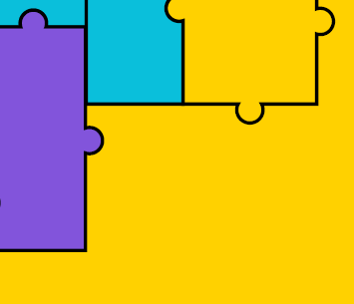
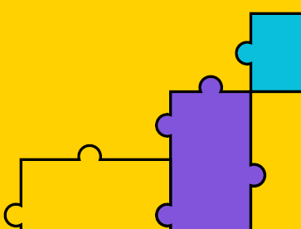
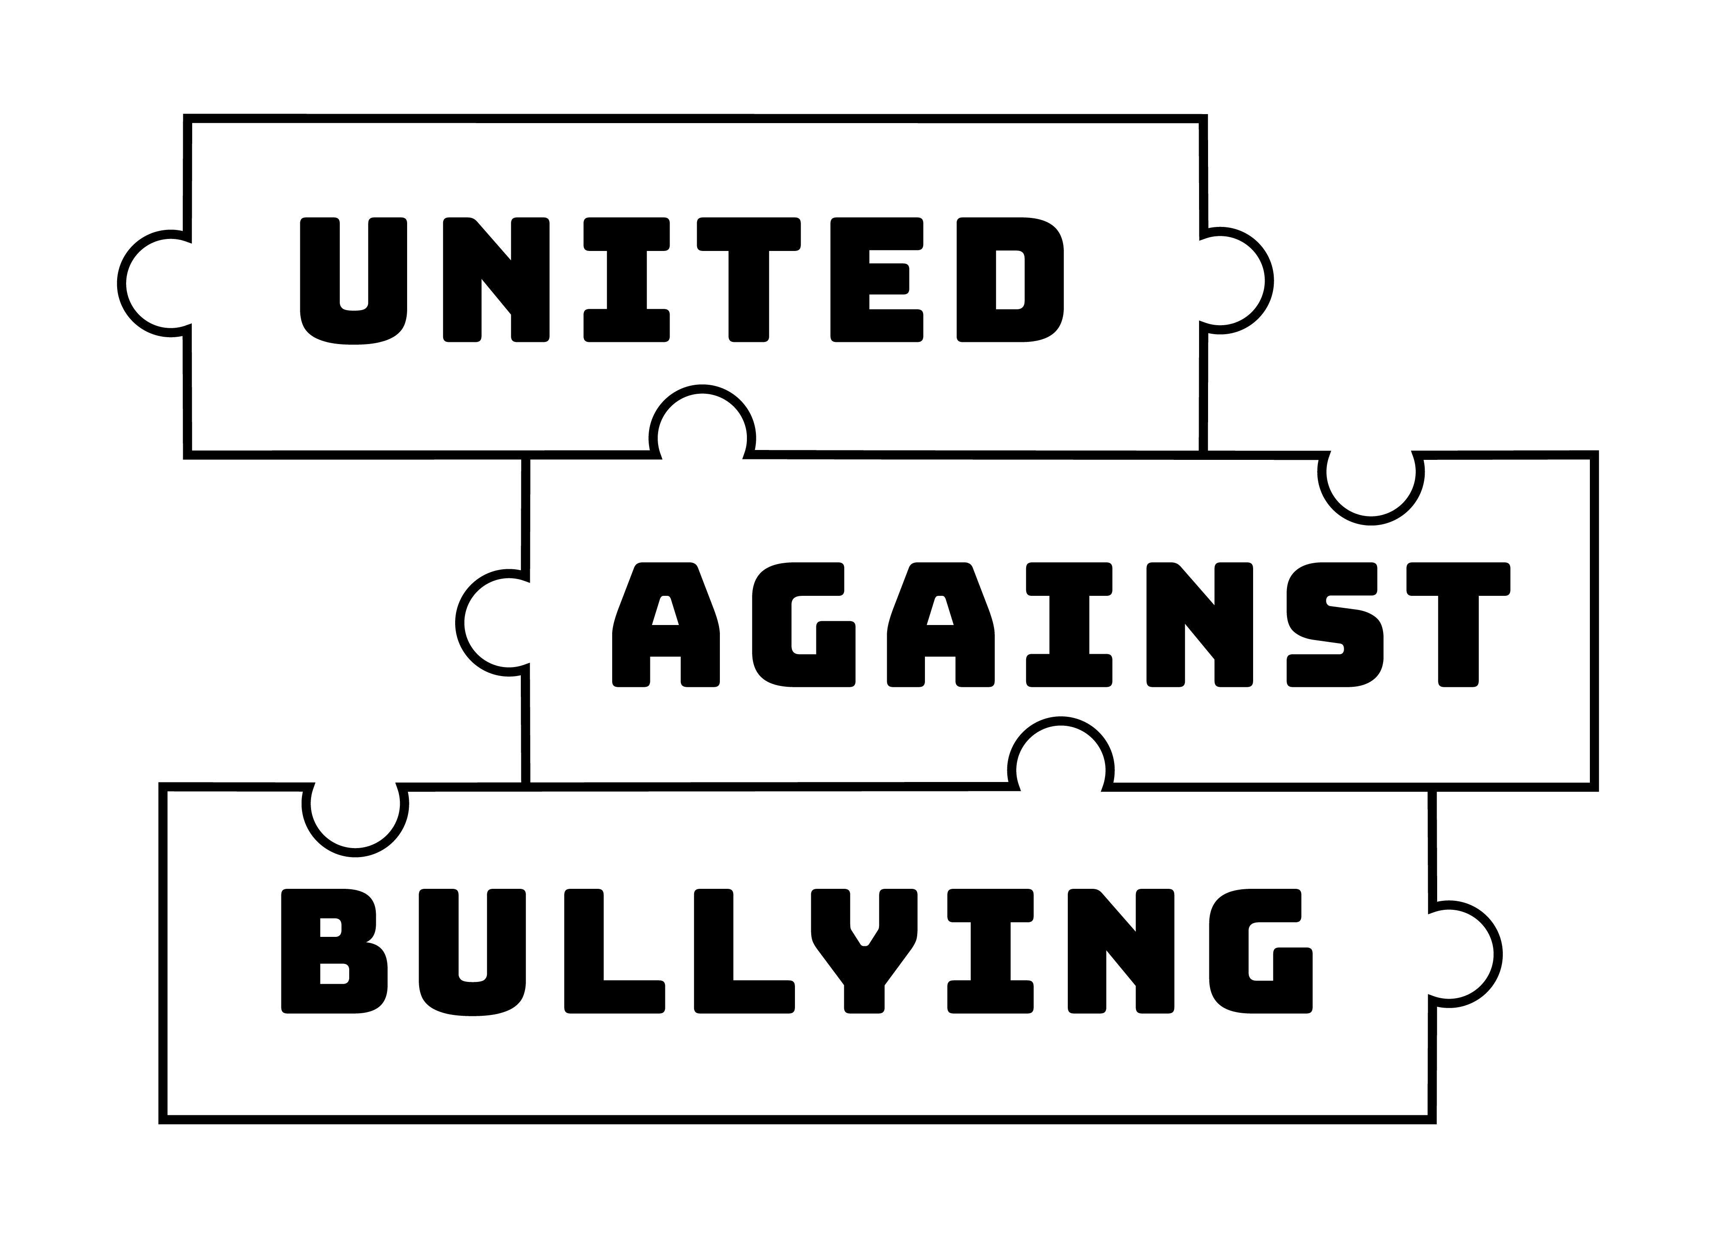
What do we already do?

Slide 12
United against bullying
Does it go beyond school / teachers / students?
Are we all doing everything we can?
What more could we do?

Slide 13
What part will you play?

Slide 14
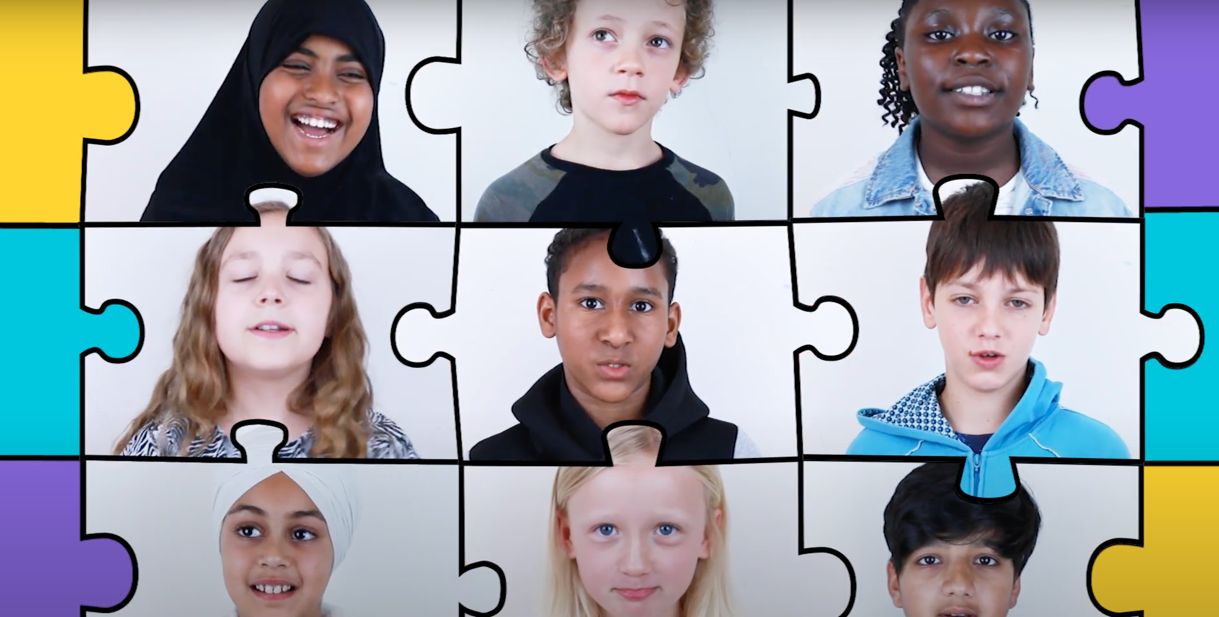
Film slide
https://youtu.be/e8e7NRIk4AA

Slide 15
Thank you for watching - anti-bullyingalliance.org.uk

