Slide 1
Anti-Bullying Week 2020 Secondary Assembly PPT

Slide 2
Anti-Bullying Week 2020: United Against Bullying
This year, more than ever, we’ve witnessed the positive power that society can have when we come together to tackle a common challenge.
Anti-Bullying Week is no different. Bullying has a long lasting effect on those who experience and witness it. But by channelling our collective power, through shared efforts and shared ambitions, we can reduce bullying together. From parents and carers, to teachers and politicians, to children and young people, we all have our part to play in coming together to make a difference.
We are all a piece in the puzzle, and together, we are united against bullying.
Notes:
See page 12 in their packs
ABA definition of bullying. Very important that we have a shared understanding of what bullying is to start the day. We will discuss later why it is important that a setting has a shared definition that is understood by everyone.
There are many widely-used definitions of bullying but no single legal one.
It is also useful here to bring in the concept of bullying usually being a group behaviour which you are going to come back to in later slides.

Slide 3
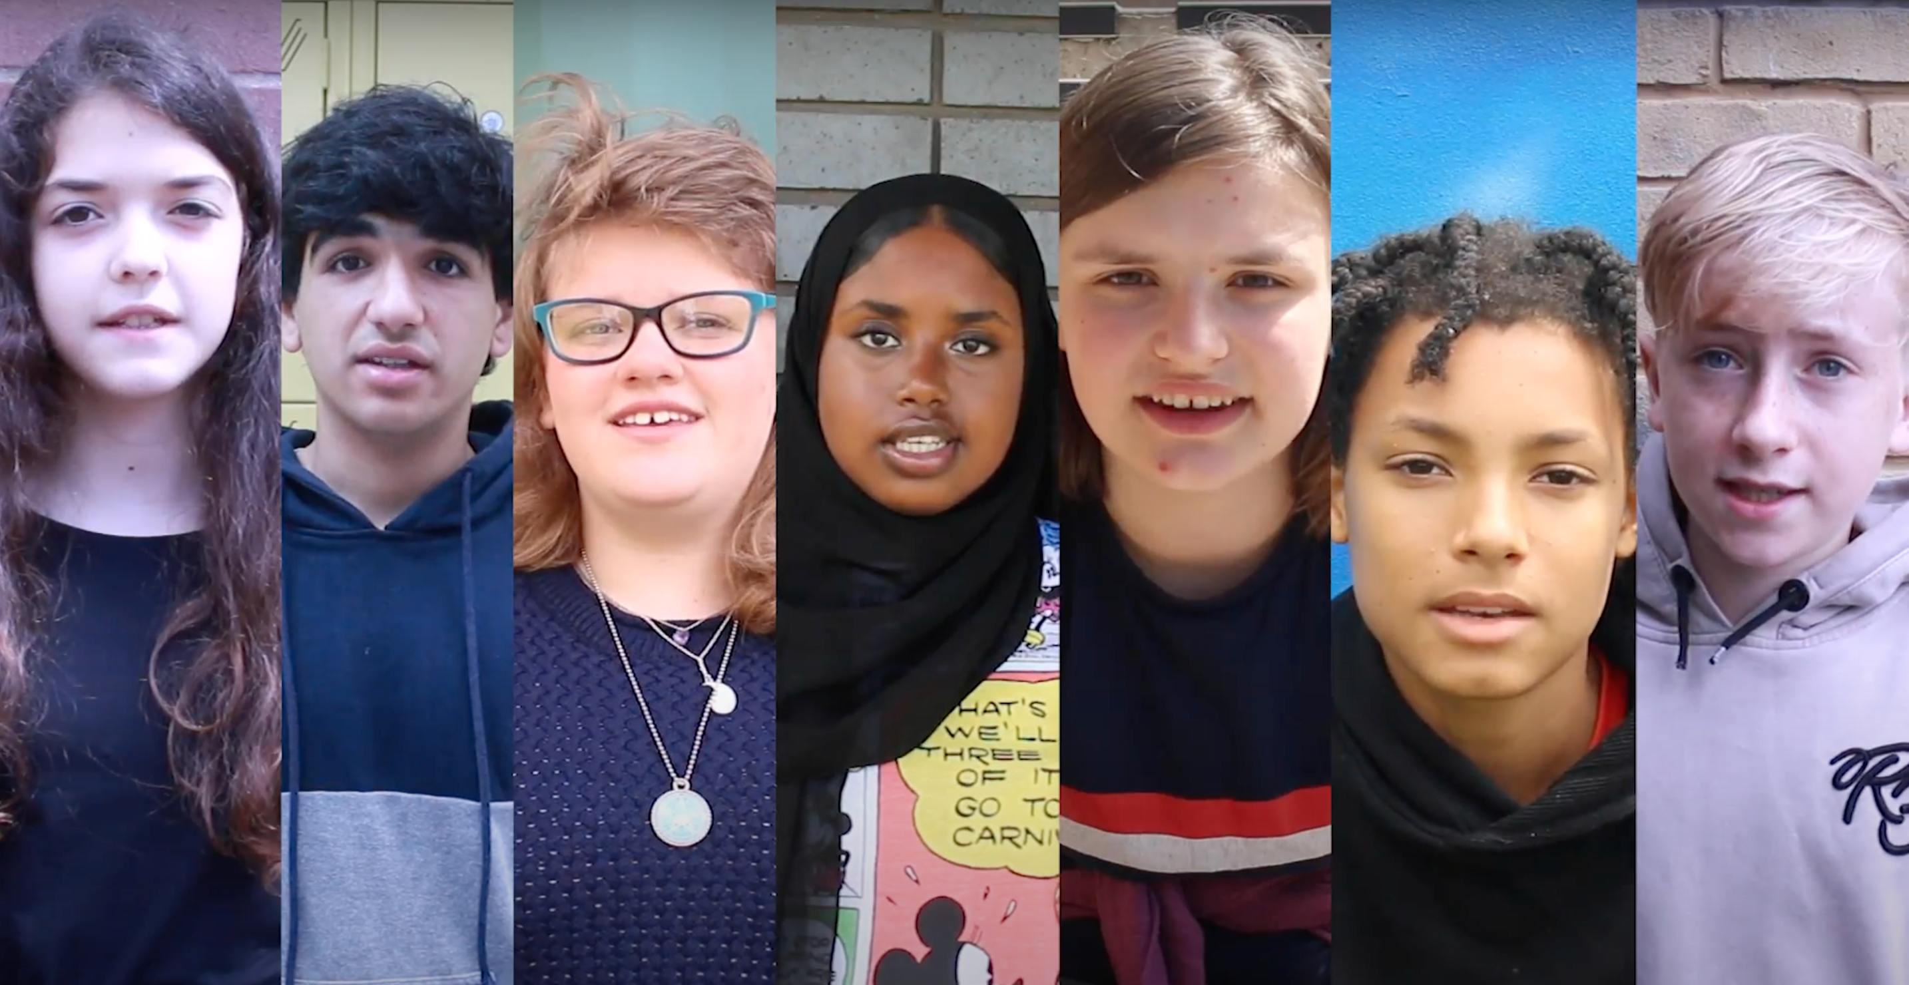
Official Film
LINK
https://youtu.be/DOeRmP3XRHg
Notes:
The film is 2 minutes long and can be found on YouTube. It has subtitles. We would advise you to watch the film before showing it to your students.

Slide 4
Thank you for watching - anti-bullyingalliance.org.uk

