Slide 1
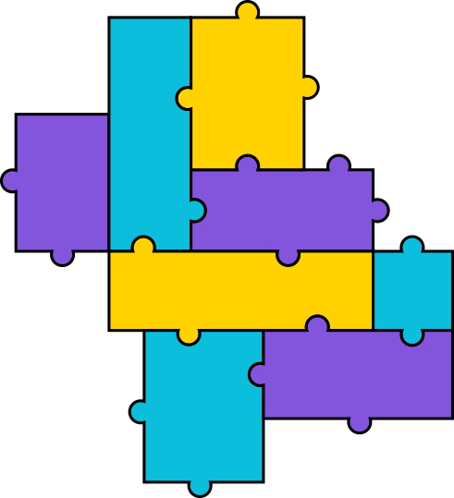


Anti-Bullying Week 2020
Secondary Lesson PPT

Slide 2

Is this bullying?
The ABA (Anti-Bullying Alliance) defines bullying as:
The repetitive, intentional hurting of one person or group by another person or group, where the relationship involves an imbalance of power.
Bullying can be physical, verbal or psychological.
It can happen face-to-face or online.
Notes:
ABA definition of bullying. Very important that we have a shared understanding of what bullying is. You may want to replace with your own definition.

Slide 3
Is it bullying?
Luke spits into a can of cola and says he will make
Ade drink it.
Priti posted a video to TikTok of herself doing a dance challenge. Someone in her class screenshot it and shared it on their Instagram and on What’s App groups and lots of other students sent unkind comments about it
Each time Grace walks into a room a group of other children giggle and whisper to each other.
Repetitive
Intentional
Hurtful
Imbalance of power
Can be physical, verbal or psychological.
Can happen face-to-face or online
Bullying?
Not bullying?
Need more information?
Notes:
Quick quiz to do in groups or as a whole. Run through all the four elements of bullying
All the answers you would need more information however there are some key messages:
Luke – probably not bullying as not repetitive but that doesn’t mean it should be not taken seriously. However it is rare that this should happen in isolation so you would need more information
Priti – yes bullying
Grace – Potentially bullying as it’s repetitive, hurtful and involves a power imbalance however we don’t know for sure it’s intentional.

Slide 4
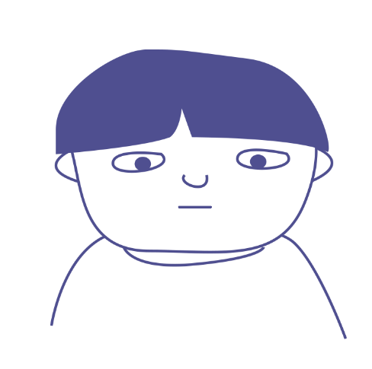
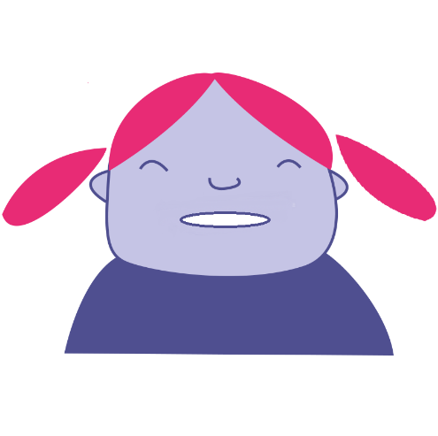
The traditional view
what happened
Find out
and sort it out
“Victim”
“Bully”
Notes:
The traditional view of responding to bullying incidents in schools is that you have a ‘Bully’ and a ‘victim’ role. You find out what happened and sort it out.
But research shows that it’s actually much more complicated than that.

Slide 5

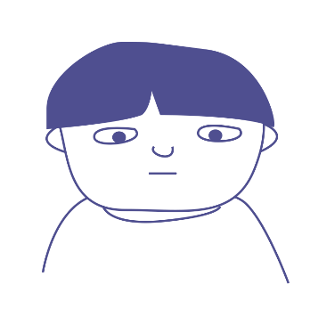
Bullying as a group behaviour
The ringleader (Bully) - Initiating and leading the bullying but not always the person ‘doing’ the bullying.
The target - The person at whom the bullying is aimed.
‘Ringleader’
‘Target’
Notes:
There is a target (some call that individual a ‘victim’) and a ringleader (some call that individual a ‘bully’). That ringleader does majority of the bullying activity and leads on it.
But there are other key roles that are important to be aware of.
Based on Salmivalli et al The Participant Role Scale. In: Cowie, H. and Wallace, P. Peer Support in Action: From Bystanding to Standing By. © Sage 2000.

Slide 6
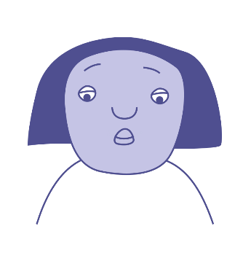
Bullying as a group behaviour
Reinforcer(s) - Supports the bullying, might laugh or encourage other people to ‘collude’ with what is going on.
‘Ringleader’
‘Target’
‘Reinforcer’
Notes:
There is also a group we call ‘reinforcers‘. They give power to the ringleader. They may not get involved directly in bullying but they incite the ‘ringleader’ and gather others to see what is happening.
They may laugh along with the bullying and give the ‘ringleader’ encouragement.
Based on Salmivalli et al The Participant Role Scale. In: Cowie, H. and Wallace, P. Peer Support in Action: From Bystanding to Standing By. © Sage 2000.

Slide 7
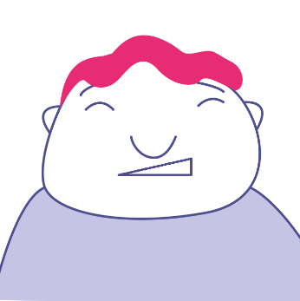
Bullying as a group behaviour
Assistant(s) - Actively involved in ‘doing’ the bullying.
‘Ringleader’
‘Target’
‘Reinforcer’
‘Assistant’
Notes:
Then there are Assistants. The ‘assistant’ joins in with the bullying even though someone else has started it, and provides physical or other assistance to the ‘ringleader’.
Based on Salmivalli et al The Participant Role Scale. In: Cowie, H. and Wallace, P. Peer Support in Action: From Bystanding to Standing By. © Sage 2000.

Slide 8
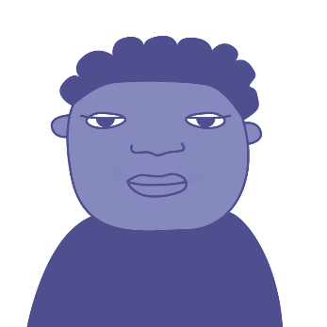
Bullying as a group behaviour
Defender(s) - Stands up for someone being bullied. Knows that bullying is wrong and feels confident enough to do something about it. This might involve talking to an adult in school.
‘Ringleader’
‘Target’
‘Reinforcer’
‘Defender’
‘Assistant’
Notes:
Then there are a group called ‘defenders’. The ‘defender’ supports and defends the ‘target’. They may do this openly by confronting the ringleader but may also do this more covertly for example, by telling a teacher or calling into question the power of the ‘ringleader’ with the ‘reinforcer’ and ‘assistant’. They may also provide friendship and encouragement to the ‘target’ empowering them to ‘say no’ to the bullying happening to them.
Based on Salmivalli et al The Participant Role Scale. In: Cowie, H. and Wallace, P. Peer Support in Action: From Bystanding to Standing By. © Sage 2000.

Slide 9
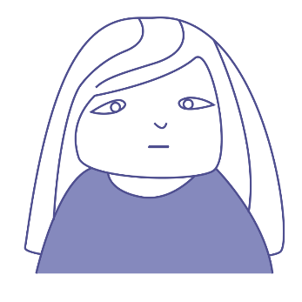
Bullying as a group behaviour
‘Ringleader’
‘Target’
‘Reinforcer’
‘Outsider’
Outsider(s) - Ignores any bullying and doesn’t want to get involved.
‘Defender’
‘Assistant’
Notes:
Finally, on the periphery of the bullying incident is the group called ‘outsiders’. An ‘outsider’ stays removed from the bullying situation and either pretends not to notice or really isn’t aware of what is happening. The ‘outsider’ does nothing about the bullying.
Based on Salmivalli et al The Participant Role Scale. In: Cowie, H. and Wallace, P. Peer Support in Action: From Bystanding to Standing By. © Sage 2000.

Slide 10
Bullying as a group behaviour
The ringleader – Starting and leading the bullying but not always the person ‘doing’ the bullying.
The target - The person who is being bullied.
Assistant(s) - Actively involved in ‘doing’ the bullying.
Reinforcer(s) - Supports the bullying, might laugh
or encourage other people to carry
on what is going on.
Defender(s) - Stands up for
someone being bullied. Knows
that bullying is wrong and feels
confident enough to do something
about it. This might involve talking
to an adult in school.
Outsider(s) - Ignores any bullying and
doesn’t want to get involved.
‘Ringleader’
‘Target’
‘Reinforcer’
‘Outsider’
‘Defender’
‘Assistant’
Notes:
Here is a round up of all the roles.
Based on Salmivalli et al The Participant Role Scale. In: Cowie, H. and Wallace, P. Peer Support in Action: From Bystanding to Standing By. © Sage 2000.

Slide 11
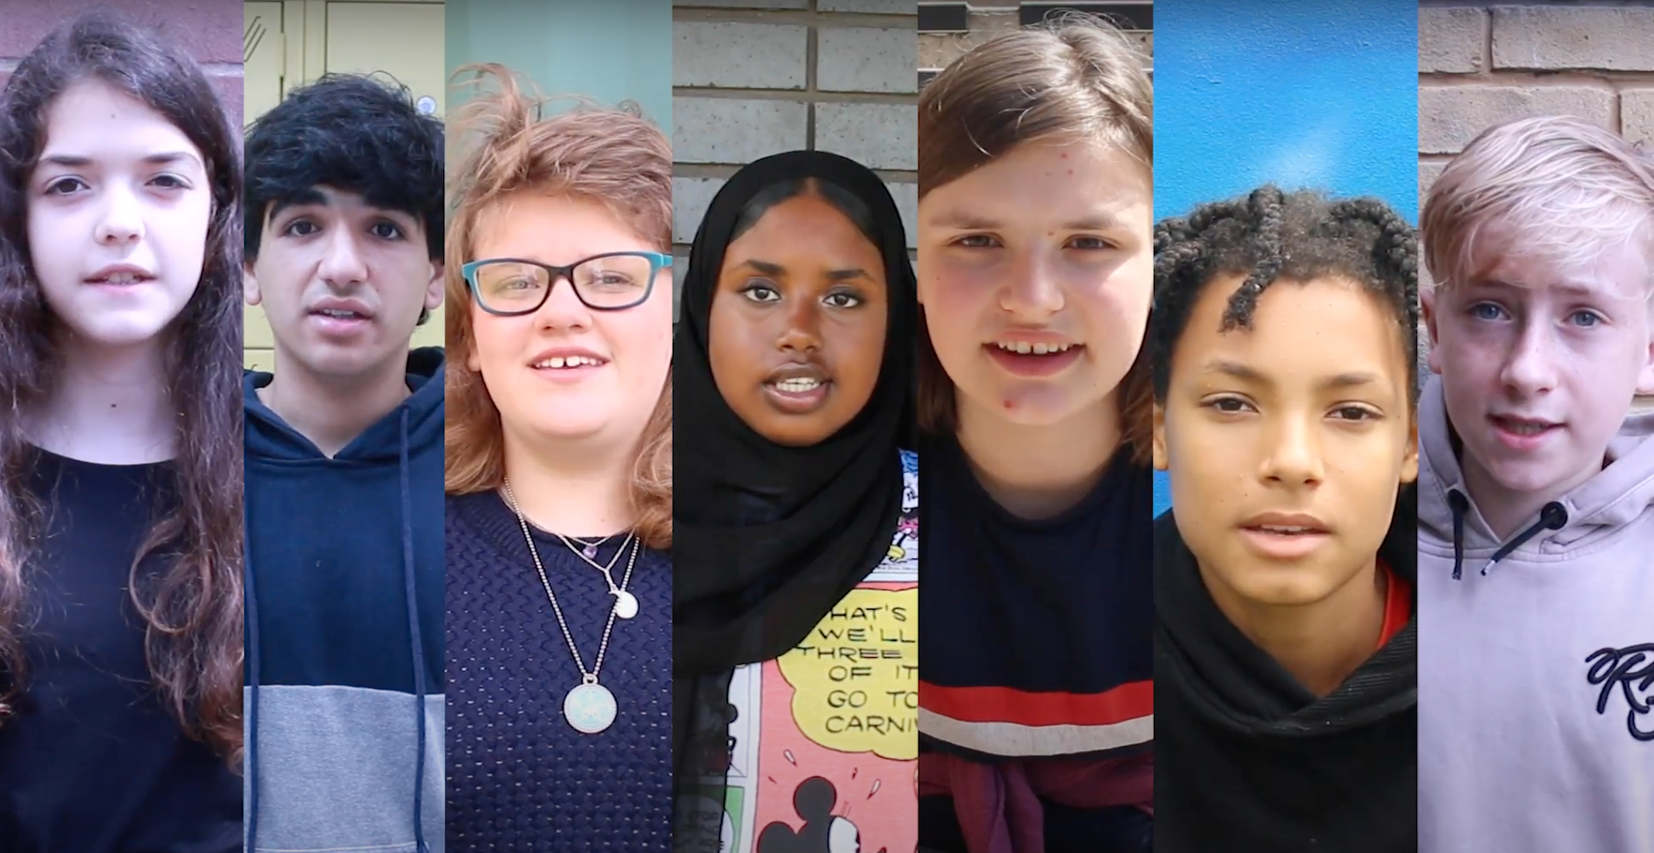

Official Film
LINK
https://youtu.be/DOeRmP3XRHg
Notes:
The film is 2 minutes long and can be found on YouTube. It has subtitles. We would advise you to watch the film before showing it to your students.

Slide 12
Thank you for watching
- anti-bullyingalliance.org.uk

