Slide 1
Young people, vapes, and cigarettes

Slide 2
What we will cover today:
What are vapes
The reasons for vaping
The physical effects of vaping
The psychological effects of vaping
The effects vaping has on the environment

Slide 3
Activity/discussion What do you already know about vaping?

Slide 4
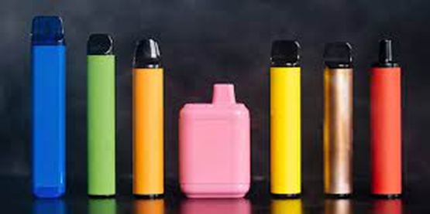
What are vapes?
Vapes are devices that deliver nicotine within an inhalable aerosol by heating a solution.
Solution contains nicotine, glycol, glycerine, and flavourings.
Vapes do not burn tobacco and do not produce tar or carbon monoxide – two of the most harmful substances in cigarette smoke. ​
Notes:
Unlike cigarettes, there is no combustion (burning) involved in e-cigarettes so there is no smoke and no other harmful products of combustion, such as tar and carbon monoxide. Nicotine in e-cigarettes poses little danger to adult users.
glycol is one of two diluents in e-liquid. It is a clear, viscous fluid that is odourless but has a slight sweetness. It is there to dilute the e-liquid and make it available easier to run through your vape tank and vape coil.
PG isn’t only used in e-liquid, it is also utilised by the food and beauty industry in products such as liquid sweeteners, whipped dairy products and face creams.
glycerine is a thick, clear fluid that is odourless, with a slight sweet taste. This is the second of the diluents contained within e-liquid and adds a thicker consistency to the juice.
VG isn’t only used in e-liquid, it is used by the food industry in things such as frozen yoghurt as well as in a wide range of beauty products.

Slide 5
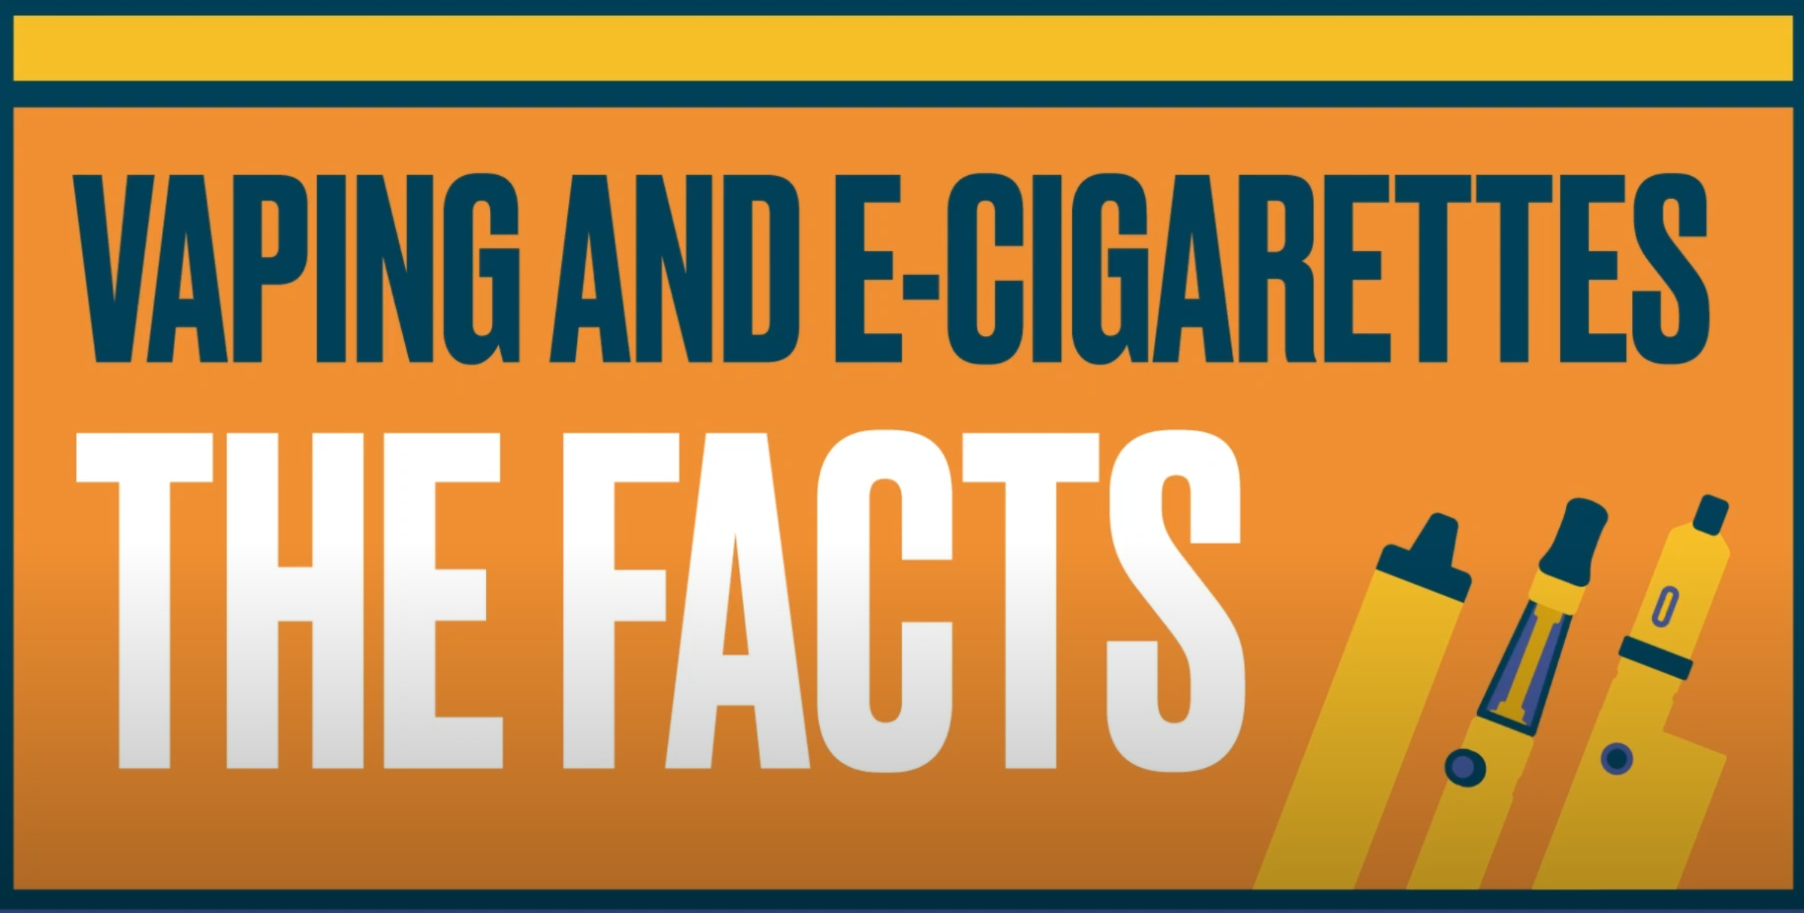
Short video:
Vaping: The Facts (youtube.com)

Slide 6
What does the law say?
Vapes should NOT be
Sold to anyone under 18
Bought for anyone under 18
It is a criminal offence to sell these devices to under 18s.
It is a criminal offence to purchase these on behalf of under 18s.
Should be sold with correct nicotine levels (under 2% or 20 mg) but often does not meet these regulations.

Slide 7
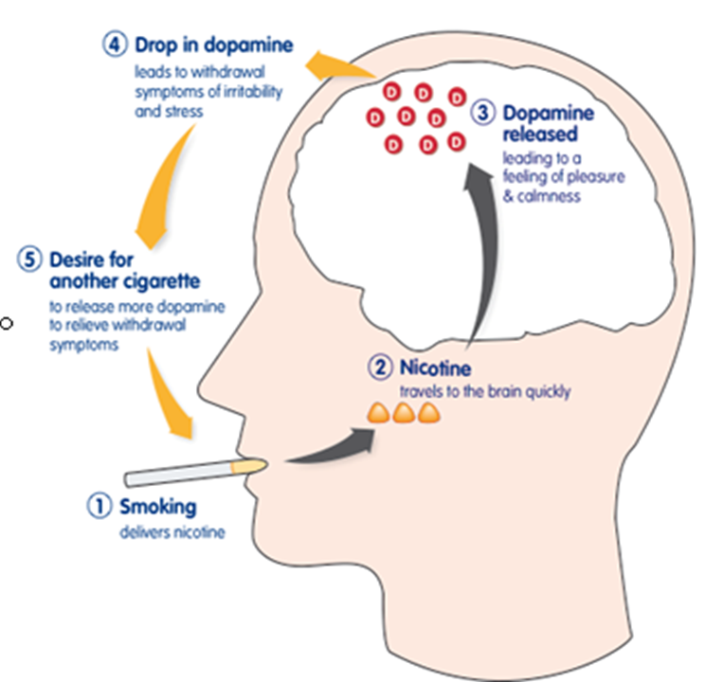
What is nicotine?
-7 seconds to reach receptors (WHO)
-Very addictive
-May increase blood pressure
-No evidence that it reduces stress
-Dopamine released (reward), satisfaction from smoking

Slide 8
Nicotine Withdrawals
Symptom | What is happening
Intense desire to vape | Brain is missing nicotine fix
Hunger | Metabolism is changing
Constipation and diarrhea | Body returning to normal
Trouble sleeping | Due to nicotine leaving the body
Mood swings, poor concentration, irritable | Signs of nicotine withdrawal and will pass

Slide 9
Young people Vaping (11-17)
This data has been provided by the campaign group Action on Smoking and Health (ASH) on their GB Youth Survey they found:
The proportion of 11 to 17 year olds who said they have tried vaping has jumped from 13.9% in 2020 (before the Covid Lockdowns) to 20.5% of children in March 2023.
There has been a significant growth in experimentation (trying an e-cig once or twice) from 7.7% in 2022 to 12% in 2023
But current use hasn’t seen a statistically significant increase and is 7.6% in 2023.
Smoking rates have also decreased but not statistically significantly.
Approx 70% of 11-17 year olds who have vaped have used a disposable e-cig.
Shops selling vapes illegally are the main source for under 18s though most are given their first vape.

Slide 10
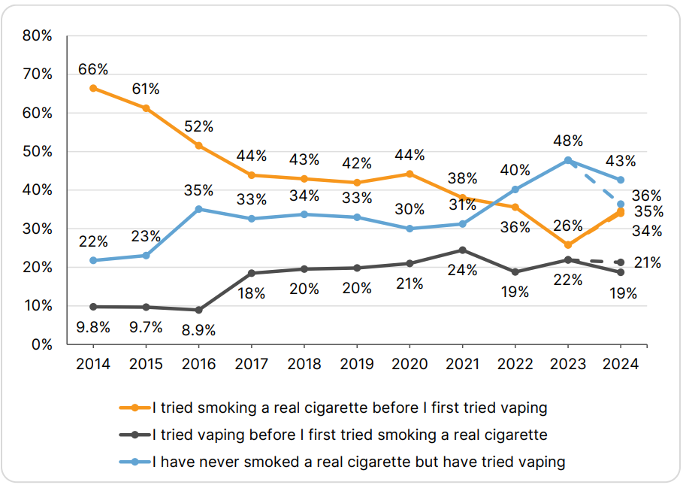
Figure 1. Pattern of vaping and smoking among GB children who have tried vaping (11- 17), 2014-2024
Young people are more like to have tried a vape rather than smoke a traditional cigarettes

Slide 11
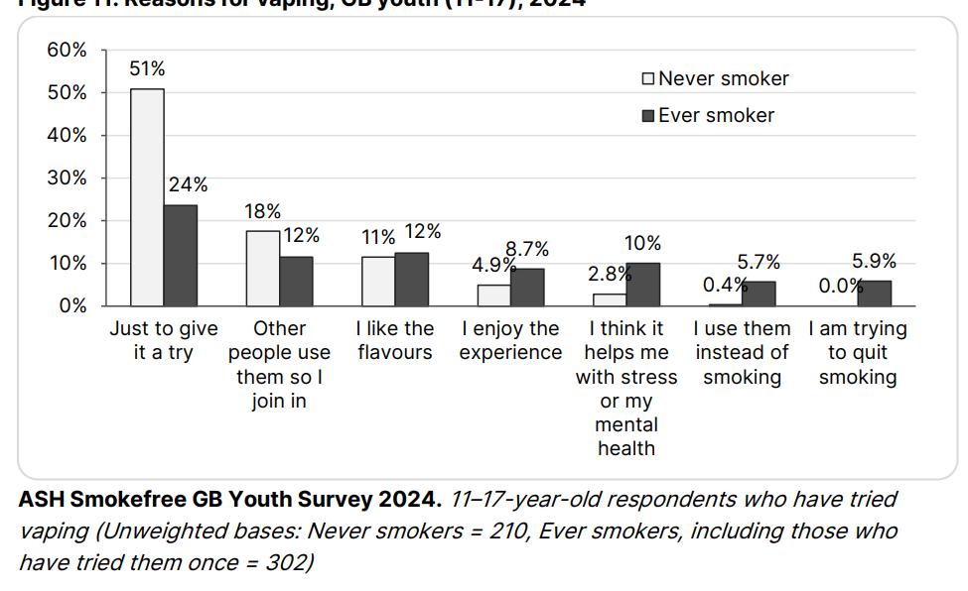
Figure 2. Reasons for vaping, among ever and never smokers 11-17, 2024

Slide 12
Health impact
Nicotine can have detrimental health effects:
Adolescents are more vulnerable to nicotine dependency than adults. Chronic nicotine exposure can impact brain development. This can contribute to cognitive and attention deficit conditions and worsen mood disorders, including depression and suicidal thoughts, (Ren and Lotfipour, 2019).
E-cigarette use can have negative effects on respiratory health:
Research has shown that young people using e-cigarettes are twice as likely to suffer from a chronic cough than non-users. Vaping can reduce the function of the lungs via disturbance of gas exchange and tissue inflammation. It can also lower immunity, increasing the risk of respiratory infection. (Bourke,Sharif, and Narayan, 2021)
Some health experts have raised concerns that e-cigarettes could be a gateway to tobacco smoking for young people.
Notes:
Vaping among teens: A growing trend? - House of Lords Library (parliament.uk)

Slide 13
Environmental Impact
A million disposable vapes are thrown every year in the UK - this equates to 10,000kg lithium from the batteries, enough to power 12,000 electric cars every year.
Plastic doesn't decompose. Plastic breaks down into smaller particles until they are too small to see. This means that every molecule of plastic produced since 1907 is still present in the environment!
Although most plastics never decompose, they do eventually break down into smaller and smaller pieces called microplastics.
For anything to decompose fully it needs to be eaten by micro-organisms. Most micro-organisms don't like plastic, and for those that do, there is simply too much plastic for them to eat.
Tesco have started recycling vapes

Slide 14
Tips to quit vaping
Gradually reduce the strength of nicotine of the e-liquid (if they are using a disposable vape, they could switch to a refillable device to do this).
Extend the time between vaping.
Taking shorter puffs (especially if they use a disposable vape).
Let them set rules about where they do and do not vape, for example only outside of the home or only on breaks at work.
For adults who have quit smoking and are vaping can also quit vaping once they are ready as long as they feel like the will not relapse and go back to smoking traditional cigarettes. If there is a chance of relapse they should continue vaping.

Slide 15
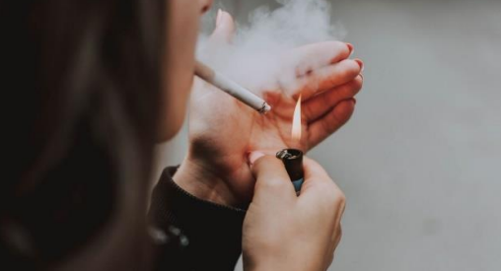
Young people and cigarettes
Most adult smokers first tried smoking when they were under 18.
A smoker who started young is even more likely than a smoker who started at an older age to become ill or die from it.
About 400,000 11- to 15-year-olds in England have tried smoking at some point and about 100,000 smoke now. More than three 15-year-olds out of one hundred smokes more than once a week.
Children with parents who smoke are about three times more likely to start smoking themselves. Children are also more likely to smoke if they have brothers, sisters or friends who smoke.
The chance of an 11- to 15-year-old being a smoker has halved in the past ten years.
Notes:
Vaping among teens: A growing trend? - House of Lords Library (parliament.uk)

Slide 16
What is in a cigarette?
Dried Tobacco leaves
Fillers: which include other parts of the tobacco plants such as the stem to bulk it
Additives: e.g. ammonia to improve the transportation of nicotine
Flavourings: e.g. sugars, cocoa and fruit extracts to make it taste more palatable
Humectants, preservatives, pesticides so that the tobacco stays moist and doesn’t rot
7,000 chemical, 70 of which cause cancer
Notes:
Vaping among teens: A growing trend? - House of Lords Library (parliament.uk)

Slide 17
What is the government doing ?
They are creating the first smoke-free generation so children turning 15 this year or younger will never be legally sold tobacco. The age of sale will be raised by one year each year to prevent future generations from ever taking up smoking, as there is no safe age to smoke.
To reduce the appeal of vapes to children, they also announced that new powers will be introduced to restrict vape flavours and packaging. The powers will also allow government to change how vapes are displayed in shops.
Vaping alternatives - such as nicotine pouches - will also be outlawed for children who are increasingly turning to these highly addictive substitutes.
Lastly, they will look at what more they can do to protect children from the risks of vaping and explicitly asks for more evidence on any potential long-term harms.
Notes:
Vaping among teens: A growing trend? - House of Lords Library (parliament.uk)

Slide 18
What can you do? Very Brief Advice
ASK
Personalise Advice: Relate advice to their goals and values
ACT
Discuss and choose strategies that fit their lifestyle and preferences. Ask for help
GPs, Pharmacies, stop smoking services
Ask open-ended questions to understand their vaping behavior and readiness to quit.
'How do you feel about your vaping?'
Provide Information: Offer clear, non-judgmental information about the risks of vaping
ADVICE

Slide 19
Alleviating Withdrawals
Try distraction techniques: exercising, listening to music, creating a playlist, engaging with a small DIY project, drawing, painting, reading.
Buddy up with another friend
If feeling anxious avoid caffeine
Use an app to keep track of your savings and to keep you accountable such as the Nicorette Stop Smoke & Vape App
Try practical tasks like tidying up a personal space or decluttering.

Slide 20
Our Service
8 week NCSCT treatment programme (adapted for pregnancy and mental health)
Behavioural support for quitting and harm reduction approach (reducing tobacco and cutting down to quit)
8 weeks of pharmacological support (NRT)
E-cigarette friendly service
Accredited NCSCT Practitioners and can support patients on the programme who would like to make a change to their smoking

Slide 21
Thank you!
What are your questions about the service?
Get in touch!
Email: wlm-tr.hls@nhs.net
Ealing Smokefree Service :: West London NHS Trust

