Slide 1
Implementing the PSHE scheme of work
Health Improvement Team

Slide 2
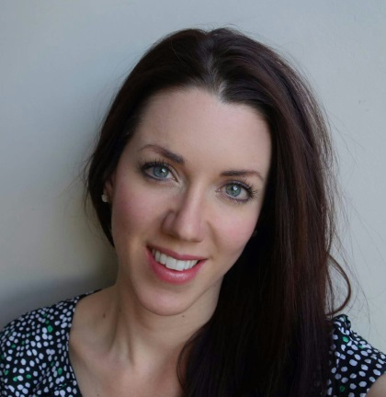
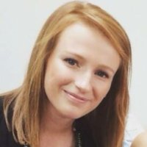
Meet the team
The Health Improvement Experts
Karen Gibson
Nicole McGregor
Claire Meade
Stacey Edmead
Mubina Asasia
Health Improvement Team Manager
Safeguarding
Health Improvement Officer
Nutrition & Exercise
Health Improvement Officer
RSE & PSHE
Health Improvement Officer
Mental Health & Emotional Wellbeing
Health Improvement Advisor
Preventing Extremism in schools

Slide 3
Our services to schools
The Health Improvement team’s three services
Universal
All schools receive this service for free.
Health Partnership
Workshops, resources and training.
Bespoke
Four day customised service.

Slide 4
What we do
We provide support and training in five areas:
Safeguarding
RSE
Nutrition
PSHE
Emotional wellbeing

Slide 5
Aims of the workshop
Increased Confidence
In delivering, monitoring and evaluating PSHE across a school
Increased knowledge
Of the PSHE scheme of work and how to implement it
Increased understanding….
Of how to monitor and assess PSHE
Increased understanding….
Of how to ensure consistency in PSHE

Slide 6
Ice breaker
Find someone who…

Slide 7
PSHE Scheme of work
What do you currently use?
How do you implement your current scheme of work?

Slide 8
PSHE Scheme of work
What are the barriers to implementing the SOW?

Slide 9
PSHE scheme of work
Personal
Social
Health
Economic

Slide 10
Ealing scheme of work
Last updated in July 2015
Year 1 to Year 6
Split into half term topics
Split over a two year cycle

Slide 11
Two year cycle
Cycle A
Years 1, 3 and 5
Mainly focused on personal and interpersonal relationships and health issues
Cycle B
Years 2, 4 and 6
Mainly focuses on social and economic relationships, including international relationships

Slide 12
Two year cycle
Cycle A
We’re all stars
Be friendly, be wise
Live long, live strong
Daring to be different
Dear diary
Joining up and joining in
Cycle B
It’s our world
Say no!
Money matters
Who likes chocolate?
People around us
Growing up

Slide 13
Main topics
RSE:
Live long, live strong
Growing up
Drugs and alcohol:
Say No!
Not covered in cycle A
Anti bullying
Be friendly, be wise
Say No!

Slide 14
Looking at overview
What’s working well?
Even better if…

Slide 15
Implementing the scheme of work
Give teachers the planning each half term
They must then return the planning
They must provide one sample of learning and one sample of assessment
They should also record circle time

Slide 16
Monitoring
Collect planning, learning and assessment
Collect circle time evaluation
PSHE observations
Pupil conferencing

Slide 17
Observations
15 – 20 minutes
Allows you to identify best practice
Use observation template
Feedback to teachers

Slide 18
Learning objective should be s
shared and discussed
Games and discussion are
important to begin PSHE lessons
What happened during the lesson?
How has SMSC and safeguarding
featured in the lesson?
How was assessment used in
the lesson AOL or AFL?
What were the strengths?
What needs to improve?

Slide 19
Pupil conferencing
Once a term
3-5 pupils per year group
Simple open ended questions
Provides extra evidence

Slide 20
Pupil conferencing
Year 3 Live long, live strong
Year 6 money matters

Slide 21
Assessment
Gives a baseline
Allows us and the children to see progress
Can be built into lessons
Allows creativity

Slide 22
Plan assessment for…
Year 2 Say No!
Year 3 Dear Diary

Slide 23
What is being taught in your school in Autumn 2?
Planning
Assessment
Monitoring
Evidence

Slide 24
THANK YOU
meadec@ealing.gov.uk
www.egfl.org.uk
020 8825 6173

