Slide 1
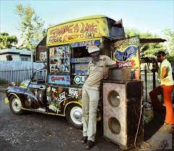
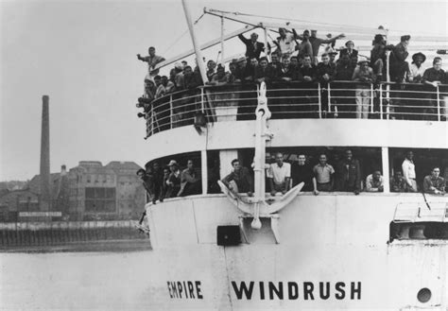
75 years since the Windrush generation arrived
The Windrush generation refers to the people who left the caribbean countries and arrived in the UK between 1948 and 1971
Redemption Song
https://www.youtube.com/watch?v=kOFu6b3w6c0

Slide 2
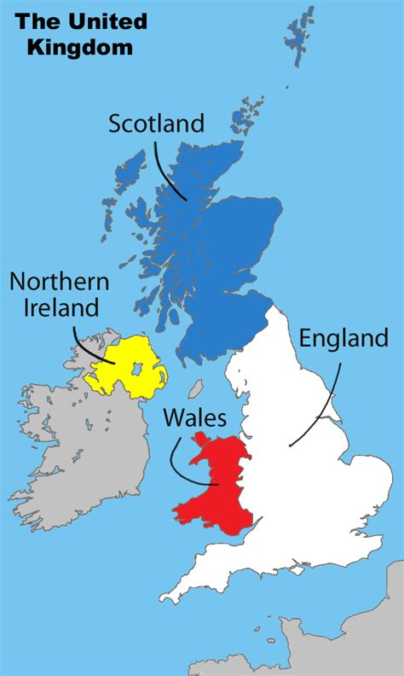
In 1948, Britain was beginning to recover from WWII.
They invited people to come to Britain from the Caribbean because there was a shortage of people to fill job vacancies. In years to come they also invited people from other colonies.

Slide 3
There are people who come to Britain all the time, so what makes this migration unusual?
They were illegal immigrants
B) The people who came were invited and persuaded to come by the British government.
C) The people from the caribbean were trying to get British citizenship.

Slide 4
There are people who come to Britain all the time, so what makes this migration unusual?
They were illegal immigrants
B) Britain invited and even persuaded people to come to the UK.
The British government sent people from Britain to the islands to persuade people to move to the UK.
C) The people from the caribbean were trying to get British citizenship.
The British Nationality Act 1948 said that all people living in the British colonies had automatic citizenship and rights to work in Britain. So the windrush generation were already British citizens.

Slide 5
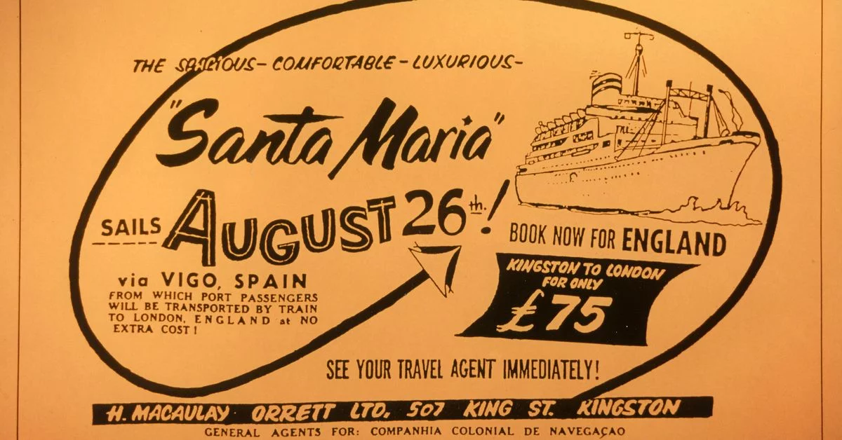
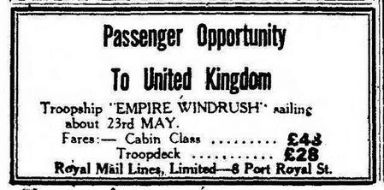
If someone invites you to their home, how do you expect to be treated? Why?
https://www.bbc.com/news/av-embeds/uk-43782241/vpid/p065w53b
Notes:
https://www.bbc.com/news/av-embeds/uk-43782241/vpid/p065w53b
Sam King MBE speaking about arriving on the empire windrush. (2 minutes).
The unions blamed Black people for things going wrong because it was ran by a popular fascist Oswald Mosley. (More about him later).

Slide 6
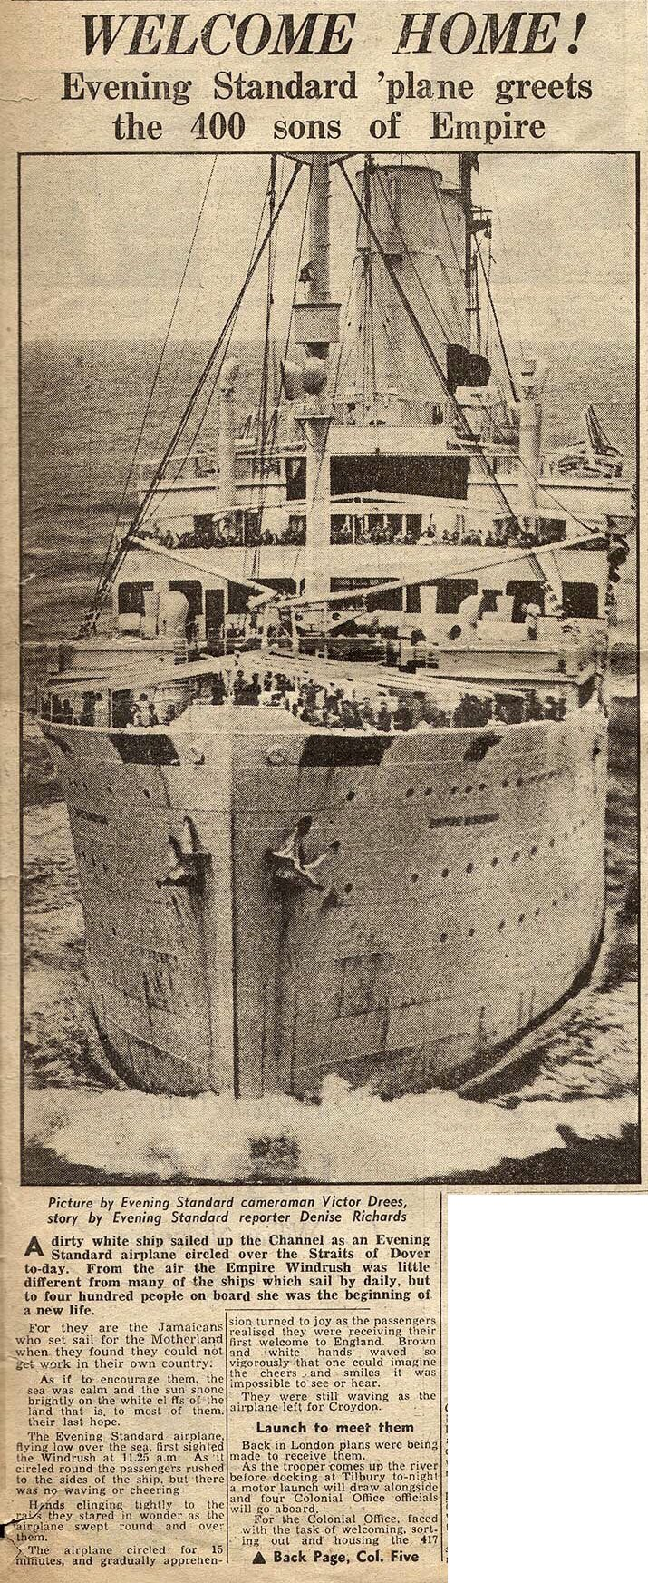
If someone invites you to their home, how do you expect to be treated? Why?
1948 June 22nd newspaper labels the people who arrive as “sons of Empire” and tells them “Welcome Home”.

Slide 7
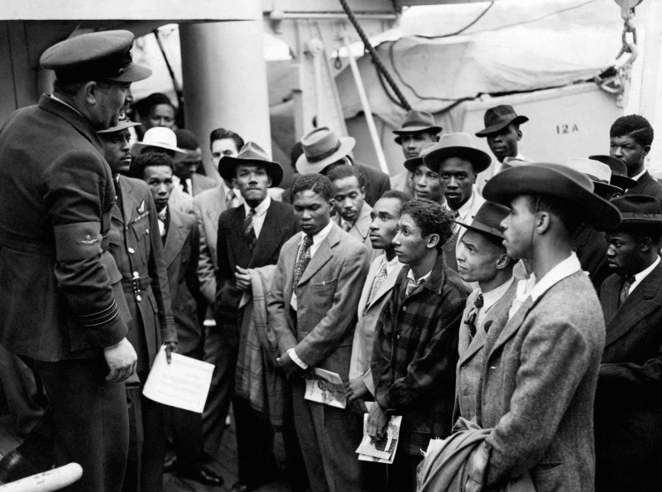
Welcomed on arrival
Jamaican immigrants welcomed by RAF officials from the Colonial Office after the ship 'Empire Windrush' landed them at Tilbury in 1948. These were the first arrivals.
The group who migrated are named after the Empire Windrush, a ship that docked near London in 1948 carrying the first group of migrants from the Caribbean who had been invited by the government to relocate to Britain to help fill a labour shortage after World War II.

Slide 8
Many of the people who arrived were very disappointed. Why do you think they were disappointed?
They didn’t know that food in Britain was being rationed
They could not find any jobs
They did not feel welcome due to racist behaviour of many white people and many police officers.

Slide 9
Many of the people who arrived were very disappointed. Why do you think they were disappointed?
They didn’t know that food in Britain was being rationed
They could not find any jobs
They did not feel welcome due to racist behaviour of many white people and many police officers.

Slide 10
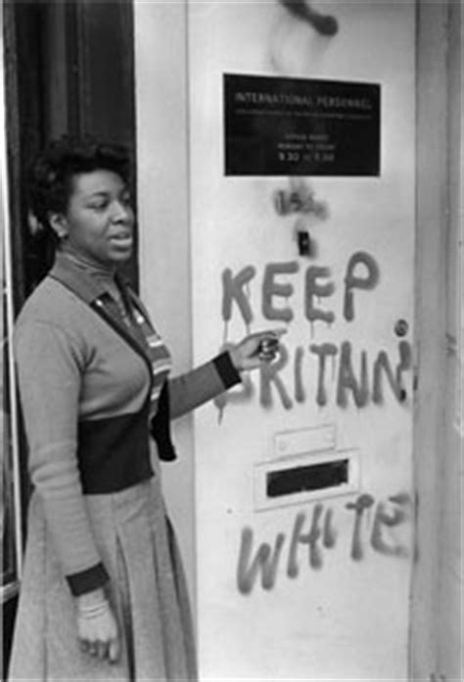
The Windrush generation arrived to a society needing their labour, but resentful of their presence. There was a “shocking level of racism” (BBC documentary) in Britain at the time.
The new arrivals faced racism when applying for some jobs, housing, mortgages and loans for starting businesses, and were treated very unfairly due to some people’s racism, and even the police.
There was a lot of racism in the schools too.
Notes:
No sign for primary schools.

Slide 11
This is a very sad and shameful part of our British history. And it can be upsetting for those who remember what it was like. We all know how wrong it is to treat someone unfairly because of their differences.
We are all equal.

Slide 12
When the Windrush generation arrived, it was the start of multicultural Britain and racism in the UK…
False
B) True, the Windrush migrations were the start of multicultural Britain.

Slide 13
When the Windrush generation arrived, it was the start of multicultural Britain and racism in the UK…
False
Some African Caribbean and Asian people were already living in Britain, after serving in WWI and many came here to study at university. Racist people started riots after WWI in Britain, so racial violence was not new.
B) True
It was not the first time racist issues existed in Britain.
The colour bar is an agreement to not give employment, housing or access to some services to anyone who is African, African Caribbean or Asian. They used to hang up signs to say they are not welcome.
This is a very sad shameful part of British history, because no one should be treated unfairly because of their differences. But it is also very important to tell the truth about what the Windrush generation have experienced since arriving in Britain.

Slide 14
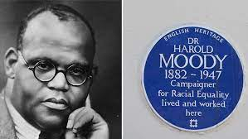
Before the Windrush: Harold Moody was a medical doctor who founded Britian’s first civil rights movement (LCP) which demanded an end to the colour bar in Britain.
Harold Moody, a medical jamaican doctor (born 1882) arrived in the UK to study medicine. He graduated top of his class at King’s College University, London in 1910. Edwardian England was extremely racist, and the colour bar system meant no one would employ him. Despite being highly qualified and having won numerous academic prizes. He opened his own GP practice in Peckham. It was very successful!
Notes:
Dr Harold Moody was born on October 8, 1882, in the Jamaican capital of Kingston. He received early exposure to the medical field while in secondary school through his work for his father’s pharmaceutical business. Determined to become a doctor, he left Jamaica in 1904 to study medicine in London.
Dr. Moody soon came face-to-face with rampant racism in Edwardian London. Even though he qualified to practice medicine, finished top of his class, and won numerous academic prizes, he was repeatedly refused work due to the racist color bar system of segregation in England, that denied people opportunities based on skin colour.
Instead, he opened his own private medical practice in Peckham, South East London. He treated countless impoverished children free of charge, in a time before the U.K. had a National Health Service. In doing so, Dr. Moody earned a reputation as a compassionate humanitarian and philanthropist who would always help those in need.
Dr. Moody’s determination to improve the lives of those around him wasn’t limited to his medical practice—he simultaneously focused his attention on combating racial injustice as well. He founded the League of Coloured Peoples in 1931 with the mission to fight for racial equality both in the U.K. and around the world. The group pushed for change, at a government level, to combat discrimination in its many forms.
Thank you, Dr. Moody, for paving the way towards a more equal future.

Slide 15
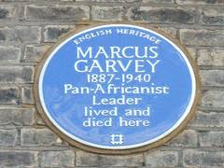
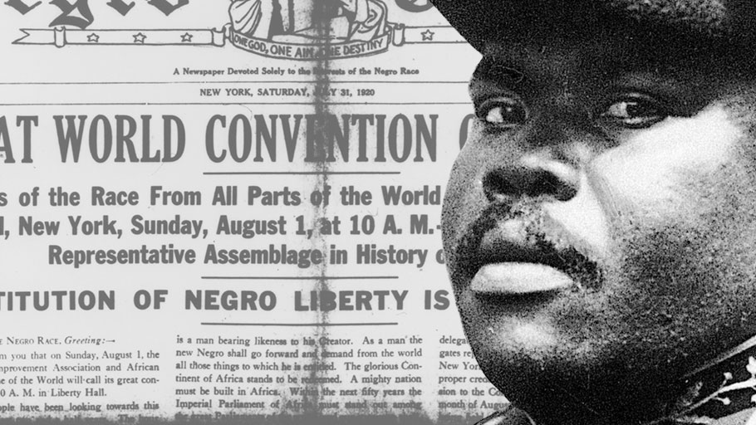
Before the Windrush: Marcus Garvey, national hero of Jamaica, built the largest Black organisation in history, and had a headquarters in London for 5 years.
Marcus Garvey came to England in 1912 until 1914. He worked at the offices of the African Times and Orient Review, the first political journal produced by Black people in Britain. It was printed monthly in Fleet Street in London.
When he returned in 1935, Marcus Garvey regularly spoke at speakers corner in Hyde park. He had at one point built the largest Black movement in history with millions of members across 40 countries. He encouraged Black people to unite and stand against racism everywhere.
Marcus Garvey died in London, Hammersmith in 1940 and became a national hero of the country he came from, Jamaica.
Bob Marley quotes some of his speeches in his song Redemption Song.( https://www.youtube.com/watch?v=ZcYSmOnbkp0 ) Listen.
Notes:
Dr Harold Moody was born on October 8, 1882, in the Jamaican capital of Kingston. He received early exposure to the medical field while in secondary school through his work for his father’s pharmaceutical business. Determined to become a doctor, he left Jamaica in 1904 to study medicine in London.
Dr. Moody soon came face-to-face with rampant racism in Edwardian London. Even though he qualified to practice medicine, finished top of his class, and won numerous academic prizes, he was repeatedly refused work due to the racist color bar system of segregation in England, that denied people opportunities based on skin colour.
Instead, he opened his own private medical practice in Peckham, South East London. He treated countless impoverished children free of charge, in a time before the U.K. had a National Health Service. In doing so, Dr. Moody earned a reputation as a compassionate humanitarian and philanthropist who would always help those in need.
Dr. Moody’s determination to improve the lives of those around him wasn’t limited to his medical practice—he simultaneously focused his attention on combating racial injustice as well. He founded the League of Coloured Peoples in 1931 with the mission to fight for racial equality both in the U.K. and around the world. The group pushed for change, at a government level, to combat discrimination in its many forms.
Thank you, Dr. Moody, for paving the way towards a more equal future.

Slide 16
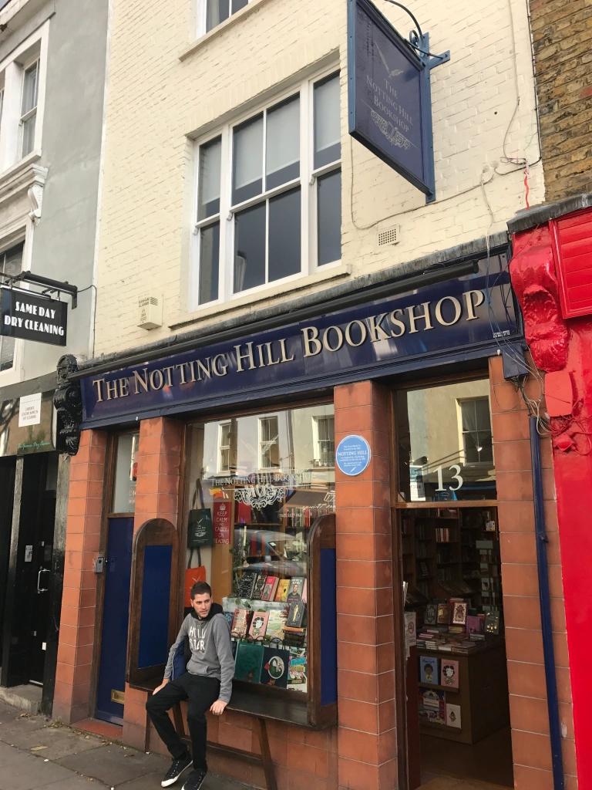
From 1948 the Windrush generation started to arrive. Over many years the African Caribbean community organised to improve their lives in Britain.

Slide 17
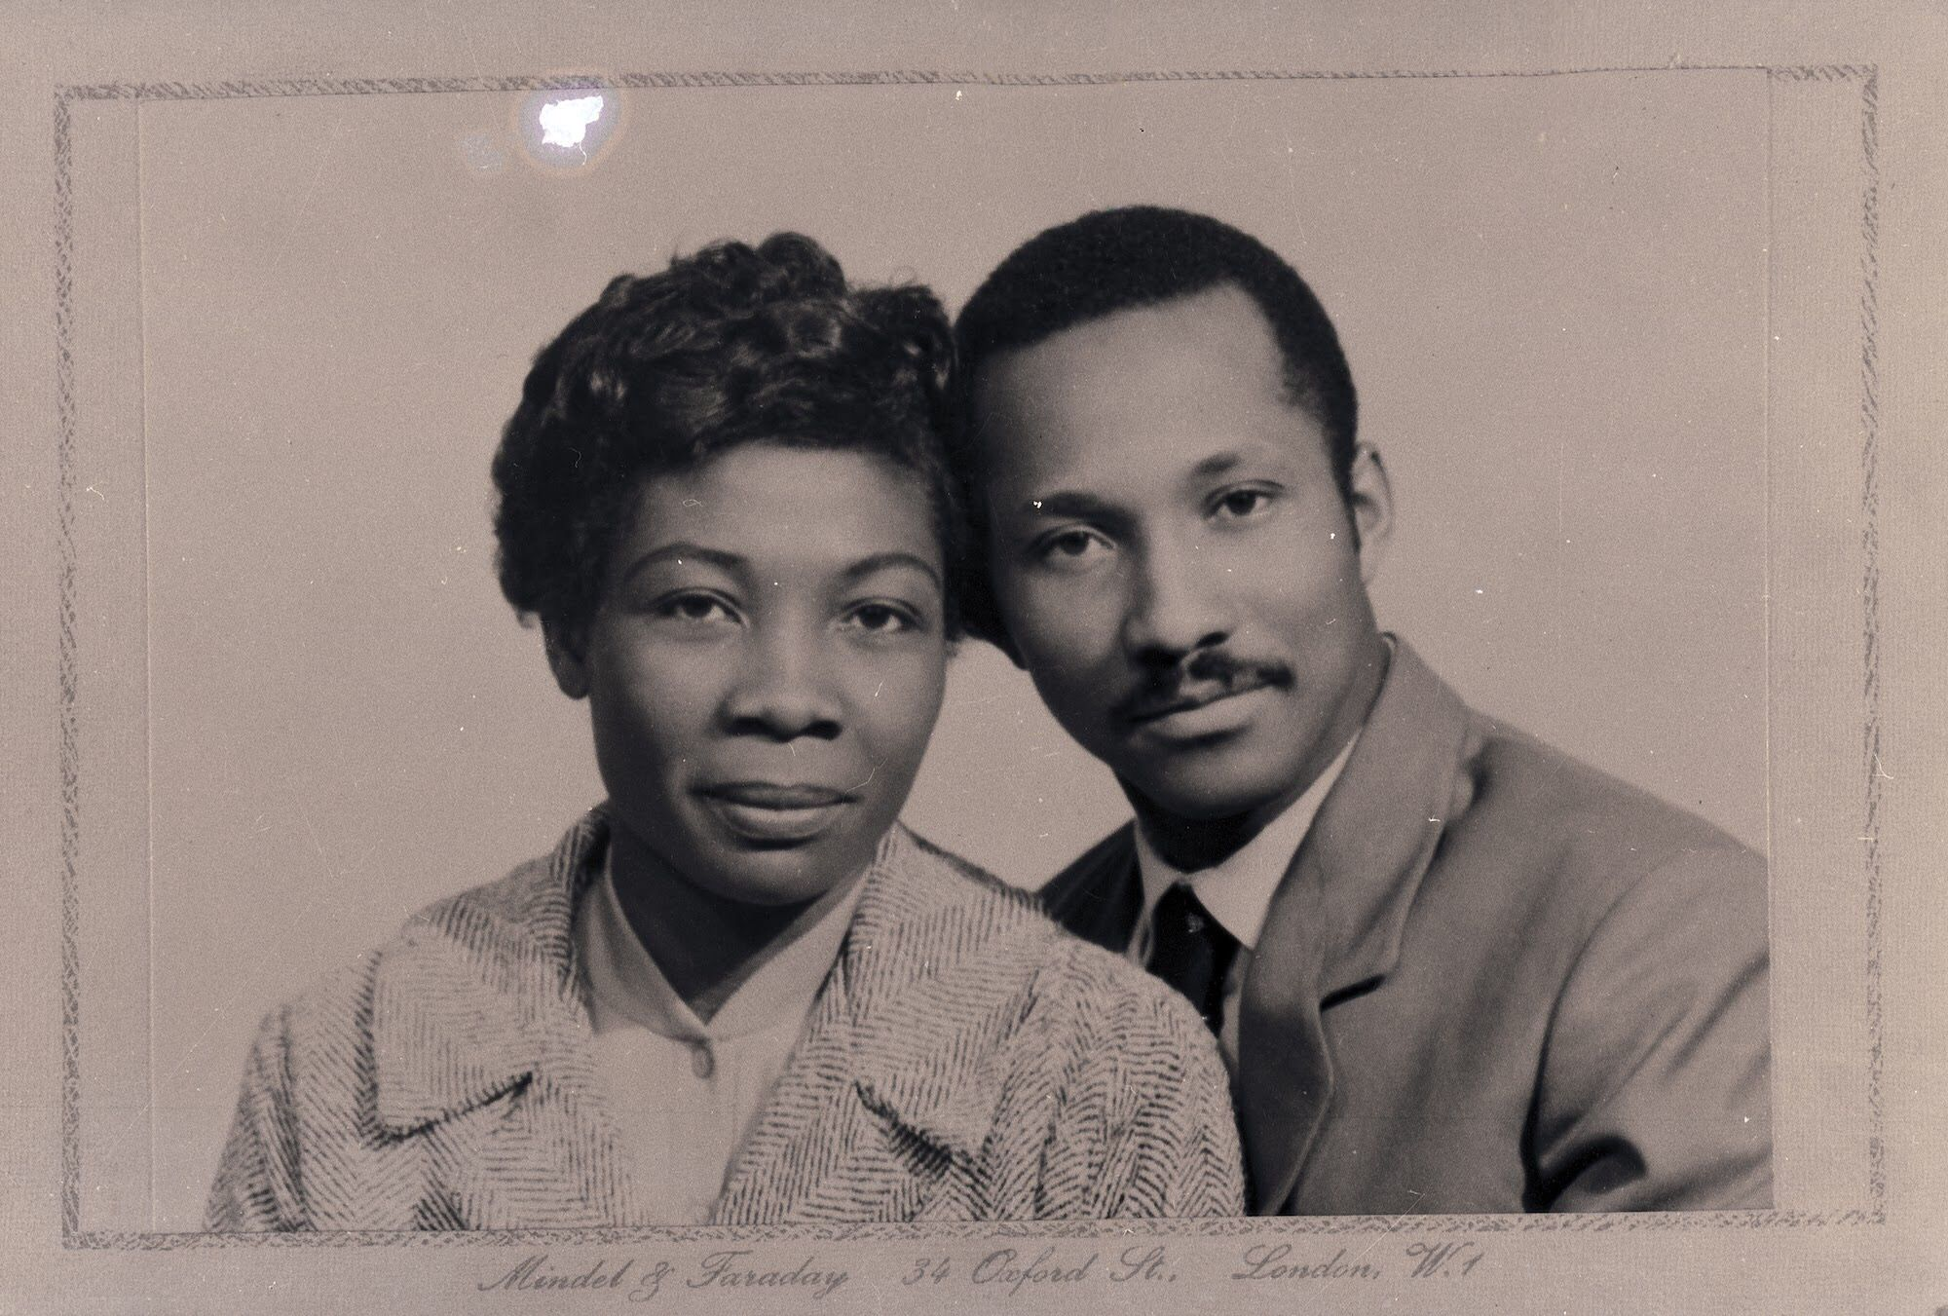
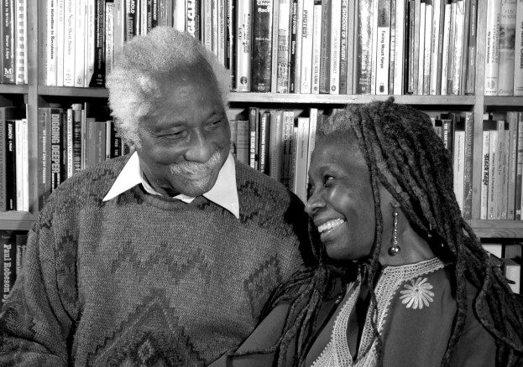
Eric and Jessica Huntley founded a publishers in 1974, and the Walter Rodney bookshop in Ealing, West London.
The Huntleys were passionate about education and believed it was important for Africans and African Caribbeans to overcome racism for a better future. They opened a book shop and publishing house, Saturday school for children and helped organise protests and write letters to politicians and the government to put pressure on them to act to stop the awful racist treatment.
Think about it! Reading books was the only way to educate yourself in the 1970’s. It was before Google, YouTube, or the internet. And so reading books was the only way to learn history, and the thoughts and opinions of others. 🤔
Notes:
The Huntleys were passionate about education and believed it was essential for Africans and African Caribbeans to make progress and build a better future. They opened a book shop and publishing house in the west London borough of Ealing, where Black writers could get their books published, read the work of other authors and educate themselves. Due to racism, Black authors found it hard to get their books published, and they found it equally hard to get hold of books and writing by Black authors, and books that would inspire and encourage their progress.
Reading books was the only way to educate yourself in the 1970’s. It was before Google, youtube, or the internet. And so reading books and having access to information about the history and thoughts and opinions of others was even more essential for any group of people to progress.
The Huntley’s opened a Saturday school for children so that they could learn without racism and they helped organise the 1981 Black People’s Day of Action march that attracted 20,000 black Britons from all over the country and was the largest protest march of black people. They also helped organise action against discrimination in schools and racist violence against school aged children, including the Black Parents Movement (BPM) formed in 1975 following the arrest and assault by Haringey police of a Black schoolboy named Cliff McDaniel outside his school.
However, their shop had come under racist attack by people who wanted it shut down. The Huntley’s did not let this stop them. They continued on their mission to spread knowledge and set up the Caribbean Education and Community Workers Association (CECWA), where they worked with others in the community to continue improving education for Black people in Britain. In 2005 the Huntleys deposited their archives at the London Metropolitan Archives (LMA).

Slide 18
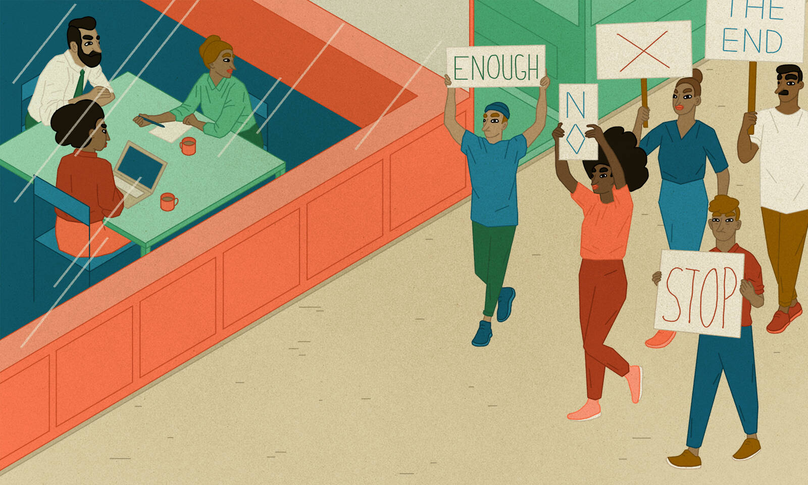
What is a boycott?
A Boycott is when many people agree together to stop paying money to a company, person or country. They do this if they disagree with something that the company, person or country has done.
Although people from the Caribbean had come to help, they were not always made to feel welcome. This was due to racism.Racism is when someone is treated unfairly because of the colour of their skin or their background.
In the city of Bristol, in 1963 the bus company refused to hire people because their skin colour. This included Asian people who had began to come to England too,
This was very wrong. Many people were very upset and they decided to come together and stand up to the bus company. They stood up against racism and started a bus boycott.

Slide 19
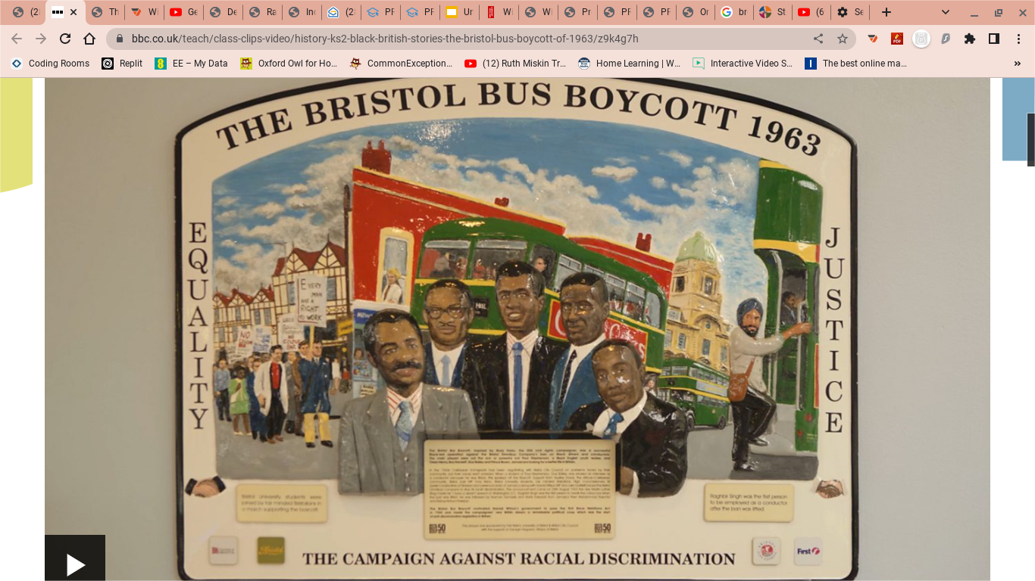
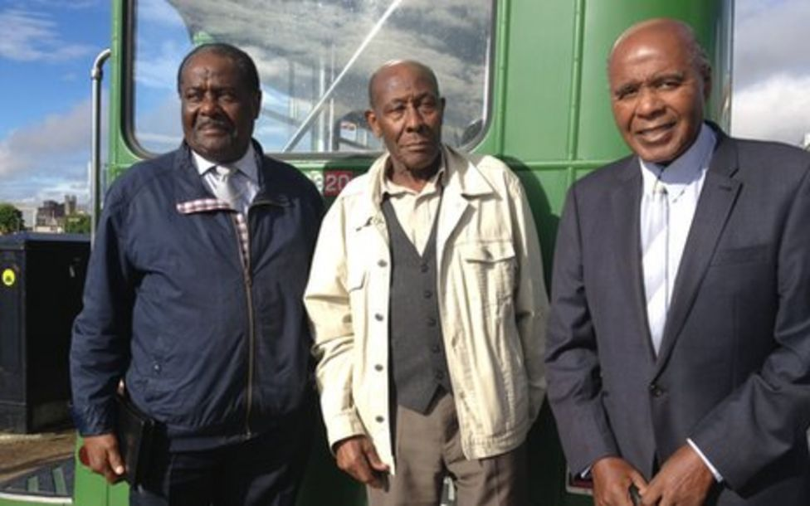
The Bristol Bus Boycott in 1963 forced the bus company to end their racist employment rules.
Guy Bailey, Roy Hackett and Paul Stephenson organised the successful 1963 Bristol bus boycott, taking a stand against racism in employment.

Slide 20
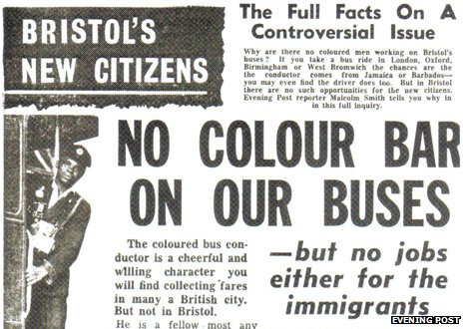
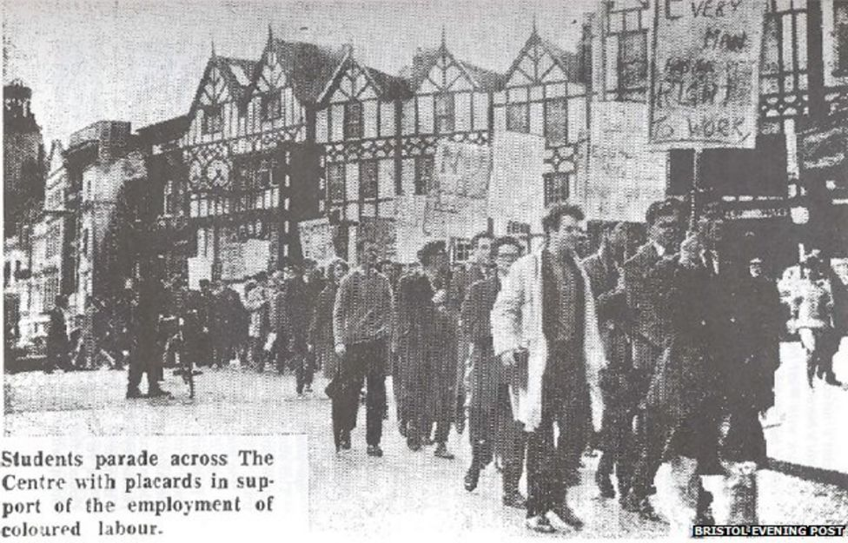
The Bristol Bus Boycott in 1963 help force a change in the law, so that no one is allowed to decide not to employ someone due to the colour of their skin.

Slide 21
Did the bus boycott end racism in Britain?
Yes
No

Slide 22
Did the bus boycott end racism in Britain?
Yes
No

Slide 23
Did the bus boycott end racism in Britain?
Yes
No
Sadly not. Even though the law was changed to help stop racism in employment, there is still some racism in society today.
Whenever we think racism has happened to someone, we can tell a trusted adult ,or a teacher.

Slide 24
Despite having to stand up against racism, the Windrush generation have contributed to life in Britain….

Slide 25
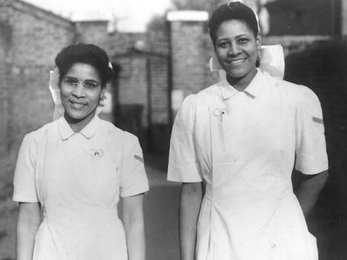
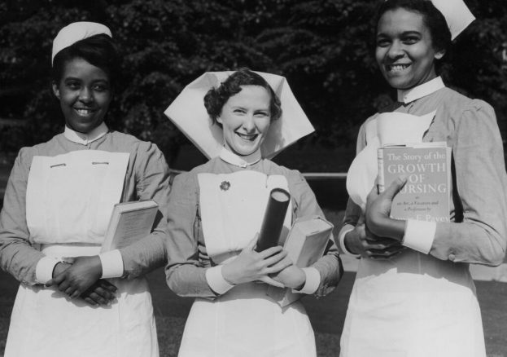
Qualified nurses came to work in the NHS.
The NHS had just been formed in 1948, but Britain didn’t have enough qualified people to fill the roles.

Slide 26
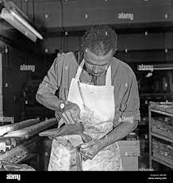
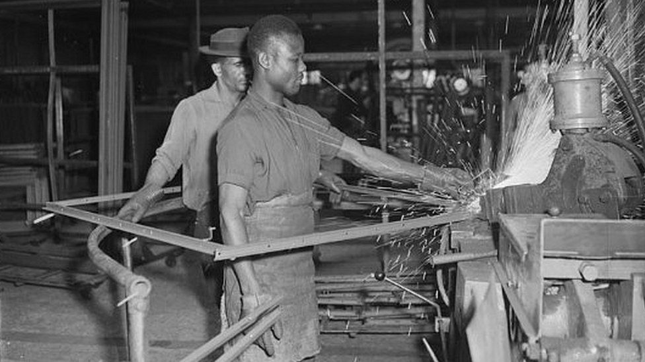
Many worked in factories and as builders.

Slide 27
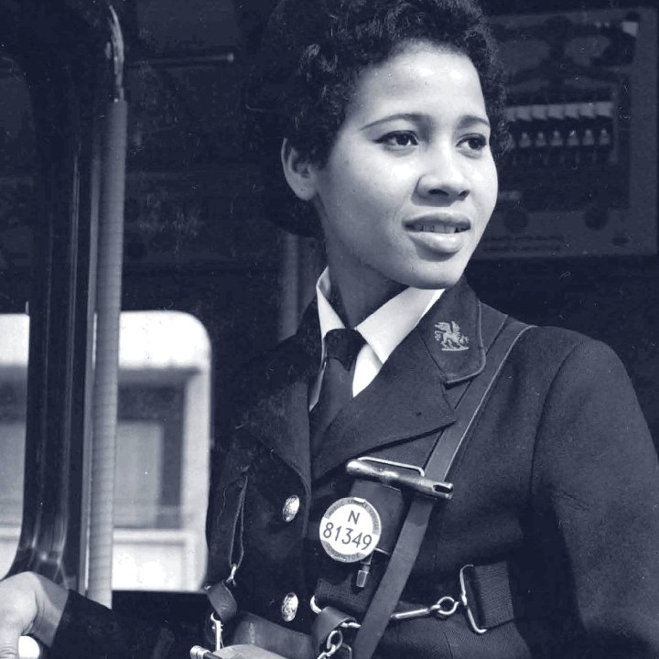
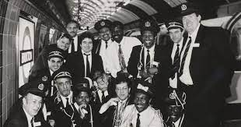
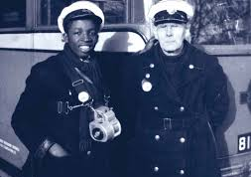
And in the transport industry…

Slide 28
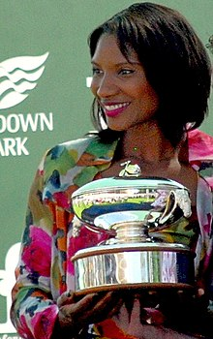
And some have even represented Great Britain in sport.
Denise Lewis - athlete and presenter.
5th Oct 2019 men and womans’s relays teams win silver.
Tokyo 2020 Olympics - Bronze medal relay team.

Slide 29
And some individuals who have achieved success include…

Slide 30
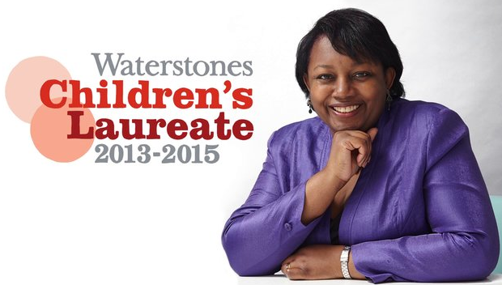
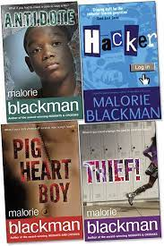
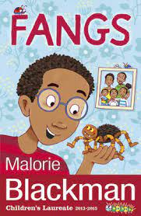
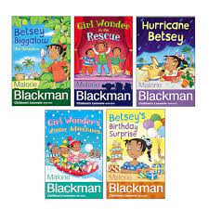
Malorie Blackman - Author and children’s Laureate, 2013.
Malorie Blackman was born in Clapham, London, and grew up in Bromley, one of five siblings. Her parents were both from Barbados and had come to Britain as part of the "Windrush generation". Her father was a bus driver and her mother worked in a factory. They worked hard and taught Malorie the same.
Malorie Blackman has written over 60 books, was appointed Children’s Laureate – in June 2013, and was named the most influential person in Britain.

Slide 31
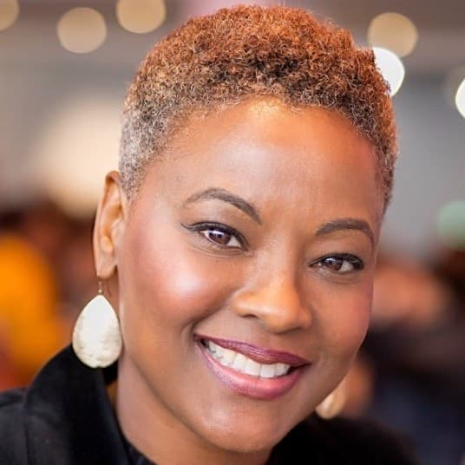
Samantha Tross - Orthopaedic surgeon and winner of the Clinical Excellence Award for her service to the NHS.
In 2018, Samantha Tross was the first woman in Europe to perform robotic hip surgery. Dr Tross is currently the Lead Orthopaedic Surgeon at Ealing Hospital. She has also been named in Tatlers 100 most Influential doctors in the UK in 2013.
Samantha Tross, a Guyana-born (African Caribbean) consultant surgeon who shares her knowledge and skills by mentoring others in the field of medicine and also teaches internationally, including in London and Nigeria.

Slide 32
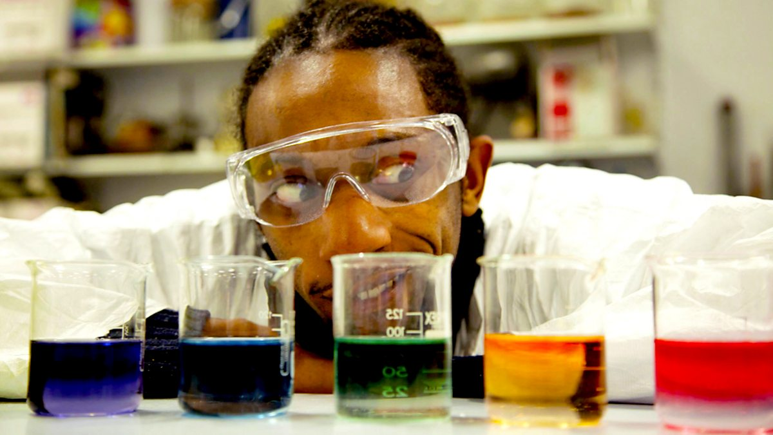
Jonathan Chase - never gave up at science.
Jonathan’s parents arrived during the Windrush from Barbados. Chase attended Twyford High school in Acton, London. He took A levels in physics, pure maths and computer science and went to university to study aerospace engineering. He was unhappy with his degree grade, and decided to take a second degree in science, and achieved a upper second class honours.
Proud of his achievement, he continued to challenge himself and did a Masters degree in communicating science and achieved distinctions! He became an associate lecturer at the university for some time.
Chase combined his love for hip hop music, science and maths to write hip hop style raps for young people. He performed his scientific raps on BBC bitesize and even made a video for NASA about astrobiology.
Here is one on equivalent fractions: https://youtu.be/uvLi3C_5rWg (Listen here)
Notes:
Jonathan’s parents arrived during the Windrush from Barbados. Chase attended Twyford High school in Acton, London. Chase took A levels in physics, pure maths and computer science and went to university to study aerospace engineering. He was unhappy with his low degree grade, and decided to take a second degree in science where he achieved a upper second class honours. Proud of his achievement, he continued to challenge himself and did a Masters degree in communicating science and achieved distinctions! He became an associate lecturer at a university for some time.
Jon says he had challenges along the way, but he will not allow anyone to hold him back, and he doesn’t make excuses for his shortcomings.
He combined his love for hip hop music, science and maths to write hip hop style raps for young people. He performed his scientific raps on BBC bitesize and even made a video for NASA about astrobiology.

Slide 33
After 75 years since the arrival of the Windrush generation, we are thanking the ‘Windrush’ generation and their children for helping to…
Rebuild Britain after the war…
Re-build Britain after the war…
Keep transport running after the war…
Develop and sustain the NHS
Stand for civil rights in Britain…
Get laws changed to improve race equality for all people in Britain

