Slide 1
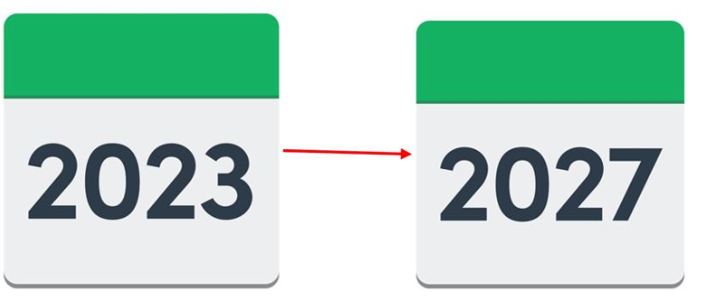
Ealing’s Draft Strategy for Special Educational Needs, Disability (SEND) and Inclusion 2023-27
Easy read guide

Slide 2
Contents
Introduction to Ealing’s Special Educational Needs and Disabilities (SEND) Strategy | Page 3
Section 1:Our vision, mission and principles | Page 4
Section 2:Our priorities and aims | Page 5
Section 3:Your views and comments | Page 13
Section 4: Action Plans – how Ealing will respond to your views and comments | Page 14
If you need someone to talk to about this document, place contact Ealing Family Information Service
Tel: 020 8825 5588
Email: children@ealing.gov.uk
Page 2

Slide 3
Introduction to Ealing’s Strategy for Special Educational Needs and Disability 2023-2027
Ealing Council and Ealing Health Partners are launching a new Special Educational Needs, Disability (SEND) and Inclusion Strategy for 2022-2026.
A strategy is a plan that happens over a long period of time. Our plan is for 2023-2027.
This is the final strategy We shared the draft strategy views on our plans for children and young people with additional educational needs and disabilities before we make any final decisions.
Page 3

Slide 4
Section 1: Our vision, mission and principles
As part of our plan we have chosen a vision, mission and set of principles
The vision is what Ealing wants for local children and young people.
The mission explains how the council will support the achievement of the vision. It also describes what the council needs to do to ensure the vision can be achieved.
The principles are what should be followed by all professionals working with children and young people who have additional educational needs and disabilities.
Page 4

Slide 5
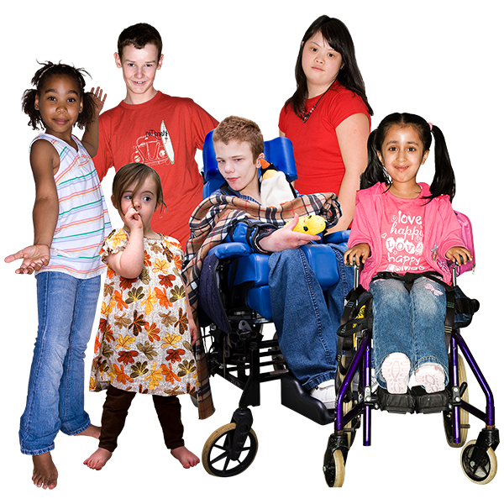
Section 1: Our vision, mission and principles
For our Principles we have chosen:
Strive to ensure that all services are inclusive and welcoming to our community.
Work in partnership with parents, children, and young people with Additional Educational Needs and Disabilities (AEND) across their journey from 0-25.
Operate with a commitment to equality, transparency, and fairness.
This means that Ealing Council and its partners will:
Make sure all services are able to welcome everyone in the community
Work with parents, carers, children and young people.
Treat everyone with fairness and be open and honest.
Page 5

Slide 6
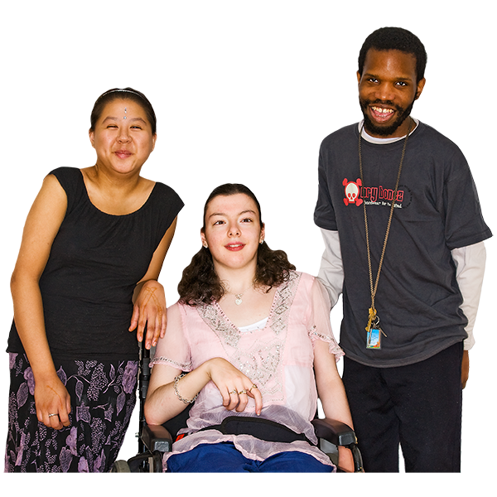
Section 1: Our vision, mission and principles
For our Vision we have chosen:
‘Every child, young person and their family feels welcome, happy, safe in their community and is included in choices about their lives.’
This means that we want children, young people and their families to:
Feel happy
Feel safe in the community
Be involved in any decisions made about their lives
Page 6

Slide 7
Section 1: Our vision, mission and principles
For our Mission we have chosen:
‘Ealing Council will invest in services to enable the right support so every child and young person can thrive and contribute to their communities’
This means that Ealing Council will:
Fund (pay for) services that support children and young people
Meaning that children and young people can progress
As well as come up with ideas for their communities
Page 7

Slide 8
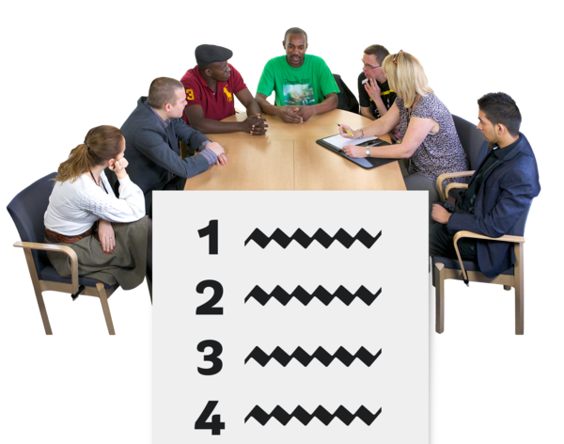
Section 2: Our Priorities and Aims
As part of our draft strategy we have also set out four priorities and aims.
Our priorities are the four important things that we want to make improvements on.
Our aims are how we will make it work to meet with these targets.
Page 8

Slide 9
Section 2: Our Priorities and Aims
For Our Priority 1 we have chosen :
‘To provide guidance, earlier identification of needs and support for children, young people and their families, so that schools and settings are supported to welcome every child and young person, and set the highest expectations for them.
The aim is: Ensure best practice is common practice to provide the right support.
This means that we will offer support and identify any needs early
Make sure that schools and settings feel supported to welcome every child and young person and to make them feel happy and comfortable
We will do this by making sure everyone has the correct support
Page 9

Slide 10
Section 2: Our Priorities and Aims
For Our Priority 2 we have chosen:
‘Every child and young person in Ealing is prepared for the transition to a purposeful adulthood with opportunities for training and meaningful employment’
The aim is: Young People at the centre of decisions about their future
This means that every child and young person is ready to become an adult and are supported with the transition.
That there will also be training available as well as opportunities for jobs they really want.
We will do this by making sure young people are involved in any decisions about their future.
Page 10

Slide 11
Section 2: Our Priorities and Aims
For Our Priority 3 we have chosen:
‘Ensure parents, young people and professionals work together to assess, review and meet needs and improve the quality of Education, Health and Care plans through co-production’
The aim is: Co-production is at the heart of what we do we do.
Co production means working together with parents/carers and young people.
This means that we will make sure parents, young people, and any professionals all work together to assess, review and meet needs of children and young people
We will also work together to improve the standards of Education, Health and Care Plans.
We will do this by making sure we all work together, and involve parents, young people and professionals.
Page 11

Slide 12
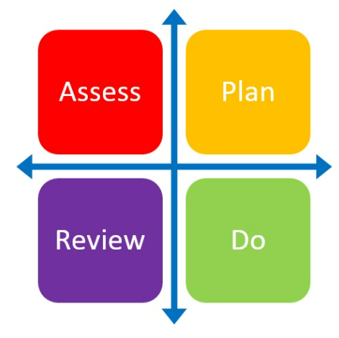
Section 2: Our Priorities and Aims
For Our Priority 4 we have chosen:
‘Ensure sufficiency and quality of provision in settings, schools and services so that children and young people can have their health, social care and educational needs met and feel part of the wider local community’
The aim is : Embed a sustainable offer based on the graduated response
This means that we will make sure we will deliver good quality in settings, schools, and services.
This is so that children and young people can have their health, social care and educational needs met and feel part of the wider local community.
We will do this by making sure we use the Ealing Graduated Response tool. The graduated response approaches are set up in four parts. ‘Assess, Plan, Do, Review'. This means: look at the situation, make a plan, follow the plan and then review it to see if it is working or not.
Page 12

Slide 13
Section 3: What you told us
The council takes your views into account when making their decisions.
Ealing Mencap asked Pupils in Ealing how young people want to be treated when they are talking to professionals in school/ services/ organisations
“Really listen to me. Don’t just nod and move onto something else or talk to someone else”.
“I like talking to my teacher as she knows me. She understands what I am trying to say when the words won’t come out”
“ At the end, explain what will happen next”
looked at what they wanted to be consulted on to make their experience better
“Explain to me why we are meeting/talking. Give me stuff to help me prepare and give my best”
“Let me know who else will be there and what they do. I get nervous with lots of people”
“Why do you want to hear what I have to say? I’ve told people what I think before but nothing changed”
“I don’t want to talk about the future. It makes me nervous”
Ealing Mencap looked at the 7 golden rules of Participation. The group discussed each point
1: Understand my Rights - They were unsure what their rights were and how to exercise them.
2: Chance to be involved
3: Remember - It's my Choice - “It’s my Choice” What is? The do not get what they get to choose
4: Value Me -
5: Support Me - Group feels that they have staff and people who they trust to help support them.
6: Work Together - Group enjoy working with new people and sharing experiences, but one young person said he only gets asked what he feels but nothing else
7: Keep in Touch - Group rarely gets feedback about next steps in consultations.
Page 13

Slide 14
Section 4: Our Priority Action Plans
Based on what you told us, and what people who work in Ealing supporting children and young people with SEND and what the families told us, an action plan for each of our 4 Priorities for the next 3 years has been written down.
The 4 Priority action plans set out the goals for each priority (what we want to achieve)
The Action plans have been written by the people that are leading on each of the 4 priorities. They are responsible helping everyone in the Priority Action plan with reaching their goals.
The plans have set out check points dates when we can ask for priority leads to tell us how they are doing, or if we need to do something else to get the goal (where we want to be).
Page 14

Slide 15
Section 4: Our Priorities and Aims
For Our Priority 1 we have chosen :
‘To provide guidance, earlier identification of needs and support for children, young people and their families, so that schools and settings feel supported to welcome every child and young person, and set the highest expectations for them.
The aim is: Ensure best practice is common practice to provide the right support.
This means that we will offer support and identify any needs early
Make sure that schools and settings feel supported to welcome every child and young person and to make them feel happy and comfortable
We will do this by making sure everyone has the correct support
Page 9

Slide 16
Section 2: Our Priorities and Aims
For Our Priority 2 we have chosen:
‘Every child and young person in Ealing is prepared for the transition to a purposeful adulthood with opportunities for training and meaningful employment’
The aim is: Young People at the centre of decisions about their future
This means that every child and young person is ready to become an adult and are supported with the transition.
That there will also be training available as well as opportunities for jobs they really want.
We will do this by making sure young people are involved in any decisions about their future.
Page 10

Slide 17
Section 2: Our Priorities and Aims
For Our Priority 3 we have chosen:
‘Ensure parents, young people and professionals work together to assess, review and meet needs and improve the quality of Education, Health and Care plans through co-production’
The aim is: Co-production is at the heart of what we do we do.
Co production means working together with parents/carers and young people.
This means that we will make sure parents, young people, and any professionals all work together to assess, review and meet needs of children and young people
We will also work together to improve the standards of Education, Health and Care Plans.
We will do this by making sure we all work together, and involve parents, young people and professionals.
Page 11

Slide 18
Section 2: Our Priorities and Aims
For Our Priority 4 we have chosen:
‘Ensure sufficiency of provision in settings, schools and services so that children and young people can have their health, social care and educational needs met and feel part of the wider local community’
The aim is : Embed a sustainable offer based on the graduated response
This means that we will make sure we will deliver good quality in settings, schools, and services.
This is so that children and young people can have their health, social care and educational needs met and feel part of the wider local community.
We will do this by making sure we use the Ealing Graduated Response tool. The graduated response approaches are set up in four parts. ‘Assess, Plan, Do, Review'. This means: look at the situation, make a plan, follow the plan and then review it to see if it is working or not.
Page 12

