Slide 1


Expansion of Early Years entitlements 2023-2025
Introduction
November 2023
Leah Forgacz-Cooper: Early Years Project Manager. Families Information Service
Email:forgaczcooperl@ealing.gov.uk
CHILDREN’S & ADULTS’ SERVICES

Slide 2
Contents
1. | Overview of childcare reforms | Page 2
2. | Childcare reforms- Key areas of change, milestones & timeline | Page 3
3. | ‘Help Us to Help You’ Ealing’s Sufficiency assessment | Slide 4
4 | What is the existing offer for free entitlements and how will this change up to 2025? | Page 5
5. | The eligibility criteria for government support packages | Page 6
6a. | Funding. EY supplementary grant payments: Sept 2023-March 2024 | Page 7
6b. | How do I activate my Tax-Free Childcare account? | Page 8
6c. | Childminder Start Up grants | Page 9
7. | Early Years Educator Apprenticeships | Page 9
8. | Outcomes of the EYFS consultation | Slide 10
9. | Childcare Choices Publicity & Information Campaign | Slide 11
10. | Where can I find more information? | Slide 12
11. | Key Contact List | Slide 13
1
Notes:
£368.9M net budget

Slide 3
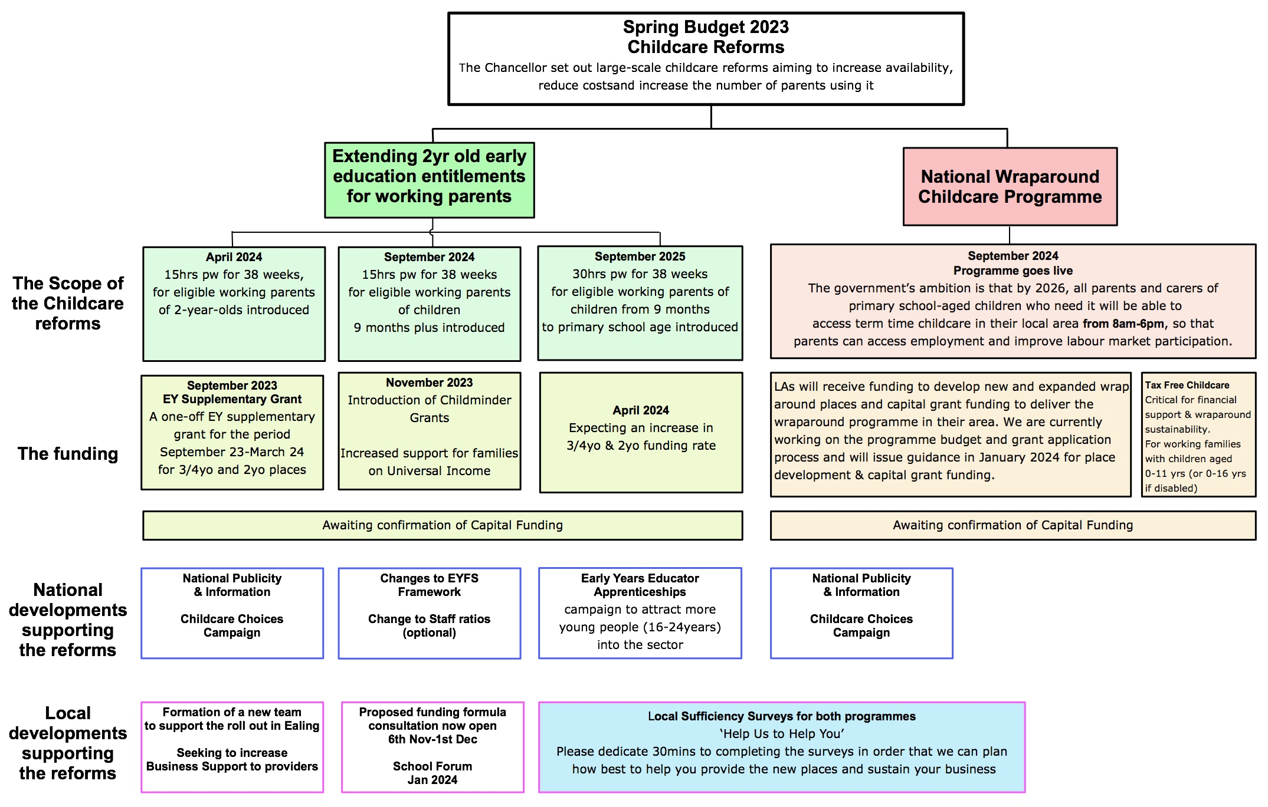
1. Overview of the childcare reforms
2
Notes:
£368.9M net budget

Slide 4
2. Childcare reforms- Key areas of change, milestones & timeline
Areas of change | Sept 2023 | Nov 23-March 2024 | April 2024 | June 2024 | Sept 2024 | Sept 2025 | Sept 2026
1. Extending early entitlements for working parents | Currently, parents who work more than 16 hours a week and earn less than £100,000 are entitled to 30hours free childcare a week for children aged three to four. |  | Programme Launch 15hrs pw for 38 weeks, for eligible working parents of 2-year-olds introduced |  | Programme Launch 15hrs pw for 38 weeks for eligible working parents of children 9 months plus introduced | Programme Launch 30hrs pw for 38 weeks for eligible working parents of children from 9 months to primary school age introduced
2. Wrap around childcare programme E.g. Breakfast & Afterschool clubs-8am-6pm |  | Local authorities expected to start planning and preparation for rollout of national programme DfE publishes guidance for schools LA information sessions LA to submit completed supply & demand mapping data to DfE |  | Deadline for LAs to submit delivery plan for programme funding to DfE SLAs, including monitoring agreements constructed and agreed between Schools/ Providers & LA & Grants distributed | Programme Launch National wraparound financial support to primary schools begins for two academic years | National wraparound financial support to primary schools continues | Wraparound financial support finishes in April 2026 All schools able to offer 8am-6pm wraparound on their own or in partnership
EY Supplementary Grant | A one-off EY supplementary grant for the period September 23-March 24 for 3/4yo and 2yo places
Expected increased funding rates |  |  | Expecting an increase in 3/4yo & 2yo funding rate
Childminder grants |  | Childminder grants become available on 30/11/23
Families on Universal income | Will pay childcare support up-front
Change in staff ratios (optional) New ‘Provider specific’ EYFS Frameworks | Changes to ratios for 2yr olds 1:4-1:5. Clarifying term ‘adequate supervision’ while children eating | Consultation response for EYFS & implementation of outcomes January 2024
New ‘Provider specific’ EYFS Frameworks | Changes to ratios for 2yr olds 1:4-1:5. Childminders can care for current max 3 children, when caring for siblings. Clarifying term ‘adequate supervision’ while children are eating |  | Further measures for flexibility of operation expected. Early 2024
3

Slide 5
3. ‘Help Us to Help You’- Ealing's Sufficiency Survey
Help Us to Help You
Ealing will be better placed to understand the needs of the sector which in turn will help with the roll out of the extension to early years entitlements and ensure we understand the sufficiency of places across the borough
Please spare 30 mins of your time to tell us about the current situation in your nursery and what your plans are for the future.
There are 3 online workshops to support with completion: Tuesday 21st at 10am Thursday 30th at 3pm and Tuesday 5th at 1pm.
Closing date for completion is Friday 8th December.
One provider will be drawn at random to receive a prize voucher from those completing the survey
Link to survey
https://forms.office.com/e/aYt7Dc44Ae
Advantages of completion for providers
Opportunity for you to tell us about what challenges you may be facing e.g. recruitment/staff retention/staff training/ support with SEND/ finance/business support etc.
This will enable us to understand your needs and we can work to support you overcome these barriers.
We can advocate on your behalf to bring together additional expertise and resources
The sufficiency report will assist you in understanding the current and future trends and potential business and training opportunities
It will help us all better meet the needs of children and support for families
4
Notes:
6
£368.9M net budget

Slide 6

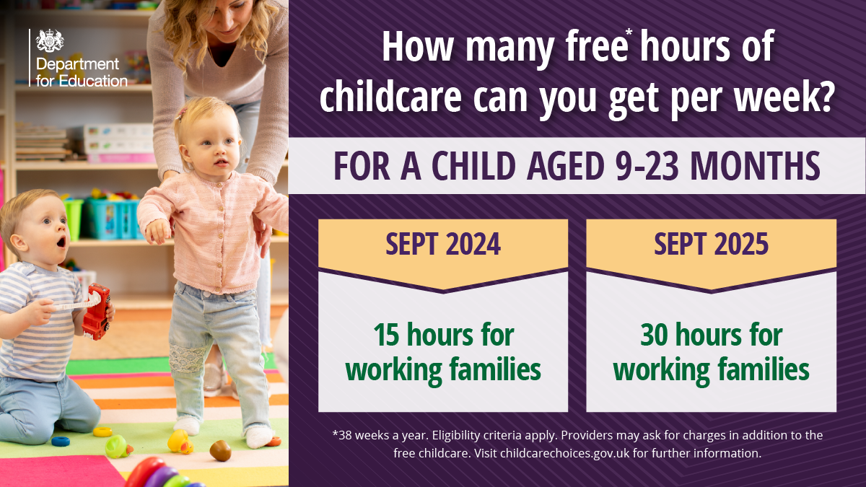
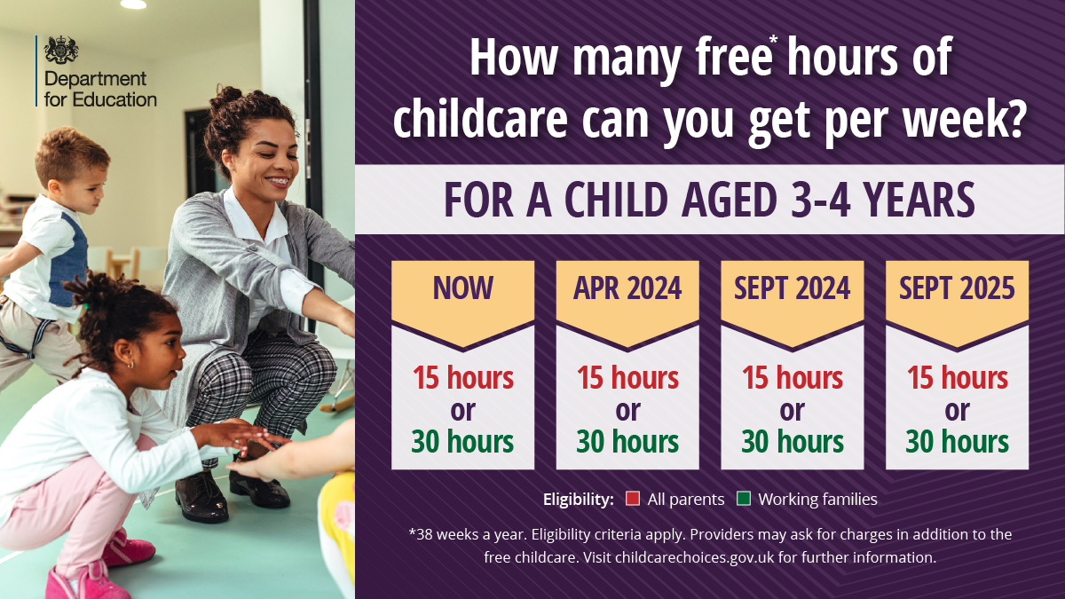
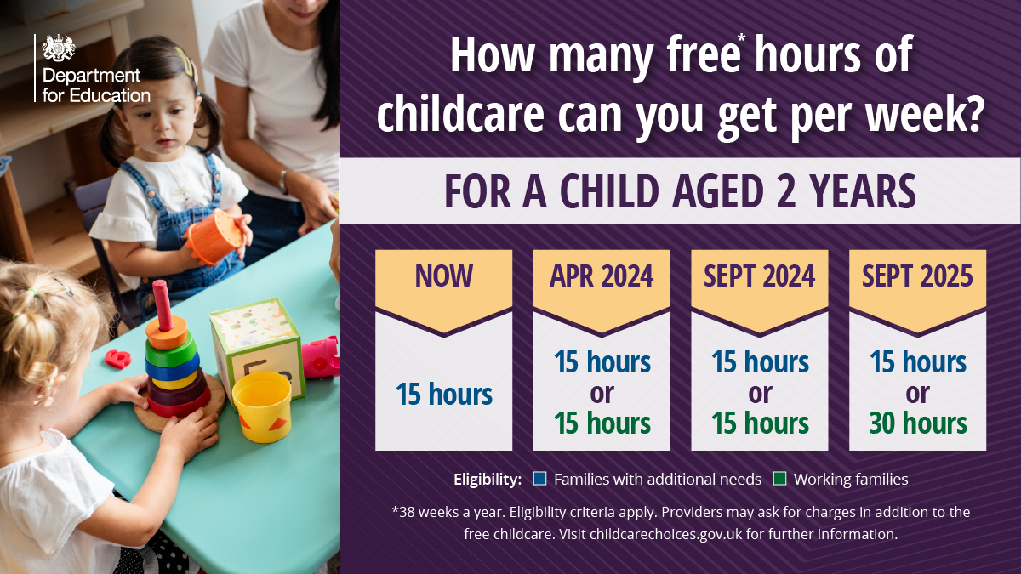
4. What is the existing offer for free entitlements and how will this change up to 2025?
Currently, all parents are entitled to 15 hours per week childcare for 3 and 4-year-olds. Parents who work more than 16 hours a week and earn less than £100,000 are entitled to 30 hours free childcare a week for children aged 3 and
Parents of disadvantaged 2-year-olds are also entitled to 15 hours per week childcare.
5

Slide 7
5. The eligibility criteria for government support packages
15 hours free childcare Age 2 | 15 hours free childcare Ages 3 & 4 | 30 hours free childcare | Tax – Free Childcare | Universal Credit support
For families in England, receiving some forms of support With 2-year-old children 15 hours of free childcare or early education for 38 weeks A total of 570 hours per year, that they can use flexibly with one or more childcare provider By already being registered, all early years settings are set-up to offer 15 hours free childcare | For all families in England with 3 and 4-year-old children 15 hours of free childcare or early education for 38 weeks A total of 570 hours per year, that they can use flexibly with one or more childcare provider By already being registered, all early years settings are set-up to offer 15 hours free childcare | For working families in England with 3 and 4-year-old children Earning under £100k and at least £152 per week (equal to 16 hours at the National Minimum or Living Wage) each 30 hours of free childcare or early education for 38 weeks A total of 1,140 hours per year, that they can use flexibly with one or more childcare provider By already being registered, all early years settings are set-up to offer 30 hours free childcare | For working families, including the self-employed, in the UK Earning under £100k and at least £152 per week (equal to 16 hours at the National Minimum or Living Wage) each Who aren't receiving Tax Credits, Universal Credit or childcare vouchers With children aged 0-11 (or 0-17 if disabled) For every £8 they pay into an online account, the government will add an extra £2, up to £2,000 per child per year (or up to £4,000 per child if disabled) Can be accessed through your registered providers and childminders who have activated their Tax-Free Childcare accounts. | For working families claiming Universal Credit, in England, Scotland, Northern Ireland and Wales With children under 17* Up to 85% of eligible childcare costs Who aren't receiving Tax-Free Childcare Can be accessed through registered providers or childminders.
6

Slide 8
6a. Funding. EY supplementary grant payments:
Sept 2023-March 2024
Funding Stream | Current Ealing Funding Rate to Providers | DfE - EYSG Published Supplementary Grant ACTUALS for Ealing | Total for Current Funding Rate + EY Supplementary Grant Published ACTUALS
2 YO | £6.92 | £2.26 | £9.18
3-4 YO | £4.73 | £0.37 | £5.10
MNS | £3.70 | £0.24 | £3.94
DAF | £828 full year per Child | £30.92 (per child 7/12) | £858.92 per child
EYPP | £0.62 | £0.04 | £0.66
Early Years consultation: Proposed funding formula for 2024/25
The purpose of this consultation is to seek the views, comments and where applicable, preferred options from key partners and stakeholders on arrangements of the Early Years block funding arrangements for 2024-25.
To seek views/comments on the Early Years Inclusion fund – proposal to hold at current levels.
To seek views/comments on the Early Years central spend – proposal to hold at current levels.
To seek views/comments on the Early Years Funding Pass Through - proposal to hold at current levels.
Unfortunately, we have no definitive figures to work with at present due to non-publication by the DfE
7

Slide 9

12. How do I activate my Tax-Free Childcare account?
Once registered with a regulator in the UK, you can boost your business and help reduce cost for working families by activating your Tax-Free Childcare (TFC) account. Setting it up is free and only takes around ten minutes.
After the registration process with the regulator has been completed, you should receive an invitation letter containing your unique 11 digit user ID, along with instructions on how to sign-up online to TFC. If you are already registered and haven’t received your invitation letter, you should contact the Childcare Service helpline: Tel:0300 123 4097 Mon-Fri 8am-6pm
Activating your TFC account:
You’ll find everything you need on the GOV.UK Tax-Free Childcare if you’re a childcare provider page. https://www.gov.uk/guidance/sign-up-to-tax-free-childcare-if-youre-a-childcare-provider
To sign up you’ll need your:
unique 11-digit user ID
business bank account details, so you can receive payments
business postcode (the one registered with your regulator)
Once you’ve signed up, you can:
Accept Tax-Free Childcare payments and get a childcare provider account which you can use to keep your details up to date • Manage payments online 24/7 (using your provider account)
Promote the financial benefits to your customers
Still accept payments from parents using childcare vouchers and other methods
Visit the Childcare Choices information for providers page to learn more about Tax-Free Childcare and how it can help your business https://www.childcarechoices.gov.uk/providers/
For working families, including the self-employed, in the UK
Earning under £100k and an average of £167 per week (equal to 16 hours at the National Minimum or Living Wage) each over three months
Who aren't receiving Tax Credits, Universal Credit or childcare vouchers
With children aged 0-11 (or 0-16 if disabled)
For every £8 families pay into an online account, the government will add an extra £2, up to £2,000 per child per year
8

Slide 10
6c. Funding
Childminder start up grants
7. Early Years Educator Apprenticeships
For new childminders that complete their registration between 15th March 23-31st March 25.
Must apply within 2 months of registering.
Childminders applying to an agency with receive first £600 following registration and a second payment of £600 once operational and caring for at least one child.
New childminders (these are individuals who have not been previously registered with Ofsted or child-minding agency within 12mths prior applying for grant)
Applications open on 30th Nov 2023.
DfE have launched social media campaign to attract more young people (16-24years) into the sector.
Ealing have a strong apprenticeship offer in place.
Already support in place for both employer and apprentice.
Additional work to commence in schools in partnerships with Connexions specifically around Early years apprenticeships.
9

Slide 11
8. Outcomes of the EYFS consultation
We have recently had the first update to the EYFS which came into force on Sep 4th 2023. The DfE have also consulted on further flexibilities that they believe would support the sector to meet the needs of the expansion to early years entitlements. This consultation closed on the 26th July and on 27th October the outcomes have been published. Further flexibilities to the EYFS have been agreed and are expected to apply from Jan 2024.
There are 2 areas that were consulted on that will not proceed:
Change in qualifications requirement outside of peak hours.
Reduce the percentage of Level 2 qualified staff required per ratio from "at least half" to 30 or 40% of all other staff.
23 further amendments will proceed, Examples below:
Create two separate EYFS frameworks (one for childminders and one for group and school-based providers)
Remove the requirement for level 3 practioners to hold Level 2 maths qualification to count within staff:child ratios and instead place this requirement on managers (for group and school-based providers only)
Allow students and apprentices to count in staff:child ratios (for group and school-based providers only)
For the full document see Early years foundation stage regulatory changes - consultation response (publishing.service.gov.uk)
10

Slide 12
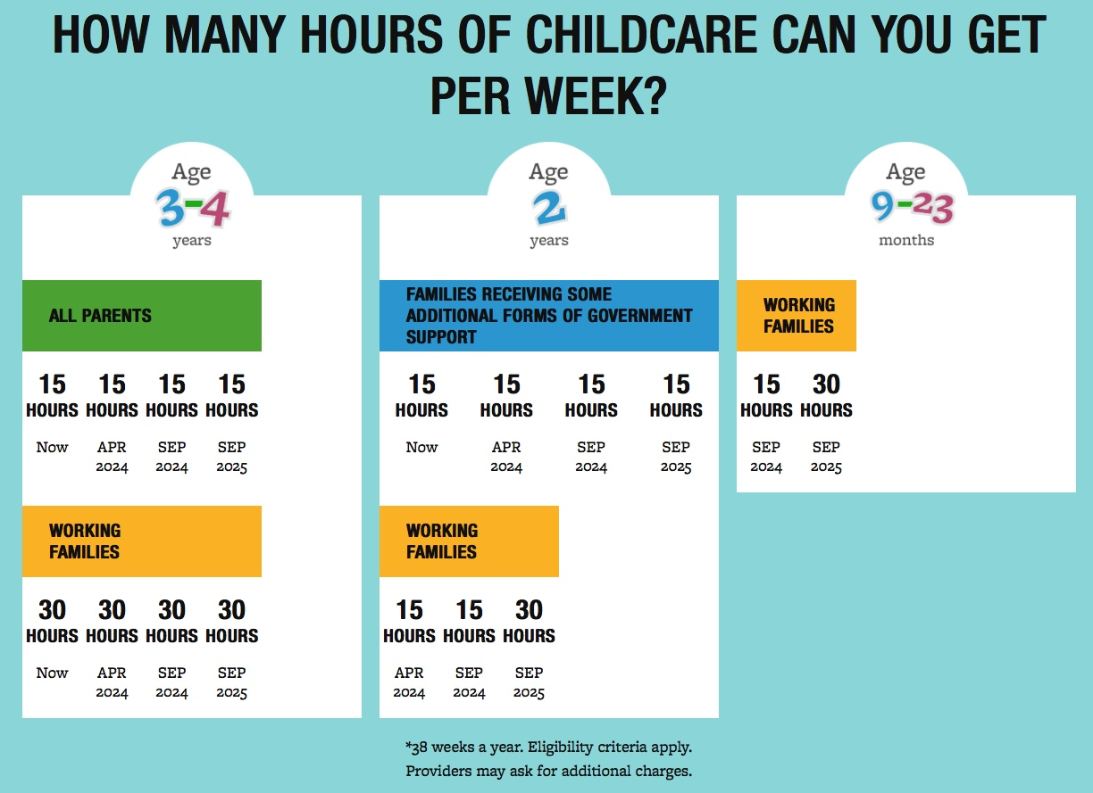
9. Childcare Choices Campaign
Childcare Choices is a cross-government campaign that aims to make more parents aware of the financial support on offer to help them with the costs of childcare.
The Childcare Choices website has now been updated to allow parents to find out what they will be eligible for and when to apply
There is also a resource page for childcare providers covering:
  Tax Free Childcare
  Business Resources
Link: https://www.childcarechoices.gov.uk
An online childcare support checker is available to help parents find the right childcare offer for them and learn how much money they can save.
An explainer summarising how entitlements are changing between now and September 2025 is available
The DfE Education Hub provides accessible information for parents, pupils and education professionals, including this piece on how we are tackling the cost of childcare.
Content is available to share on social channels, including Twitter, Facebook, LinkedIn and Instagram.
More information on wider financial support is available on the Help for Households website and leaflet.
htpps://helpforhouseholds.campaign.gov.uk
11
Notes:
13
£368.9M net budget

Slide 13
10. Where can I find more information?
Other Sources of Information
The Childcare Choices campaign helps parents understand the government childcare offers
available to them. https://www.childcarechoices.gov.uk
The Childcare Choices provider information toolkit, with guidance and resources is available here:
https://www.childcarechoices.gov.uk/providers/
The DfE Education Hub provides accessible information for parents, pupils and education
professionals, including these pieces on how we are growing our 30 hours free childcare offer and Budget 2023: Everything you need to know about childcare support.
Information about wider support for families and households is available on the Help for
Households website. https://helpforhouseholds.campaign.gov.uk
12

Slide 14
11. Key Contacts
EY Programme Manager
Key Contacts
Early Years Finance
Leah Forgacz-Cooper:
Early Years Project Manager. Families Information Service
Email:forgaczcooperl@ealing.gov.uk
Bryn Jones
Early Years Data Officer (Funding queries)
BJones@ealing.gov.uk
Bridget Keni
Early Years Support Officer (Portal queries/ basic payment queries)
Kenib@ealing.gov.uk
Anne Reilly
Early Years Business and Finance Manager
Reillya@ealing.gov.uk
Key point of contact and funding timetable can be found at:
Business and early years' funding | Ealing Grid for Learning (egfl.org.uk)
EGFL Page
https://www.egfl.org.uk/services-children/early-years/expansion-early-education-entitlements-and-wrap-around-provision-primary-schools-2023-2025
Childcare Choices
Childcare Choices is a cross-government campaign that aims to make more parents aware of the financial support on offer to help them with the costs of childcare.
The Childcare Choices website has now been updated to allow parents to find out what they will be eligible for and when to apply
There is also a resource page for childcare providers covering:
Tax Free Childcare
Business Resources
Link: https://www.childcarechoices.gov.uk
13

