Slide 1
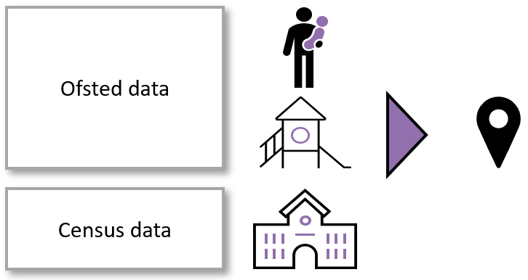
EY Sufficiency: DfE LA Readiness Data
Local Authority Readiness: Self-Assessment Data for the Expanded EY Entitlements and Wraparound Childcare Pathfinder Scheme (DFE December 2023)
Introduction
The DfE has provided Ealing local authority (LA) with information related to the expansion of funded early education and childcare entitlements and wraparound childcare announced in the Spring Budget of 2023.
Presented below are the outputs of Department for Education (DfE) analysis of the demand and supply of childcare places in Ealing. This information is presented to assist LAs in planning for the roll-out of the new 30 hours childcare entitlement for working parents of 9-month to 36-month-olds and help LAs identify where increased supply of wraparound childcare may be needed, so that all parents of school-age children can access childcare from 8am to 6pm, if they need it
Analysis overview
Data on the supply of childcare places in Ealing has been gathered from Ofsted management information as at the 30th June 2023 and the annual school census. These data allow supply of childcare places by type (places in childminders, group based providers and school based providers) to be associated to each ward.
Once the number of childcare places in each ward has been established we can work out how many supply hours these places represent.

Slide 2
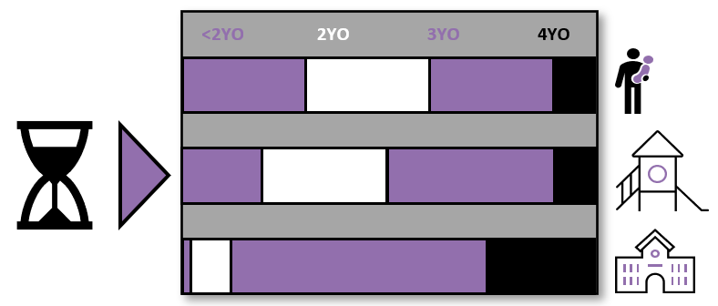
EY Sufficiency: Assumptions and Summary
Assumptions used
each place can provide 35 hours of child contact time in a week if supplied by a group-based provider or childminder.
We assume that school-based providers offer 30 place per week.
However, different provider types tend to offer different numbers of places to different age groups.
Summary
Estimated places needed and proportional increase in supply hours:
In Ealing the DfE estimate that overall, 443 places will need to be created by September 2025. This relates to a 9% increase in supply of childcare hours.
However, when estimates are mapped across each Ward, we can see clearly the distribution of places is uneven, leaving some Wards with a deficit of places and families needing to seek places outside of their Ward in which they are resident.

Slide 3
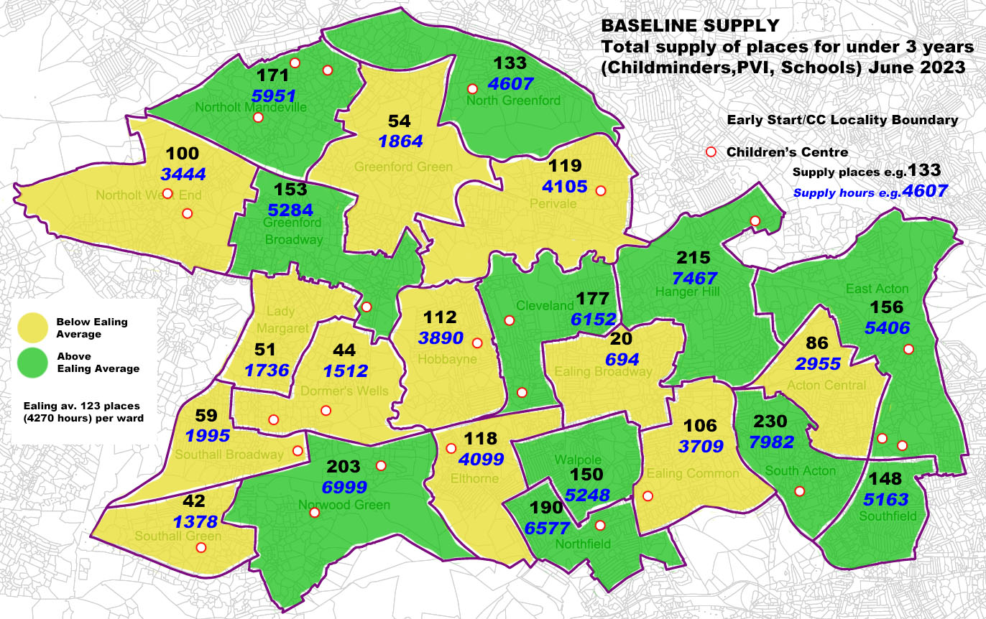
EY Sufficiency: Baseline Supply
Notes on Maps:
Due to the time periods in which data was utilised by the DfE for the calculations, the former configuration of Wards has been used for analysis
Data for each Ward has been given in both in estimated places and estimated supply hours
This map is illustrating the distribution of places/supply hours at June 2023.
This is used as the baseline in the calculations to determine the supply of EY as the new expansion of eligibility come into effect.
We can already observe an uneven distribution across the Wards

Slide 4
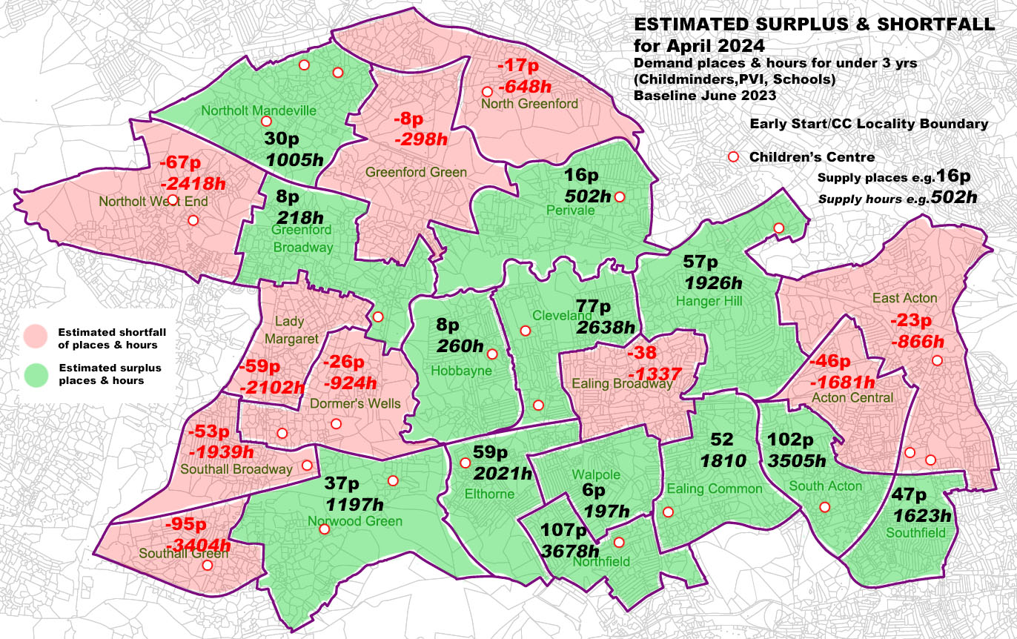
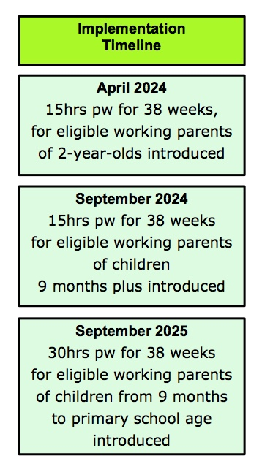
EY Sufficiency: Estimated surplus & shortfall across Wards: APRIL 2024
This map illustrates those Wards estimated to have a surplus of places/ hours and those which are estimated to have a shortfall.
Although it is estimated that we will have sufficient places in total across the borough to meet the demand in April 2024, it is evident that parents’ resident in Wards, particularly in Southall, Northolt, Acton & Greenford may have to travel outside of their Wards to secure EY places.

Slide 5
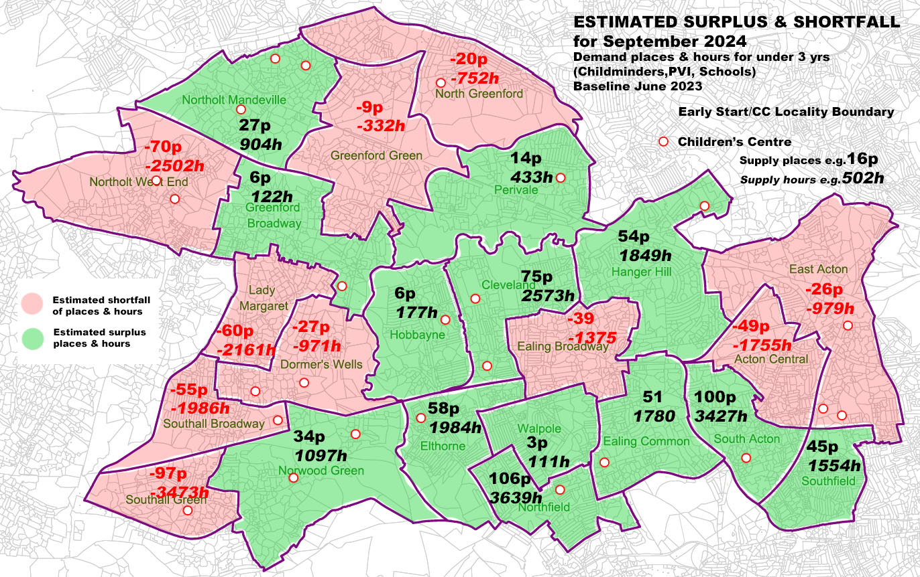
EY Sufficiency: Estimated surplus & shortfall across Wards: SEPTEMBER 2024
This map illustrates those Wards estimated to have a surplus of places/ hours and those which are estimated to have a shortfall.
It is estimated that we will have to increase places by 2% by September 2024, it is evident in this map that demand is increasing and supply is decreasing.
The sector will need to be closely monitored and supported to increase the baseline supply of EY places, particularly in areas with large deficits of places.

Slide 6
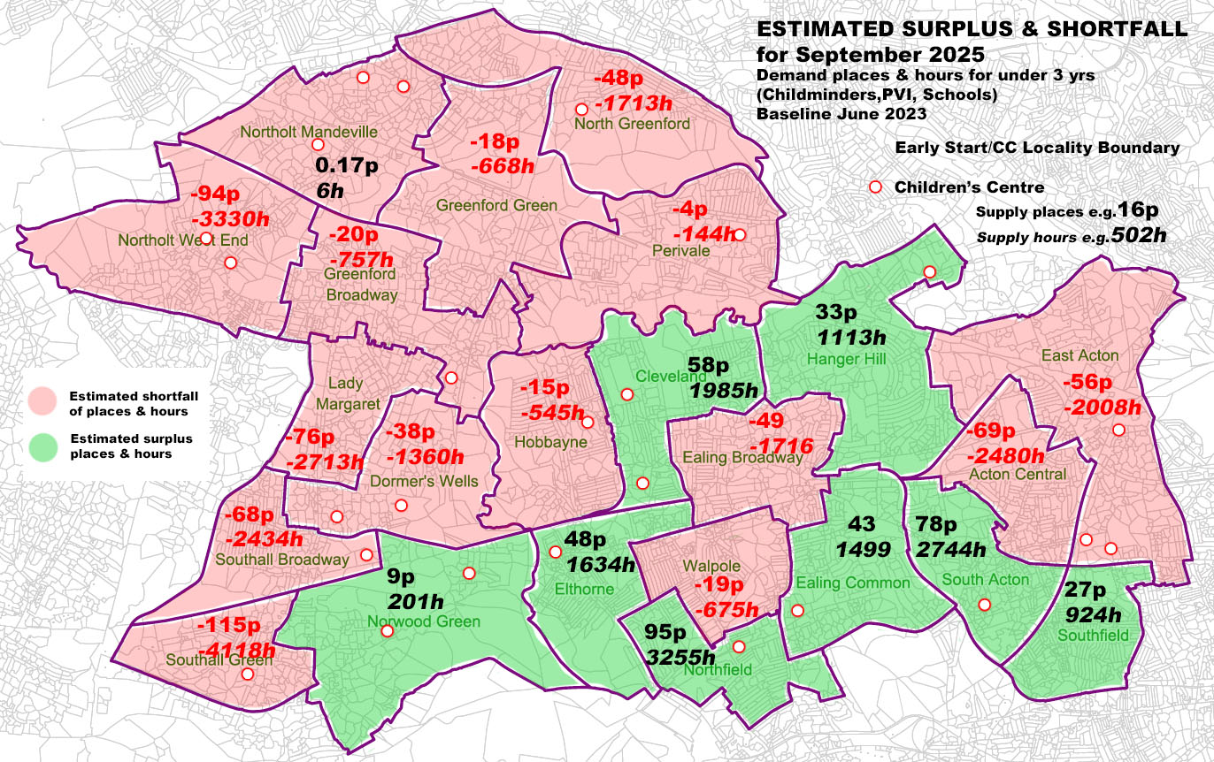
EY Sufficiency: Estimated surplus & shortfall across Wards: SEPTEMBER 2025
This map illustrates those Wards estimated to have a surplus of places/ hours and those which are estimated to have a shortfall.
It is estimated that we will have to increase places by 9% by September 2024.
This map illustrates, that without a concerted strategy to increase the availability of EY places, the majority of the Wards in the West of the borough will have no available EY places, with high demand also in Central and East Acton.

Slide 7
EY Sufficiency: Baseline Supply by Provider Type June 2023
SUPPLY BY PROVIDER TYPE | SUPPLY BASELINE JUNE 2023
Ward Name | Childminders Supply Hours (CM) | Places (1 place converted into 35 supply hours) | Group Based Providers Supply Hours (GBP) | Places (1 place converted into 35 supply hours) | School Based Providers Supply Hours (SBP) | Places (1 place converted into 30 supply hours) | TOTAL (SUPPLY HOURS) | TOTAL PLACES
Acton Central | 265 | 7.6 | 2,453 | 70 | 237 | 7.9 | 2,955 | 85.6
Cleveland | 728 | 20.8 | 5,131 | 147 | 293 | 9.8 | 6,152 | 177.2
Dormers Wells | 0 | 0.0 | 1,260 | 36 | 252 | 8.4 | 1,512 | 44.4
Ealing Broadway | 331 | 9.5 | 363 | 10 | 0 | 0.0 | 694 | 19.8
Ealing Common | 430 | 12.3 | 3,172 | 91 | 107 | 3.6 | 3,709 | 106.5
East Acton | 397 | 11.3 | 4,707 | 134 | 302 | 10.1 | 5,406 | 155.9
Elthorne | 375 | 10.7 | 3,474 | 99 | 250 | 8.3 | 4,099 | 118.3
Greenford Broadway | 265 | 7.6 | 4,553 | 130 | 466 | 15.5 | 5,284 | 153.2
Greenford Green | 187 | 5.3 | 1,465 | 42 | 212 | 7.1 | 1,864 | 54.3
Hanger Hill | 463 | 13.2 | 6,623 | 189 | 381 | 12.7 | 7,467 | 215.2
Hobbayne | 871 | 24.9 | 2,839 | 81 | 180 | 6.0 | 3,890 | 112.0
Lady Margaret | 66 | 1.9 | 1,357 | 39 | 313 | 10.4 | 1,736 | 51.1
Northfield | 507 | 14.5 | 5,645 | 161 | 425 | 14.2 | 6,577 | 189.9
North Greenford | 662 | 18.9 | 3,649 | 104 | 296 | 9.9 | 4,607 | 133.0
Notholt Mandeville | 816 | 23.3 | 4,958 | 142 | 177 | 5.9 | 5,951 | 170.9
Northolt West End | 529 | 15.1 | 2,580 | 74 | 335 | 11.2 | 3,444 | 100.0
Norwood Green | 66 | 1.9 | 6,337 | 181 | 596 | 19.9 | 6,999 | 202.8
Perivale | 441 | 12.6 | 3,283 | 94 | 381 | 12.7 | 4,105 | 119.1
South Acton | 99 | 2.8 | 7,463 | 213 | 420 | 14.0 | 7,982 | 230.1
Southall Broadway | 66 | 1.9 | 1,438 | 41 | 491 | 16.4 | 1,995 | 59.3
Southall Green | 132 | 3.8 | 672 | 19 | 574 | 19.1 | 1,378 | 42.1
Southfield | 1,114 | 31.8 | 4,049 | 116 | 0 | 0.0 | 5,163 | 147.5
Walpole | 948 | 27.1 | 4,193 | 120 | 107 | 3.6 | 5,248 | 150.5
TOTALS | 9,758 | 279 | 81,664 | 2,333 | 6,795 | 227 | 98,217 | 2838.6
This table provides the detail regarding the baseline supply and could be utilised to identify sectors and Wards which may need support to increase provision and to monitor the fluctuations of supply over the next two years

Slide 8
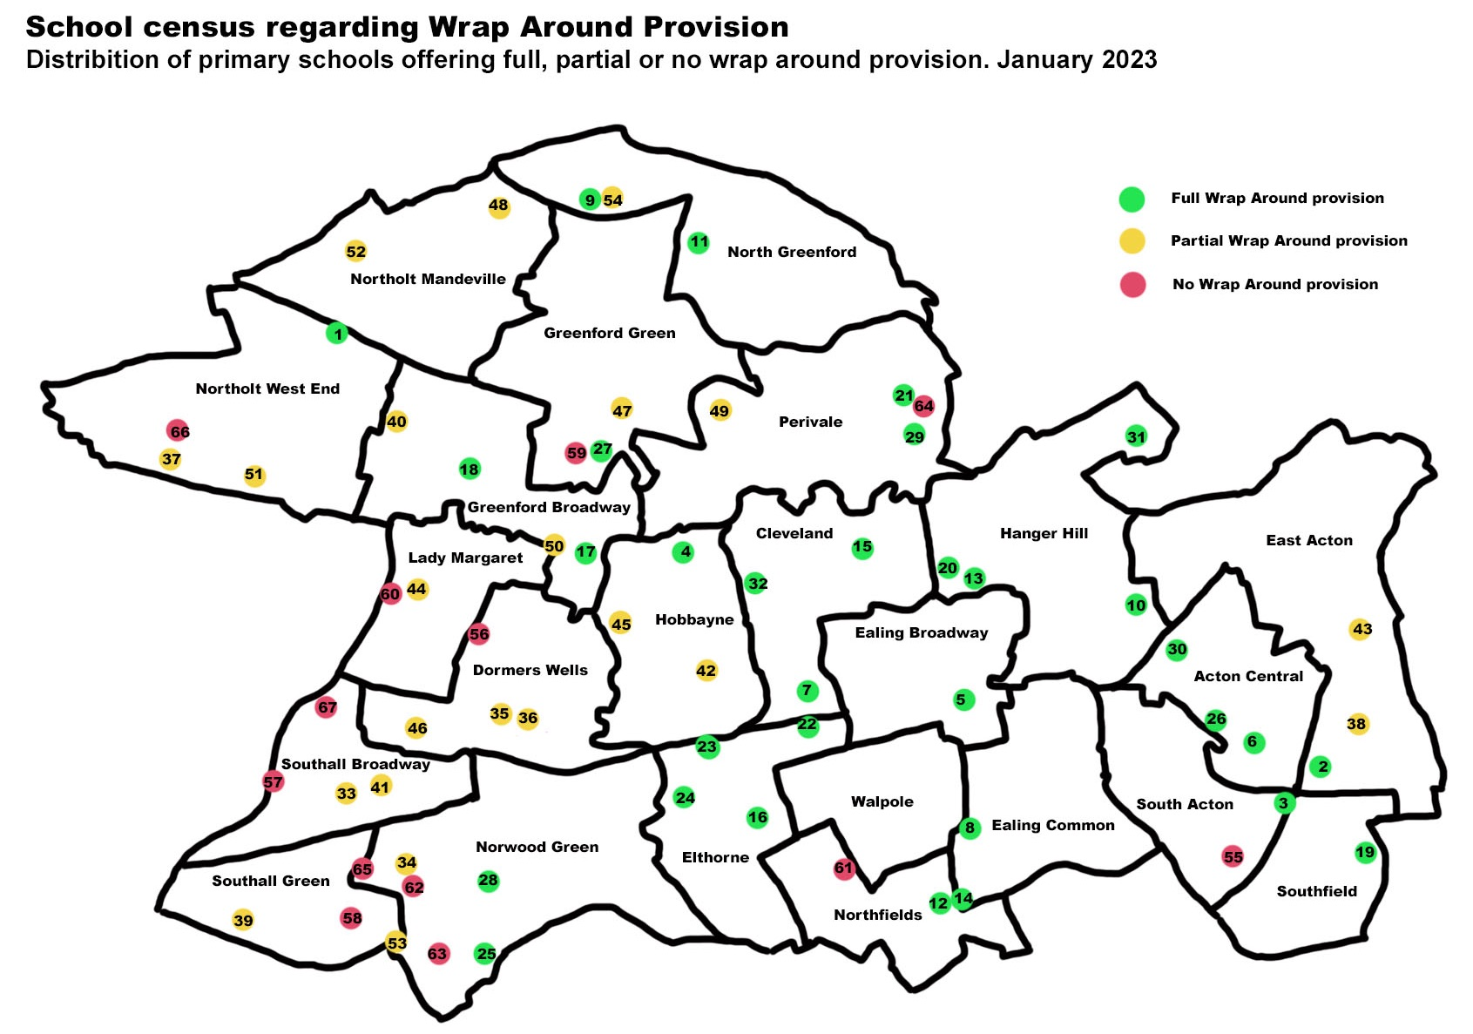
EY Sufficiency: Baseline Map for Wrap Around School Provision at January 2023
The map is indicating a higher proportion of partial or no wrap around provision in the Southall Wards

Slide 9
EY Sufficiency: Key to baseline map for Wrap Around School Provision at January 2023
Wrap Around School Status at January 2023: KEY to MAP
Number | Full Wrap Around |  | Partial Wrap Around |  | No Wrap Around
1 | Alec Reed Academy | 33 | Beaconsfield Primary and Nursery School | 55 | Acton Gardens Primary School
2 | Ark Byron Primary Academy | 34 | Dairy Meadow Primary School | 56 | Allenby Primary School
3 | Ark Priory Primary Academy | 35 | Dormers Wells Infant School | 57 | Blair Peach Primary School
4 | Brentside Primary School | 36 | Dormers Wells Junior School | 58 | Clifton Primary School
5 | Christ the Saviour C of E Primary School | 37 | Downe Manor Primary School | 59 | Coston Primary School
6 | Derwentwater Primary School | 38 | East Acton Primary School | 60 | Durdans Park Primary School
7 | Drayton Green Primary School | 39 | Featherstone Primary and Nursery School | 61 | Fielding Primary School
8 | Grange Primary School | 40 | Gifford Primary School | 62 | Havelock Primary School Nursery & Arp
9 | Greenwood Primary School | 41 | Hambrough Primary School | 63 | Khalsa Primary School
10 | Holy Family Catholic Primary School | 42 | Hobbayne Primary School | 64 | Perivale Primary School
11 | Horsenden Primary School | 43 | John Perryn Primary School | 65 | St Anselm's Catholic Primary School
12 | Little Ealing Primary School | 44 | Lady Margaret Primary School | 66 | St Raphael's Catholic Primary School
13 | Montpelier Primary School | 45 | Mayfield Primary School | 67 | Tudor Primary School
14 | Mount Carmel Catholic Primary School | 46 | North Primary School
15 | North Ealing Primary School | 47 | Oldfield Primary School
16 | Oaklands Primary School | 48 | Petts Hill Primary School
17 | Our Lady of the Visitation Catholic Primary School | 49 | Selborne Primary School
18 | Ravenor Primary School | 50 | Stanhope Primary School
19 | Southfield Primary School | 51 | Viking Primary School )
20 | St Gregory's Catholic Primary School | 52 | Willow Tree Primary School
21 | St John Fisher Catholic Primary School | 53 | Wolf Fields Primary School
22 | St John's Primary School | 54 | Wood End Primary School
23 | St Joseph's Catholic Primary School
24 | St Mark's Primary School
25 | St Mary's Church of England Primary Norwood Green
26 | St Vincent's Catholic Primary School
27 | The Edward Betham Church of England Primary School
28 | Three Bridges Primary School
29 | Vicar's Green Primary School
30 | West Acton Primary School
31 | West Twyford Primary School
32 | Woodlands Academy

