Slide 1
Ealing School Attendance Service
Autumn Term 23-24
Network Meeting
20.09.2023
Please turn cameras off and mute your microphones. The meeting will start shortly.
Notes:
1

Slide 2
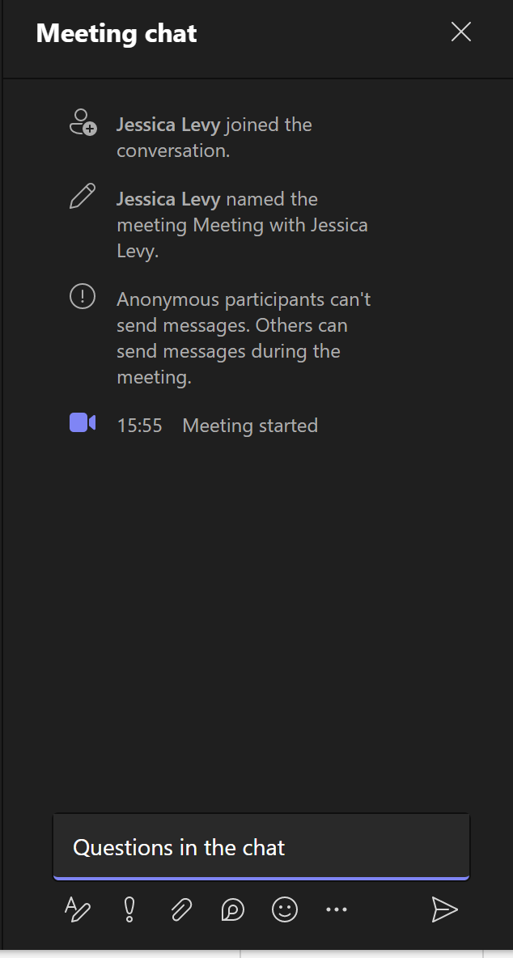
Welcome
This meeting will be recorded, and slides will be shared
Topics to be covered today
New team members
Guidance booklet
Service Level Agreement
Referral process - recap
CMOE
Severely Absent – multi-agency panel
Benchmark data
Questions
Please add questions to the chat throughout the presentation
Notes:
2

Slide 3
Ealing School Attendance and
CME Team
2023-2024
Lucinda Poole – Attendance and CME Team Leader 020 8825 5768 - lpoole@ealing.gov.uk
Alison Mornix – School Attendance Officer 020 8825 8806 - amornix@ealing.gov.uk
John O’Sullivan – School Attendance Officer 020 8825 6109 - josullivan@ealing.gov.uk
Jessica Levy – School Attendance Officer 020 8825 6014 - levyj@ealing.gov.uk
Hannah Mensah Howard – School Attendance Officer 020 8825 5367 - mensahhowardh@ealing.gov.uk
Claire Hooper – Children Missing Education Officer 020 8825 5517 - cme@ealing.gov.uk
Parminder Bantleman - Administrative and Support Officer (Fixed Penalty Fines) 0208 825 5040 - Penalty-holiday@ealing.gov.uk
Jessica Kulsingam – School Attendance and CME Apprentice
Vipul Dhamecha – School Attendance Officer 0208 825 6132 - dhamechav@ealing.gov.uk
Diane Jacobs – School Attendance Officer 0208 825 9717 - jacobsdi@ealing.gov.uk
Notes:
3

Slide 4
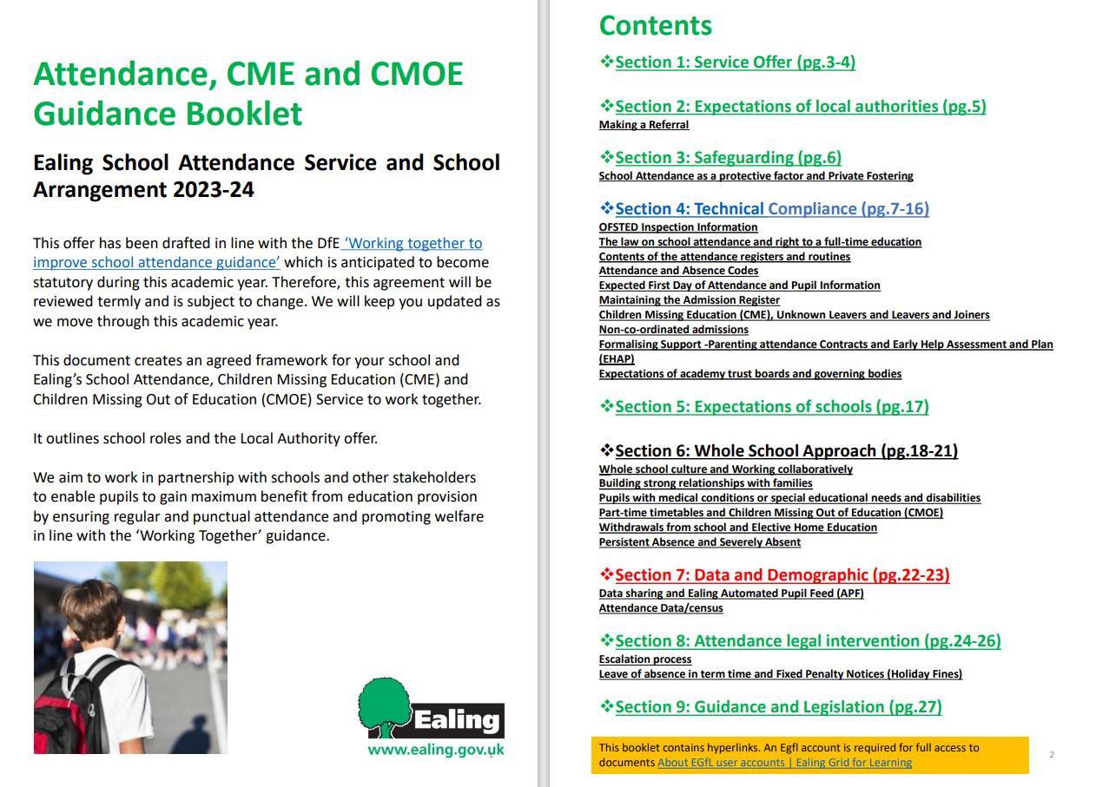
Attendance, CME and CMOE
Guidance Booklet
Hyperlinks will take you to the relevant DfE Guidelines, page in the booklet or the Attendance Toolkit
Notes:
This academic year our team have put together an attendance, CME and CMOE guidance booklet, that replaces the Service Level Agreement. The booklet will be sent to you in advance of your SLA meeting and is available on egfl. We have organised the advice into three key areas; technical compliance, whole school approach and data and demographics. The document contains hyperlinks to all of the latest Attendance guidelines and the toolkits on egfl. We hope that you find the format easy to use, and a useful resource for your school.
Attendance | Ealing Grid for Learning (egfl.org.uk)
4

Slide 5
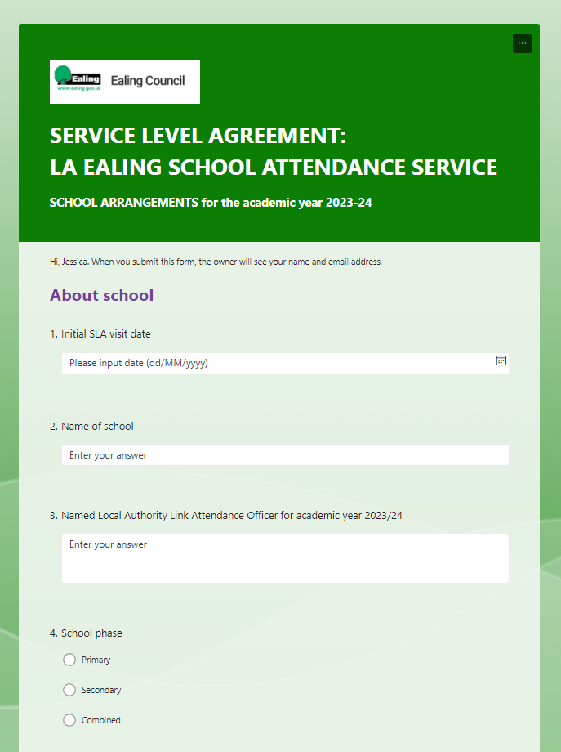

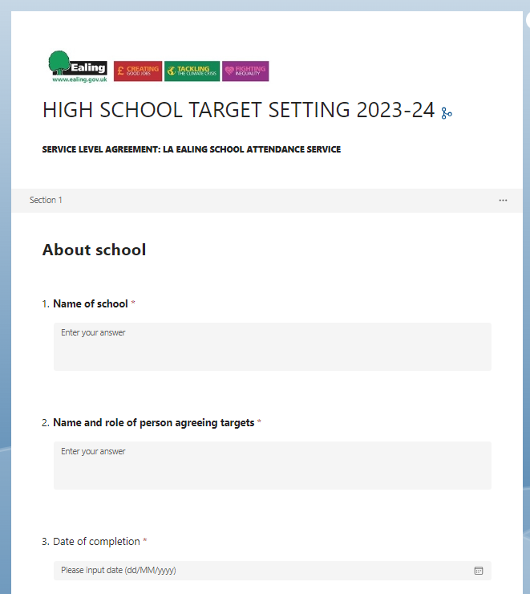
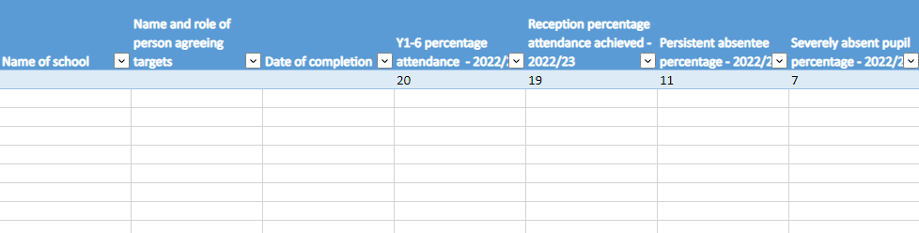
Service Level Agreement 2023-24
Benefits to school include:
More succinct format
Separate, easy to follow guidance booklet
Allows targeted support
Agreed targets will be emailed to school in an Excel spreadsheet
Notes:
The Service Level Agreement process will take on a different format this year. Our Attendance Officers will be using an interactive form to collect an initial snapshot of your school attendance arrangements. We will also be inviting you to set attendance targets for your school and consider monitoring specific groups within the borough and your specific cohort. The agreed targets will be emailed to you after the meeting in an Excel spreadsheet. Your link officer will be in touch to arrange a meeting for this term very soon.

Slide 6

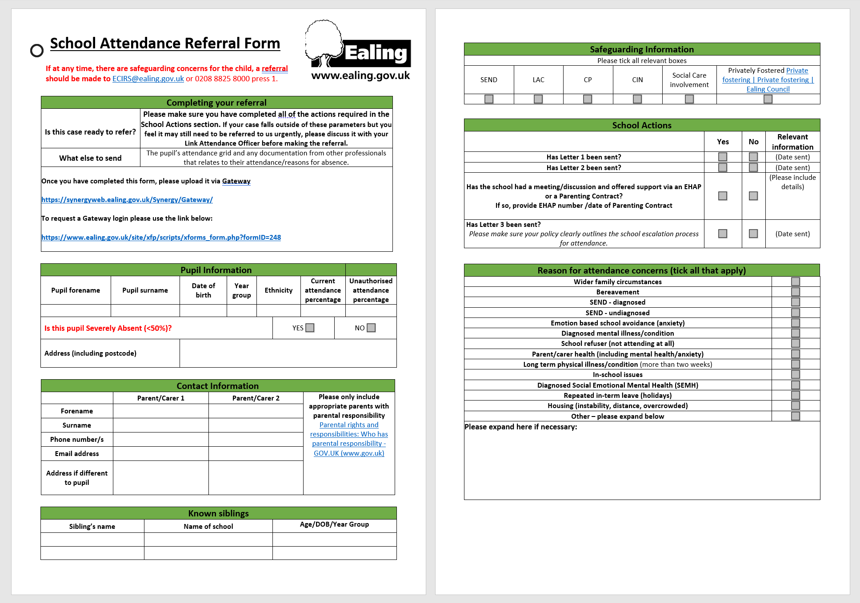
Making a referral
Completed forms will be uploaded via Gateway
(all documents as PDF)
Notes:
The referral for attendance cases remains largely the same and is on egfl in word format. We ask that all referrals to our team are now made via Gateway. Please remember you can contact your link officer for advice at anytime via email or phone. Your termly targeting support meetings will also give you an opportunity to discuss potential referrals. If a case was discussed with your link officer last academic year; please check if you need to make a new referral. If there hasn’t been any active work, your link officer may ask you to send a referral once you have carried out your internal escalation processes/referred to the Persistent Absentee flow-chart. The flow-chart is available as part of the toolkit on egfl. Attendance | Ealing Grid for Learning (egfl.org.uk) Children missing education (CME) | Ealing Grid for Learning (egfl.org.uk)
6

Slide 7

Gateway
Step 1: request access to Gateway
Email: ealingeducationICT@ealing.gov.uk
The person responsible for uploading the referral should request a login to the Gateway
This needs to be assigned to a named email address i.e. jrsmith@testschool.sch.uk not admin@testschool.sch.uk
Accounts close after 45 days of inactivity, and you will need to request re-instatement
Notes:
To get started with Gateway, you will need to request a login from Ealing Education ICT. The account needs to be set up with a named email address, and accounts do close after 45 days of inactivity.
SENDCOs with existing log-ins will need to request access to the ‘school referral’ profile to make CMOE uploads.
7

Slide 8
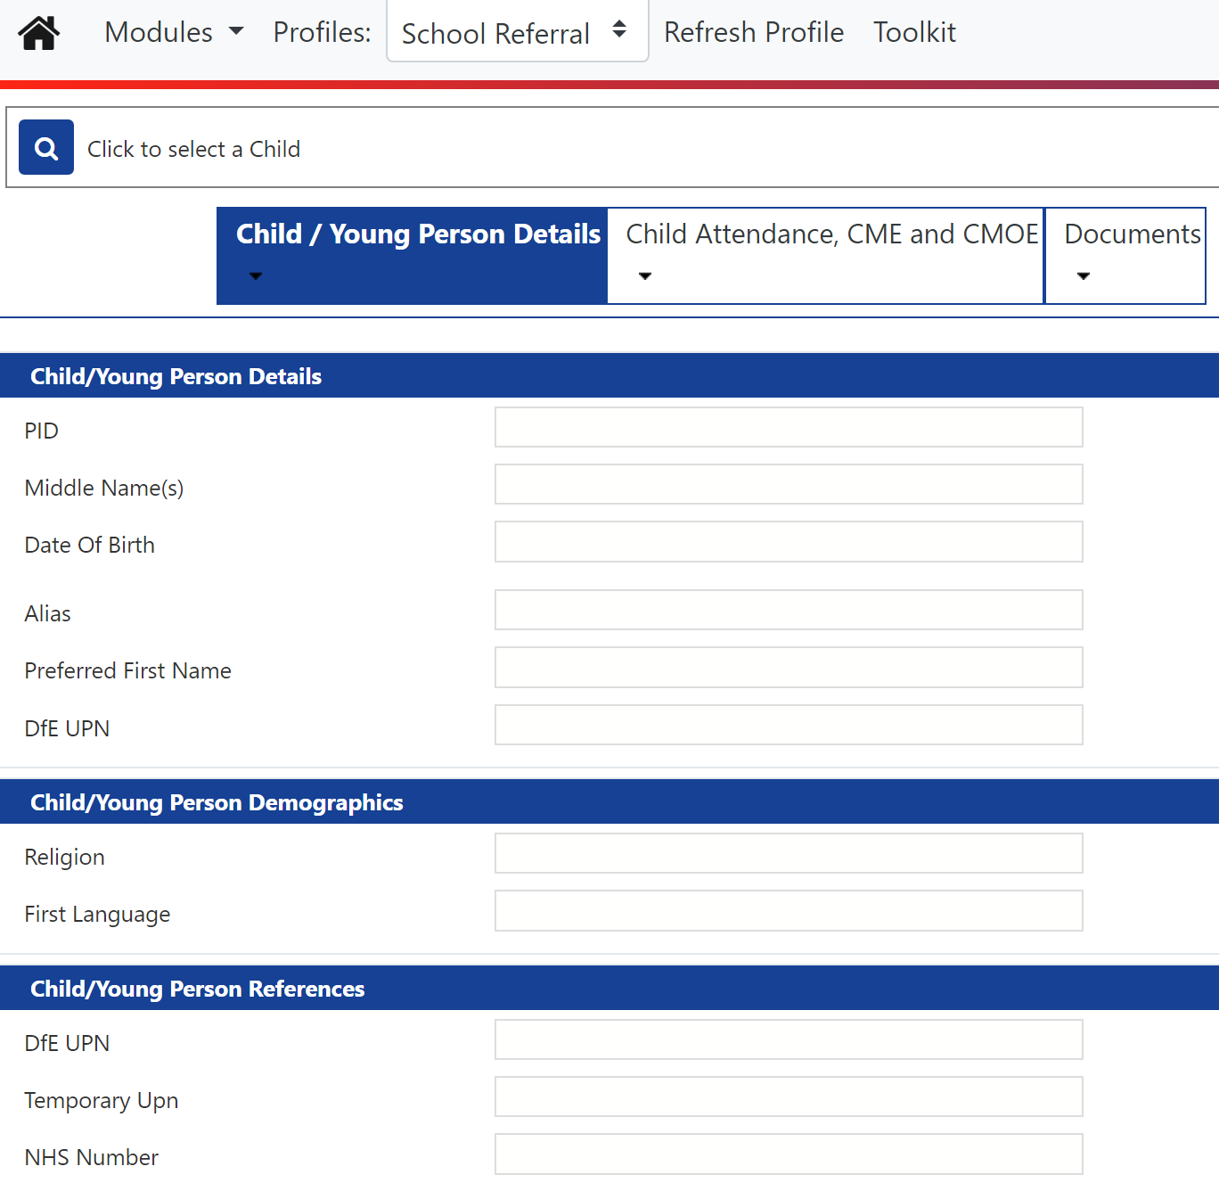
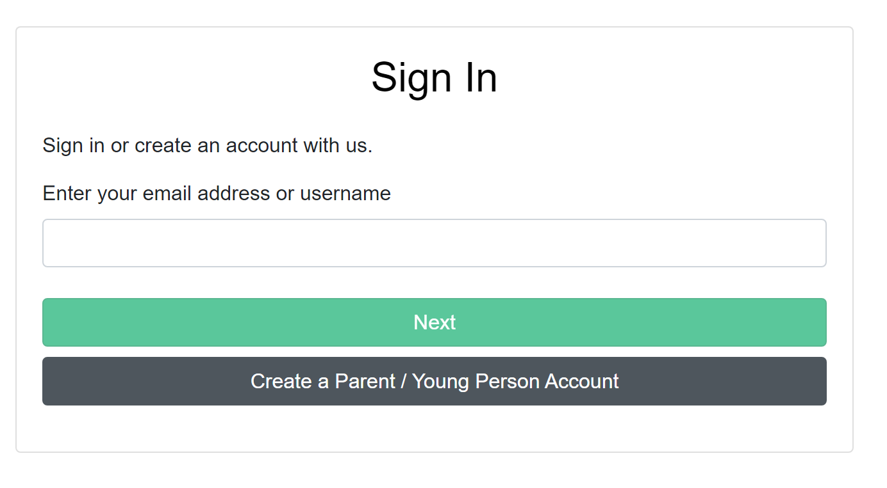
Step 2: access to Gateway
ttps://synergyweb.ealing.gov.uk/Synergy/Gateway/
Notes:
Once you have received your log-in details, you will need to use the link above to be taken to the Gateway portal
Sign In - Parent and Professional Portal (ealing.gov.uk)
8

Slide 9
Using Gateway to make an Attendance referral
If you cannot locate the pupil on the Gateway,
please email ealingeducationICT@ealing.gov.uk
for assistance
Notes:
2. Navigate to the second tab
Navigate to the second tab at the top of the page. This is the area where you are going to select the type of referral you want to make:
Children Missing Education (CME)
Children Missing Out on Education (CMOE)
School Attendance Referral
Unauthorised Term Time Leave (Holiday fine)
If you are sending a CMOE notification, you will also need to complete the hours in school, hours in alternative provision and combined hours section.
3. Navigate to the third tab: document upload
Move onto the third tab and upload your referral documents. This will include the referral form, and any other relevant information. Documents can only be uploaded in PDF or JPEG format. You will need to select new, and then give the document a title. You can then navigate to the document you wish to upload using the upload new file button. Importantly you will need to select the Document Category from the four options, so that our team know which type of referral is being made.
Submission tab
The final stage is the school referral submission tab. Here you will need to click on the run report icon in the right-hand corner. A pop-up box will give you four options. Please also check the open report after creation button. You will then be given an instant PDF receipt for your referral.
Locate the pupil
Once logged into Gateway, you will need to do is locate the pupil. Click on the magnifying glass search symbol in the top left-hand corner. You can search by date of birth, forename, surname etc. Once you have located the pupil you click on the selection to load the page. If you cannot locate the pupil, please contact Ealing Education ICT for assistance ealingeducationICT@ealing.gov.uk
Please update parent/carer contact information where known by using the edit button and click update to save changes.

Slide 10


Step 3: Form and supporting documents uploaded – referral submitted
Thank you for your referral………
You will receive a holding response from your named officer i.e. levyj@ealing.gov.uk within 24 hours.
Step 4: Your allocated Link Attendance Officer will contact you to advise you of next steps
Notes:
Once submitted, your link attendance officer will aim to acknowledge the referral within 24 hours. Once the officer has looked through the referral documents, you will be advised of the next steps. They will contact you to discuss the case and ask for further information if needed.
10

Slide 11
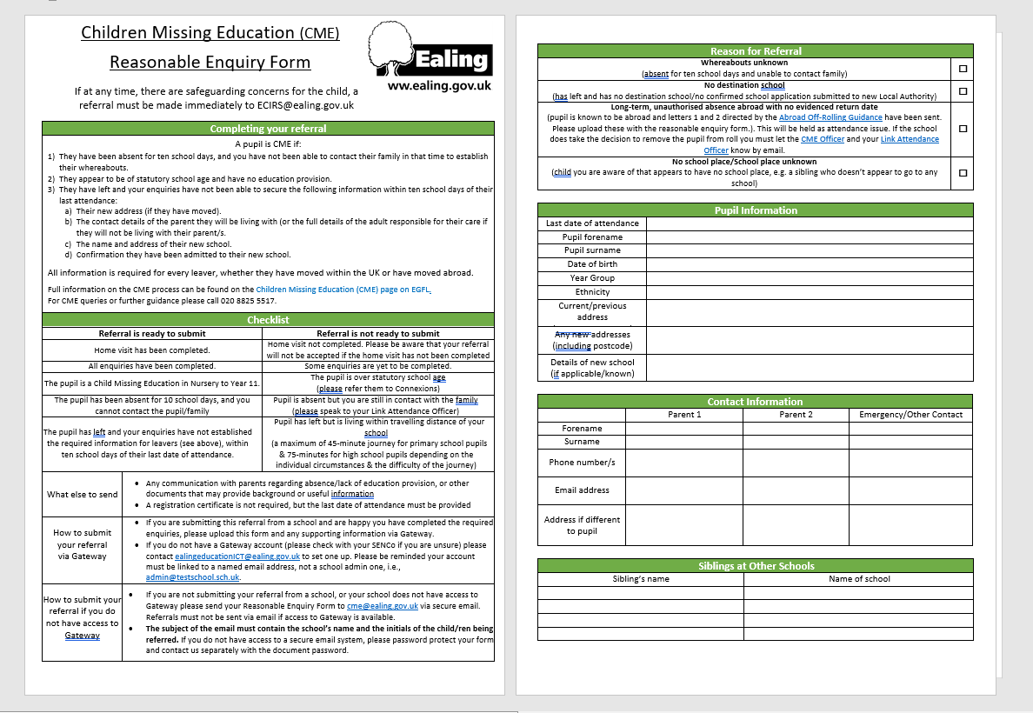
CME
Upload completed reasonable enquiry form
Children missing education (CME) referral flow | Ealing Grid for Learning (egfl.org.uk)
If the pupil has an EHCP, advise their EHCCo (SEN Caseworker) of the absence and the referral to CME.
You will receive an acknowledgment email to advise when the pupil can be taken off roll.
Notes:
The CME reasonable enquiry form has been amended and is available to download from egfl. Once completed, please remember to upload via Gateway. If a pupil has an EHCP, please also liaise with the named SEN Caseworker. You will receive an acknowledgement email from CME, and be advised about when a pupil can be taken off roll. Children missing education (CME) referral flow | Ealing Grid for Learning (egfl.org.uk)

Slide 12
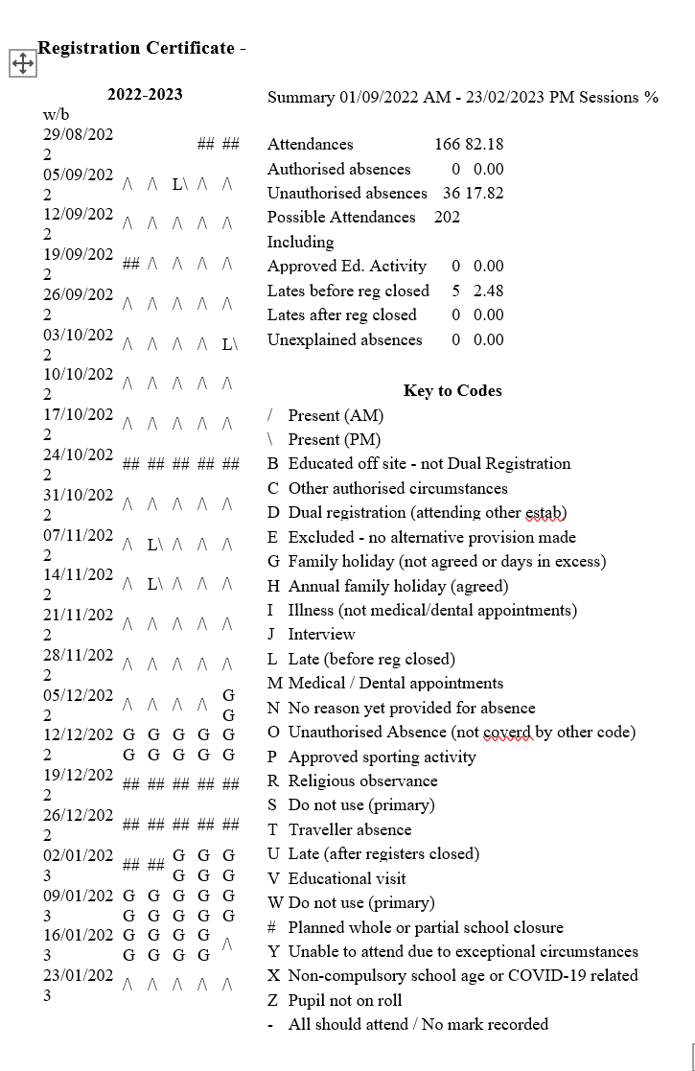
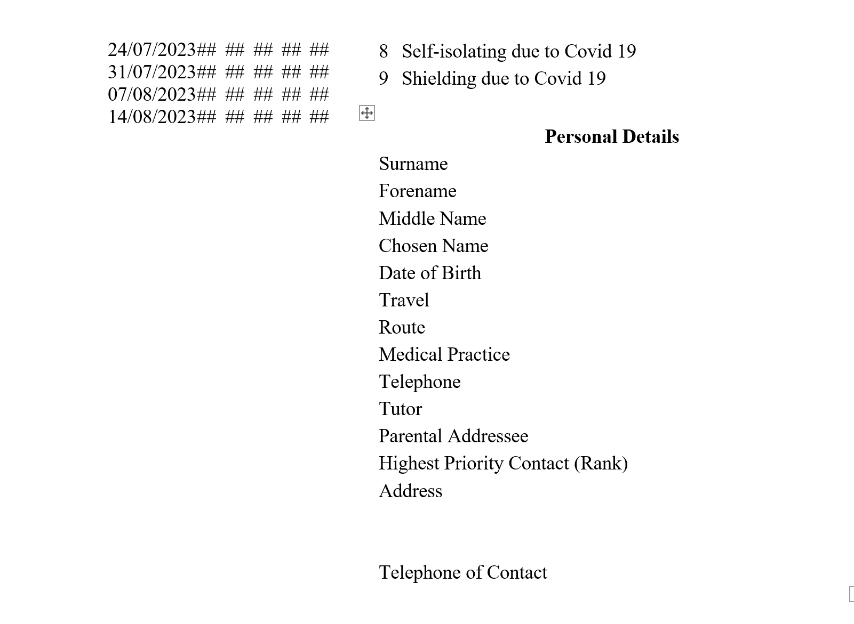
Fixed Penalty Notice (holiday)
Populate pupil details and select ‘Unauthorised Term Time Leave’ referral type.
Upload attendance certificate.
No form needed.
Notes:
To request a fixed penalty notice/holiday fine, please also use the Gateway portal. You will need to upload an attendance certificate in PDF or JPEG format showing the G codes. Requests are no longer accepted via email. You do not need to use a referral form.
Leave of absence in term time and fixed penalty notices update | Ealing Grid for Learning (egfl.org.uk)

Slide 13
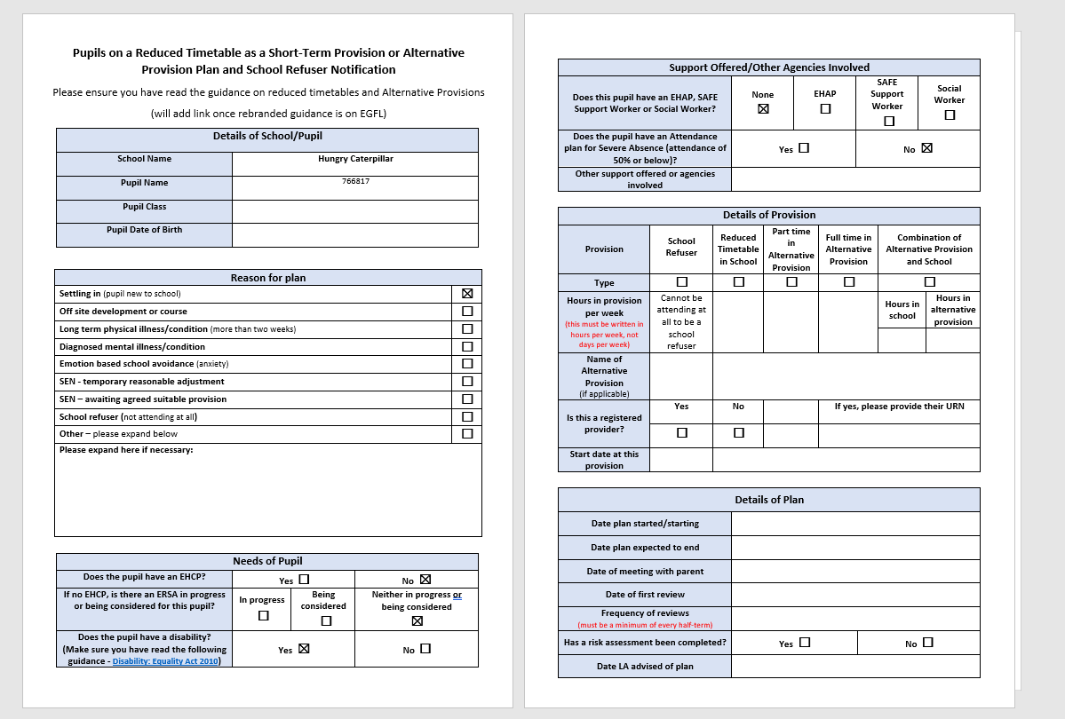
CMOE
CMOE Notifications
If you are notifying us about a pupil being put on a reduced timetable or attending an alternative provision you must fill in the section below with the number of hours they will be spending in school per week, and/or the hours they will be attending their alternative provision per week, and the number of hours combined.
Notes:
CMOE notifications should also be submitted via the Gateway, and this replaces the biannual return for part-time pupils. There is a form, and a review document for schools to use available on egfl. Children missing out on education | Ealing Grid for Learning (egfl.org.uk)

Slide 14
Training for school staff on Children Missing Education and related areas
Please find below the list of dates for school staff training on Children Missing Education, leavers, Children Missing Out on Education, required returns and other related areas:
Friday 22nd September at 10:30am – Click here to join the meeting
Wednesday 18th October 2023 at 2:30pm - Click here to join the meeting
Friday 8th December 2023 at 2:30pm - Click here to join the meeting
Wednesday 21st February 2024 at 10:30am - Click here to join the meeting
Friday 19th April 2024 at 2:30pm - Click here to join the meeting
Wednesday 12th June 2024 at 10:30am - Click here to join the meeting
Notes:
There are some specific training dates for CME and CMOE. These are offered by Claire Hooper our CME Officer. The first one is being delivered on Friday this week. The slides sent to you after this meeting will include the links.
Friday 22nd September at 10:30am – Click here to join the meeting
Wednesday 18th October 2023 at 2:30pm - Click here to join the meeting
Friday 8th December 2023 at 2:30pm - Click here to join the meeting
Wednesday 21st February 2024 at 10:30am - Click here to join the meeting
Friday 19th April 2024 at 2:30pm - Click here to join the meeting
Wednesday 12th June 2024 at 10:30am - Click here to join the meeting

Slide 15
Points to remember
The referral process is now operational
You can contact your Link Attendance Officer to discuss a case before referral
The Gateway referral system, will enable the Attendance Service to run reports and target support
Targeting Support meetings will take place termly
Your Link Attendance Officer will discuss potential referrals with you as part of the termly meet, and then ask you to submit
You can make a referral at any time – please try to ensure school has carried out advised escalation process before making a referral
If your case falls outside of these parameters but you feel it may still need to be referred, please discuss with your Link Attendance Officer

Slide 16
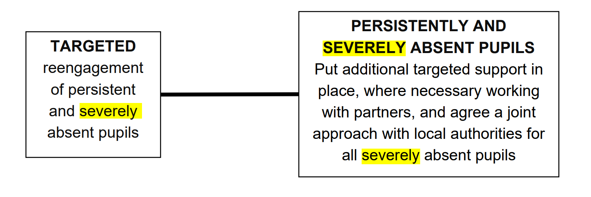
Severely Absent – multi agency panel
SA pupils should be flagged up and discussed as part of termly Targeting Support Meeting.
Referrals should be made via Gateway.
SA pupils may also be CMOE, and a plan may already be in place, in which case they will only be discussed at Panel if the existing plan is not working.
Panel members will agree a joint approach in the best interests of the child and considering the work that has already been undertaken. The Panel will decide how to proceed i.e., progression to prosecution, or what key services need to work further with the family.
The Attendance Team will be closely monitoring data for Severely Absent pupils.
Pupils with <50% attendance will be now be discussed at a multi-agency panel.
The Panel will meet half-termly at Perceval House to discuss cases.
The Panel will include Lucinda Poole, (Head of Attendance and CME) and professionals from key Local Authority teams i.e., SAFE, The Virtual school, ECIRS, EHAP, SEND, Health Improvement Team etc. School will be invited to attend.

Slide 17

Quick poll
How supported do you feel within your school on managing attendance and preparedness for the new guidance?

Slide 18
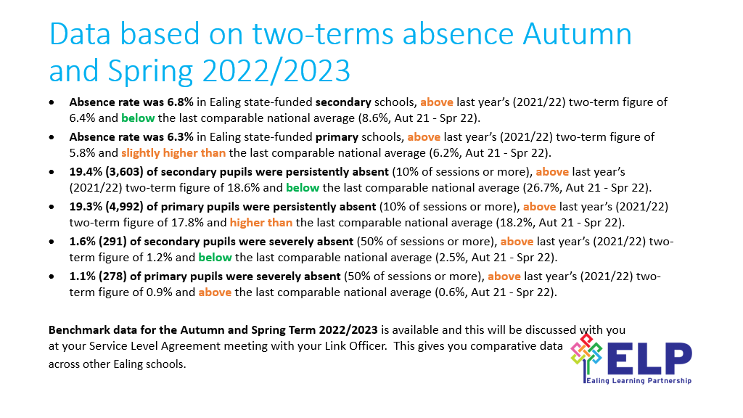

Slide 19

Questions
Slides will be emailed to all participants and made available on egfl here: Ealing school attendance network meeting | Ealing Grid for Learning (egfl.org.uk)
Notes:
19

Slide 20
Useful Links
Attendance Toolkit
CME Flowchart
Synergy Gateway Log in To request a Gateway login please email: Email: ealingeducationICT@ealing.gov.uk
Notes:
Thank you for joining us and we look forward to working with you this academic year
Attendance Toolkit
CME Flowchart
Synergy Gateway Log in
To request a Gateway login please email: ealingeducationICT@ealing.gov.uk
20

