Slide 1
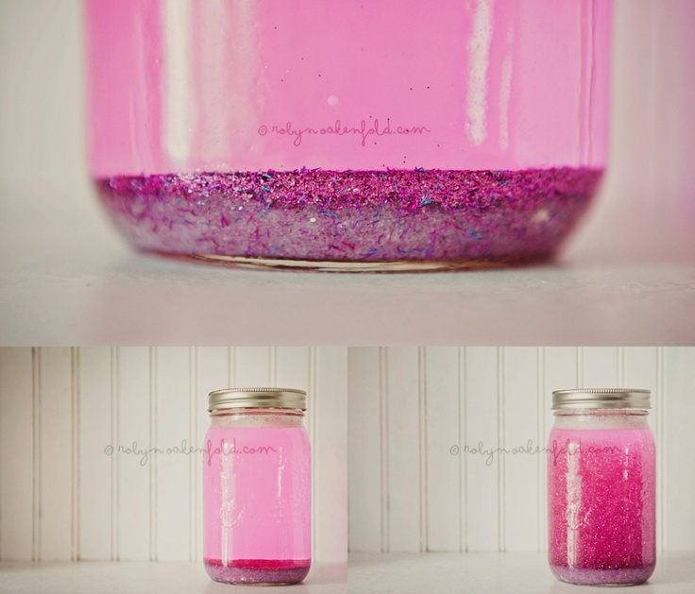
SEND Toolkit
Social, Emotional and Mental Health
Emotional regulation tasks
Mind Jars
The use of mind jars helps children to take time for emotions to calm. Encourage children to shake the glitter and watch it fall.
Make with a plastic jar and a mixture of glitter and oil. Ensure the lid is firmly secure.
Did you know: On average an emotion can last for up to 12 seconds?

Slide 2
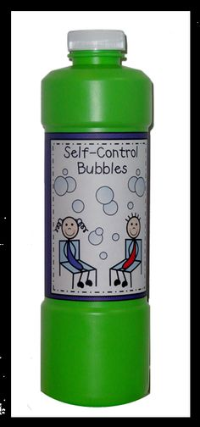
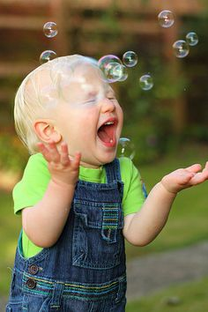
SEND Toolkit
Social, Emotional and Mental Health
Emotional regulation tasks
Bubbles
Waiting for the bubbles to pop help children with self control

Slide 3
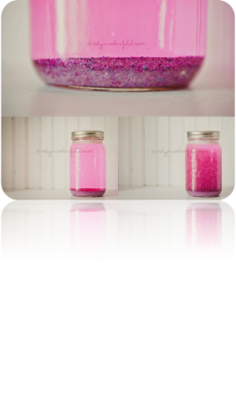
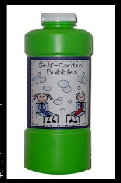
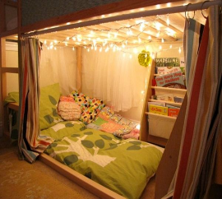
SEND Toolkit
Social, Emotional and Mental Health
Emotional regulation tasks
When I am upset:
Help children to choose their preferred emotional regulation strategy by making visual choice tools. Blank version for use at your setting on the next page.

Slide 4
SEND Toolkit
Social, Emotional and Mental Health
Emotional regulation tasks
Help children to choose their preferred emotional regulation strategy by making visual choice tools.
Tailor the visual tool by adding pictures/symbols that are personal and responsive to the individual child

