Slide 1
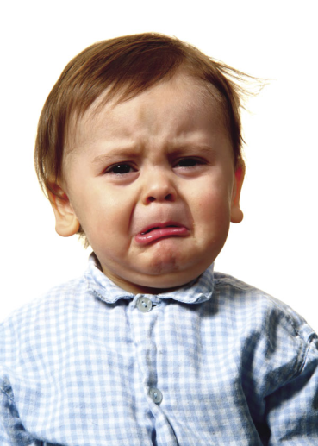
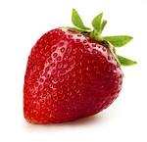
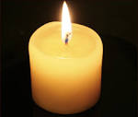
SEND Toolkit
Social, Emotional and Mental Health
Simple relaxation tasks
Imagine you have a strawberry and a candle
Sniff the strawberry (breathing in)
Blow out the candle (Breath out)

Slide 2
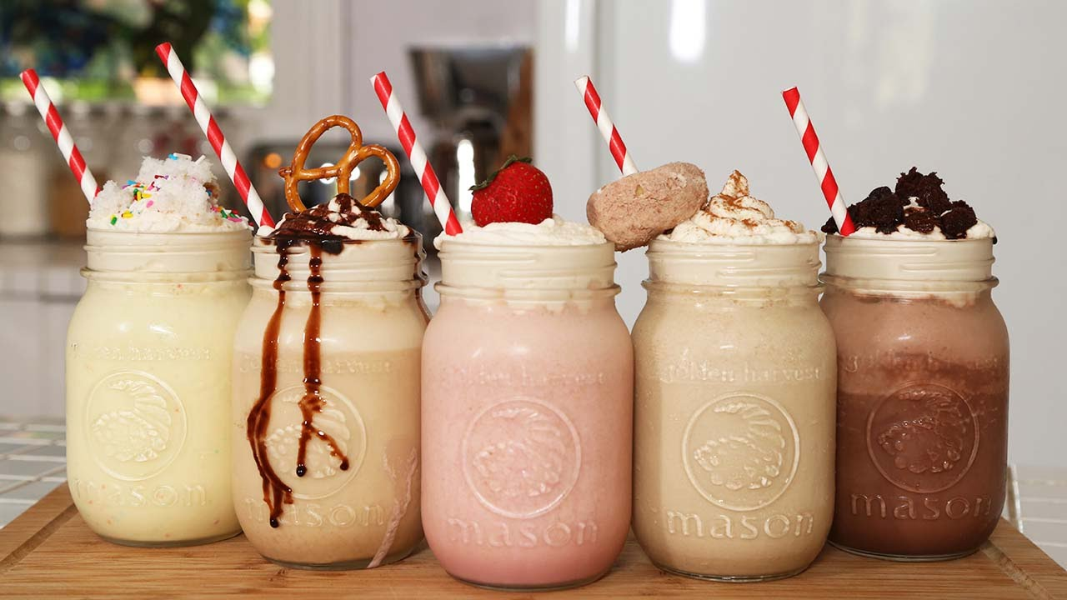
SEND Toolkit
Social, Emotional and Mental Health
Simple relaxation tasks
Laughter milkshake
For some light relief, mix your own laughter milkshake with the children. Imagine pouring in as many funny thoughts as you can and shake it all around. Drink in the funny thoughts and share the laughter!
See more at: http://kidsrelaxation.com/uncategorized/the-peacock-breath/#sthash.8KrOLqDA.dpuf

Slide 3
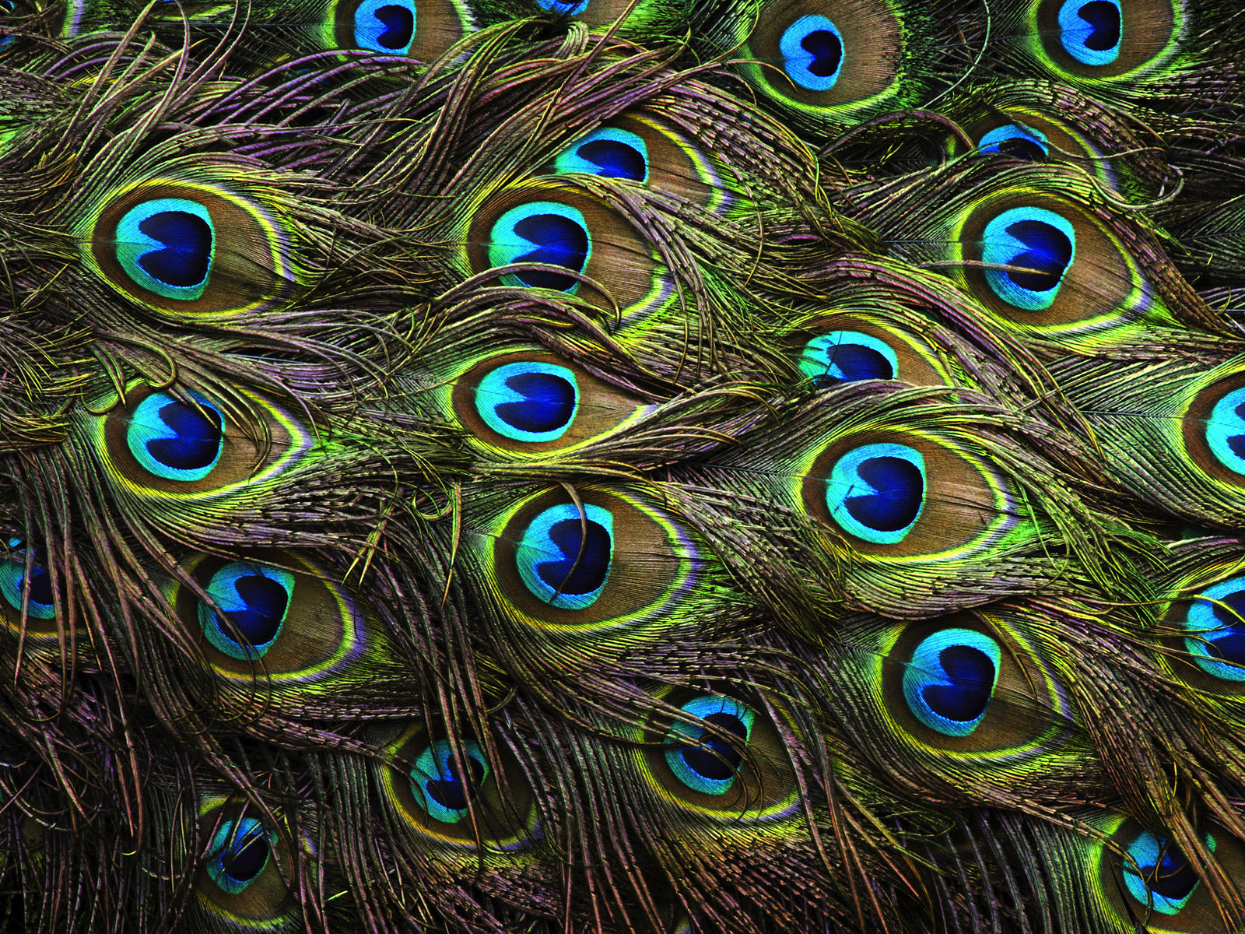
SEND Toolkit
Social, Emotional and Mental Health
Simple relaxation tasks
Breathing in and out slowly whilst blowing on the peacock feather can help support relaxation. See how long the children can make the feather move for with their out-breath. Encourage the children to breath in slowly before each time they blow the feather.
Add peacock feathers to quiet areas of the room, which can be used when children are feeling tense
See more at: http://kidsrelaxation.com/uncategorized/the-peacock-breath/#sthash.8KrOLqDA.dpuf

Slide 4
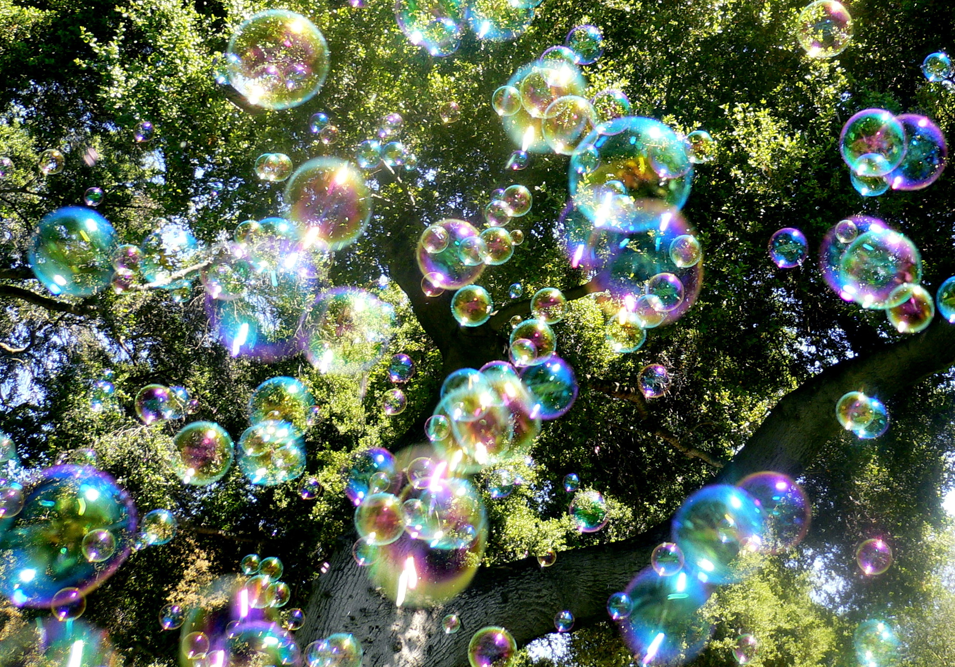
SEND Toolkit
Social, Emotional and Mental Health
Simple relaxation tasks
Practice taking deep breaths with the children while blowing bubbles
Put happy thoughts into the bubbles, take turns to share your happy thoughts. You can “send” happy thoughts to others in the group, by catching the bubbles on your wand/hands/clothing. Discuss how we can pull out a happy thought any time we feel upset or unfocused or overwhelmed during the day

Slide 5
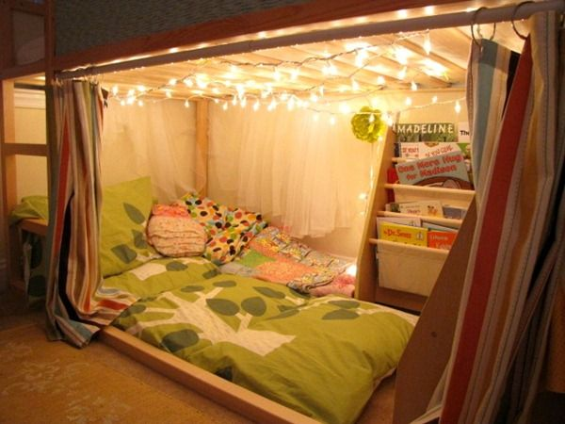
SEND Toolkit
Social, Emotional and Mental Health
Simple relaxation tasks
Areas for retreat
Children are often learning to control their bodies and minds and are working towards many vital milestones that enable them to eventually manage their feelings and behaviour.
During a busy day in the setting, they will often lose attention or completely disengage with learning, the environment and the people within it.
Children must have a place to retreat, relax and rejuvenate to positively engage with learning again.
Often ‘reading corners’ become this area but we need to consider areas solely dedicated to relaxation.

Slide 6
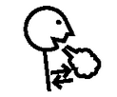
SEND Toolkit
Social, Emotional and Mental Health
Simple relaxation tasks
Five deep breaths visual support
Five deep breaths

