Slide 1
Oral hygiene guide-SEN
Adele Francois
Whittington Health NHS Trust
Notes:
11.00am-11.20 am

Slide 2
Community dental services
Exists to treat children with special needs and disabilities in a relaxed and friendly environment.
A referral is required by a doctor or other health professional.

Slide 3
Tooth decay
Most common disease affecting children in England
Main reason for hospital admissions in children under the age of 19
Almost a third of 5-year-olds have tooth decay
On average 4 teeth are decayed or missing due to extractions under general anaesthetic

Slide 4
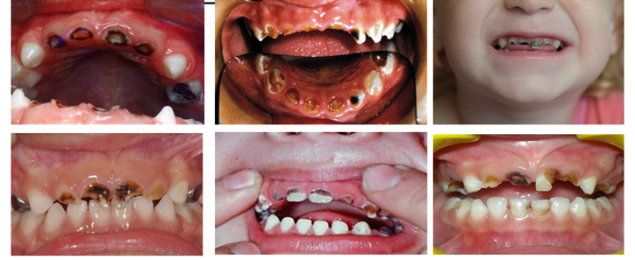
Tooth decay from bottles

Slide 5
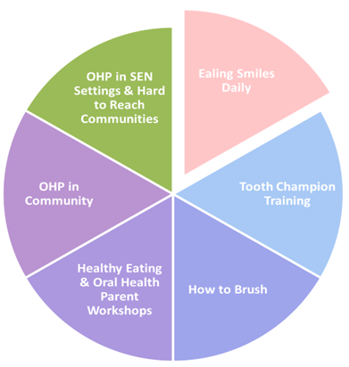
What we are doing in Ealing
Ealing Smiles Daily
Tooth champion training
How to brush
Healthy eating and oral health parent workshops
OHP in community
OHP in SEN settings and hard to reach communities

Slide 6
How to prevent / limit tooth decay
Try to give sugars at mealtimes only
Avoid giving sugary snack or drinks last thing before bedtime
Change from a feeding bottle to trainer cup or free flowing beaker as soon as you can with milk or water
Try to avoid thickening agents containing maltodextrin as this causes decay. A dietician can help you limit how often they are given or suggest if a different type could be used
If a high calorie diet is needed ask your dietician about ways of reducing tooth decay
Start to visit the dentist regularly as soon as first tooth appears

Slide 7
Teeth and fluoride
Fluoride helps to strengthen the outer surface of the teeth against acid attacks
Fluoride in toothpaste:
Under 3 years not less than 1000ppm of fluoride in toothpaste and only smear
Over 3 years around 1450ppm is recommended and only a pea size
High fluoride toothpaste or mouthwash may be prescribed by a dentist if required
A dentist may apply a fluoride varnish

Slide 8
Tips when brushing is a struggle
Choose a relaxing time to brush e.g., when watching TV, in the bath listening to calm music
Use a cloth, finger brush, small headed soft toothbrush

Slide 9
Simple brushing aids

Slide 10
Special brushes
Barman’s super brushes
Electric toothbrush with pressure sensor

Slide 11
Special brushes

Slide 12
Toothpaste and mouthwash

Slide 13
Useful aids

Slide 14
Oral health website
Visit the oral health website:
Ealing Oral Health Promotion Team (whittington.nhs.uk)
https://www.whittington.nhs.uk/default.asp?c=42363
Scan me to view website:

Slide 15
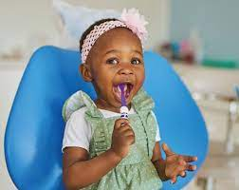
Why oral health is in the early years framework
The EYFS framework states that early years providers must promote good oral health of children who attend their setting.
Oral health is important, even with baby teeth. This is because children’s baby teeth:
Help them to bite and chew
Support speech and language development
Help them feel confident when they smile
Make space for and help guide adult teeth
Good oral health also keeps children free from toothache, infection and swollen gums.
For all oral health support please contact:
Adele Francois, Whittington health NHS trust adele.francois@nhs.net
Notes:
15
11am delivery.
£368.9M net budget

